Slide 1
Decisive Results in Chess by Game Length and Opening
Questions
Do longer games necessarily result in more decisive results, or is there a tipping point where longer games are more likely to end in a draw?
How does this change when we condition on opening move?
How do the outcome and length distributions change when we condition on opening classification?

Slide 2
Data, Code, and Visualization Sources
Data Sources
Dataset comes from Chess DB, an online chess database with over 5.5 million games, in the format of PGN files.
https://chess-db.com/public/index.jsp
Code Sources
Python for Data Analysis by Wes McKinney
Web Scraping with Python by Ryan Mitchell
Visualization Sources
Matplotlib examples for line graphs and stacked bar charts: https://matplotlib.org/3.1.1/gallery/index.html

Slide 3
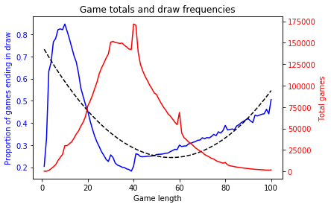
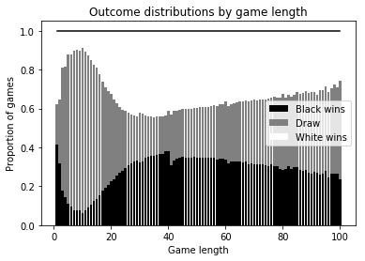
Results – Question 1
Games with 39 moves see the smallest proportion of draws
After that, draw proportion rises once again

Slide 4
Results – Question 2
Tipping point doesn’t change when we condition on opening, but we see several other interesting associations.
King’s Pawn openings are significantly more likely to end decisively (~72% vs ~68%), but they don’t give white an advantage !
With either opening white wins about 39%, but black wins ~33% of games beginning with 1. e4, but only ~30% of other games
We extended our analysis to the top five opening moves (~98% of games), and found that white’s win percentage is about 39% for all openings, but black’s varies.
Black is most successful in e4 games (wins ~33%) and least successful in Nf3 games (wins ~27%)

Slide 5
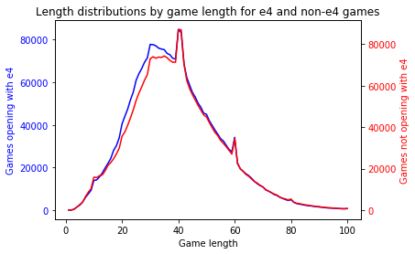
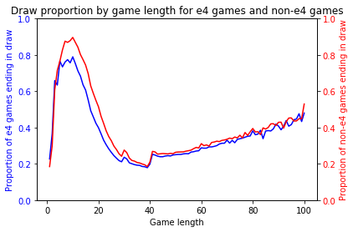
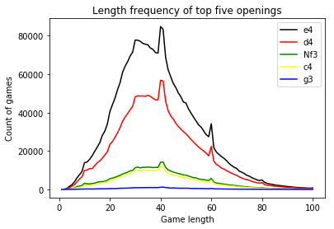
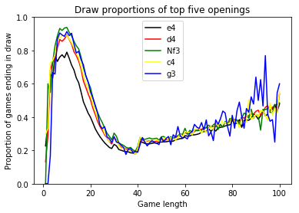
Results – Question 2

Slide 6
Results – Question 3
The tipping point is at 39 moves for all opening classifications.
Open games are shortest on average (~38) and Indian defense games are longest (~40).
Open games have the highest win percentage for white (~42%) while Indian defense games have the lowest (~37%).
Black is most successful in semi-open games (~34%) and least successful in closed games (27%).
Draws are most common in Indian defense games (~33%) and least common in open and semi-open games (~28% each), the e4 games.
A possible explanation is that non-symmetrical replies are more effective at reducing white’s advantage.

Slide 7
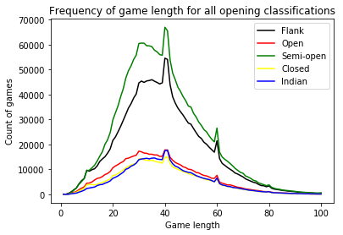
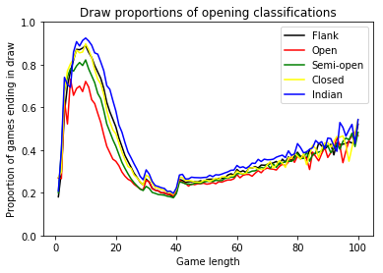
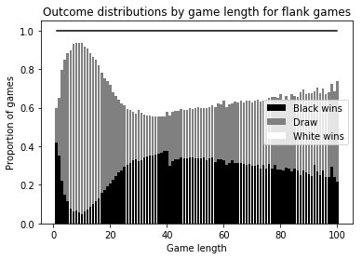
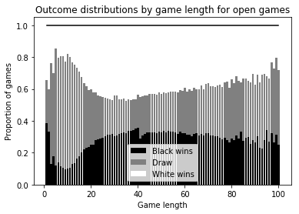
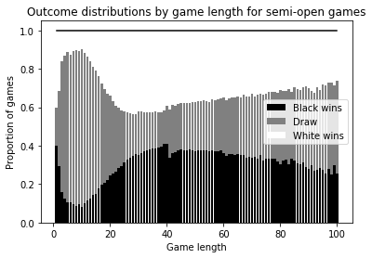
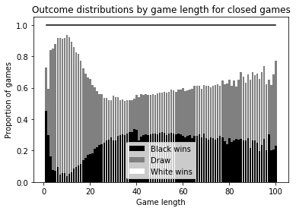
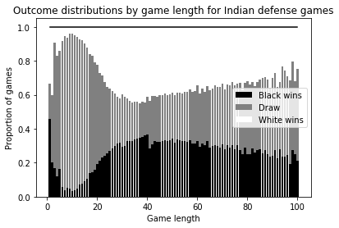
Results – Question 3

Slide 8
Libraries Used and Tasks Completed
Libraries Used: matplotlib, pandas, numpy, beautifulsoup, and requests
Tasks Completed
Use Requests and BeautifulSoup to download over 120,000 PGN files
Convert 5.5 million games from PGN to CSV
Extract outcome distributions for the entire dataset and numerous opening configurations
Use Pandas to read in outcome distributions and analyze data
Use Matplotlib to plot results

