Slide 1
Digital Portfolio
STUDENT NAME: S. Bhavana
REGISTER NO AND NMID: 222402965
DEPARTMENT: Bsc computer science
COLLEGE: COLLEGE/ UNIVERSITY:Annai therasa arts and science college, mangalam

Slide 2
PERSONAL PORTFOLIO

Slide 3


AGENDA
Problem Statement
Project Overview
End Users
Tools and Technologies
Portfolio design and Layout
Features and Functionality
Results and Screenshots
Conclusion
Github Link
3/21/2024 Annual Review

Slide 4

PROBLEM STATEMENT
I created this digital personal portfolio to solve that gap by offering a centralized, well-organized, and personalized space to present my work, achievements, and on going learning journey.
The goal of this portfolio is not only to highlight my experience and skills but also to build meaningful connections with potential employers, collaborators, and peers by giving them a deeper insight into my work and values.

Slide 5

PROJECT OVERVIEW
Website Objective: Created a modern, responsive website to showcase my work.
Tools Used: HTML, CSS, JavaScript.
1) About Me Section:
Purpose: Shared my background details.
2) Certificate Section:
Fundamentals of Web Development Certificate (IBM)
📍 Online 📅 Completed August 2025
3) Education Section:
Purpose: Shared my High School, Higher Secondary and pursuing college details.
4) Skills Section:
Purpose: Shared my course studied details
5) Contact Section:
Purpose: Make it easy for people to reach out.

Slide 6

WHO ARE THE END USERS?
The primary end-users of a digital personal portfolio are:
Recruiters
Hiring Managers
Potential Clients
Students and professionals also use portfolios:
To demonstrate their capabilities
To showcase their work for potential admission to educational programs, and for personal career development.

Slide 7

TOOLS AND TECHNIQUES
1. Website Builders
Developer — User-friendly, good for beginners
2. Coding Platforms
HTML, CSS, JavaScript — Basic web technologies
3. Design Tools
Canva — Simple graphics and layouts.
4. Version Control & Hosting
GitHub — For version control and collaboration

Slide 8
PORTFOLIO DESIGN AND LAYOUT
1. Header Section:
Includes the portfolio owner's name.
It contains navigation links to key sections: About, Certificate, Education, Skills, Contact.
2. Hero Section :
It contains a professional photo or avatar.
Tagline summarizing about myself.
3. Work Showcase section:
Organized horizontal layout
4. Footer Section:
Copyright info.
8

Slide 9
FEATURES AND FUNCTIONALITY
1. About Me Section
Personal introduction to give visitors a quick overview of who am I.
2. Project Showcase
Includes images, descriptions, and sometimes links to live certificates.
3. Contact Information
Clear and accessible contact details.
Often includes email, phone number.
4. Skills Section
Helps recruiters quickly assess your expertise.
5. Interactive Elements
Animations, hover effects, or transitions to engage visitors.
6. Responsive Design
Portfolio adjusts layout based on screen size (desktop, tablet, mobile).
7. Social Media Integration
Links or feeds from platforms like GitHub.

Slide 10
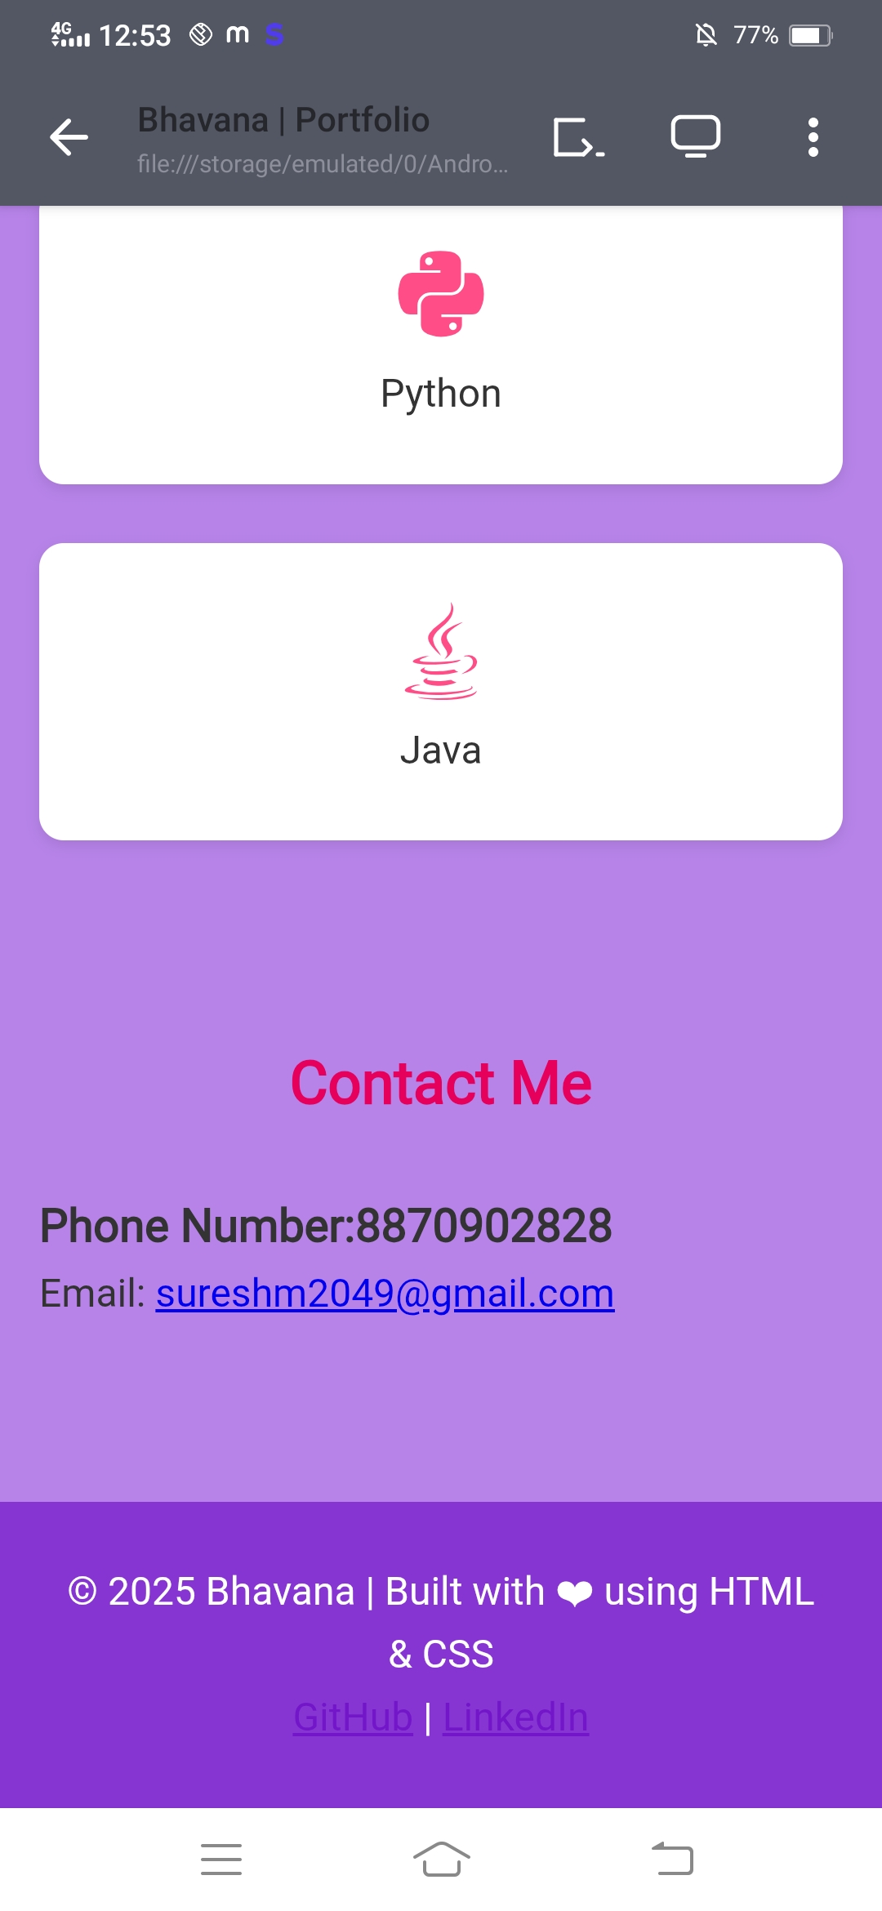
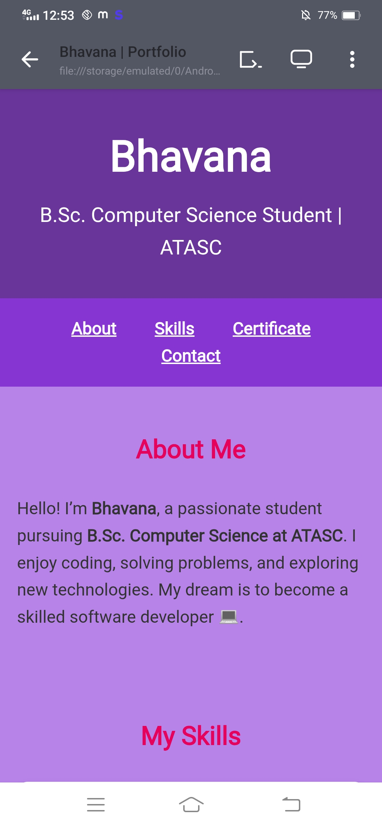
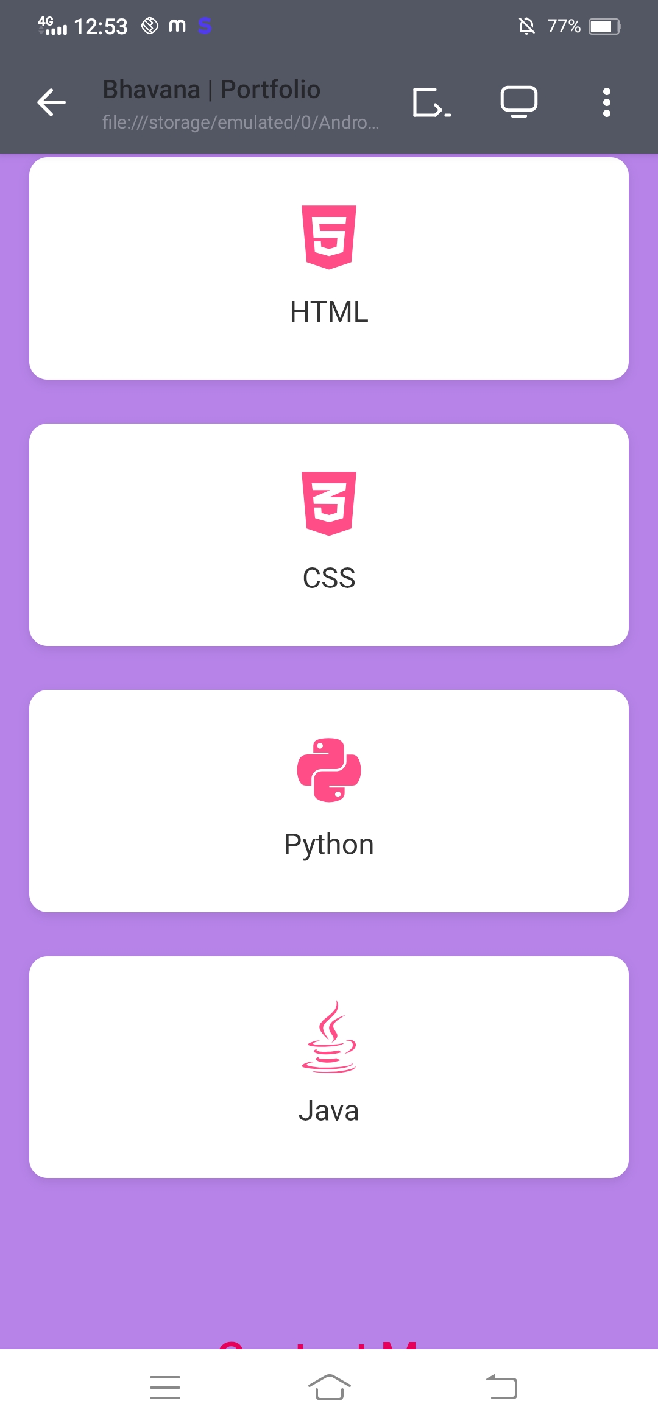

RESULTS AND SCREENSHOTS
3/21/2024 Annual Review
10

Slide 11
CONCLUSION
This digital portfolio reflects my journey as a web developer, showcasing the skills and projects that define my expertise. It highlights my commitment to continuous learning, creativity, and delivering quality work.
I welcome you to explore my work, connect with me, and discover how I can contribute to your projects or team.
11

Slide 12
GITHUB LINK
https://github.com/sureshm2049-arch/NM2025.git
12

