Slide 1
1. Skewness should apply after filling missing values?

Slide 2
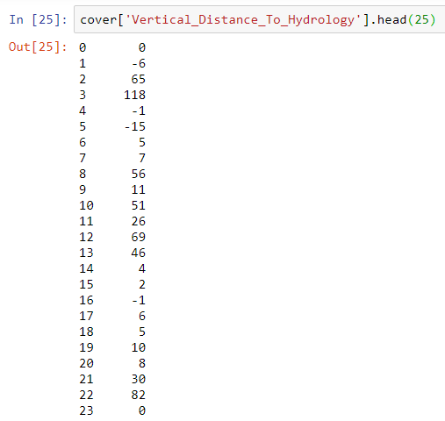

Slide 3
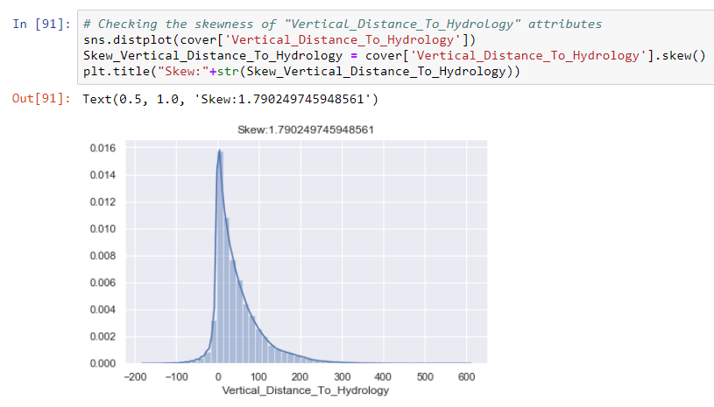

Slide 4
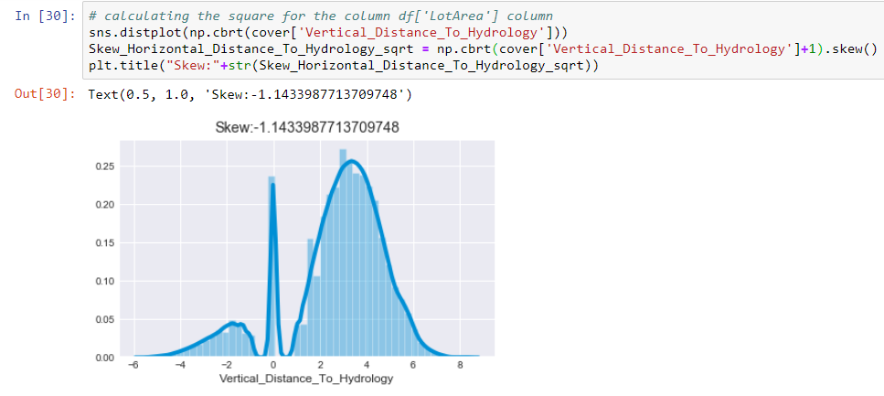
Cube Root

Slide 5
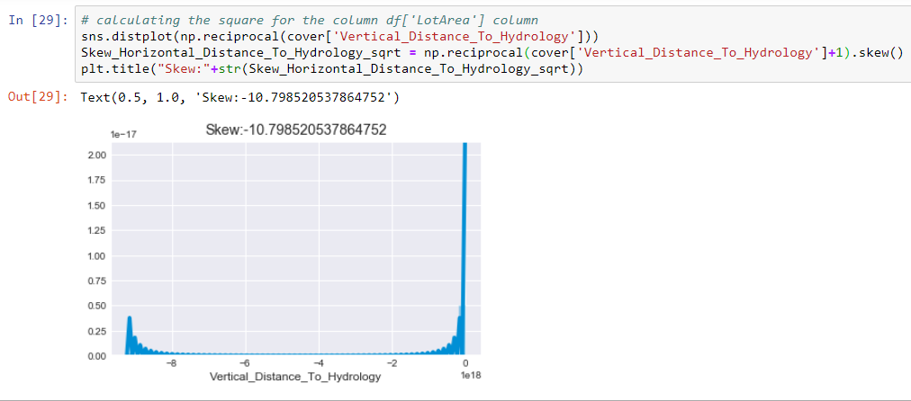
Reciprocal

