Slide 1
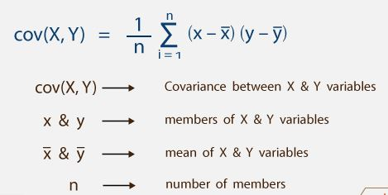
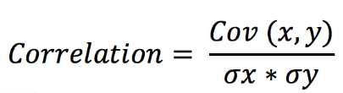
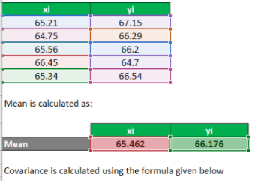
(65.21-65.462)(67.15-66.176) + (64.75-65.462)(66.29-66.176) +
(65.56-65.462)(66.2-66.176) + (66.45-65.462)(64.7-66.176) +
(65.34-65.462)(66.54-66.176)
-------------------------------------------------------------------------------------
5

Slide 2
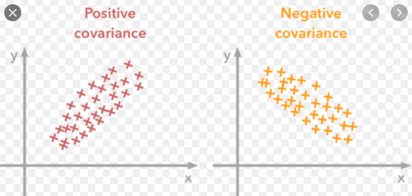

Slide 3
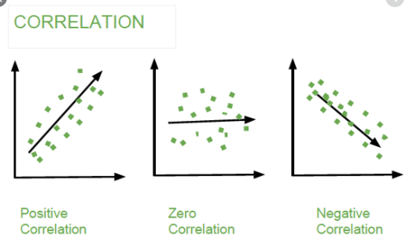
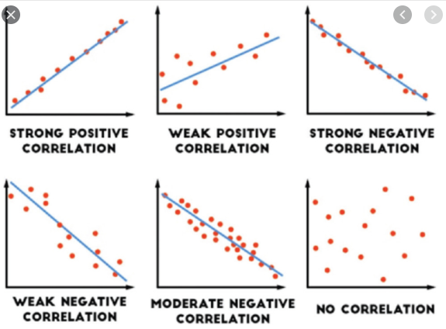

Slide 4
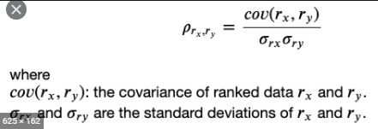

Slide 5
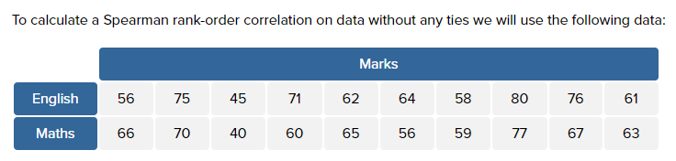
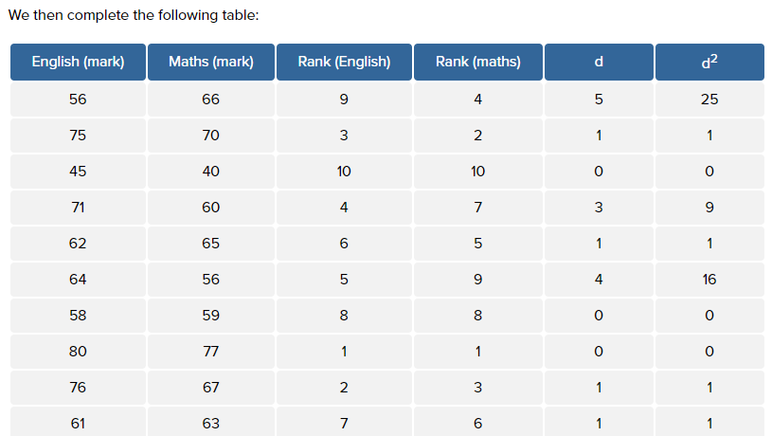

Slide 6
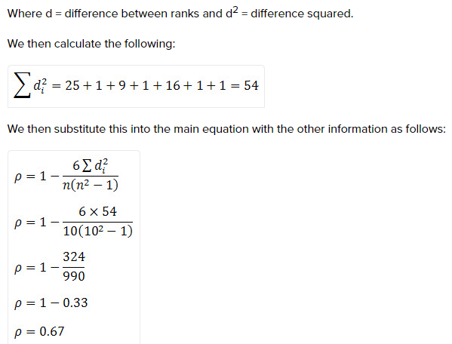
as n = 10. Hence, we have a ρ (or r_{s}) of 0.67. This indicates a strong positive relationship between the ranks individuals obtained in the maths and English exam. That is, the higher you ranked in maths, the higher you ranked in English also, and vice versa.

