Slide 1
NumPy - Matplotlib

Slide 2
1. pyplot( ) is the most important function in matplotlib library, which is used to plot 2D data.
a. plot( ) function of pyplot submodule of matplotlib package.
b. subplot( )
c. bar( ) function of pyplot submodule used to generate bar graphs.
import numpy as np
from matplotlib import pyplot as plt
# Plot the points using matplotlib
plt.plot(x, y)
plt.show()

Slide 3
a. Plot( )
To display the circles representing points, instead of the line in the above example, use “ob” as the format string in plot() function.
The following script plots the equation y = 2x + 5
import numpy as np
from matplotlib import pyplot as plt
x = np.arange(1,11)
y = 2 * x + 5
plt.title("Matplotlib demo")
plt.xlabel("x axis caption")
plt.ylabel("y axis caption")
plt.plot(x,y)
plt.show( )
import numpy as np
from matplotlib import pyplot as plt
x = np.arange(1,11)
y = 2 * x + 5
plt.title("Matplotlib demo")
plt.xlabel("x axis caption")
plt.ylabel("y axis caption")
plt.plot(x,y,"ob")
plt.show()
“ob”
O → Circle marker
b → blue

Slide 4
from matplotlib import pyplot as plt
plt.scatter(x,y)
plt.plot(x, y, color=‘red’)
plt.show()

Slide 5
Sr.No. | Character & Description
1 | '-‘ Solid line style
2 | '--‘ Dashed line style
3 | '-.‘ Dash-dot line style
4 | ':‘ Dotted line style
5 | '.‘ Point marker
6 | ',‘ Pixel marker
7 | 'o‘ Circle marker
8 | 'v‘ Triangle_down marker
9 | '^‘ Triangle_up marker
10 | '<‘ Triangle_left marker
11 | '>‘ Triangle_right marker
12 | '1‘ Tri_down marker
13 | '2‘ Tri_up marker
14 | '3‘ Tri_left marker
15 | '4‘ Tri_right marker
16 | 's‘ Square marker
17 | 'p‘ Pentagon marker
18 | '*‘ Star marker
19 | 'h‘ Hexagon1 marker
20 | 'H‘ Hexagon2 marker
21 | '+‘ Plus marker
22 | 'x‘ X marker
23 | 'D‘ Diamond marker
24 | 'd‘ Thin_diamond marker
25 | '|‘ Vline marker
26 | '_‘ Hline marker
Character | Color
'b' | Blue
'g' | Green
'r' | Red
'c' | Cyan
'm' | Magenta
'y' | Yellow
'k' | Black
'w' | White

Slide 6
b. subplot( )
The subplot( ) function allows you to plot different things in the same figure. In the following script, sine and cosine values are plotted.
import numpy as np
import matplotlib.pyplot as plt
# Compute the x and y coordinates for points on sine and cosine curves
x = np.arange(0, 3 * np.pi, 0.1)
y_sin = np.sin(x)
y_cos = np.cos(x)
# Set up a subplot grid that has height 2 and width 1,
# and set the first such subplot as active.
plt.subplot(2, 1, 1)
# Make the first plot
plt.plot(x, y_sin)
plt.title('Sine')
# Set the second subplot as active, and make the second plot.
plt.subplot(2, 1, 2)
plt.plot(x, y_cos)
plt.title('Cosine')
# Show the figure.
plt.show()

Slide 7
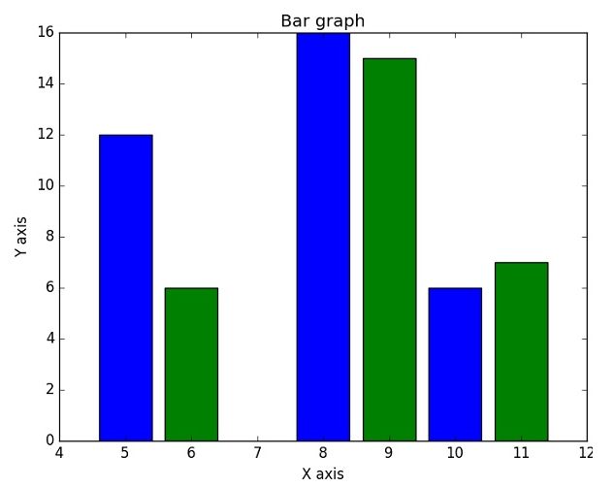
c. bar( )
from matplotlib import pyplot as plt
x = [5,8,10]
y = [12,16,6]
x2 = [6,9,11]
y2 = [6,15,7]
plt.bar(x, y, align = 'center')
plt.bar(x2, y2, color = 'g', align = 'center')
plt.title('Bar graph')
plt.ylabel('Y axis')
plt.xlabel('X axis')
plt.show()

