Slide 1
Data Visualization Using Pandas Python
Data visualization with Pandas in Python is carried out in following ways:
1. Histogram
2. Scatter Plot
Note: Call %matplotlib inline to set up plotting inside Jupyter Notebook.

Slide 2
Data Structures
We will start with the following two important data structures of Pandas:
1. Series and
2. DataFrame

Slide 3
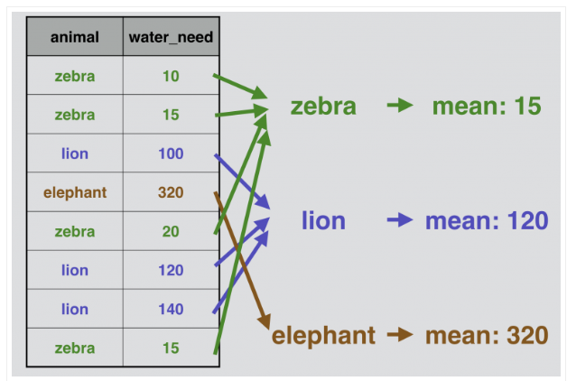
Grouping in pandas

Slide 4
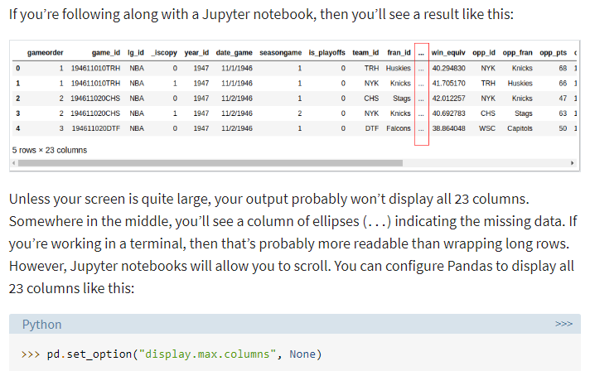

Slide 5
