Slide 1
Module
Datetime
classes
datetime
timedelta
date
time
method
today()
Timedelta (days)
now()
Only current time
Date & time
Adding & subtracting dates
only date
only time
Module.classes.method
today = datetime.datetime.today()
tomorrow = today + datetime.timedelta(days=1)
yesterday = today - datetime.timedelta(days=1)

Slide 2
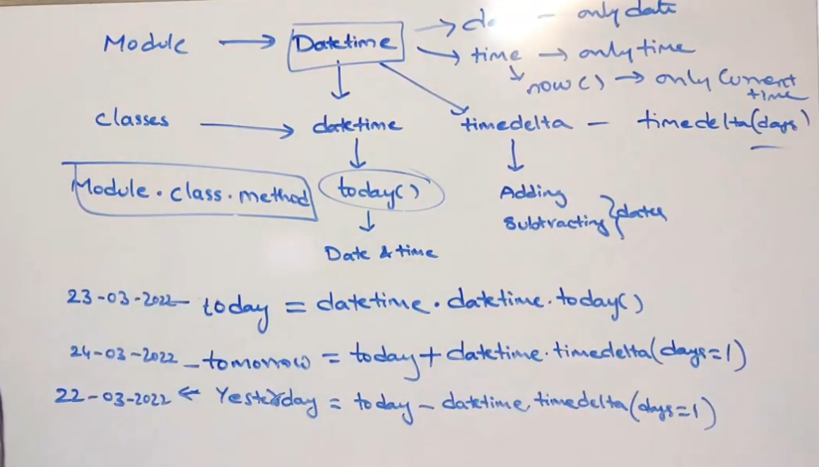
today = datetime.datetime.today()
tomorrow = today + datetime.timedelta(days=1)
yesterday = today - datetime.timedelta(days=1)

