Slide 1
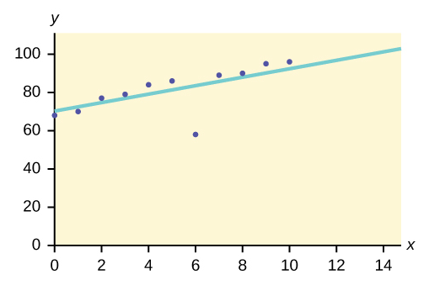
Outlier Analysis or Anomaly Analysis:
This data mining method is used to identify the data items that do not comply with the expected pattern or expected behavior. These unexpected data items are considered as outliers or noise. They are helpful in many domains like credit card fraud detection, intrusion detection, fault detection etc. This is also called as Outlier Mining.
For example, let’s assume the graph below is plotted using some data sets in our database.
So the best fit line is drawn. The points lying nearby the line show expected behavior while the point far from the line is an Outlier.
This would help to detect the anomalies and take possible actions accordingly.

