Slide 1
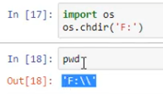
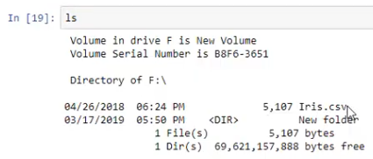

Slide 2
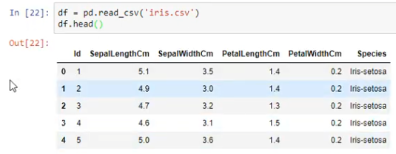

Slide 3
https://towardsdatascience.com/data-wrangling-with-pandas-5b0be151df4e
https://www.pluralsight.com/guides/data-wrangling-pandas
https://github.com/pandas-dev/pandas

Slide 4
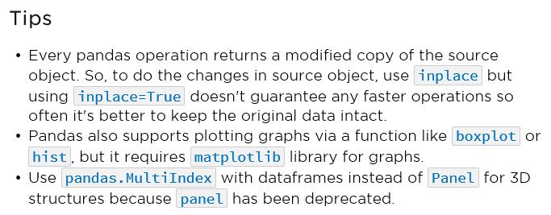

Slide 5
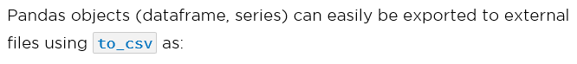

Data Storage
product_df = pd.DataFrame(data={'product': ['E-book', 'Plants'],
'unit_sold': [2000, 5000],
'types': [800, 200]})
product_df.to_csv('aa.csv',
index=False, # otherwise will add extra comma at start
sep=',',
encoding='utf-8)

Slide 6


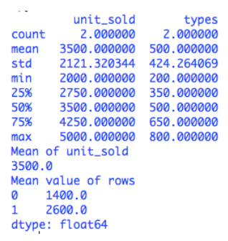


describe( ) Vs axis = 1; axis = 0
Data Analysis
Pandas makes calculations fairly easy by providing inbuilt support for mathematical and statistics operations to calculate various measures like mean, median, standard deviation, min, max, etc.
1. These functions can also be performed using
2. Can be performed on a single row or a column using the property as:
product_df = pd.DataFrame(data={'product': ['E-book', 'Plants'],
'unit_sold': [2000, 5000],
'types': [800, 200]})
product_df.describe()
product_df['unit_sold'].mean()
product_df.mean(axis=1)
will perform the operation on the values of rows.
which means column-wide calculations.

Slide 7
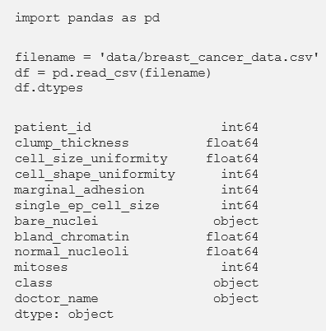
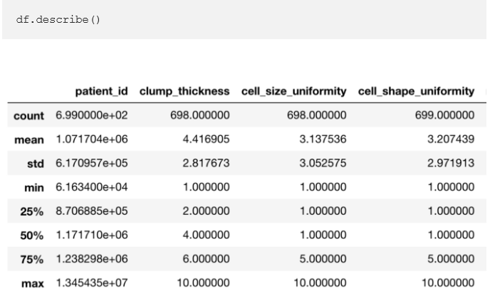
1. Data exploration
Let us begin by reading in our dataset (csv file) into pandas and displaying the column names along with their data types. Also take a moment to view the entire dataset.
To verify that our data matches up with the source we can use the describe option in pandas:

Slide 8
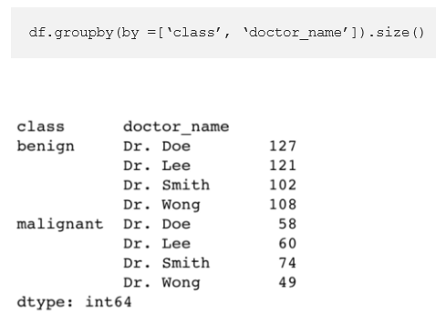
For categorical data we can hand this by grouping together values:

Slide 9
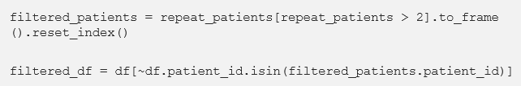
Filtering data
If we want to remove patients that show up more that 2 times in the data set.
If we did not have the tilde (“~”) we would get all individuals that repeat more than twice. By adding a tilde the pandas Boolean series is reversed and thus the resulting data frame is of those that do NOT repeat more than twice.

Slide 10
Reshaping data
The dataset has elements of categorical data in the “doctor_name” column. To feed this data into a machine learning pipeline, we will need to convert it into a one hot encoded column. This can be done with a sci-kit learn package, however we will do it in pandas to demonstrate the pivoting and merging functionality. Start off by creating a new data frame with the categorical data.
categorical_df = df[['patient_id','doctor_name']] categorical_df['doctor_count'] = 1
We add a column an extra column to identify which doctor a patient deals with. Pivot this table so that we only have numerical values in the cells and the columns become the doctors’ name. Then fill in the empty cells with 0.
doctors_one_hot_encoded = pd.pivot_table( categorical_df, index = categorical_df.index, columns = ['doctor_name'], values = ['doctor_count'] )doctors_one_hot_encoded = doctors_one_hot_encoded.fillna(0)
Then drop the multiIndex columns:
doctors_one_hot_encoded.columns = doctors_one_hot_encoded.columns.droplevel()

Slide 11
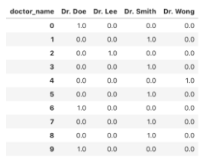
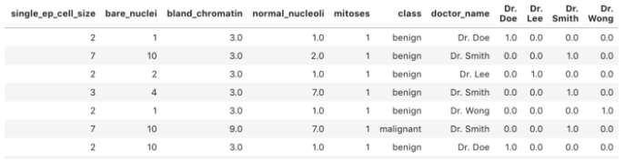
The ‘doctors_one_hot_encoded’ dataframe looks like this.
The resulting left join looks like this.
We can now join this back to our main table. Typically a left join in pandas looks like this:
We can drop the column that we no longer need by the following
combined_df = combined_df.drop(columns=['doctor_name']
leftJoin_df = pd.merge(df1, df2, on ='col_name', how='left')
However we are joining on the index so we pass the “left_index” and “right_index” option to specify that the join key is the index of both tables
combined_df = pd.merge(df, one_hot_encoded, left_index = True,right_index =True, how =’left’)

Slide 12
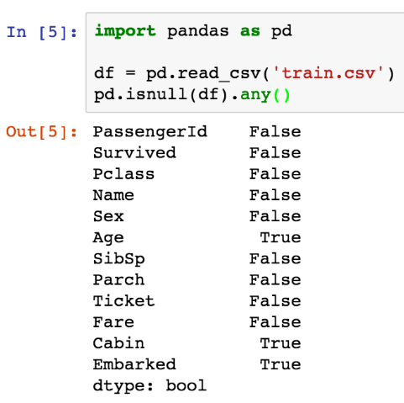
Dropping missing or null values in the dataset.

Slide 13
Dummy variables in pandas
Map
Embarked
https://www.youtube.com/watch?v=0s_1IsROgDc

Slide 14
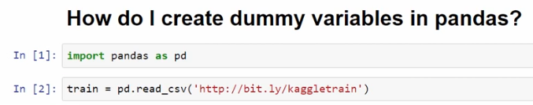
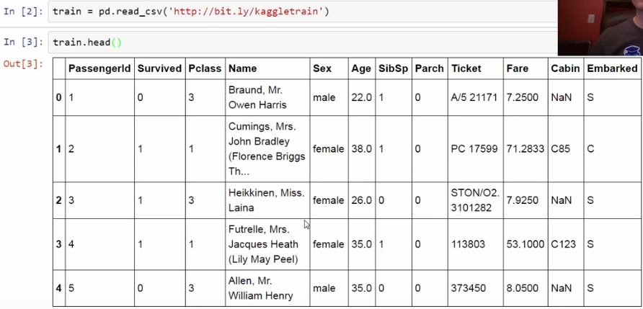

Slide 15

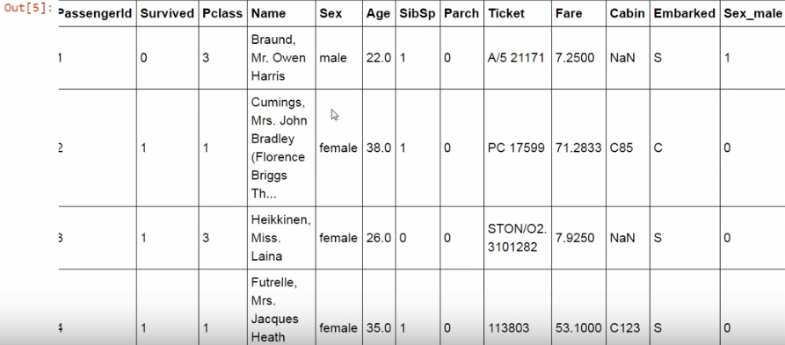
Dummy Variable

Slide 16
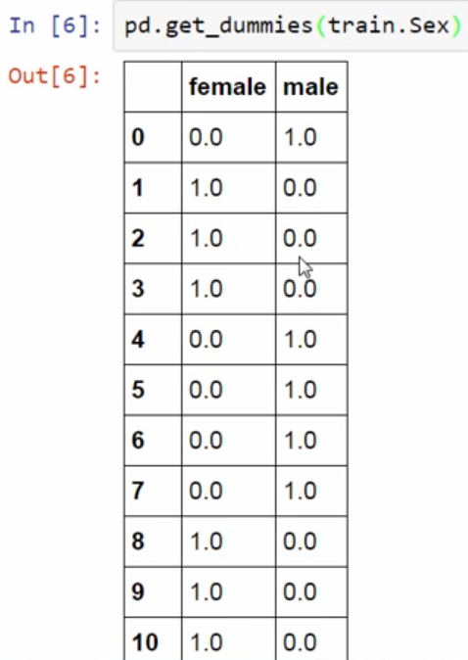
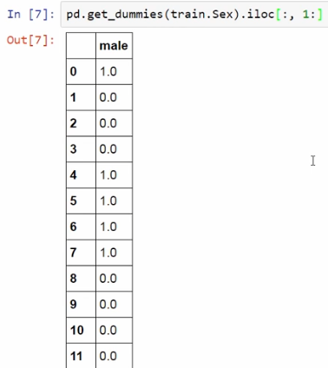
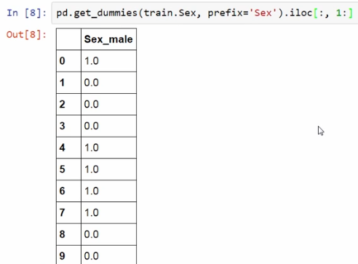

Slide 18
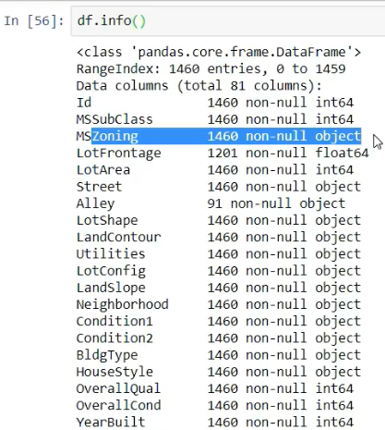
Categorical Feature

Slide 19
