Slide 1
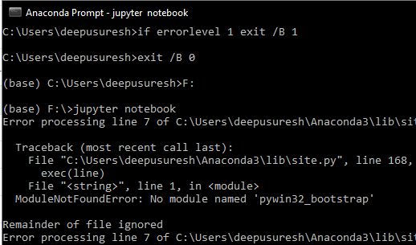
cmd
F:
Jupyter notebook

Slide 2
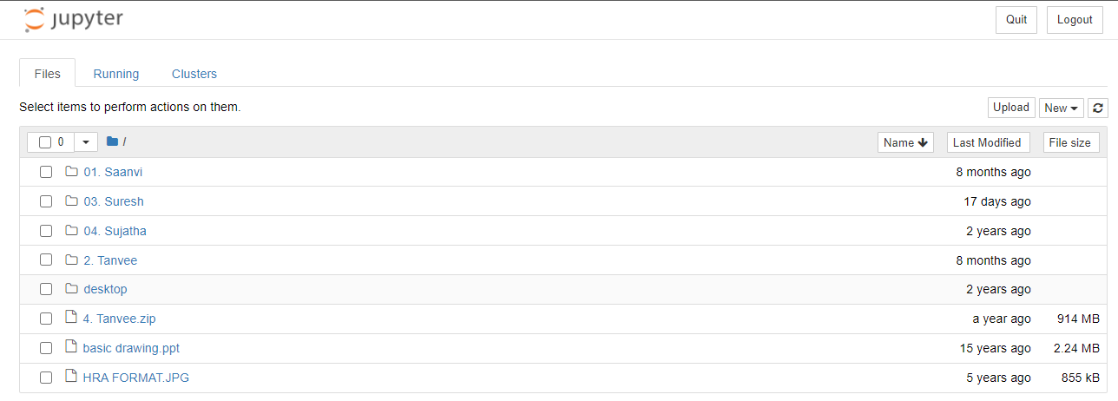

Slide 4
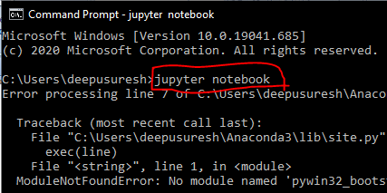
cmd
jupyter notebook

