Slide 1
AngularJS Starter Template
Why starter template
Prerequisite
Setup
Development
Testing
Code Quality
Gulp tasks

Slide 2
Prerequisite
Software Requirements
Nodejs ( which contains both node and npm)
https://nodejs.org/en/
Git
https://git-scm.com/
Gulp for automating build management
npm install –g gulp
Bower for installing client packages
npm install –g bower
Note: Proxy Issue refer the links below
https://confluence.compasquality.siemens-info.com/display/CM/Node.js+%2C+NPM%2C+Bower
https://confluence.compasquality.siemens-info.com/display/CM/GIT

Slide 3
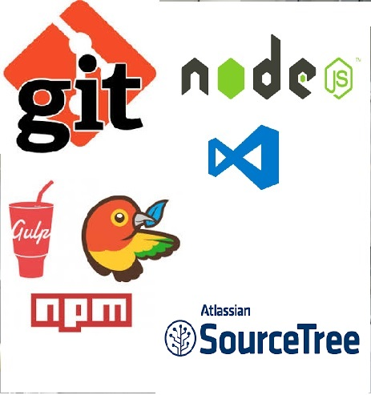
Setup
Clone the repository using favorite tools.
Ex: GIT Cli, Source tree, Visual Studio Team Explorer, etc
Open the cloned repository using editor
Ex: VS Code, Visual Studio, Net Beans, etc
Install npm and bower packages
npm install
bower install

Slide 4
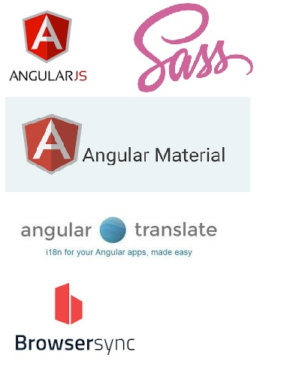
Development
Project structure.
Create folder for module
Define the module definition file
Define other components
Data Service module
Resources i.e. images, css, resource bundle etc.

Slide 5

Testing
Create a spec file
Creating mock data
Executing Unit test scripts.

Slide 6

Code Quality
JSCS and JSHint
Istanbul
Plato

Slide 7
Gulp tasks
 | Gulp tasks
Development | gulp serve-dev
Production | gulp build gulp serve-build
Code Quality | gulp plato gulp vet
Testing | gulp serve-specs gulp build-specs gulp test
Other | gulp gulp clean

Slide 8


