Slide 1

Capstone Project - MyShuttle

Slide 2



Personal BACKGROUND
Team : Group 4
Sai Palleboina
Shriya Jorrigala
Ganesh Korasala
Karri Varun
www.collaberadigital.com

Slide 3


Key Takeaways/Learnings from the Program (HTD)
Developed an understanding of test case design and acquired skills in manual testing to execute functional and non-functional test cases.
Learned Selenium WebDriver for automating web application testing.
Learned how to perform load and stress testing using tools such as JMeter.
Learned performing security testing using ZAPROXY
Understood key performance metrics and how to analyze the test results.
Gained hands-on experience with API testing using tools like Postman.
Incorporated daily scrum meetings into the training experience to simulate real Agile environments.
Understood the software development lifecycle (SDLC) and Agile methodology for better collaboration with cross-functional teams.
Learned version control using Git and how to manage code repositories on platforms like GitHub.
Understood the significance of non-functional requirements (NFRs) such as performance, security, and usability in software testing.
Practiced defect lifecycle management and effective bug reporting using tools like Jira.
Gained exposure to real-time project scenarios and end-to-end QA processes, enhancing industry readiness.

Slide 4

Problem Statement of the Capstone Project
The MyShuttle application aims to provide a seamless and efficient platform for users to manage and track their shuttle services. However, the existing system lacks comprehensive automated testing, which leads to potential inefficiencies and undetected bugs in the application.
The project will focus on implementing a robust testing framework using Selenium, Java and other relevant tools to ensure that all core features of the MyShuttle application are working as expected.
The main goal is to enhance the quality of the application, improve user experience, and ensure high performance and stability by conducting extensive manual, automated, and performance testing across different modules of the application.

Slide 5
Exploratory Testing and Manual Testing
As part of the manual testing process for our application, we have written and executed User Acceptance Tests (UAT) to ensure the system meets the business requirements and functions as expected from an end-user perspective.
User Management (ID: 380) Handles user registration, login, profile management, and role-based access control to ensure secure and efficient user interactions.
Ride Booking (ID: 393) Facilitates users in scheduling rides by providing options for real-time bookings, preferred routes, and estimated time of arrival.
Payment System (ID: 392) Manages secure transactions by supporting various payment methods, including credit/debit cards, digital wallets, and in-app payment processing.
Notification System (ID: 375) Sends timely notifications to users and drivers, including ride confirmations, updates, reminders, and alerts for critical events.
Marketing Campaigns (ID: 378) Supports the design, execution, and monitoring of promotional activities to increase user engagement and attract new customers.
Frequent Rider Program (ID: 376) Implements loyalty rewards for frequent users, offering discounts, points, and exclusive benefits to enhance customer retention.
Driver Management (ID: 377) Provides functionalities for driver onboarding, profile management, performance tracking, and allocation of ride requests.
Admin Portal (ID: 379) Acts as a centralized dashboard for administrators to manage system configurations, monitor activities, and generate reports.
For more information, refer to the provided Git Repository Link: cognixia042025/MyShuttle/Myshuttle at saipalleboina_repository-branch · sureshnanjan/cognixia042025

Slide 6
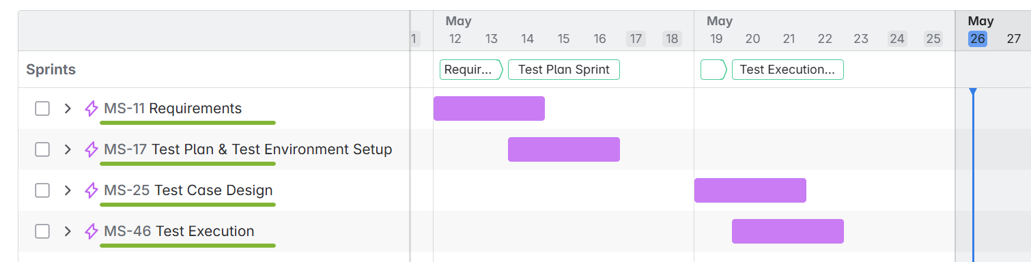
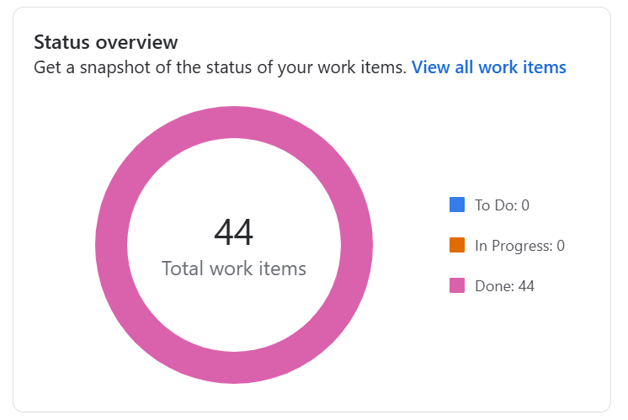
Sprint Planning

Slide 7
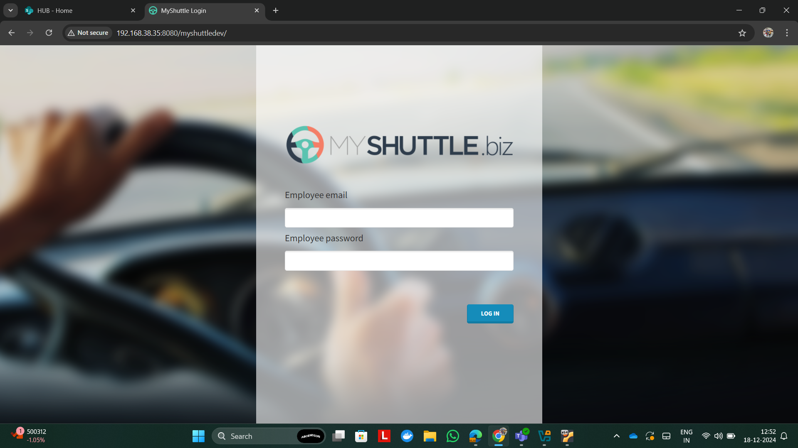
Important areas of the Project with screenshots
This picture shows the MyShuttle Login page, featuring a user-friendly interface where users can enter their email and password to access their accounts. The page includes a prominent login button and may display helpful error messages if incorrect information is entered.

Slide 8
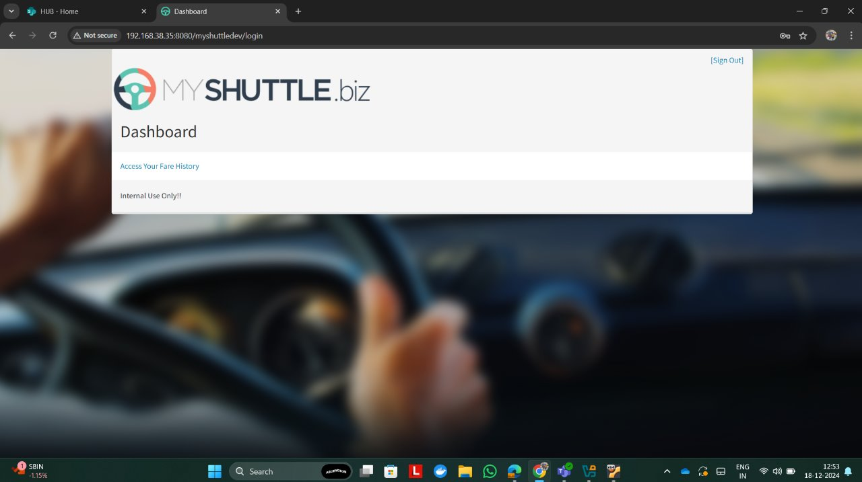
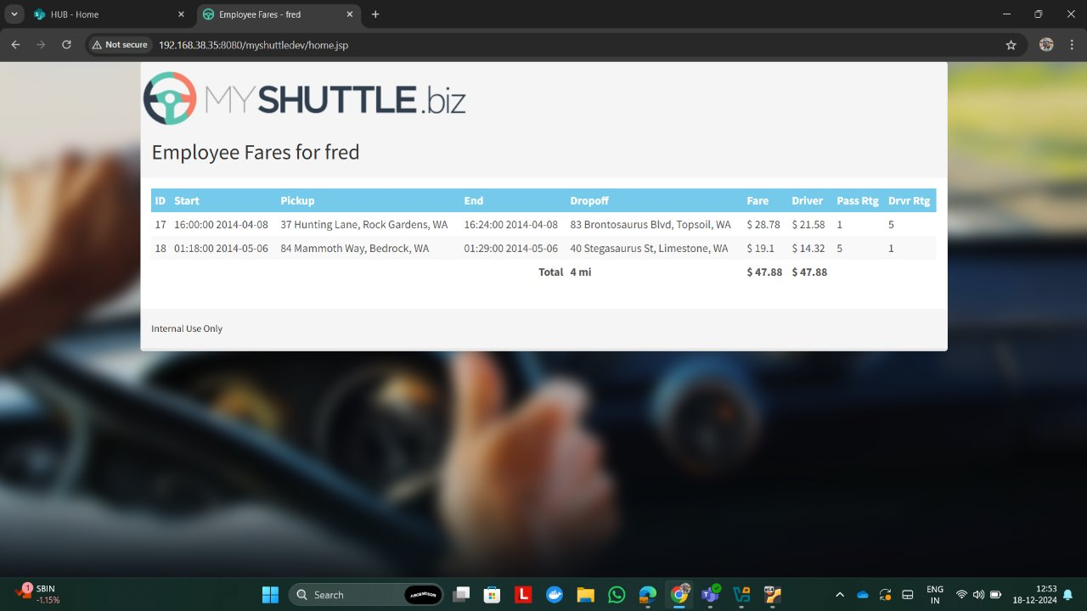
Important areas of the Project with screenshots
This picture shows the Dashboard Page of the MyShuttle application, which includes a link to access the user's Fare History.
This picture displays the Employee's Fare History, showcasing a detailed record of all fares associated with the employee.

Slide 9
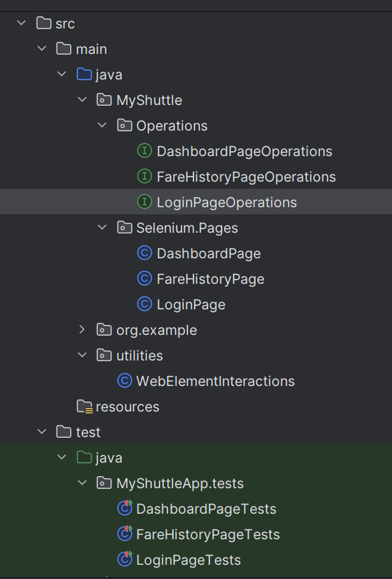
Automation Testing
Automation testing for the MyShuttle application involves using automated test scripts and tools to verify the functionality, performance, and security of the application. The goal is to ensure that features like booking rides, tracking shuttles, and user authentication are working as expected across different devices and platforms.
Steps followed for Automation Testing of MyShuttle:
Deployment and Setup
Tool Selection: Selenium
Test Case Creation: Object Model Implementation
Test Automation
Execution and Reporting
Continuous Improvement
For more information, refer to the provided Git Repository
Link: cognixia042025/MyShuttle/Myshuttle at saipalleboina_repository-branch · sureshnanjan/cognixia042025

Slide 10
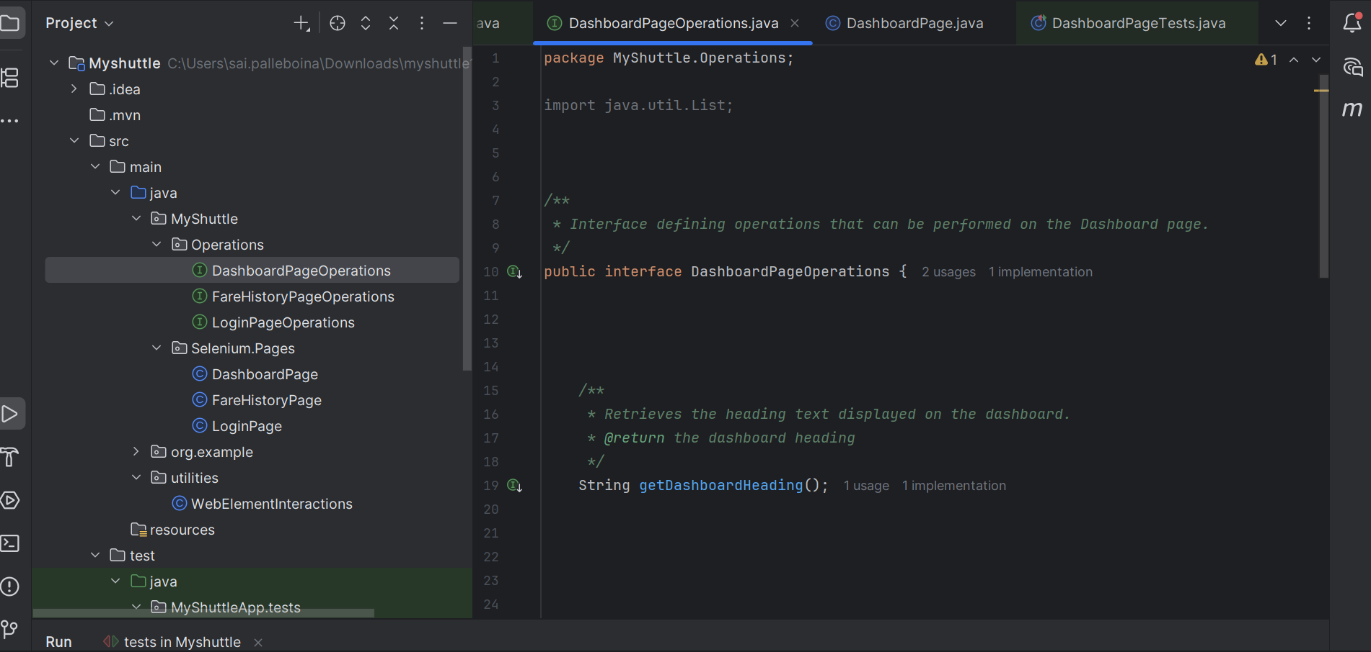
Automation Testing Execution

Slide 11
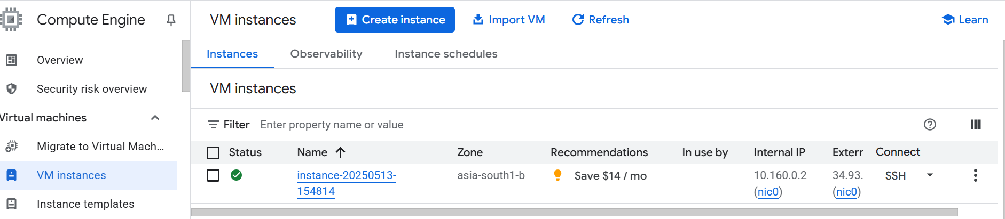
Important areas of the Project with screenshots
Virtual Machine Instance
Link of Virtual Instance: https://console.cloud.google.com/compute/instances?hl=en&inv=1&invt=AbyZdw&project=probable-dream-459616-f3

Slide 12
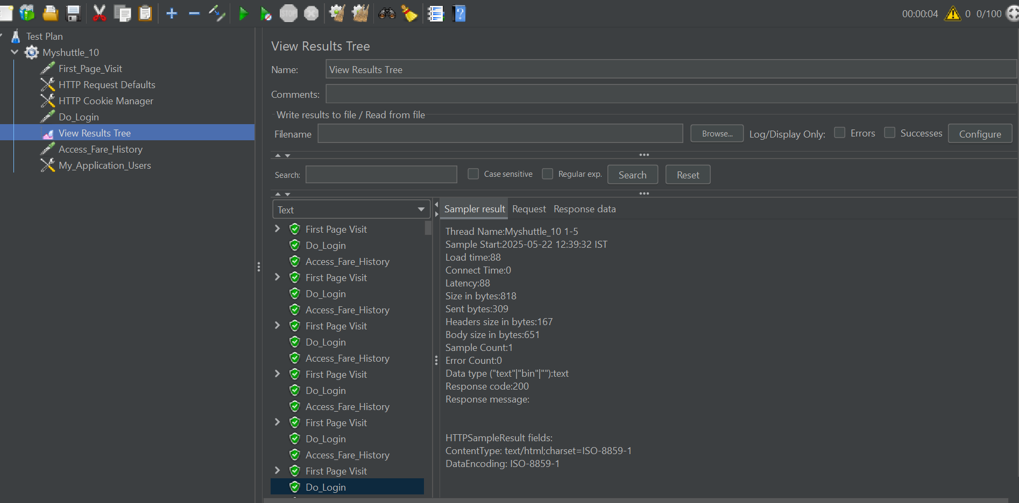
Important areas of the Project with screenshots
These pictures shows the Performance testing execution & results of Myshuttle using Apache Jmeter

Slide 13
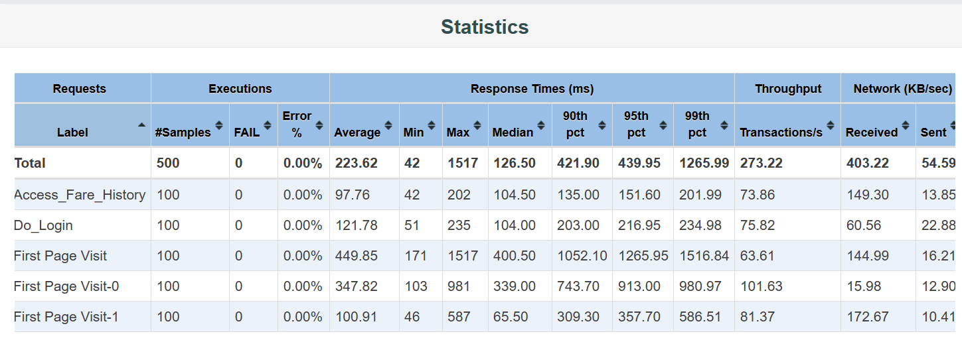
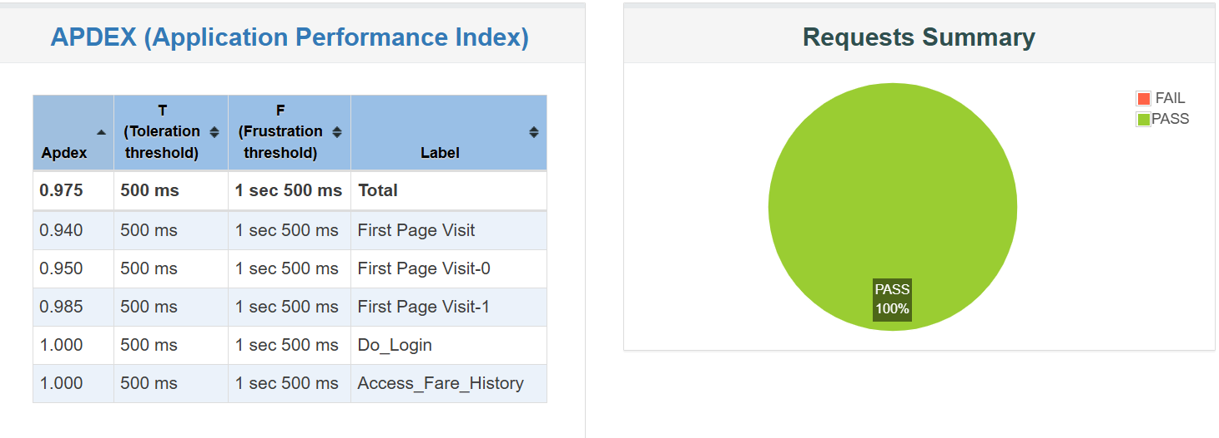
Important areas of the Project with screenshots
These pictures shows the Performance testing results of Myshuttle using Apache Jmeter

Slide 14
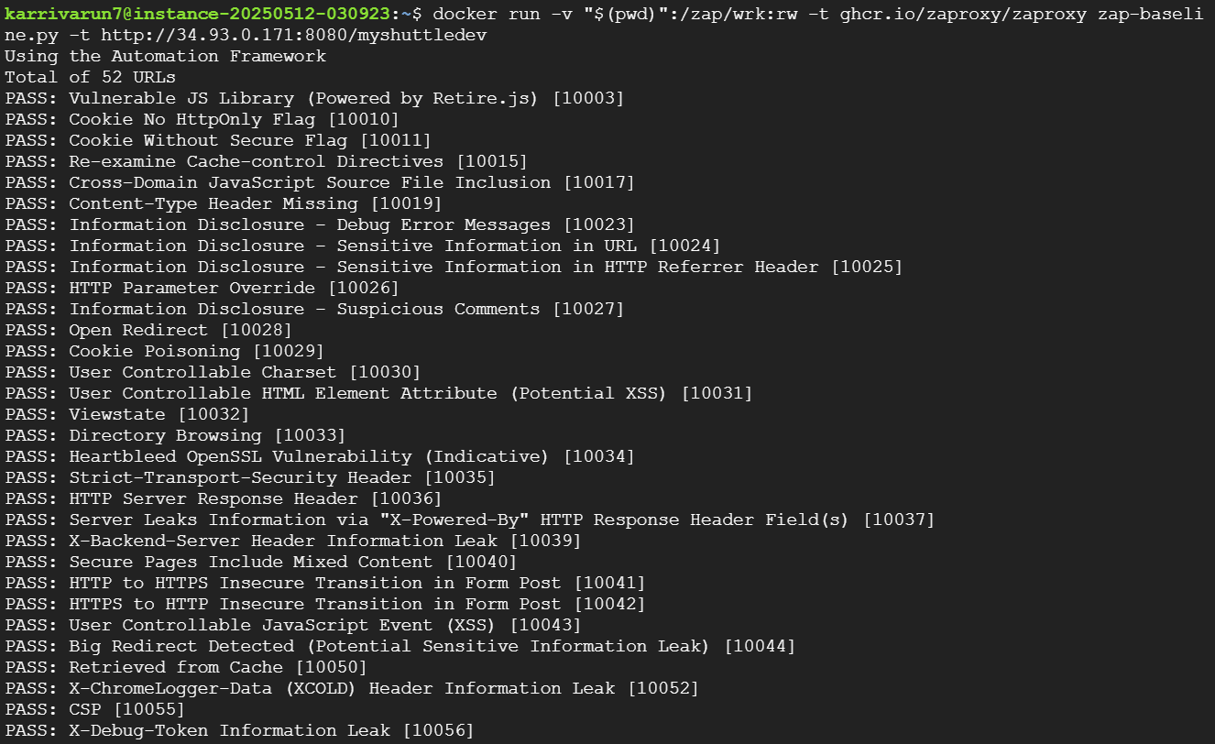
Important areas of the Project with screenshots
This picture shows the Security testing Execution and results of Myshuttle using Owasp ZAPROXY

Slide 15
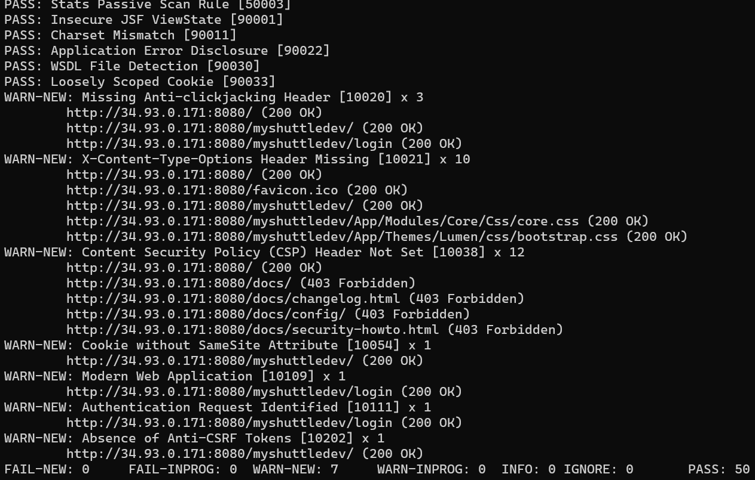
Important areas of the Project with screenshots
This picture shows the Security testing results of Myshuttle using Owasp ZAPROXY

Slide 16
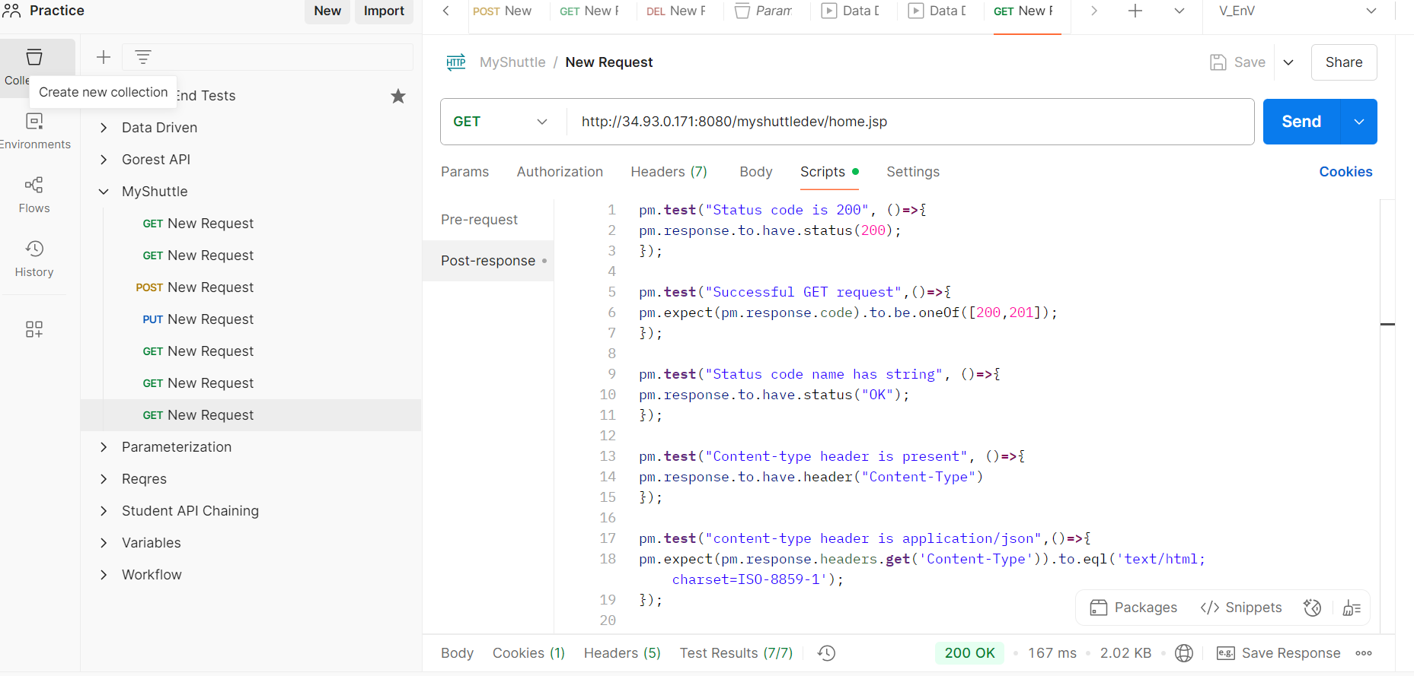
Important areas of the Project with screenshots
This picture shows the API testing results of Myshuttle using POSTMAN

Slide 17
Conclusion
The journey through the Quality Engineering training and the completion of the MyShuttle application project have been profoundly enriching and insightful. Over the past 30 sdays, we gained comprehensive exposure to essential skills such as Java programming, Selenium for automation, manual testing, performance testing, API testing and Google Cloud Platform.
The MyShuttle project served as a hands-on opportunity to apply these learnings effectively. By implementing features like login, fare history, and dashboard, we enhanced our understanding of real-world application development and testing methodologies. Additionally, the structured daily scrum meetings simulated an office environment, improving our ability to collaborate, communicate, and deliver as a team.

Slide 18
Thank You

