Slide 1
Test Design and Execution
Sub Heading Here

Slide 2
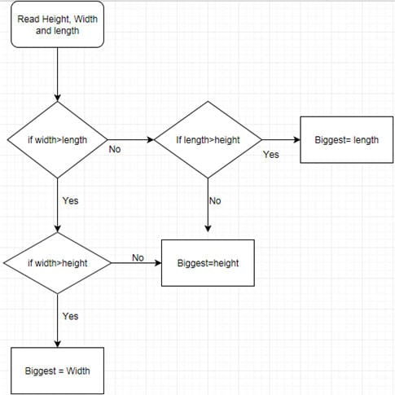
Flow Chart
Flow Charts:
Flow charts are best for process illustrations. They use specific symbols for each task/type of action that is carried out within the process. It allows for decisions, branches, loops etc., making it a perfect tool for documentation and understanding.
The testers will usually find the flow charts in the test plan, test strategy, requirements artifacts (BRD, FRD, etc.) or other process documents.
The most commonly used symbols and their meanings in a flow chart are:
Ovals- For start and stop
Rectangles- For processing/or a task
Diamond- For decisions
Here are two ways we testers use flow charts:
Flow charts for control flow and statistical analysis: (Cyclomatic Complexity: = Number of connections or Lines – Number of Nodes + 2)
Flow charts for process illustration
Source: https://www.teacherspayteachers.com/Sellers-Im-Following/Add/Fun-In-My-Fab-Lab

Slide 3
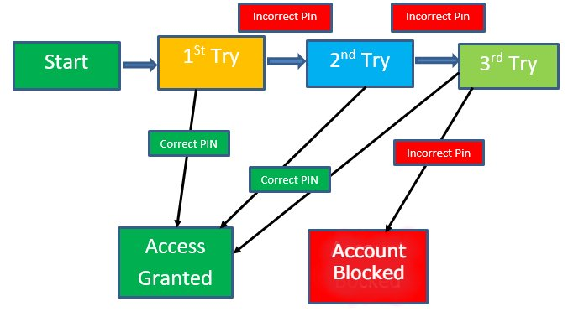
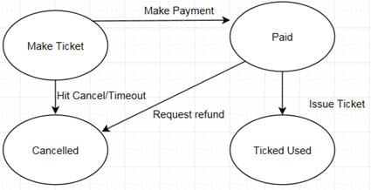
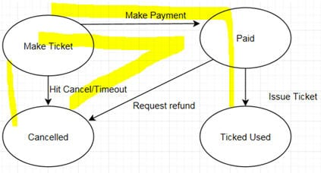
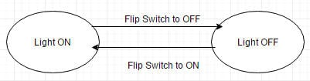
State transition diagrams
State transition tables or diagrams are great analysis tools when you are looking at complex systems that undergo a lot of changes from one state to another.

Slide 4
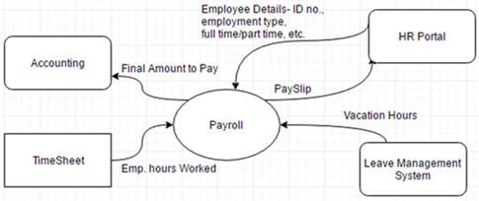
Context diagrams
Software systems rarely function as independent units. Simple Applications such a calculator, notepad, etc. might work on their own, but enterprise application often interfaces with many other applications.
Context Diagrams help testers understand the system in a broader sense and aid in creating test strategies that include these inbound and outbound relationships that the system has with the other entities.

Slide 5
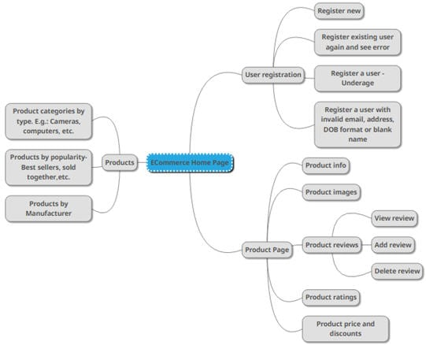
Mind Maps
A mind map tracks a busy mind that hops from topic to topic; every thought getting deeper and branching out wider with each idea. It is a diagram form of just starting with your main idea and documenting every single sub-thought that originates from it.

Slide 6
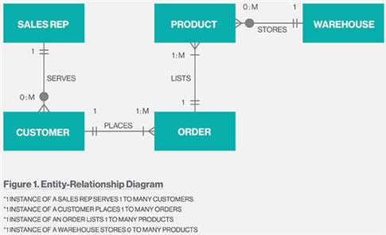
ER Diagram
Entity-Relationship (ER) diagrams are used for Database modeling. They help us understand the tables, their fields and how fields in one table relate to fields in other tables in the DB system. It shows the components of your DB system and the relationships between them in a visual way.
ER diagrams also act as an initial trial run of the DB model and visualization before DB systems are designed and built.
ER diagrams have entities (the instances of DB tables) and their relationships (one to one, one to many, one to mandatory, etc.) represented using boxes and crow’s feet connectors. ]

Slide 7
Summary
1) Flow Diagram :- Understanding the basics of anything. How system works at high or detail level 2) Transition Diagram :- Good when there is an object which changes states 3) Contextual Diagram :- To connect various system to understand a larger picture like you have taken example how a software interacts with time sheets, employee system 4) Mind Map :- Create a central topic and you can generate various ideas around it 5) ER diagram :- To understand how tables are linked to each other 6) Mock ups – to give an idea to tester how the things should be like in actual software visually

Slide 8
Test Execution Considerations
Let us now make a list of all things that are important to understanding the Test Execution phase:
#1) The build (the code that is written by the dev team is packaged into what is referred to a build- this is nothing but an installable piece of software (AUT), ready to be deployed to QA environment.) being deployed (in other words, installed and made available) to the QA environment is one of the most important aspects that needs to happen for the Test Execution to start.
#2) Test Execution happens in the QA environment. To make sure that the dev team’s work on the code is not in the same place, where the QA team is testing, the general practice is to have a dedicated Dev and QA environment. (There is also a production environment to host the live application).
This is basically to preserve the integrity of the application at various stages in the SDLC lifecycle. Otherwise, ideally, all 3 environments are identical in nature.
#3) Test team size is not constant from the beginning of the project. When the Test Plan is initiated the team might just have a Team lead. During the test design phase, a few testers come on board. Test Execution is the phase when the team is at its maximum size.
#4) Test Execution also happens in at least 2 cycles (3 in some projects). Typically in each cycle, all the test cases (the entire test suite) will be executed. The objective of the first cycle is to identify any blocking, critical defects, and most of the high defects.
The objective of the second cycle is to identify remaining high and medium defects, correct gaps in the scripts and obtain results.
#5) Test Execution phase consists of- Executing the Test scripts + Test script maintenance (correct gaps in the scripts) + Reporting (defects, status, metrics, etc.) Therefore, when planning this phase schedules and efforts should be estimated taking into consideration all these aspects and not just the script execution.

Slide 9
Test Execution Considerations
Let us now make a list of all things that are important to understanding the Test Execution phase:
#6) After the Test script being done and the AUT is deployed – and before the Test execution begins, there is an intermediary step. This is called the “Test Readiness Review (TRR)”. This is a sort of transitional step that will end the test designing phase and ease us into the test execution.
#7) In addition to the TRR, there are few more additional checks before we ensure that we can go ahead with accepting the current build that is deployed in the QA environment for test execution.
Those are the Smoke and Sanity tests.
#8) Upon successful completion of TRR, Smoke and Sanity tests, the test cycle officially begins.
#9) Exploratory Testing would be carried out once the build is ready for testing. The purpose of this test is to make sure critical defects are removed before the next levels of testing can start. This exploratory testing is carried out in the application without any test scripts and documentation. It also helps in getting familiar with the AUT.
#10) Just like the other phases of the STLC, the work is divided among team members in the Test Execution phase also. The division might be based on module wise or test case count wise or anything else that might make sense.
#11) The primary outcome of the test execution phase is in the form of reports primarily i.e. Defect Report and Test Execution Status report. The detailed process for reporting can be found at Test Executions reports.

