Slide 1
No API? No problem!
API mocking with WireMock
An open source workshop by …
Originally created by Bas Dijkstra – bas@ontestautomation.com – http://www.testautomation.com - @_basdijkstra
Notes:
Please replace the … with your own name. I would really like it if you left the bottom line intact though, as a way of thanking me. That’s really all I’m asking for, the rest of the workshop is yours to butcher (erm, improve).

Slide 2
What are we going to do?
Stubbing, mocking and service virtualization
WireMock
Get your hands dirty
Notes:
The workshop starts with a background on how stubbing, mocking and service virtualization can help you remove bottlenecks in your test environment. Then, we’re going to take a look at how WireMock enables you to write mocks in Java using a powerful and intuitive API. And of course, most importantly, the participants are going to do the hard work..

Slide 3
Preparation
Install Eclipse (or any other IDE)
Install m2e (if you’re using Eclipse)
Import Maven project in IDE
Update project (if you’re using Eclipse)
Notes:
Depending on the way you deliver this workshop, this sheet can be altered or even removed. When I delivered it, I had participants bring in their own laptop and asked them to follow installation instructions. I only provided them for Eclipse and mentioned that whenever they wanted to use a different IDE, they were allowed to do so. I wanted to keep things simple and therefore did not provide installation instructions for other IDEs.

Slide 4
Problems in test environments
Systems are constructed out of of many different components
Not all of these components are always available for testing
  Parallel development
  No control over testdata
  Fees required for using third party component
  …

Slide 5
Problems in test environments
Mobile app
SaaS dependency
Under development
Access fees
System under test
No suitable test data
Limited access
Backend system
Mainframe

Slide 6
Simulation during test execution
Simulate dependency behavior
Regain full control over test environment
  Available on demand
  Full control over testdata (edge cases!)
  No third party component usage fees
  …

Slide 7
Stubbing
Predefined responses
No flexibility
Status verification

Slide 8
Mocking
Define mock behavior during test initialization
(Somewhat) more flexible
Behavior verification

Slide 9
Service virtualization
Simulate complex dependency behavior
‘Next level’ stubbing / mocking
Support for many different protocols and message formats
Data driven

Slide 10
Problems in test environments
Mobile app
SaaS dependency
Under development
Access fees
System under test
No suitable test data
Limited access
Backend system
Mainframe

Slide 11
Simulation in test environments
Virtualized mobile app
Virtualized SaaS dependency
Unrestricted access
Unrestricted access
System under test
Unrestricted access
Unrestricted access
Virtualized backend system
Virtualized mainframe

Slide 12
WireMock
http://wiremock.org
Java
HTTP mock server
  only supports HTTP(S)
open source
  developed and maintained by Tom Akehurst

Slide 13
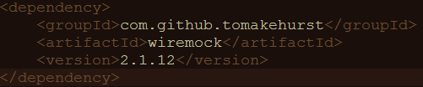
Install WireMock
Add .jar file to Java project
Maven
Gradle

Slide 14
Run WireMock
In Java (via Junit @Rule)
In Java (without using JUnit)
Standalone

Slide 15
Configure responses
In (Java) code
Using JSON mapping files

Slide 16
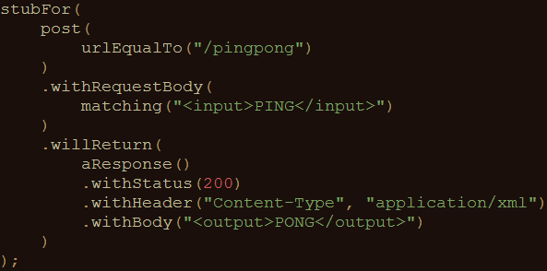
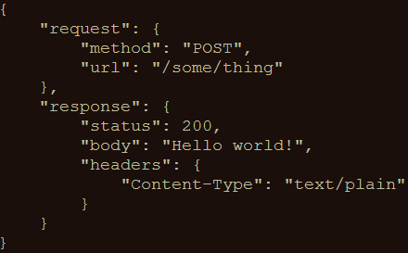
An example mock
In Java
In JSON

Slide 17
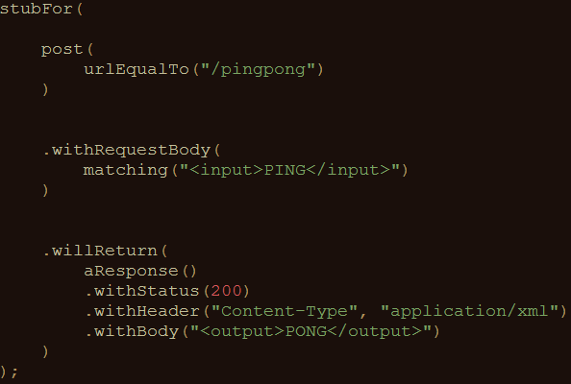
Syntax
This stub responds to:
A HTTP POST to /pingpong
With body <input>PING</input>
With an answer having:
HTTP status code 200
body type application/xml
body <output>PONG</output>

Slide 18
Useful WireMock features
Verification
  Verify that certain requests are sent by application under test
Record and playback
  Generate mocks based on request-response pairs (traffic)
Fault simulation
…
Full documentation at http://wiremock.org/docs/

Slide 19
Running WireMock standalone
Start WireMock server
  Options: port, keystore, ...
Make mocks permanently available
  For example for multiple teams
Reconfigure mocks via JSON

Slide 20
Starting and stopping WireMock during test execution
Integration in test execution
Mocks in version control (Git, etc.)
JUnit integration
Can be used without having to use JUnit as well

Slide 21
Demo
Running and using WireMock in standalone mode
Use of WireMock in the exercises
Writing your very first mock

Slide 22
Get your hands dirty!
WireMockExercises1
Create simple mocks
Exercises are defined in the comments
Verify your solution by running the tests

Slide 23
Request matching
Determine response to be sent based on specific request characteristics
Options:
  URL
  HTTP method
  Query parameters
  Headers
  Request body elements
  …

Slide 24
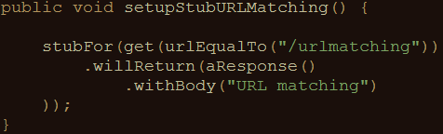
Example: URL matching
Other URL options:
  urlPathEqualTo
  urlMatching
  urlPathMatching

Slide 25
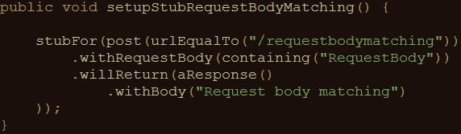
Example: body element matching
Other request body matching options:
  equalTo
  matching, notMatching (using regular expressions)

Slide 26
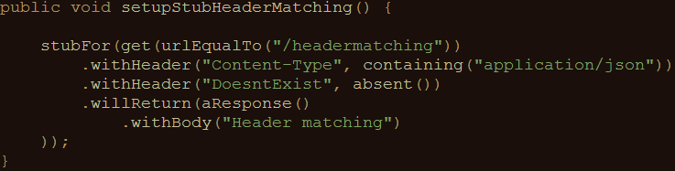
Example: header matching
absent(): check parameter is not in request

Slide 27
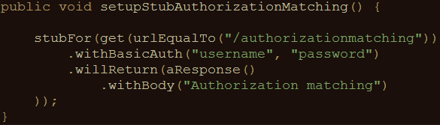
Example: basic authentication matching
No support (yet) for other authentication mechanisms
  Like OAuth2
HTTPS is supported

Slide 28
Get your hands dirty!
WireMockExercises2
Use request matching
Exercises are defined in the comments
Verify your solution by running the tests

Slide 29
Fault simulation
Extend test coverage by simulating faults
Often hard to do in real systems
Easy to do using stubs or mocks
Test exception handling application under test

Slide 30
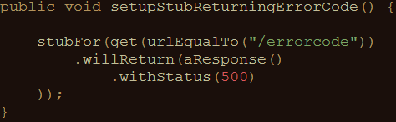
Example: HTTP status code
Often used status codes:
Client error Server error
403 (Forbidden) 500 (Internal server error)
404 (Not found) 503 (Service unavailable)

Slide 31
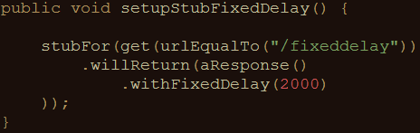
Example: timeout
Other delay options:
  Random
  Uniformly distributed
Can be configured on a per-stub basis as well as globally

Slide 32
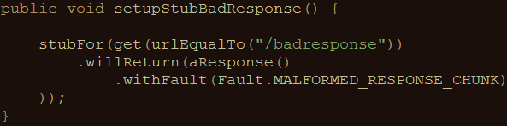
Example: bad responses
HTTP status code 200, but garbage in response body
Other options:
  RANDOM_DATA_THEN_CLOSE (as above, without HTTP 200)
  EMPTY_RESPONSE

Slide 33
Get your hands dirty!
WireMockExercises3
Use fault simulation
Exercises are defined in the comments
Verify your solution by running the tests

Slide 34
Stateful mocks
Mocks until now have been stateless
Order of calling mocks does not influence behavior
Not always true in the real world
Request A > request B differs from request B > request A

Slide 35
Stateful mocks in WireMock
Scenario
Status transitions
Current state (partly) determines the response being sent

Slide 36
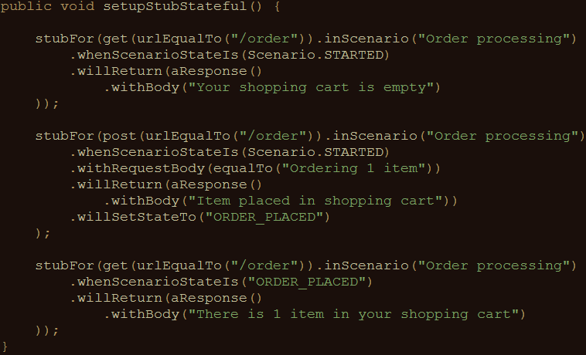
Stateful mocks: an example

Slide 37
Get your hands dirty!
WireMockExercises4
Use stateful mocks
Exercises are defined in the comments
Verify your solution by running the tests

Slide 38
Record and playback options
Use WireMock as a proxy
Record request-response pairs (traffic)
Genererate mock from recorded traffic

Slide 39
Demo
Using record and playback in WireMock

Slide 40
Pros and cons of record and playback
Pros:
  Easy creation of mocks
  Analyse traffic of which there are no specifications
Cons:
  Rerecording necessary when interface changes
  Mocks are not flexible
  Mocks are hard to extend
Similar to record and playback in test automation

Slide 41
Other useful features
Verification (was a given message sent ?)
Response transformations (via extensions)
Integration into a CI / CD pipeline
Documentation: http://wiremock.org/docs/

Slide 42
Questions
?

Slide 43
Contact
Email:
Blog:
LinkedIn:
Twitter:

