Slide 1
Stock Open Price Prediction as a service
By:
Anusha Basavaraj
Suresh N Nayak

Slide 2
Components
Kubernetes, deployment and scalability
Deep-learning model to predict opening price
rabbitMQ, messaging
redis, database
Flask REST server

Slide 3
Architectural Diagram

Slide 4
A License Plate Tracking System
car.jpg
CZTHEDA %80.23
md5sum car.jpg
40.032115, -105.258897

Slide 5
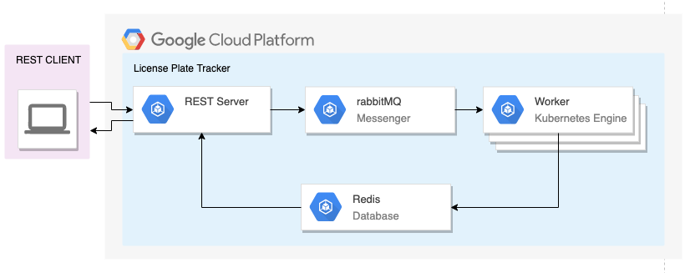
Architectural Diagram

Slide 6
Debugging
Logging with rabbitMQ
Cluster communication
Launching under a new gcloud project

Slide 7
Learnings
Scaling the worker to meet demand
What happens if the database is overwhelmed?
What happens if the front end is overwhelmed?

Slide 8
Thank You!
And good luck with your projects!

