Slide 1
Stock Open Price Prediction as a service
By:
Anusha Basavaraj
Suresh N Nayak

Slide 2
Components
Kubernetes, deployment and scalability
Deep-learning model to predict opening price
rabbitMQ, messaging
redis, database
Flask REST server

Slide 3
Architectural Diagram

Slide 4
Components
Kubernetes, deployment and scalability
Deep-learning model to predict opening price
rabbitMQ, messaging
redis, database
Flask REST server

Slide 5
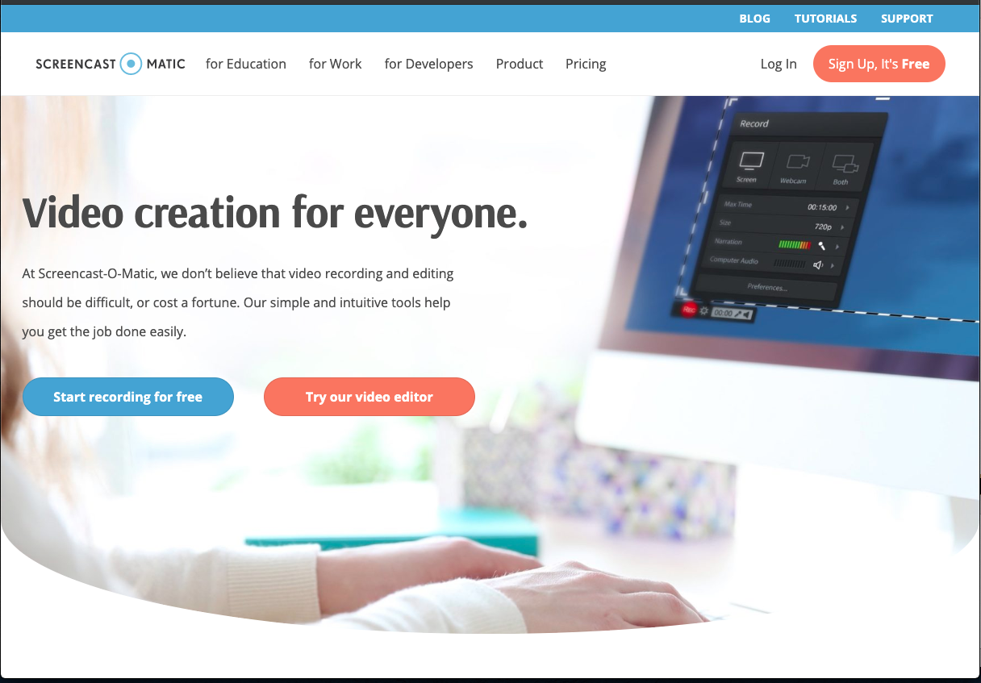
screencast-o-matic.com

Slide 6
License Plate Tracker
By Max Hollingsworth
Partner Name

Slide 7
A License Plate Tracking System
car.jpg
CZTHEDA %80.23
md5sum car.jpg
40.032115, -105.258897

Slide 8
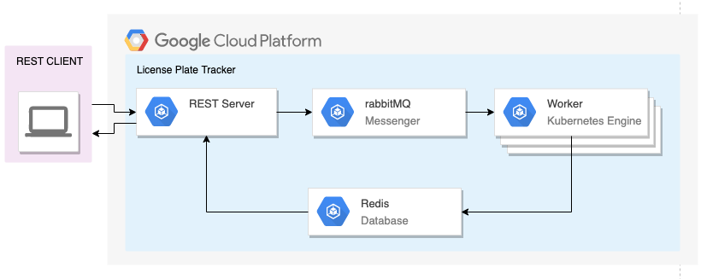
Architectural Diagram

Slide 9
Debugging
Logging with rabbitMQ
Cluster communication
Launching under a new gcloud project

Slide 10
Learnings
Scaling the worker to meet demand
What happens if the database is overwhelmed?
What happens if the front end is overwhelmed?

Slide 11
Thank You!
And good luck with your projects!

