Slide 1
ORACLE FUSION MIDDLEWARE

Slide 2

ORACLE – FMW
Introduction
What is Fusion Middleware
Components of Fusion Middleware
Web tier
Middle tier
Fusion Application
Grouping
Oracle Fusion Middleware administration

Slide 3
ORACLE – FMW
Oracle Fusion Middleware is a collection of standards-based software products that spans a range of tools and services: from Java EE and developer tools, to integration services, identity management, business intelligence, and collaboration. Oracle Fusion Middleware offers complete support for development, deployment, and management.
Middleware provides the infrastructure which facilitates creation of business applications, and provides core services like concurrency, transactions, threading, and messaging. When configured appropriately, it also provides security and enables high availability functionality to your enterprise.

Slide 4
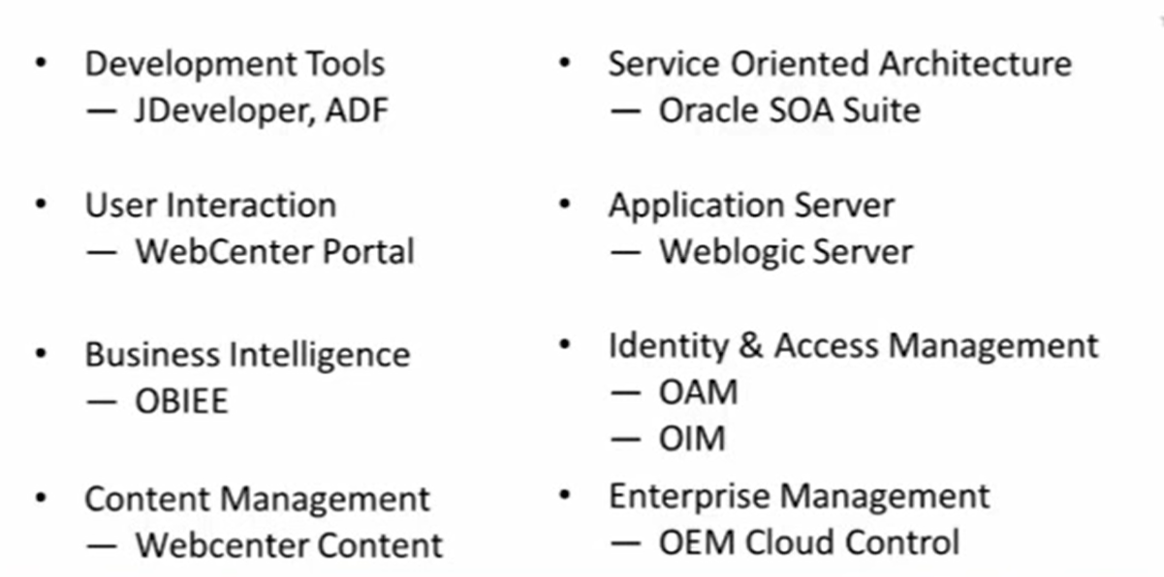
ORACLE – FMW Components

Slide 5
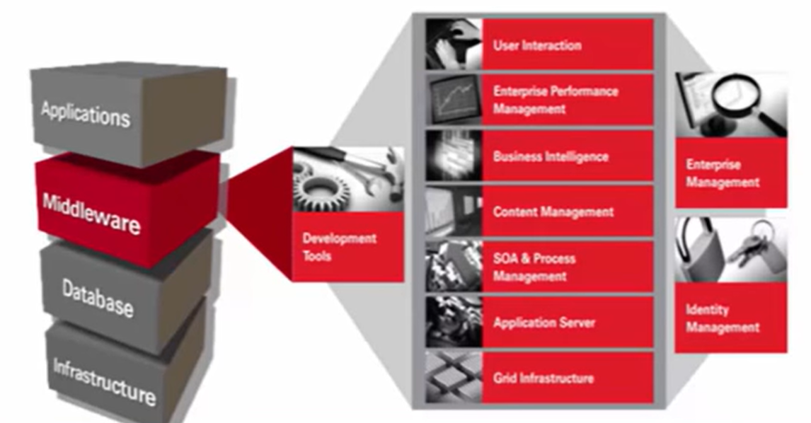
ORACLE – FMW

Slide 6
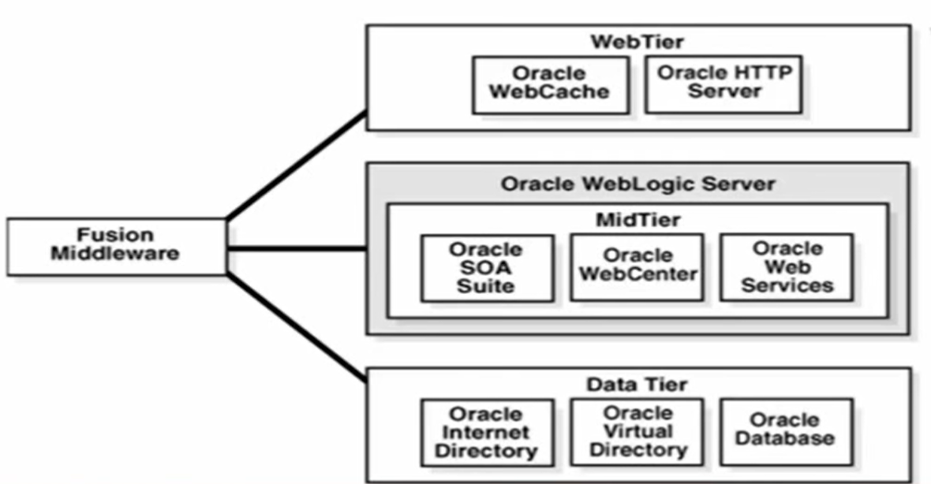
ORACLE – FMW 3 Tier Architecture

Slide 7
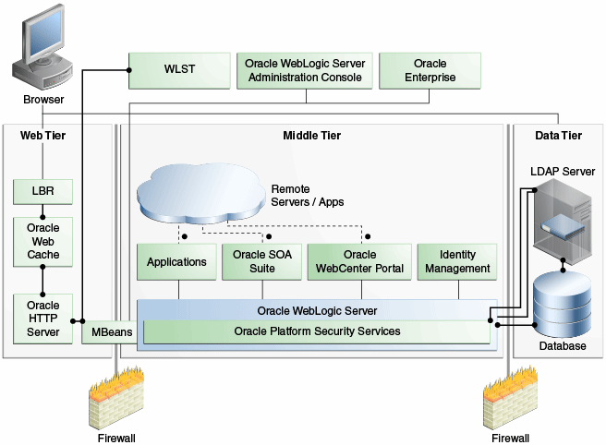
ORACLE – FMW n Tier Architecture

Slide 8
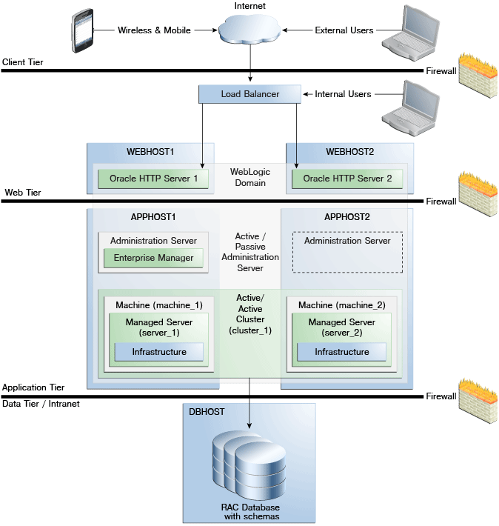
ORACLE – FMW n Tier Architecture

Slide 9
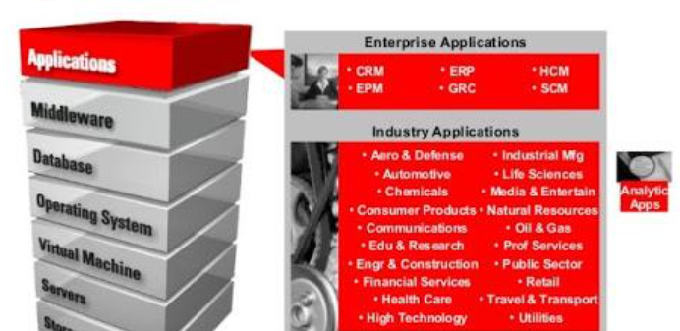
ORACLE – FMW Enterprise Applications

Slide 10
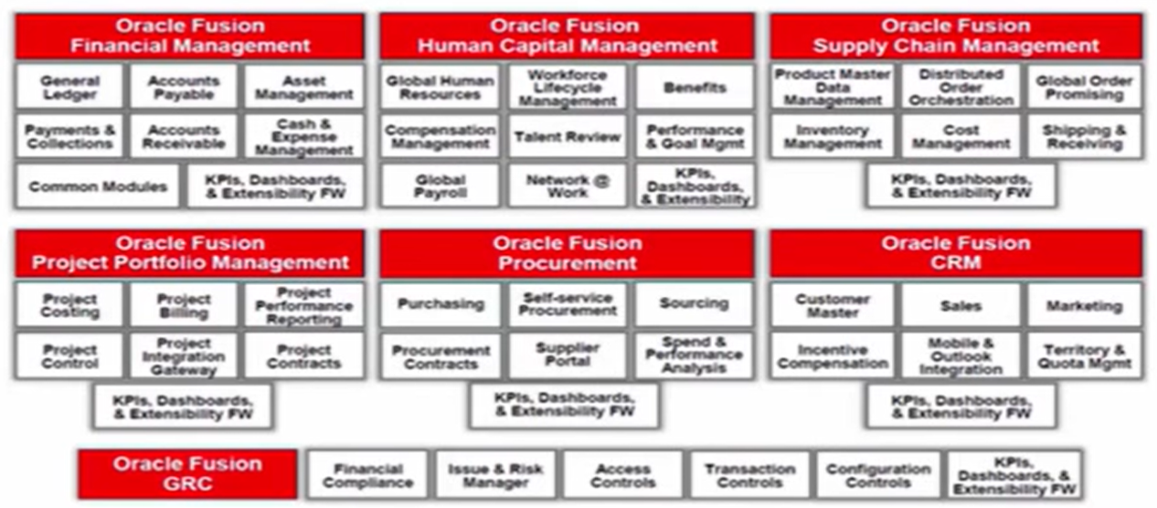
ORACLE – FMW Fusion Applications

Slide 11
ORACLE IDENTITY & ACCESS MANAGEMENT SUITE
Oracle Identity Manager
Oracle Entitlement Server
Oracle Access Manager
Oracle Privileged Accounts Manager
Oracle Adaptive Access Manager
Oracle Mobile Security Suite

Slide 12

ORACLE IDENTITY MANAGER
Enterprise SSO
Authentication & Authorization
Eliminates Multiple Authentication
Allows & Restricts Access
LDAP server integration
Oracle Identity Manager

Slide 13

OIM & OAM INTEGRATION
Oracle Identity Manager
Oracle Access Manager

Slide 14
ORACLE IDENTITY & ACCESS MANAGEMENT SUITE
Overview of Oracle Identity Manager
Application Onboarding Fundamentals
➢ Reconciliation and Provisioning
➢ Process Definition
➢ Forms
➢ Lookups
➢ Application Instances
➢ Entitlements
➢ Reconciliation Rules and Mapping

Slide 15
ORACLE IDENTITY & ACCESS MANAGEMENT SUITE
Introduction to OIM API
➢ User Management API
➢ Provisioning Service API
➢ Entitlement and Catalog Service API
➢ Lookup Service API
➢ Request Service API
➢ OIM Service API

Slide 16
ORACLE IDENTITY & ACCESS MANAGEMENT SUITE
OIM to OUD Integration
➢ Introduction to Directory Server
➢ History of LDAP products
➢ 3 Different Modes of OUD
➢ Some Myths about OUD
➢ Requirements for OUD Installation
➢ Installation of OUD
➢ Installation of Application Development Runtime
➢ Installation of WebLogic
➢ WebLogic Domain Creation
➢ Creation of Directory Server Instance
➢ Starting and Stopping of OUD Server
➢ Understanding Provisioning Big Picture

