Slide 1
ORACLE FUSION MIDDLEWARE

Slide 2
ORACLE IDENTITY & ACCESS MANAGEMENT SUITE
Overview of Oracle Identity Manager
Application Onboarding Fundamentals
➢ Reconciliation and Provisioning
➢ Process Definition
➢ Forms
➢ Lookups
➢ Application Instances
➢ Entitlements
➢ Reconciliation Rules and Mapping

Slide 3
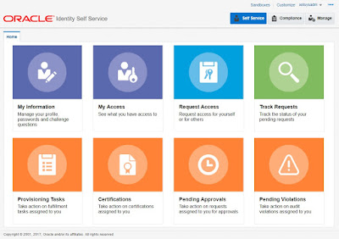
ORACLE IDENTITY MANAGER

Slide 4
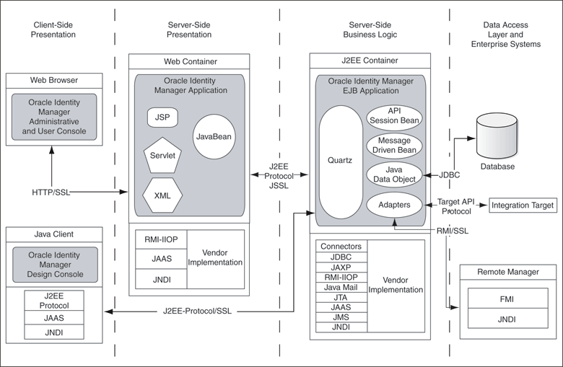
ORACLE IDENTITY MANAGER System Architecture

Slide 5
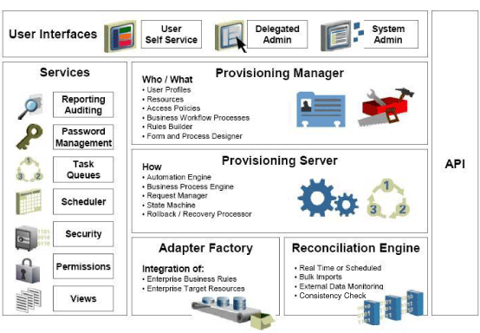
ORACLE IDENTITY MANAGER System Component Architecture

Slide 6
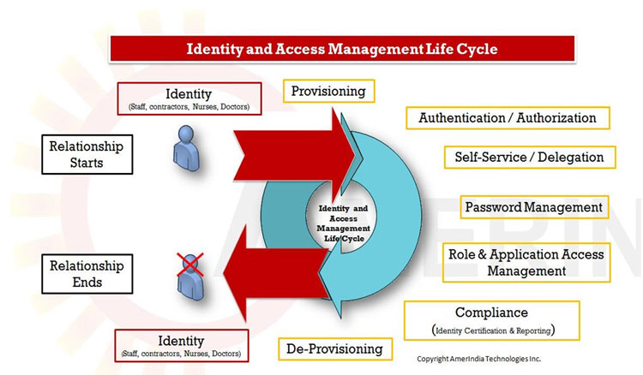
ORACLE IDENTITY MANAGER Provisioning & Reconciliation

Slide 7
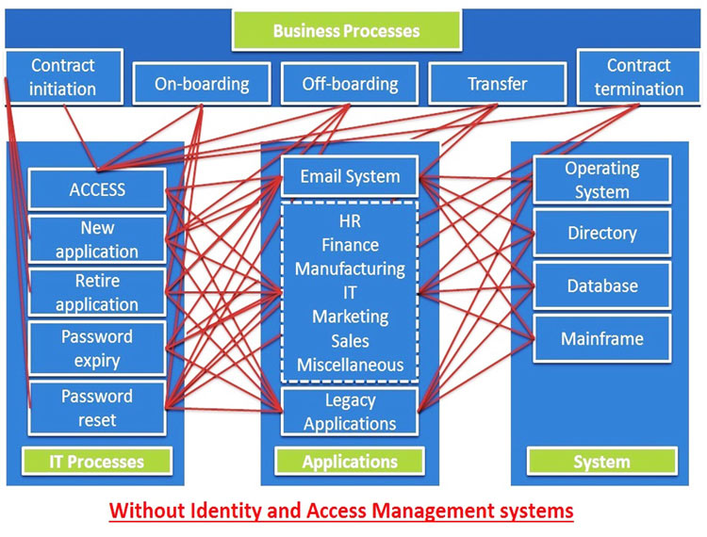
ORACLE IDENTITY MANAGER Provisioning & Reconciliation

Slide 8
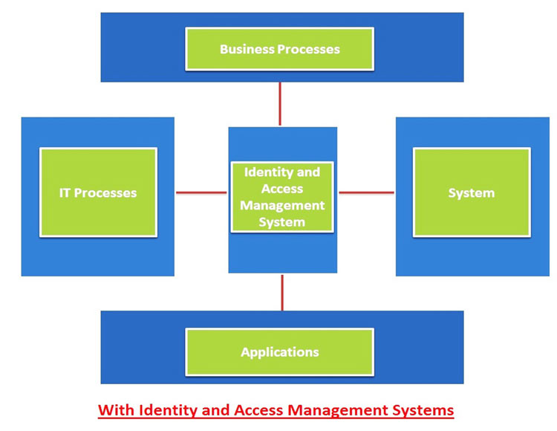
ORACLE IDENTITY MANAGER Provisioning & Reconciliation

Slide 9
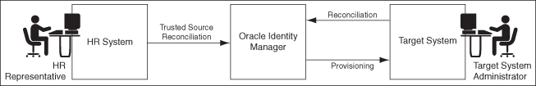
ORACLE IDENTITY MANAGER Provisioning & Reconciliation

Slide 10
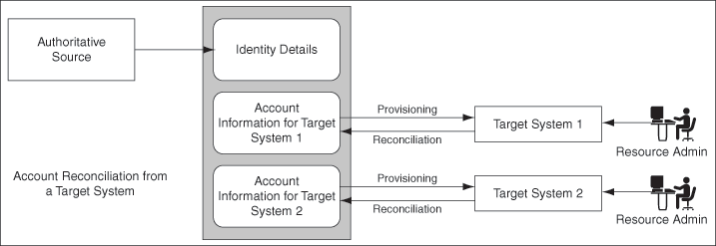
ORACLE IDENTITY MANAGER Managing Reconciliation

Slide 11
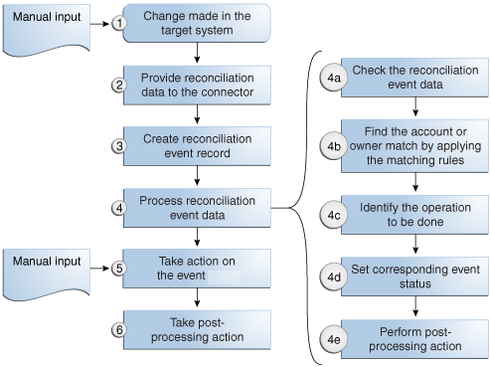
ORACLE IDENTITY MANAGER Reconciliation Process Flow

Slide 12
ORACLE IDENTITY MANAGER Application Instance
Managing Application Instances
You manage application instances by using Oracle Identity System Administration. This includes:
Creating Application Instances
Searching Application Instances
Modifying Application Instances
Deleting Application Instances
Creating and Modifying Forms

Slide 13
ORACLE IDENTITY MANAGER Application Instance
User, Account, and Entitlement Provisioning
Oracle Identity Manager provides a comprehensive provisioning solution for many enterprise resources. Predefined connectors and a flexible Adaptor Factory enable customers to easily establish connectivity with well-known targets and custom systems.
This connectivity forms the basis of Oracle Identity Manager, enabling you to provide support for self-service and delegated administration, password management, provisioning, and request and approval workflow across many enterprise targets.
This chapter explains how you can integrate Oracle Identity Manager with other components to provision users, accounts, and entitlements for your enterprise applications. It contains these sections:
Oracle Identity Manager Connectors for Oracle Identity Management
Oracle Identity Manager Connectors for Databases
Oracle Identity Manager Connectors for Oracle Applications
Oracle Identity Manager Connectors for Third-Party Applications

Slide 14
ORACLE IDENTITY MANAGER Oracle Unified Directory
Oracle Unified Directory
This chapter provides an overview of Oracle Unified Directory and describes some unique features of Oracle Unified Directory.
This chapter contains the following topics:
"What is Oracle Unified Directory?"
"Overview of Directory Server"
"Overview of Proxy Server"
"Overview of the Replication Gateway"

Slide 15

ORACLE IDENTITY MANAGER Oracle Unified Directory - Components
Components of Oracle Unified Directory
Oracle Unified Directory components include:
LDAP directory server, used for storing data
Proxy server, where the server acts as an interface between the client and the directory server that contains the data
Replication gateway between Oracle Unified Directory and Oracle Directory Server Enterprise Edition

Slide 16
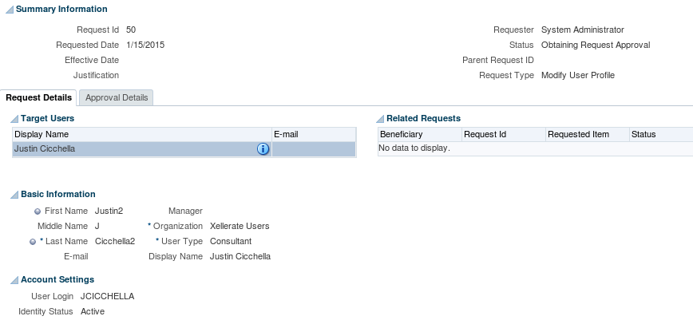
OIM Request Service API

