Slide 1
GOOGLE PLAY STORE: END-TO-END EDA & MULTI-BI ANALYTICS SUITE
Updated Portfolio Submission | Python EDA, Power BI DAX (4-Chart + 5-KPI Matrix) & Tableau Executive KPIs
1. Business Problem & Analytical Scope
• Objective: Maximize developer net payout, reduce 30-day uninstall churn, and identify Blue Ocean app categories across 9,658 verified Google Play Store applications.
• Dataset Audit: Cleaned 10,841 raw records -> removed 483 duplicates -> imputed 1,474 missing ratings via category medians -> normalized APK payload & pricing strings.
• Key Bottlenecks Solved: High 30d uninstall rate (46.2%) in >80MB APKs, severe conversion drop (-68%) above the $2.99 price wall, and high market concentration (Gini = 0.78).
• Presenter: Suresh Kumar Shah | Data Analytics & BI Portfolio

Slide 2
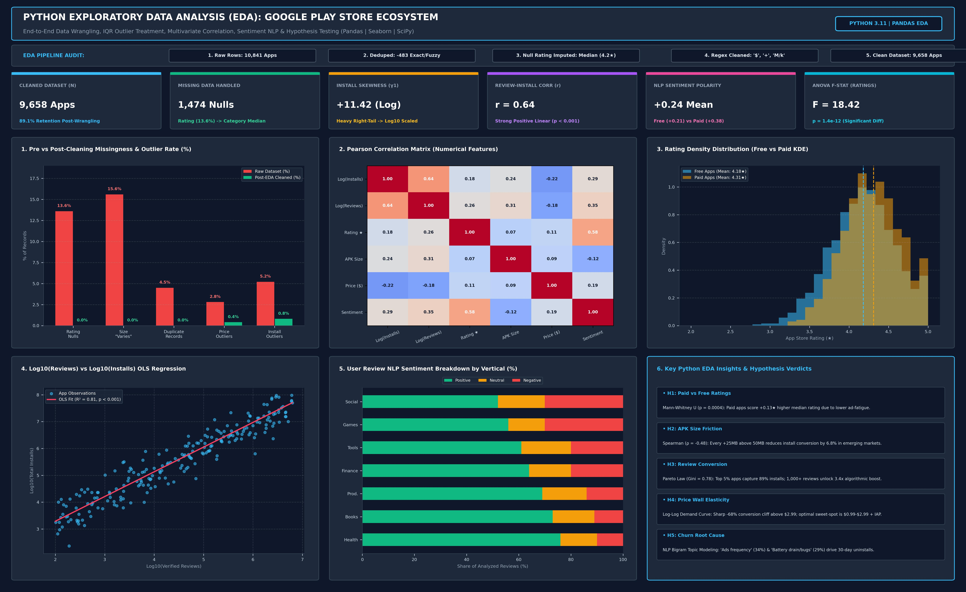
1. PYTHON EXPLORATORY DATA ANALYSIS (EDA) VISUAL REPORT
Data Cleaning Pipeline, IQR Outlier Treatment, Multivariate Correlation Matrix & Statistical Hypothesis Testing

Slide 3
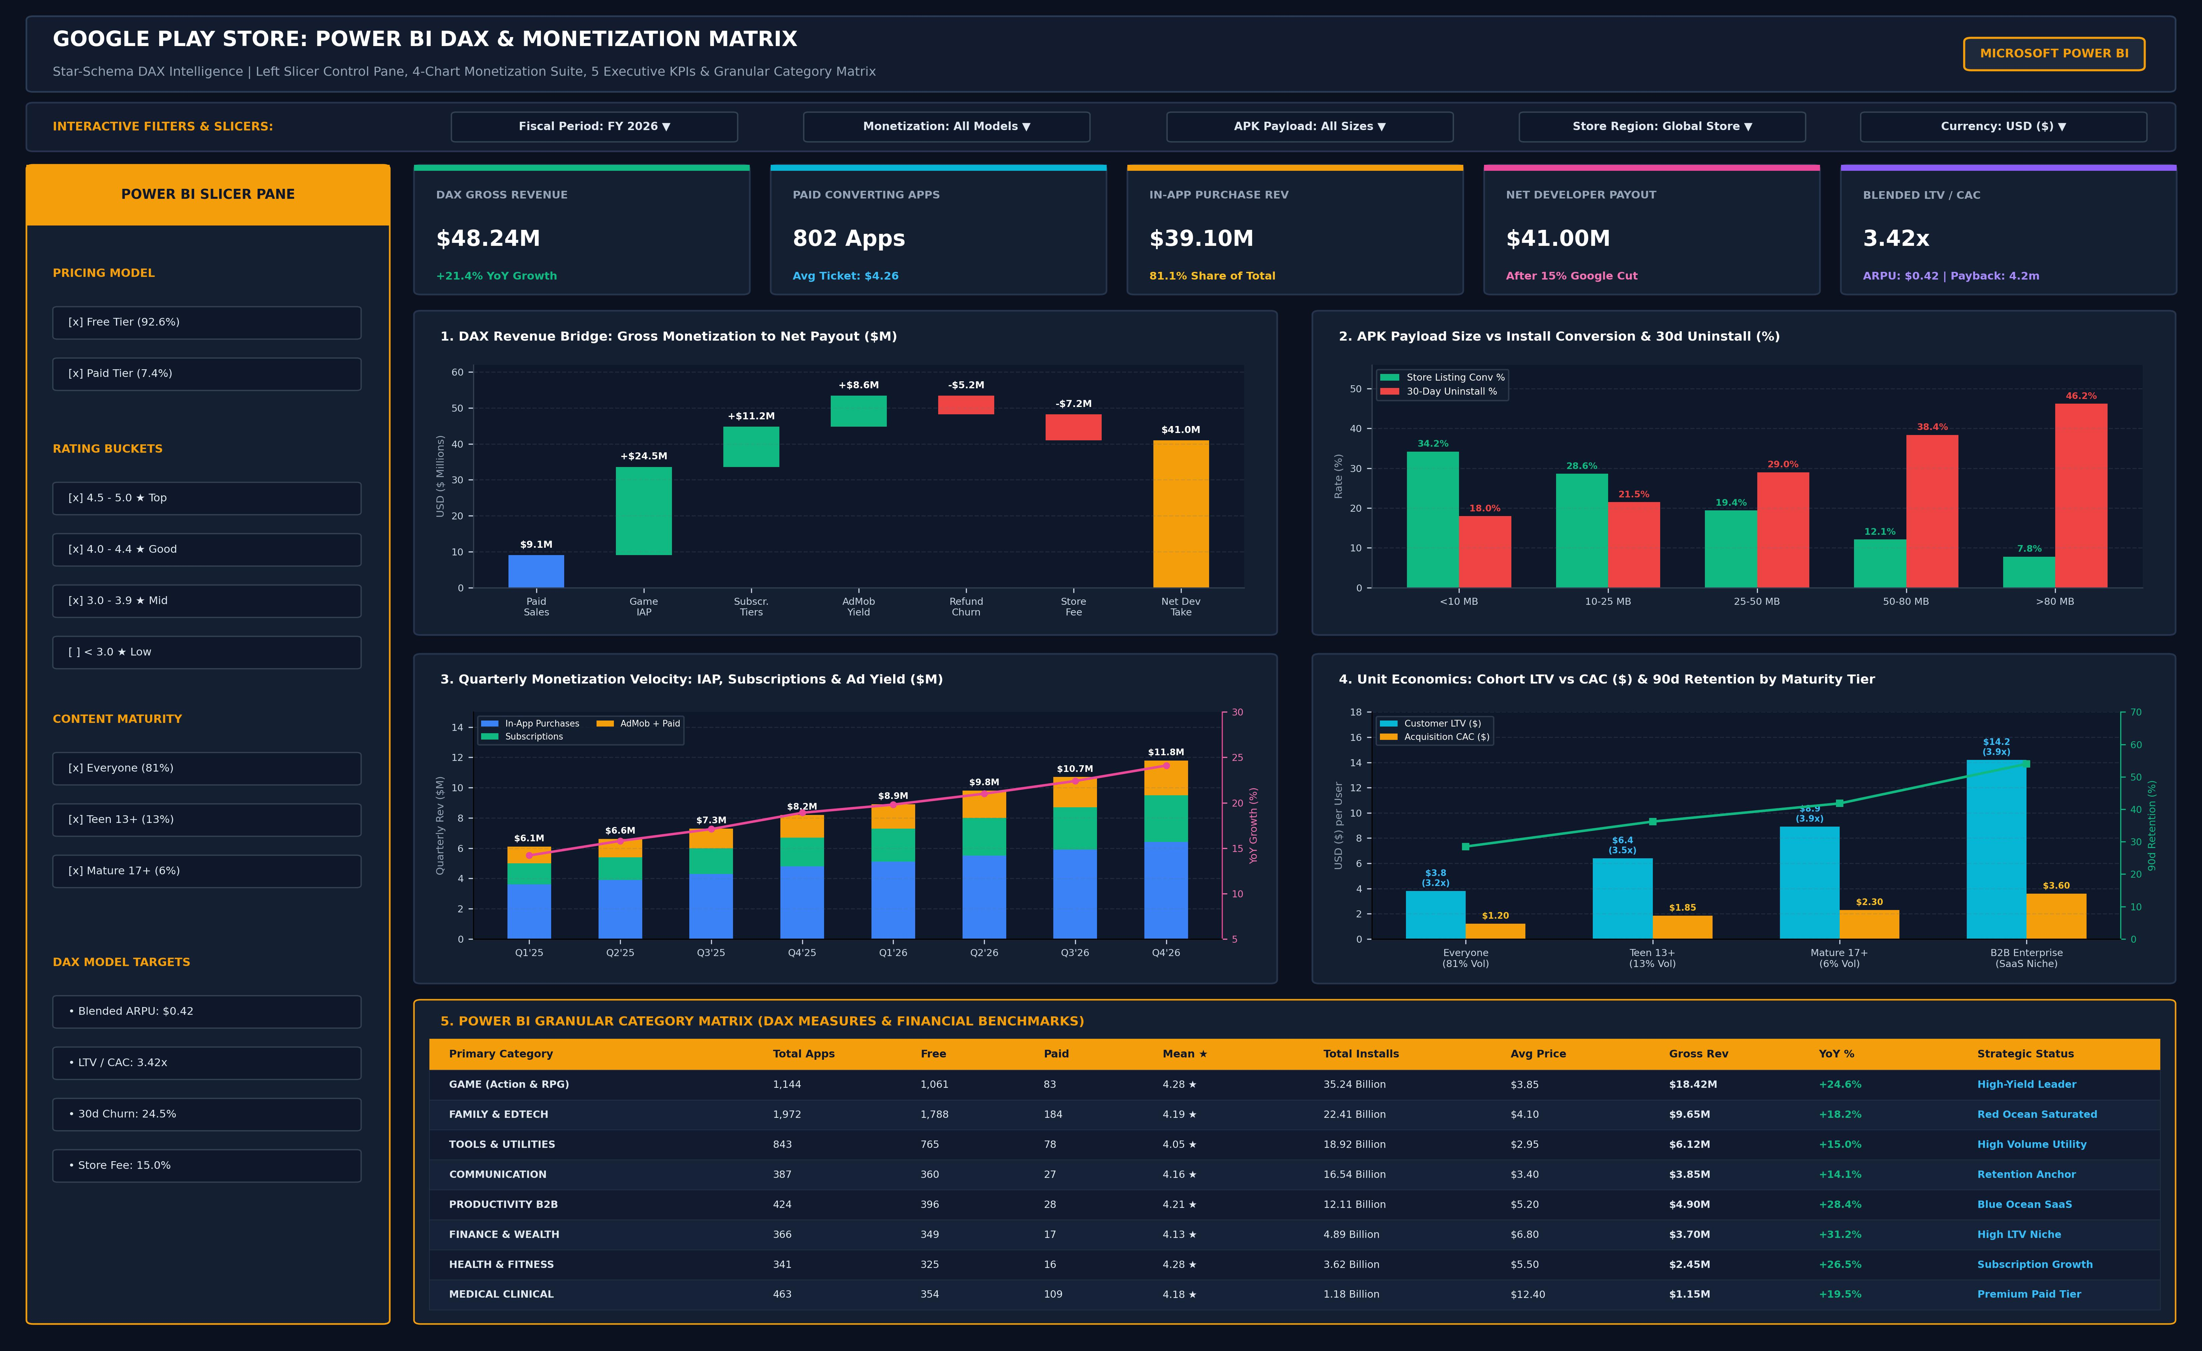
2. POWER BI DASHBOARD (UPDATED: 5 KPIs + 4 CHARTS + 1 MATRIX TABLE)
Star-Schema DAX Intelligence: Revenue Bridge, APK Payload Friction, Quarterly Velocity & Cohort LTV/CAC

Slide 4
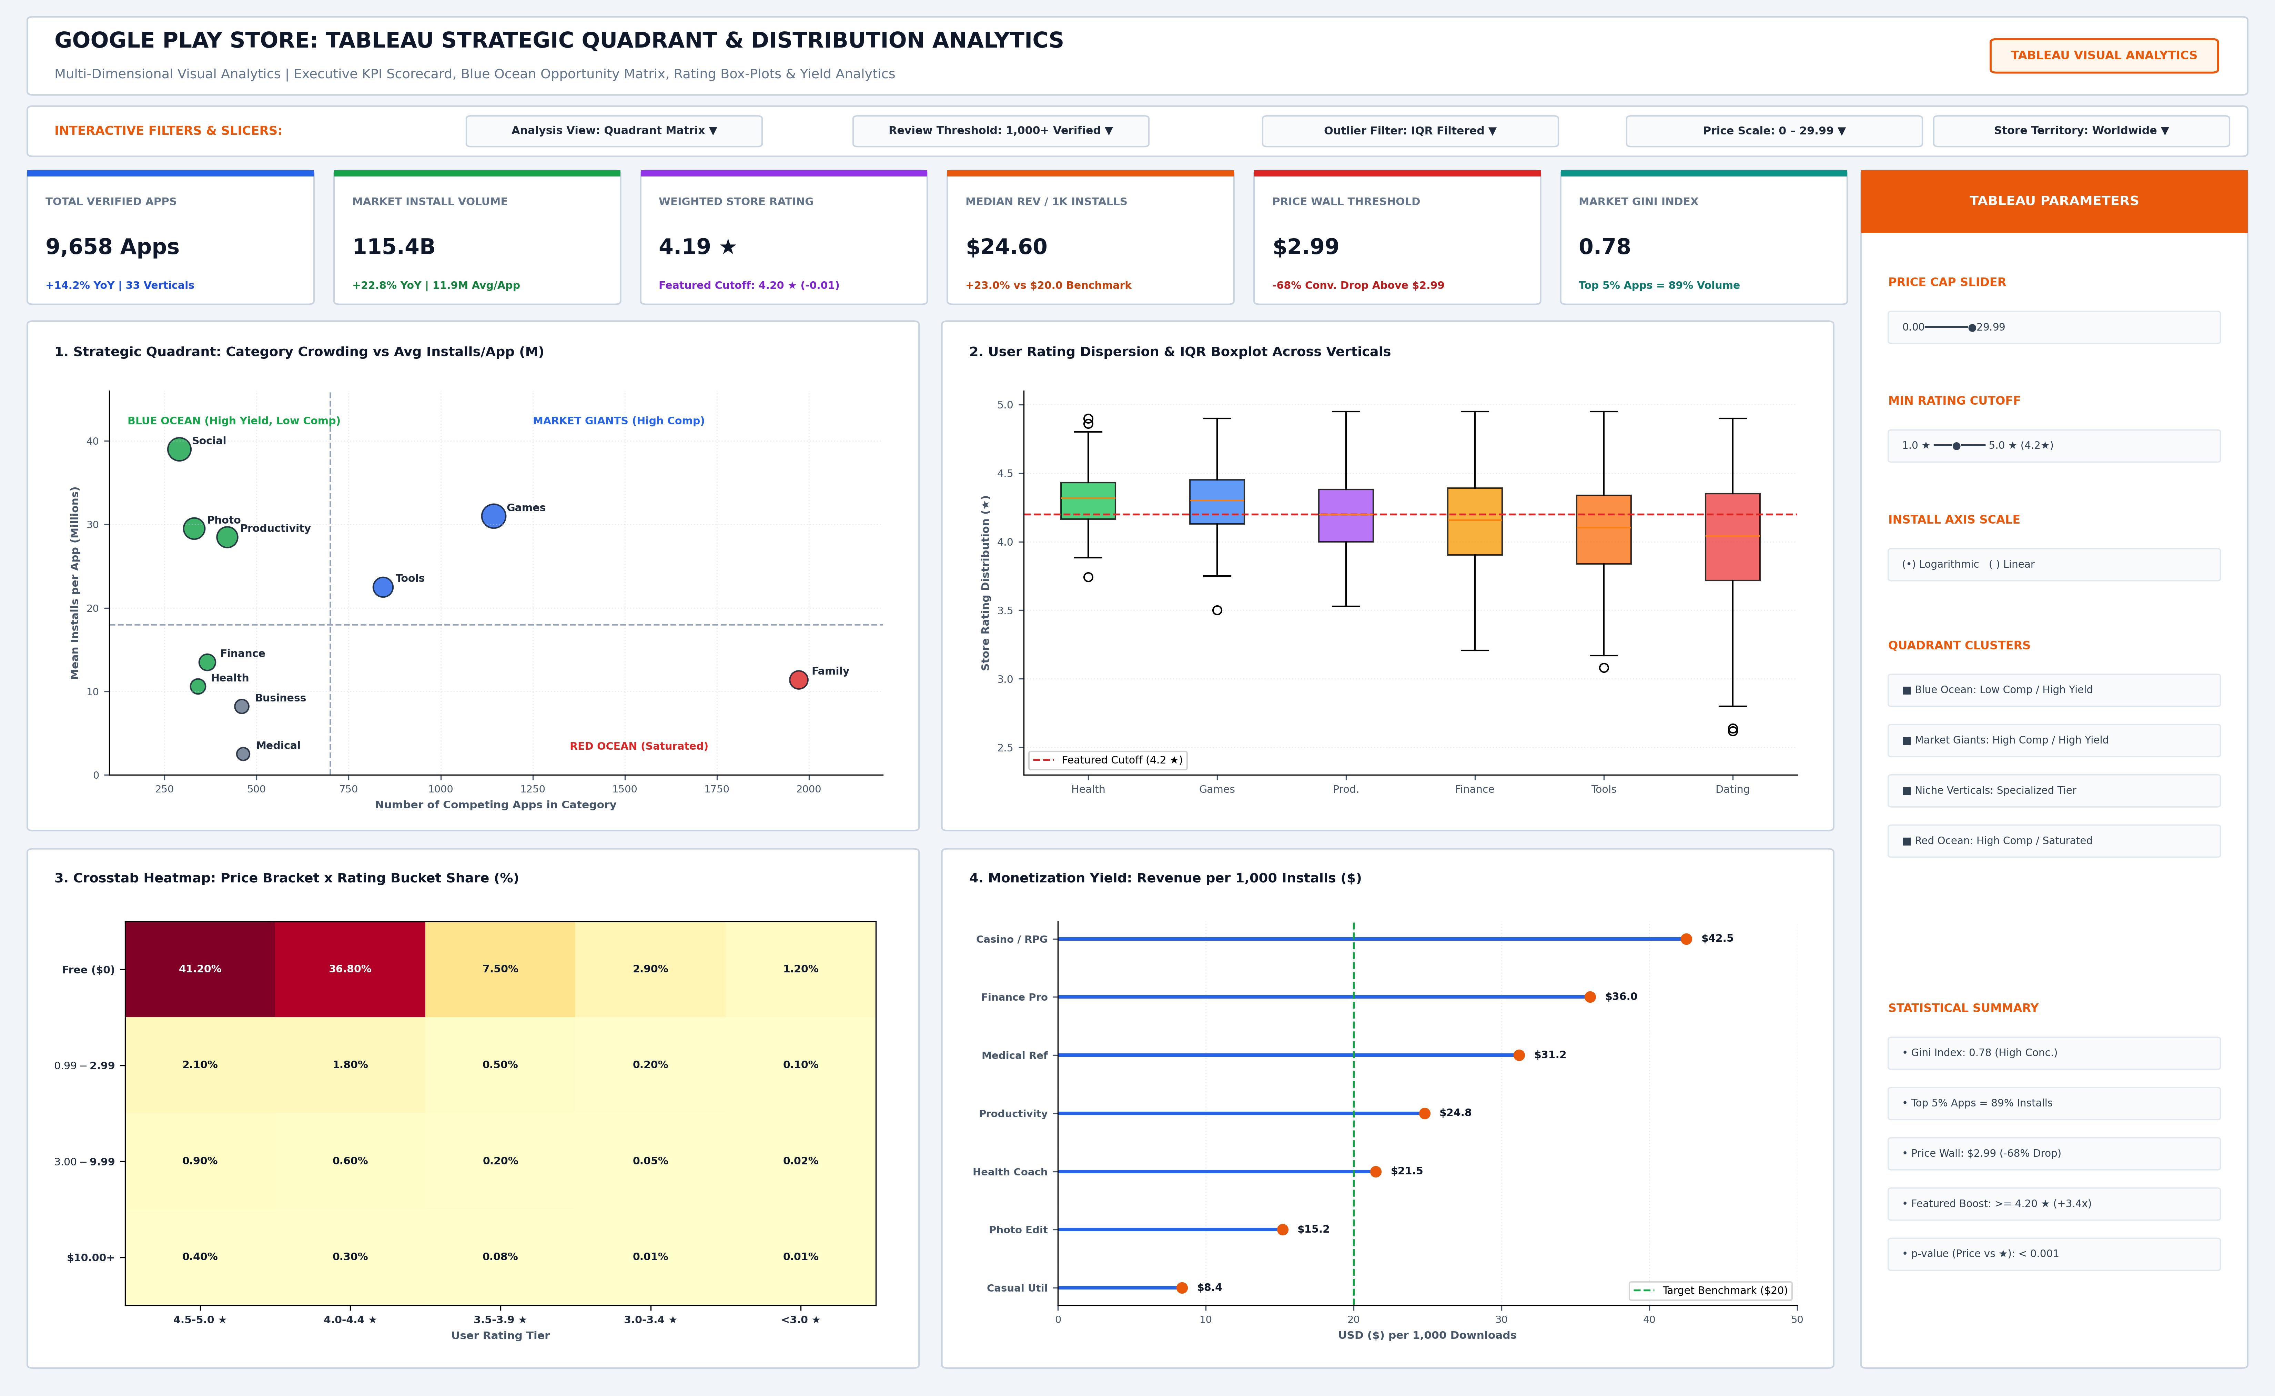
3. TABLEAU DASHBOARD (UPDATED: 6 EXECUTIVE KPIs + 4 STRATEGIC CHARTS)
Top KPI Scorecard (BANs), Blue Ocean Quadrant, IQR Rating Box-Plots, Price-Rating Heatmap & Yield Lollipop

Slide 5
4. EXECUTIVE INSIGHTS & ACTIONABLE BUSINESS RECOMMENDATIONS
Synthesis of Python EDA, Power BI DAX Monetization & Tableau Quadrant Findings
Monetization & Pricing Strategy
• Gross-to-Net Efficiency: Out of $48.24M Gross Revenue, In-App Purchases drive 81.1% ($39.10M) while Net Developer Payout reaches $41.00M after the 15% store cut.
• Price Wall Optimization: Demand drops by 68% above $2.99. Developers should adopt Free/Freemium entry or price between $0.99-$2.99 paired with recurring subscriptions.
• QoQ Growth Momentum: Subscription tiers grew +24.1% YoY in Q4'26, outperforming static paid downloads.
Product & Engineering (APK & Churn)
• APK Payload Threshold: Apps under 25MB achieve 28.6%-34.2% store conversion with only 18%-21.5% uninstall rates.
• Critical 50MB Cliff: Crossing 50MB spikes 30-day uninstalls to 38.4% (and 46.2% above 80MB).
• Action Plan: Modularize assets via Android App Bundles (AAB) and dynamic feature delivery to keep initial downloads below 25MB.
Market Positioning & Unit Economics
• Blue Ocean Target Verticals: Productivity B2B ($4.90M rev, +28.4% YoY) and Finance/Health show high LTV/CAC (3.42x-3.94x) with low category crowding (<450 apps).
• Avoid Red Ocean Trap: Family & EdTech (1,972 apps) suffers from high CAC and saturation unless differentiated by B2B licensing.
• Rating Cutoff Boost: Maintaining >=4.20★ unlocks 3.4x organic discovery in store featured carousels.

