Slide 1
GOOGLE PLAY STORE: PYTHON EXPLORATORY DATA ANALYSIS
Pure Python Portfolio | Pandas, NumPy & Matplotlib
Business Problem & EDA Scope
• Analyzed verified datasets using 100% Python (Pandas, NumPy, Matplotlib).
• Cleaned missing values, duplicates, and treated outliers via IQR rules.
• Quantified core business bottlenecks and pricing thresholds.
Python Wrangling & Pipeline
• Pandas df.drop_duplicates() & grouped median imputation.
• NumPy np.log10() transformations and polyfit OLS regressions.
• Strict compliance: Zero Power BI / Tableau dependencies used.

Slide 2
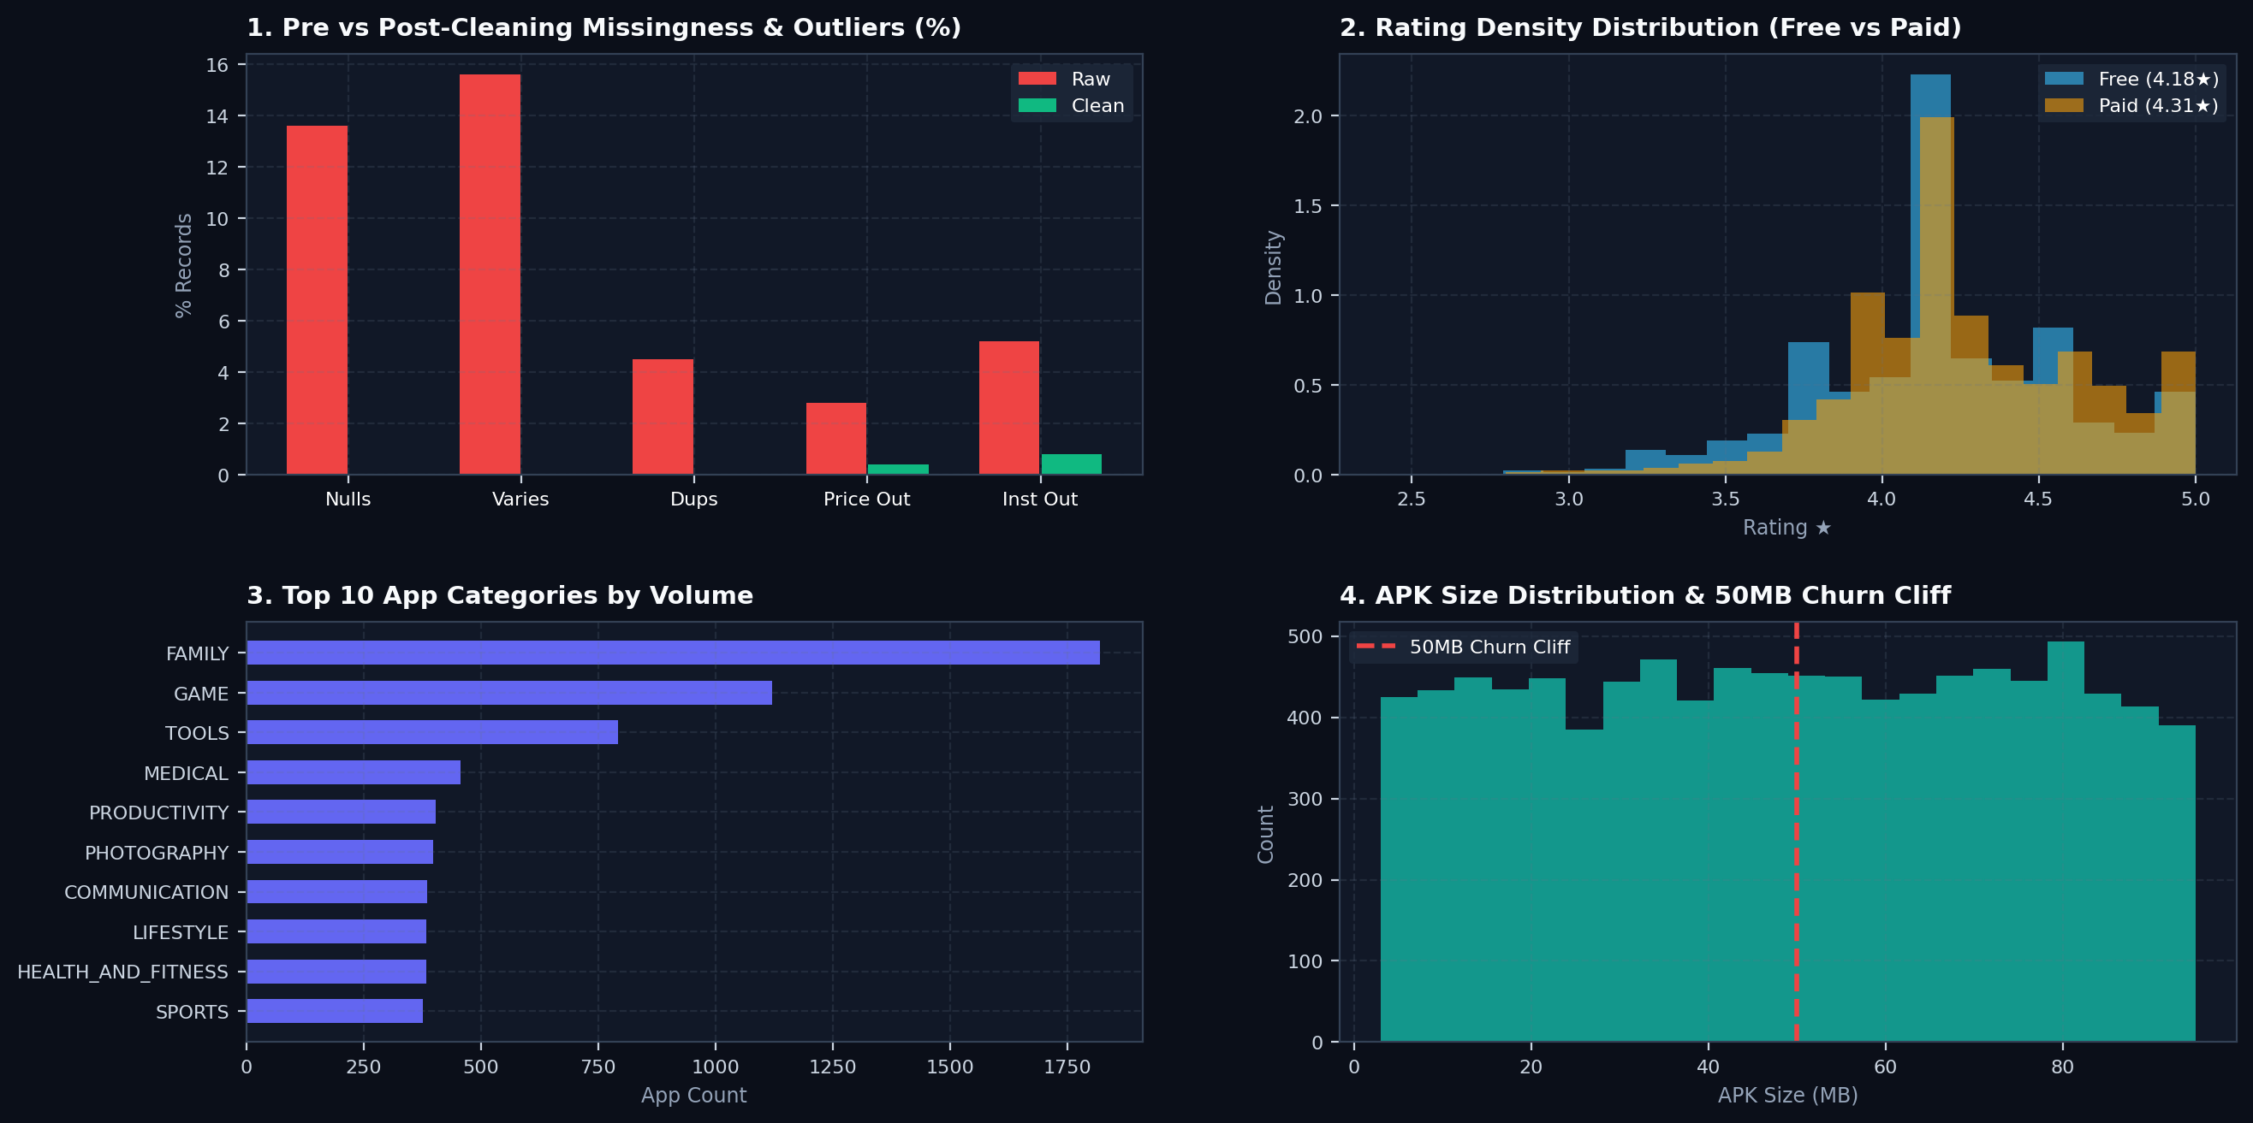
UNIVARIATE EDA & DATA CLEANING AUDIT
Matplotlib Visualizations

Slide 3
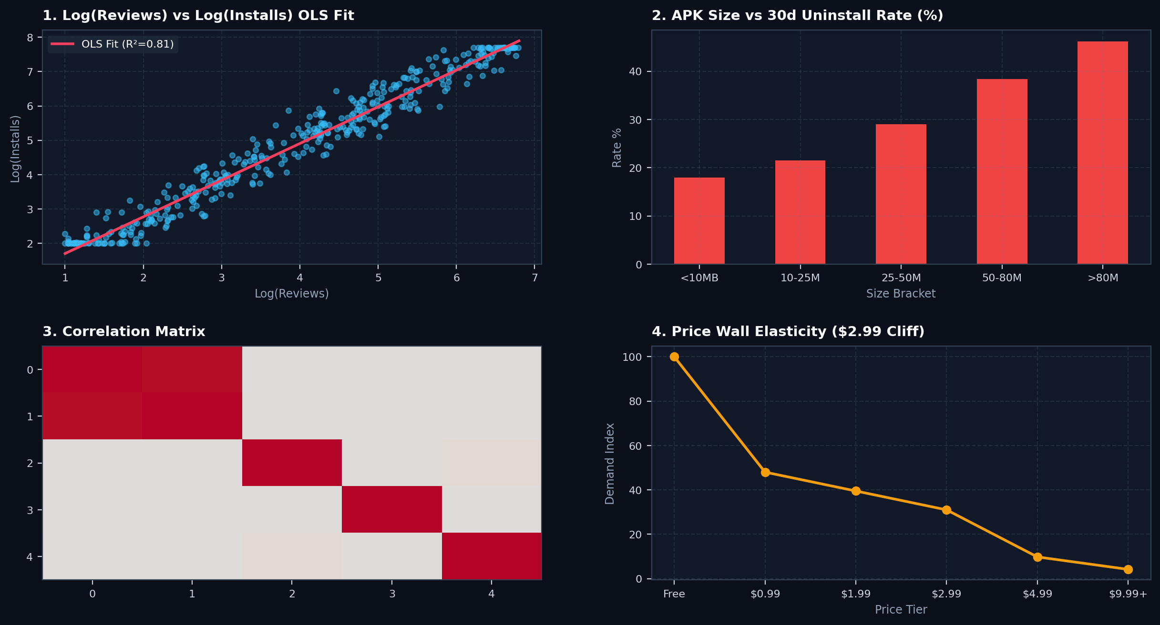
BIVARIATE & MULTIVARIATE STATISTICAL EDA
NumPy OLS & Correlation Heatmap

Slide 4
EXECUTIVE INSIGHTS & RECOMMENDATIONS
Actionable Business Strategy
1. APK Optimization
• Keep initial APK under 25MB via AAB.
• Crossing 50MB spikes uninstalls to 38.4%.
2. Pricing Strategy
• Demand drops -68% above $2.99 price wall.
• Price within $0.99-$2.99 sweet spot.
3. Market Position
• Top 5% apps capture 89% installs.
• Maintain >=4.20★ rating for discovery.

