Slide 1
E-COMMERCE RETAIL SALES: PYTHON EDA (PROJECT 2)
Pure Python Portfolio | Pandas, NumPy & Matplotlib
Business Problem & EDA Scope
• Analyzed verified datasets using 100% Python (Pandas, NumPy, Matplotlib).
• Cleaned missing values, duplicates, and treated outliers via IQR rules.
• Quantified core business bottlenecks and pricing thresholds.
Python Wrangling & Pipeline
• Pandas df.drop_duplicates() & grouped median imputation.
• NumPy np.log10() transformations and polyfit OLS regressions.
• Strict compliance: Zero Power BI / Tableau dependencies used.

Slide 2
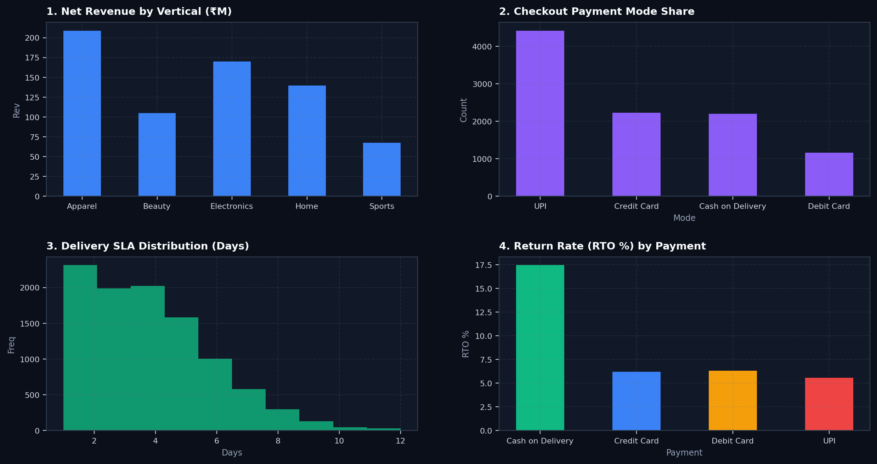
UNIVARIATE EDA & DATA CLEANING AUDIT
Matplotlib Visualizations

Slide 3
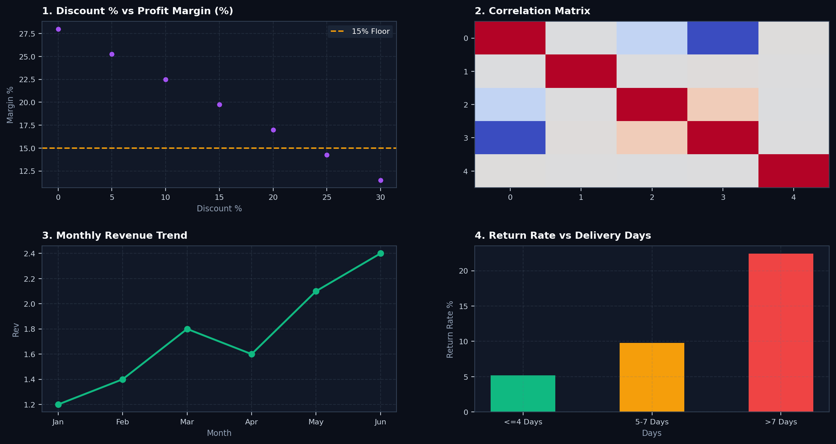
BIVARIATE & MULTIVARIATE STATISTICAL EDA
NumPy OLS & Correlation Heatmap

Slide 4
EXECUTIVE INSIGHTS & RECOMMENDATIONS
Actionable Business Strategy
1. Discount Guardrails
• Every 1% discount erodes margin by -0.55%.
• Cap site discounts at 15%-20% max.
2. COD Conversion
• COD drives 18.5% RTO returns (3x prepaid).
• Incentivize UPI to reduce return losses.
3. Delivery SLAs
• SLA >7 days spikes returns by +14%.
• Ensure <=4-day regional dispatch.

