Slide 1
mod_proxy
Clustering and load balancing
with Apache 2.2 mod_proxy
Notes:
Running cluster of Tomcat servers behind the Web server can be demanding task if you wish to archive maximum performance and stability. This presentation describes new Apache 2.2 mod_proxy and new features it brings to allow such tasks.
For the new Apache 2.1/2.2 mod_proxy has been rewritten and has a new AJP capable protocol module (mod_proxy_ajp) and integrated software load balancer (mod_proxy_balancer).
Because it can maintain a constant connection pool to backed servers it can replace the mod_jk functionality.

Slide 2
Agenda
Proxy architecture
Proxy protocols
Load balancing
Dynamic runtime management
Notes:
Proxy architecture
Describes architecture of new mod_proxy and concepts like workers, connection pool and load balancer
Proxy protocols
Brief overview of supported protocols, with focus on new mod_proxy_ajp protocols and future AJP14 standard.
Load balancing
Describes load balancer module and gives detailed overview of all configuration parameters.
Dynamic runtime management
Describes how to dynamically change and monitor runtime data for balancers and its members using balancer manager and status module

Slide 3
Proxy architecture
Worker concept
  Forward worker
  Reverse worker
  Named reverse workers
  Balancer workers
Notes:
New mod proxy introduces so called “worker” concept that is in a way similar to mod_jk workers.
Each worker represents a physical backend application server. In most cases that will be a physical box.
There are two types of workers in the system, one being physical and the other is virtual.
Virtual worker is balancer worker that is used to maintain a group of physical workers.
On mod_proxy initialization two generic system workers are created (Forward and Reverse).

Slide 4
Forward worker
Standard mod_proxy forward proxying
Enabled globally or per vhost with
ProxyRequests On
Fixed connection pool size
  Single on prefork_mpm
  ThreadsPerChild on worker_mpm
Notes:
Forward worker is used to forward proxy requests, and it behaves like original forward worker.
It can be enabled or disabled for each virtual host in the system, by defining ProxyRequests directive.
Unlike named workers it’s connection pool size can not be tuned nor configured. Instead it uses queries the mpm for maximum number of connections per child process. In case of prefork mpm that value will always be 1, while on worker or other threaded mpm’s it will be equal to ThreadsPerChild.

Slide 5
Reverse worker
Single global worker
Enabled by default
Fixed connection pool size
  Single on prefork_mpm
  ThreadsPerChild on worker_mpm
Used for unknown reverse proxy requests
from mod_rewrite
Notes:
Reverse worker is just like Forward, a generic reverse worker. This is a single global worker available inside each virtual host. It’s major usage is to enable mod_rewrite proxying support.
Mod_rewrite can be used with named workers too, but this worker enables proxying without knowing all the remotes in advance.

Slide 6
Named reverse workers
Created for each unique
hostname:port ProxyPass directive
Created for each unique
hostname:port BalancerMember directive
Dynamic connection pool size for
threaded mpm’s.
  Defaults to ThreadsPerChild
Notes:
Named worker is called like that because it represents the singleton connection pool to hostname:port. First time any ProxyPass or BalancerMember directive is defined that has unique protocol:hostname:port combination, a new worker is created. Later on it is reused instead making a duplicate thus maintaining the single connection pool to each remote, regardless of virtual hosts or multiple balancers.
By default the connection pool size equals to ThreadsPerChild or single connection in case of prefork mpm. Unlike generic forward and reverse workers its connection pool size can be tuned, but only for threaded servers. The number of connections could in that case be set to any number between 1 and ThreadsPerChild.
This is useful in situations when the number of requests to application server is much lover then total number of allowed connections. The typical use case is where Httpd is used to deliver a static content, and Tomcat for dynamic content. This allows to lower the resource usage on the remote application server, because the number of allowed connections or threads can be lower then a number of connections on httpd side.

Slide 7
Balancer workers
Virtual worker
Contain 1…n real protocol workers
  LoadModule balancer_module
  modules/mod_proxy_balancer.so
  <Proxy balancer://cluster>
  BalancerMember http://remote:port
  …
  </Proxy>
Notes:
Balancer worker is used maintain a set of real workers or connection pools to separate backends. It is responsible to elect the best worker according to some rules.
In clustered application topology the balancer equals to the cluster, and each member or node is defined by the BalancerMember directive.
Multiple balancers share the worker in case the worker names are the same. The use case for that can be to have multiple applications inside each physical node that has different load balancer factors or loads. Thus one can have multiple load balancer to the same set of nodes with different balancing factors and have each application map to different loads.
Each BalancerMember creates a shared memory slot for maintaining that data.

Slide 8
Proxy architecture
Shared memory runtime data
Parent process
Listener Socket
Child process
Scoreboard
Worker #1
Worker #1
status
elected
read
transferred
…
Worker #2
Worker #n
Child process
Worker #2
Worker #1
User
Worker #n
Worker #2
Worker #n
Notes:
On the picture you can see the internal mod_proxy architecture. All runtime data is held inside the httpd’s scoreboard or shared memory. This enables to dynamically manage the workers and to collect the runtime data from all the child process.
This fixes the common problem with previous mod_proxy causing constant connection delays if the connection to the remote can not be established or is broken. With shared memory the first connection to the remote that fails, will update the worker’s status flag in the shared memory. The consecutive requests on different child processes will in that case skip the useless connection attempts on a already dead node.

Slide 9
Proxy architecture
Session affinity
JSESSIONID=XXX.A
ajp://host1:8009 route=A
AJP13
AJP/1.3
Tomcat/host1
jvmRoute=“A”
ajp://host1:8009 route=B
AJP13
AJP/1.3
Tomcat/host2
jvmRoute=“B”
<Proxy balancer://cluster>
BalancerMember ajp://host1:8009 route=A
BalancerMember ajp://host2:8009 route=B
</Proxy>
Notes:
One other option added to the new mod_proxy is session affinity or sticky sessions. To be able to use that option the remote application server must have a option to append the identifier or session mark to the end of the session identifier itself. Tomcat can do that by defining the jvmRoute parameter inside the Engine that in the server.xml configuration file. Load balancer will check for that session affinity mark and instead electing a member on the load the session route will be used to determine the correct node to serve the request.
This option enables to skip the session replication between remote application servers. OTOH in case on of the node breaks the session data will be lost usually forcing user to login again.

Slide 10
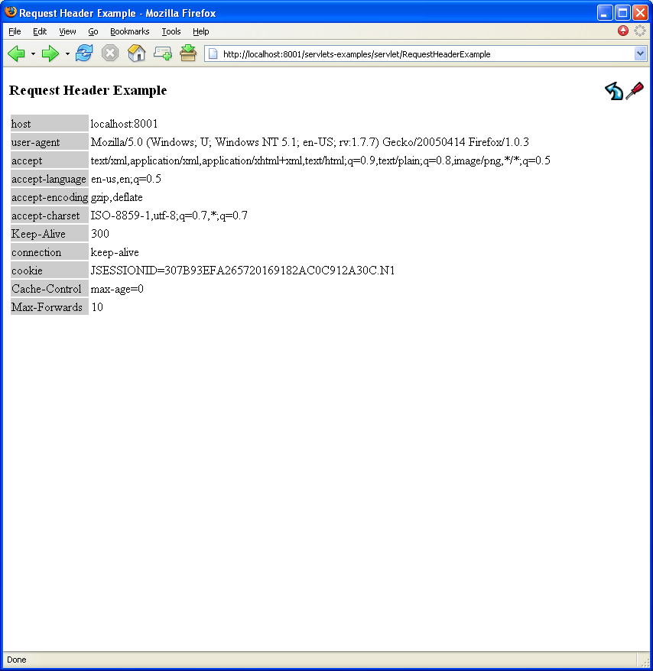
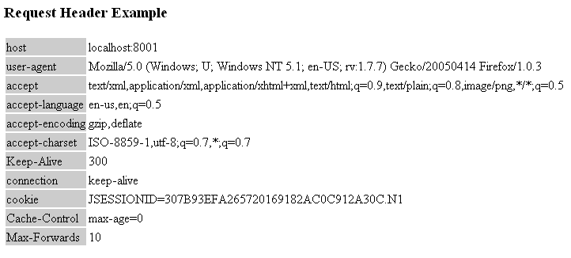
Proxy architecture
Sticky sessions
Notes:
Just a screenshot that shows the session affinity mark appended to the end of session id cookie.

Slide 11
Proxy Protocols
http/https
connect
ftp
ajp
balancer
Notes:
Mod_proxy supports various protocols to establish the connection to remote backend. Two new protocols has been added; ajp and balancer.
Like said before the balancer is not an actual protocol, but was put here because its name is in the form of standard url scheme.

Slide 12
AJP Protocol
Apache Java Protocol
  Current version 1.3 (AJP13)
  Binary http protocol
  No need to marshal/unmarshal http request
  Reusable connections
  Supported by most Java app servers
    Tomcat
    Jetty
http://jakarta.apache.org/tomcat/connectors-doc/common/ajpv13a.html
Notes:
Apache Java Protocol is a new protocol added to Apache 2.2, and is used to connect the remote application servers.
It is sometimes known as binary http protocol, because most http headers and parameter are represented a single byte instead a string like in the http protocol. Because of those facts it offers higher performance when compared with http protocol, because the request is assumed to be the correct, and because there is no need t parse the entire http header. It also offers the connection reusability, meaning that the multiple requests from different clients can go trough the same physical connection. Of course one at the time.
The current protocol specification is version 1.3.
You can find details the protocol details on the upper address.

Slide 13
AJP 1.4 Protocol
Next generation AJP protocol
  Encryption
  Compression
  Feedback from remote node
    Too busy
    Going to shutdown
    Change dynamic config
    Update load balancer factor
Q4 2005
Notes:
AJP13 protocol lacks couple of things that some users finds as showstopper for their usage. There is a new AJP 1.4 protocol specification that will be available by the end of this year, and will address some of the issues.
One of the major problems is the lack of encryption. If the https connections is made to the httpd server, then the ajp sends its as unencrypted to the remote application server. This is of course sensitive to the network packet capturing if the connection is unsecured.
Also there is no way to get the feedback from the remote backend.

Slide 14
Load Balancing
mod_proxy_balancer.so
Protocol independent
Multiple strategy
  Request
  Traffic
Session affinity
Failover
Notes:
Load balancer is one of the coolest things added to the new mod_proxy. It is both protocol and strategy independent.
Being protocol independent means that it can maintain a cluster of http, https, ajp protocols or any combination of them.
Right now it offers two strategy types. Of course you can write you own, by simply writing a new mod_proxy_balancer module, that will elect the best node to in the way you think it will be the best.
It also offers already mentioned session affinity tracking, as well as failover in case one of the nodes in the cluster fails.

Slide 15
Load Balancing
BalancerMember
  Protocol worker to remote
  Multiple protocols
  Session affinity (Sticky sessions)
  Preferred failover node
Notes:
BalancerMember is a worker or connection pool to the remote host. Each member can have various parameters set, some of them being listed here.
We’ll deal with balancer and balancer member parameter in the next few slides.

Slide 16
Balancer Parameters
<Proxy balancer://cluster param=value .. >
</Proxy>
..
ProxySet balancer://cluster param=value
Notes:
New mod_proxy configuration has been extended to enable setting various parameters to each worker.
The parameters are in the key=value form and are checked for at the end of directives.
There is also a new ProxySet directive that can be used to make the configuration more readable in case there are many parameters that need to be set.

Slide 17
stickysession
Check for session mark at the end of session identifier.
Configurable session identifier name
  stickysession=JSESSIONID
  stickysession=PHPSESSIONID
JSESSIONID=827BFE8CB4E01BCEAE41D02042485F05.SESSIONMARK
Notes:
Stickysession parameter determines the session identifier. There are no default session identifiers like JSESSIONID found in mod_jk. To be able to use the sticky sessions you will need to have a application server that is capable of adding the session affinity mark to the end of session identifier.

Slide 18
nofailover
Failover by default
  nofailover=On
    Disables failover
Bound to remote until expired
  Enables removing nodes from cluster
Notes:
When sticky sessions are defined and the node with the session affinity mark fails, mod_jk will by default failover to another cluster member. This will lead to loosing session data and usually require to logging again. Nofailover will return server error rather the failover to another node.

Slide 19
lbmethod
Defines balancer strategy
  lbmethod=Request
    Default strategy
    Counts number of requests to remote
  lbmethod=Traffic
    Default strategy
    Counts number of bytes read/transferred
Notes:
Lbmethod defines the load balancer strategy to elect the best worker. Default strategy is ‘Request’ and the best worker is determined according to the number of requests per particular worker. Together with loadfactor the right worker is elected. Traffic method uses actual data transferred instead just counting number of requests. Use this method for applications which CPU time is related to actual data produced.

Slide 20
timeout
Maximum time to wait for a free connection in seconds
  All workers are in error state
  All workers are busy
  Only for threaded mpm’s.
  Limiting the number of opened connection to remote
Notes:
Timeout property can be used only with threaded servers and makes sense only when the number of connections in the worker’s connection pool is smaller then the number of ThreadsPerChild. In case all the connections are busy worker will wait until the timeout. This may lead to slow response time, since it will queue multiple requests over the same connection. The best practice is to avoid timeout by setting higher connection pool size, but it can help with the burst load.

Slide 21
maxattempts
Maximum number of failover attempts
  Defaults to number of members
  maxattempts=1
    No failover
Notes:
This defines the number of failover attempts and by default it is set to the number of balancer members. Setting this number to one will disable the failover, because no worker will be tried after the first attempt. It is usually enough to leave that number as system default. Setting the number to higher value then number of members is, can help with failed workers because the retry mechanism can be invoked in that case.

Slide 22
Worker Parameters
ProxyPass http://host param=value ..
BalancerMember ajp://host param=value ..
..
ProxySet http://cluster param=value
Notes:
Just like for load balancer each named worker or balancer member has a specific set of tuning parameters. They can be set either when defining worker or balancer member, or by using ProxySet directive. Next few slides will cover worker parameters.

Slide 23
loadfactor
loadfactor=1
  Normalized load factor
  Used with BalancerMember
  loadfactor=1
  loadfactor=2
  Same as:
  loadfactor=3
  loadfactor=6
Notes:
Load factors is integer number used when the worker will be used inside load balancer worker, this is the load balancing factor for the worker. The load balancing factor is how much we expect this worker to work, or the worker's work quota. Load balancing factor is compared with other workers that makes the load balancer. For example if one worker has loadfactor 5 times higher then other worker, then it will receive five times more requests.

Slide 24
retry
Number of seconds to retry the worker
Default is 60 seconds.
Notes:
When worker gets into error state for example if the connection to remote could not be established it will be excluded from load balancer node election list. At some time the node might come online by restarting the remote. Retry is a time gap in seconds within the worker will be checked if alive. By default this value is 60 seconds, so the worker that is in error state will be marked for recovery after that time has elapsed. Being ‘marked for recovery’ means that the connection to the remote will be retried, and if succeeds the error status will be removed.

Slide 25
Connection pool tuning
min
  Initial number of connections to remote
max
  Maximum number of connections to remote
smax
  connections to remote that will not be destroyed
ttl
  destroy all the connections that exceed the smax
Notes:
Threaded httpd server can maintain the connection pool size that is different the ThreadsPerChild number. Connection pool is maintained using the apr-utils reslist.
If smax is smaller the max then the connections are destroyed after the ttl timeout and created as needed.

Slide 26
keepalive
keepalive=On
  Send SO_KEEPALIVE
  Useful if remote is behind firewall
Notes:
This directive should be used when you have a firewall between your webserver and the Tomcat engine, who tend to drop inactive connections.
This flag will told Operating System to send KEEP_ALIVE message on inactive connections (interval depend on global OS settings, generally 120ms),
and thus prevent the firewall to cut the connection. To enable keepalive set this property value to the number greater then 0.
The problem with Firewall cutting inactive connections is that sometimes, neither webserver or tomcat have information about the cut and couldn't handle it.

Slide 27
timeout
Connection timeout in seconds
  Defaults to ServerTimeout
Notes:
This directive allow to have a different connection and read/write timeout then defined with ServerTimeout directive.

Slide 28
route
Session route name
  Match with jvmRoute in Tomcat
  route=someName
  ..
  <Engine .. jvmRoute=“someName” />
Notes:
Defines the custom remote node identifier or session affinity mark. The backend application server must support adding session affinity mark. Here is the example for Tomcat web server that will add .someName to each session identifier.

Slide 29
redirect
Preferred failover
  If session route worker is in error state
BalancerMember .. route=A redirect=B
..
BalancerMember .. route=B
Notes:
Redirect or preferred failover is the way to tell the load balancer to use the particular balancer member instead next one. This is useful for hot standby scenarios where one can have a server that just sits and accepts no connections until one of the nodes fails. In that case redirect worker is used.

Slide 30
Dynamic runtime management
Runtime status
  Hook for status_module
Balancer manager
  Web page management
Notes:
New mod_proxy offers two new powerful features. First one is the hook for status module that shows all the runtime data and status for each balancer and its members defined for a designated Server. Second feature is balancer manager that offers dynamic balancer and balancer member management using web page

Slide 31
Runtime status
LoadModule status_module ..
..
<Location /server-status>
SetHandler server-status
Order deny,allow
Deny from all
Allow from localhost
</Location>
..
ProxyStatus On
Notes:
To enable showing runtime mod_proxy status you will need the status module configured, and ProxyStatus directive set to On.

Slide 32
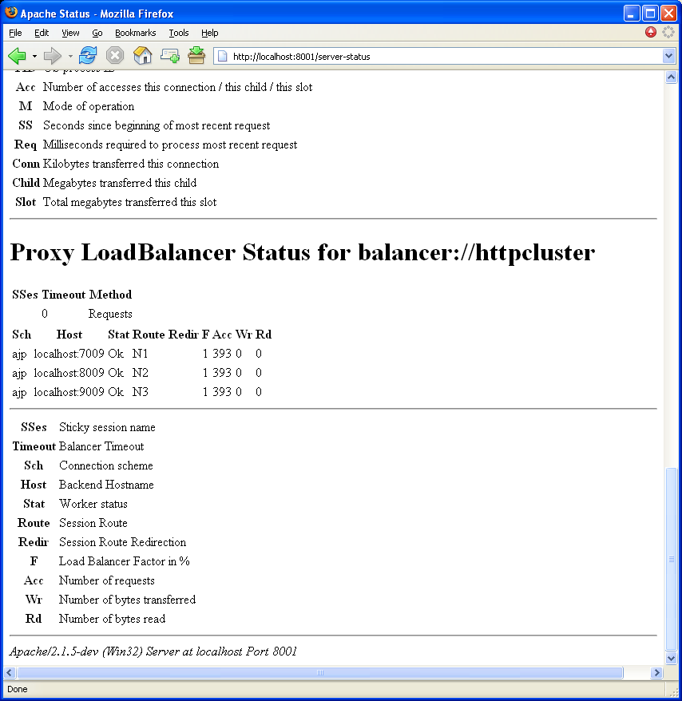
Runtime status
Notes:
Screenshot of status page with proxy status enabled.

Slide 33
Balancer Manager
Dynamic management of balancer
Management of balancer members
Notes:
This is web page that allows changing various balancer and balancer member parameters. Thanks to the fact that runtime data is held in shared memory, those data is visible across all child processes.

Slide 34
Balancer Manager
LoadModule proxy_balancer_module ..
..
<Location /manager>
SetHandler balancer-manager
Order deny,allow
Deny from all
Allow from localhost
</Location>
Notes:
Balancer module has a special handler like status or info modules for example. Use SetHandler balancer-manager inside any desired Location directive

Slide 35
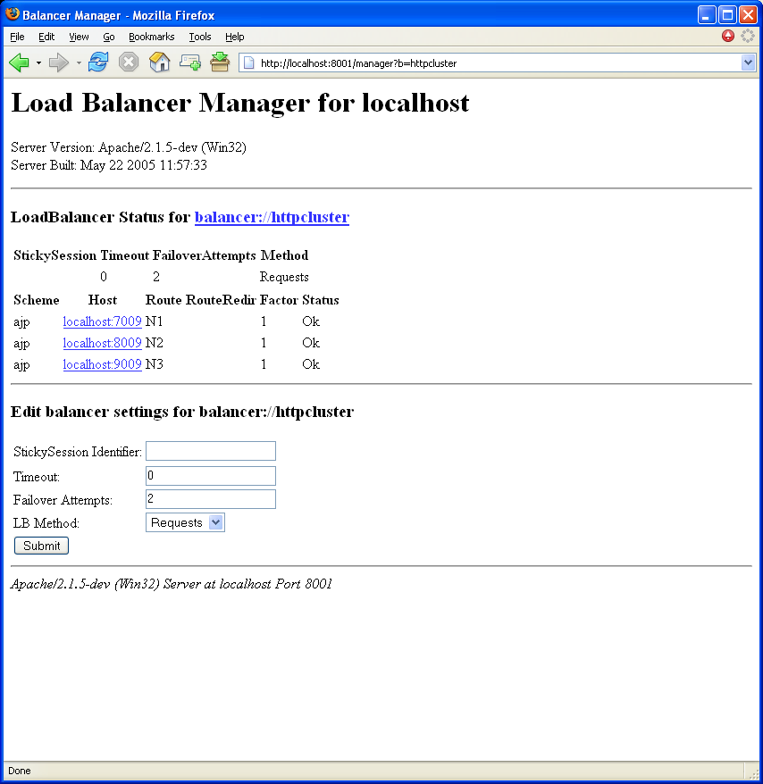
Notes:
Clicking on balancer url editor is displayed. Setting parameters and clicking Submit button changes the configuration

Slide 36
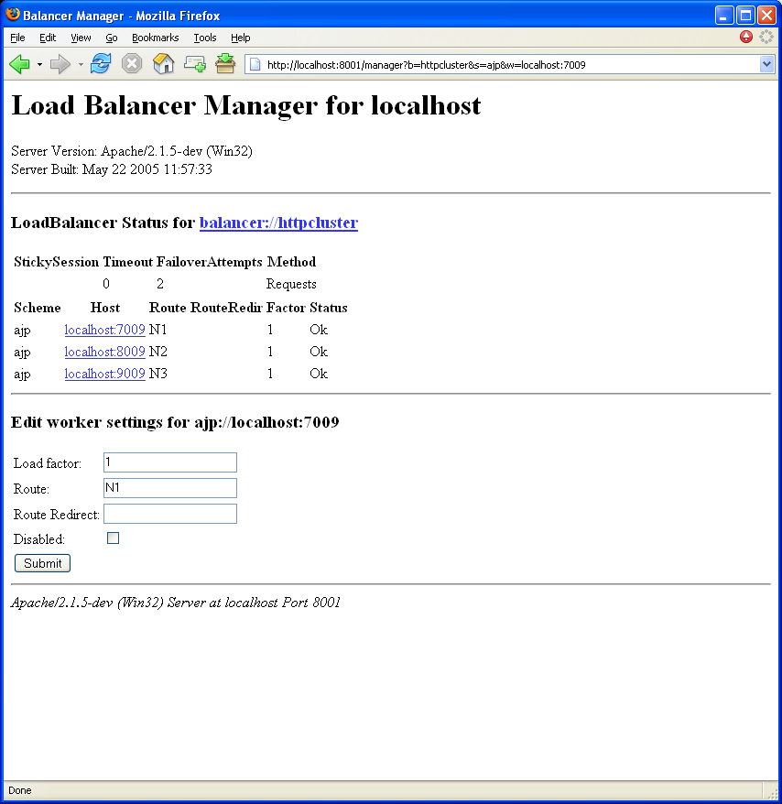
Notes:
Clicking on particular balancer member its data is displayed and can be edited.
You will see the disabled check box that can be used to gracefully remove the node from the cluster for maintenance without using exiting sessions. When the worker status is disabled it will not accept new connections without session id, but will preserve existing one.

Slide 37
Q&A
Notes:
Couple of questions if time permits.

Slide 38
Thank you
Mladen Turk mturk@apache.org

