Slide 1
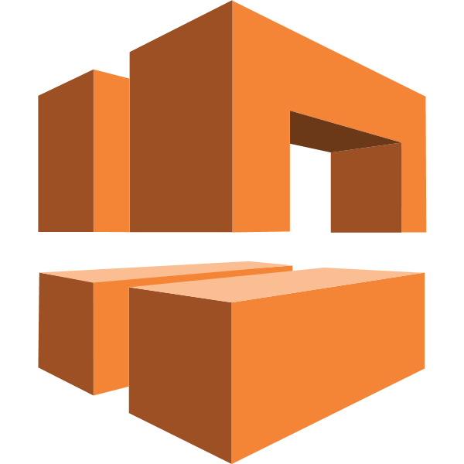
CONTENTS
1. LAN,MAN,WAN
2. Drawbacks of In-House Hosting.
2. VPC,SUBNETS & TYPES
3. VPC ARCHITECTURE
4. INTERNET-GATEWAY,ROUTE-TABLE,SG
5. NAT, TYPES OF IP’S
6. CIDR RESERVATIONS
7. PRACTICAL
-Suresh Siripuram
AWS VPC (Virtual Private Cloud)

Slide 2
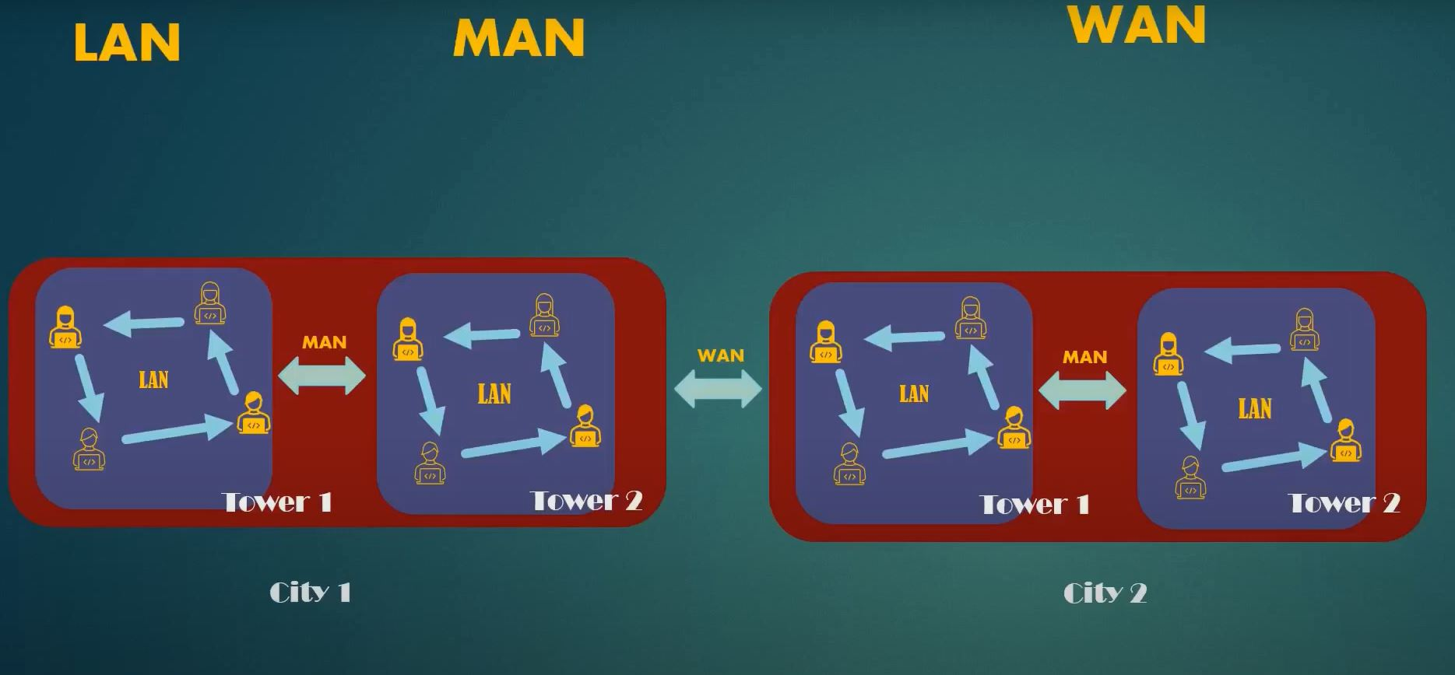
Computer Network
Local Area Network.
Metropolitan Area Network.
Wide Area Network.

Slide 3
Drawbacks of In-House Hosting.
We need to Setup High-End Cpu,Ram,storage.
We need a dedicated channel of Network with high speed Internet connection and that need a backup line.
We need a dedicated static ip address to expose to public world
24/7 power Backup.
To ensure Better performance we need to have air-conditioned environment.
We need high-end hardware resources like Network-router, firewalls,..etc to ensure better security for servers.

Slide 4
VPC: A virtual private cloud (VPC) is a secure, isolated private cloud hosted within a public cloud.
SUBNETS:
Subnets are smaller chunks of network in VPC.
Each subnet has its own IP-range
we can preferable choose availability zones for subnet
TYPES OF SUBNETS:
Private Subnet (No incoming & outgoing traffic allowed)
Public Subnet (Incoming & Outgoing traffic is allowed)
Hybrid Subnet (when we attach NAT gateway to Public subnet then it’s Hybrid)
Availability zone:
An availability zone is a logical data center in a region available for use by any AWS customer.

Slide 5
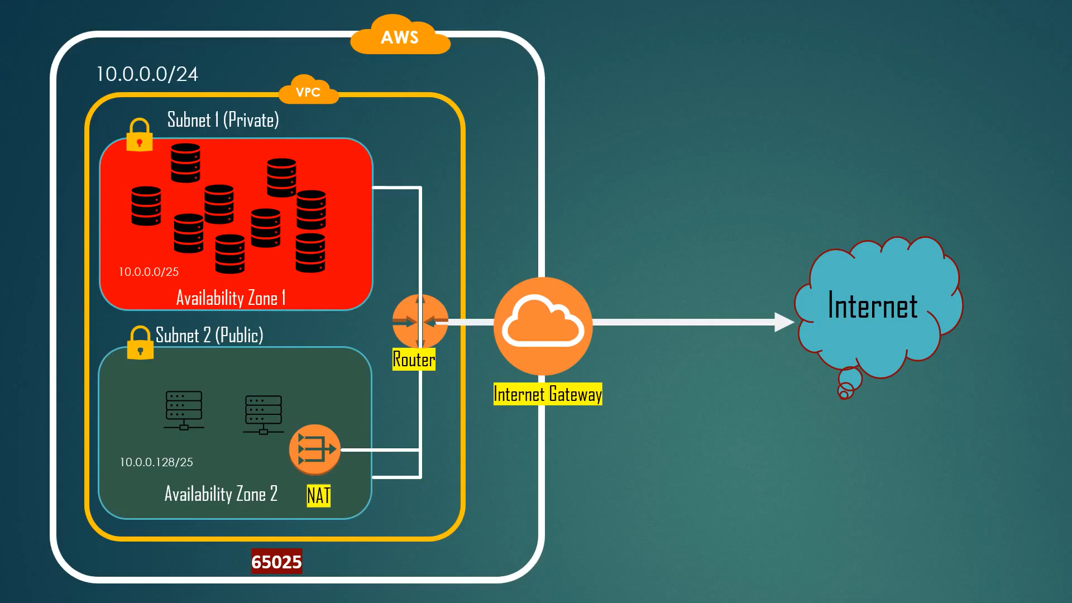
Drawbacks of In-House Hosting.
VPC- ARCHITECTURE

Slide 6
INTERNET-GATEWAY (IG): Internet-gateway enables the internet to the VPC. By default, we have a aws internal network communication But we don’t have an internet connection for vpc. we can only have internet connection to servers whenever we associate internet-gateway to VPC.
ROUTING TABLE (RT):
Route table is used for Routing the network traffic between the subnets..
Based on the Route table configuration traffic from internet gateway is allowed to route table which we will associate route table to subnet.
SECURITY GROUP (SG) :
Security group acts as a virtual firewall for your EC2 instances to control incoming and outgoing traffic. Both inbound and outbound rules control the flow of traffic to and traffic for instance.

Slide 7
NAT GATEWAY:
NAT Gateway, also known as Network Address Translation Gateway, is is an aws provided network device which allows only outbound traffic, will not permit incoming traffic to the Resources of the Subnet. In simple words it enables the internet/access communication from the public subnet to private subnet.
TYPES OF IP ADDRESS’S IN AWS:
Public IP
Private IP
Elastic IP

Slide 8



Private ip , Public ip , Elastic ip
Private ip These Private ip addresses are not routed on the Internet no traffic can be sent to them from the internet. They are only supposed to work within the aws local network.
Elastic ip An Elastic IP address is a static public IPv4 address associated with your AWS account in a specific Region.
Public ip Public ip address is an IP address that is used to access the internet globally.

Slide 9
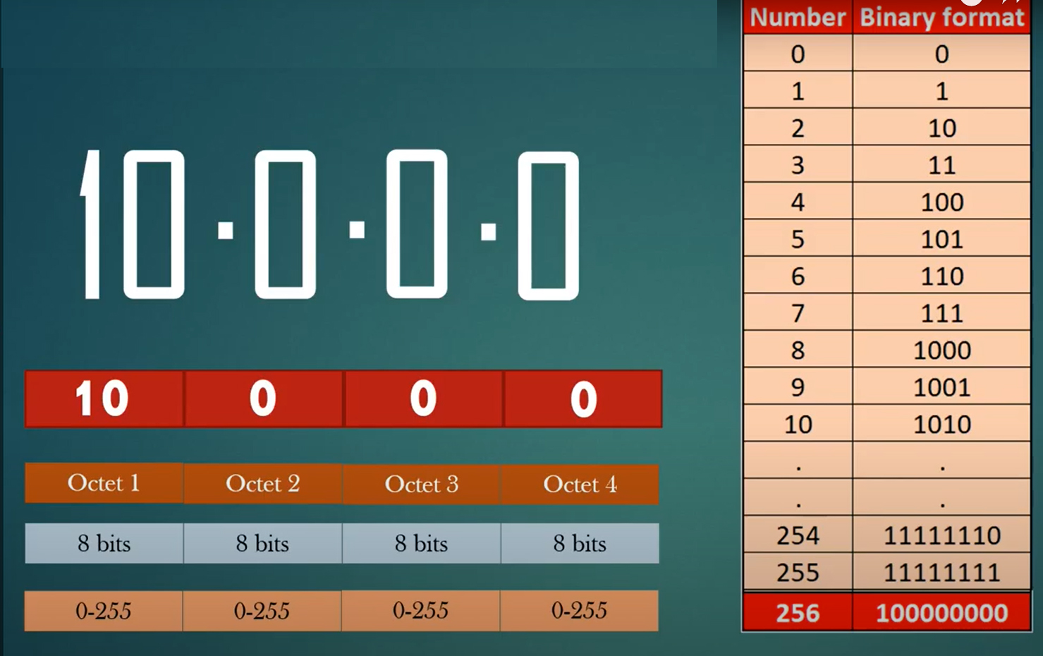
Classless Inter-Domain Routing

Slide 10
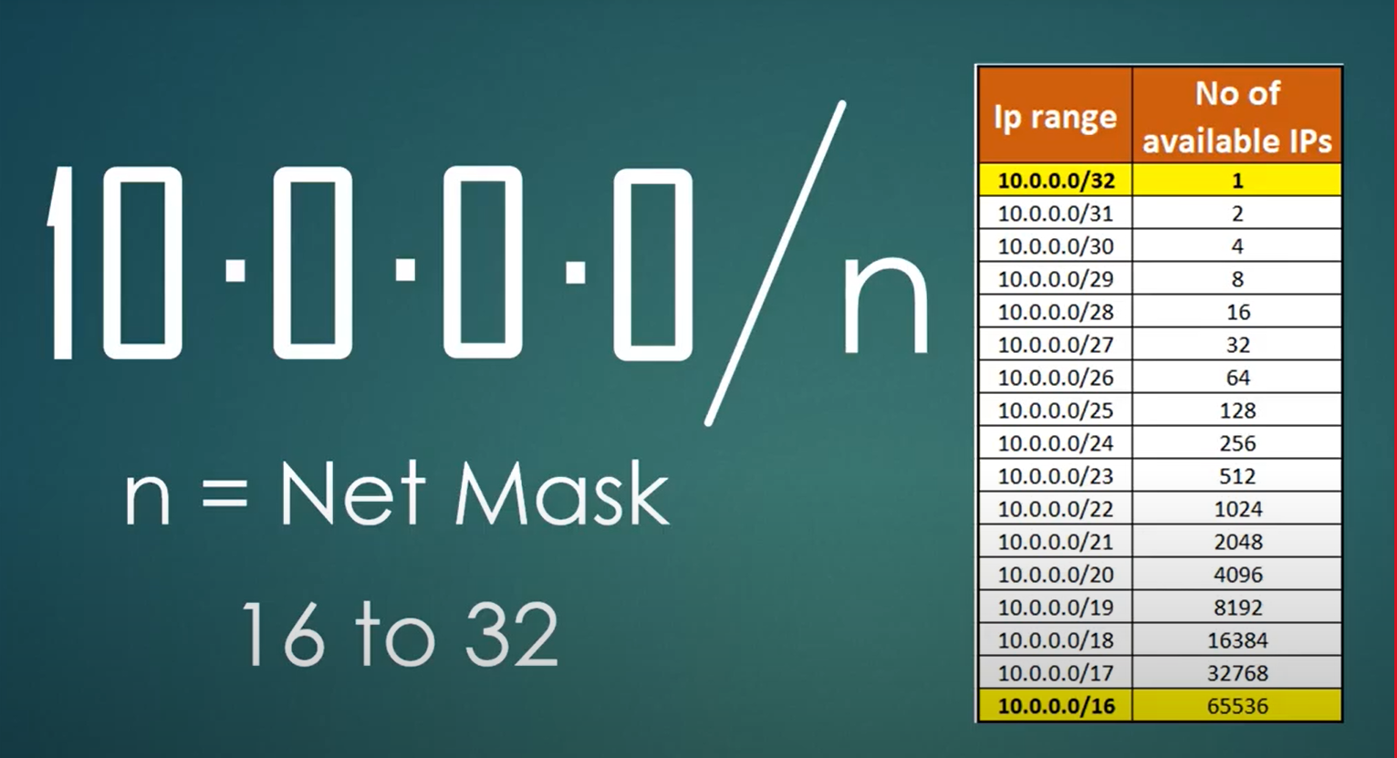

CIDR RESERVATION
Ex:-

Slide 11
Procedure:
1. Create VPC (Enfec-vpc)
2. Create 2 SUBNETS public (Enfec-pulic-subnet) and private(Enfec-private-subnet)
3. Create INTERNET GATEWAY (Enfec-ig)
4. Attach Internet gateway to VPC
5. Create 2 ROUTE TABLES (Enfec-RT-public) & (Enfec-RT-Private)
6. Add routes rules as 0.0.0 to public to access anywhere and no routes for private
7. Associate subnets like (Enfec-Public-subnet) to (Enfec-RT-public) & (Enfec-private-subnet) to (Enfec-RT-Private)
8. Create Ec2-servers in both the subnets (Enfec-public-subnet)(Enfec-Public-ec2) & (Enfec-private-subnet)(Enfec-Private-ec2)
9. Create a NAT-GATEWAY (Enfec-NAT)
10. Attach Nat-gateway to public Subnet to connect ig of publicsubnet to private isolated subnet).

Slide 12

Thank You!

