Slide 1


Indian Institute of Information Technology Senapati, Manipur
E-Commerce Website
Presented by
Guided by
Kethavath Pavan (21010125)
Dr Kishorjit Nongmeikapam
Submitted for the course named Project - I (CS321)
Computer Science and Engineering
Oct - 2023

Slide 2
Introduction
E –Commerce Defination
About our System
Online Shopping
Oct-2023
2

Slide 3
What is E-Commerce
Commonly known as Electronic Marketing.
It consist of buying and selling goods and services over an electronic systems Such as the internet and other computer networks.
Online Shopping
Oct-2023
3

Slide 4
Our System
Our System is an e-commerce website from where people can buy products online.
A monitors the activity by the users and checks the transactions.
Online Shopping
Oct-2023
4

Slide 5
Features
Menu
Catalog Browsing
-Category List
-Product List
Catalog Management
Product Browsing
-Product Reviews
-Related Products
Shopping Cart
Checkout
Auto generated bill
Payment Gateway
Online Shopping
Oct-2023
5

Slide 6
Business Process Model
Start
Login
Product List
Buy Product
Payment Type
Check Transition
End
Online Shopping
Oct-2023
6

Slide 7
Tools and technology
HTML 5+
CSS 3+
Bootstrap
PHP
MySQL
Xampp
VS Code
Note Pad
Chrome
Online Shopping
Oct-2023
7

Slide 8
Advantages Of E-Commerce
Faster buying/selling procedure, as well as easy to find products.
Buying/selling 24/7.
More reach to customers, there is no theoretical geographic limitations.
Low operational costs and better quality of services.
No need of physical company set-ups.
Easy to start and manage a business.
Online Shopping
Oct-2023
8

Slide 9
Disadvantages Of E-commerce
Unable to examine products personally
Not everyone is connected to the Internet
There is the possibility of credit card number theft
Mechanical failures can cause unpredictable effects on the total processes.
Online Shopping
Oct-2023
9

Slide 10
Future Plan
We are thinking of some modifications and adding some advanced new features in out system. Some of them are.
- Users can sell their products
- Gul modification (more user friendly)
-Users can signup / login using their social media account such
as facebook, google+ etc..
Online Shopping
Oct-2023
10

Slide 11
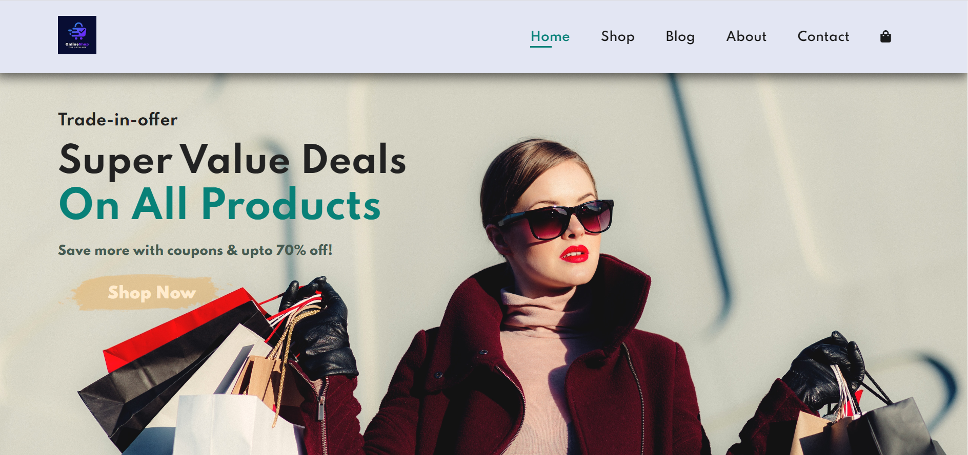
Home Page
Online Shopping
Oct-2023
11

Slide 12
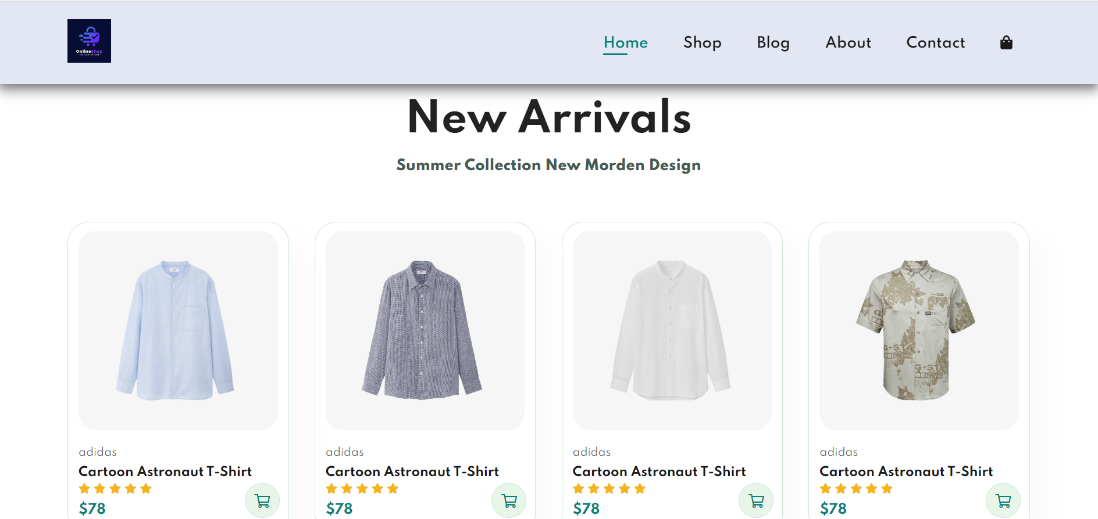
Home Page
Online Shopping
Oct-2023
12

Slide 13


