Slide 1
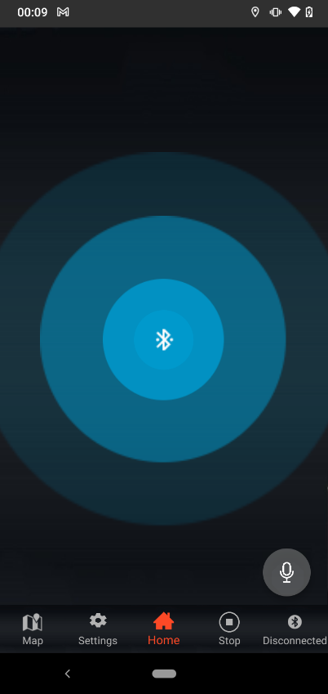
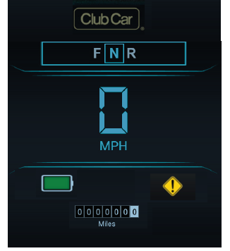
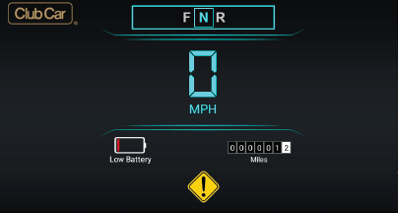
Connect & Home Screen
Connection Screen
Home Screen -Landscape mode
Home Scrren-Portrait mode

Slide 2
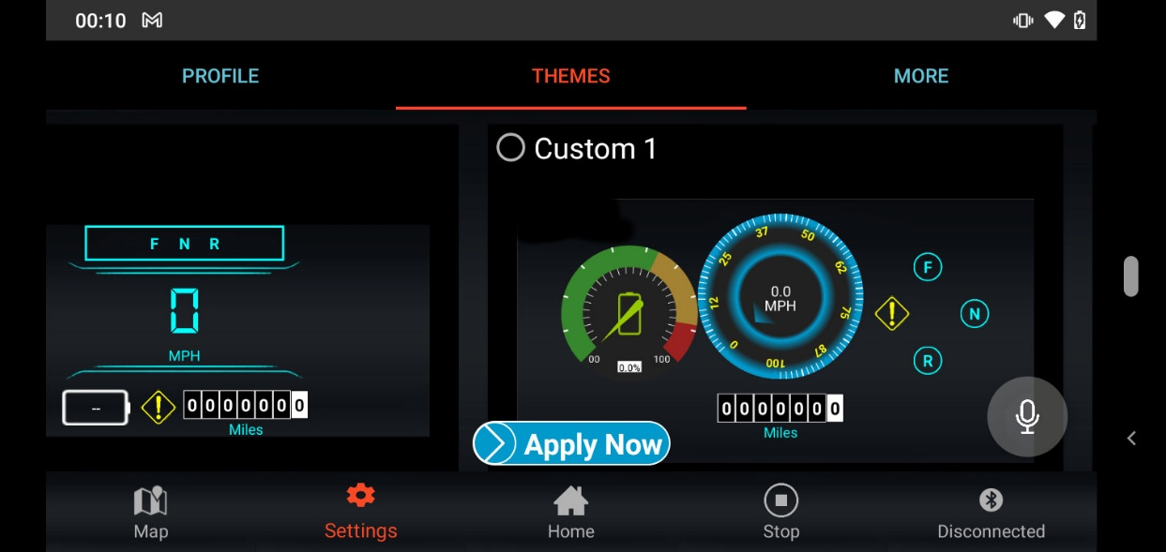
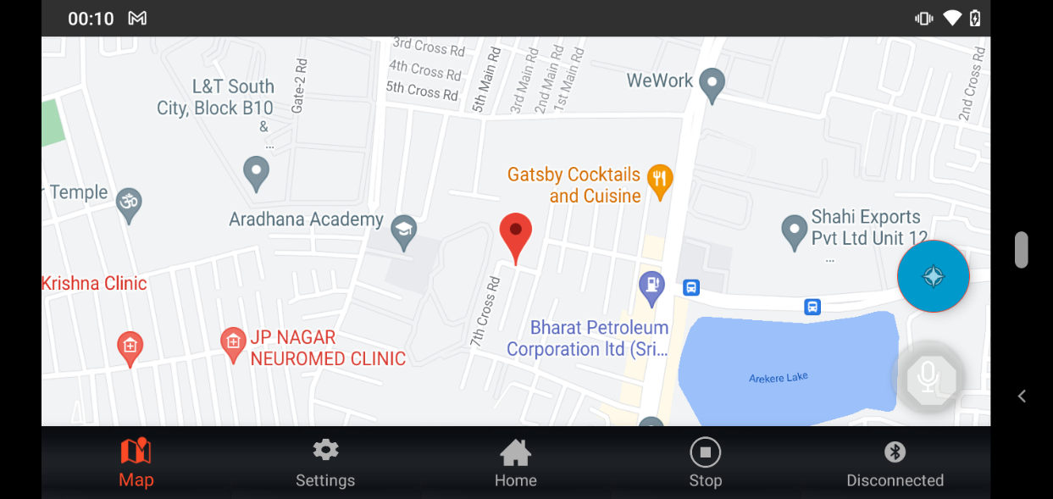
Theme & Map
Theme Settings
Map Screen -Landscape mode

