Slide 1
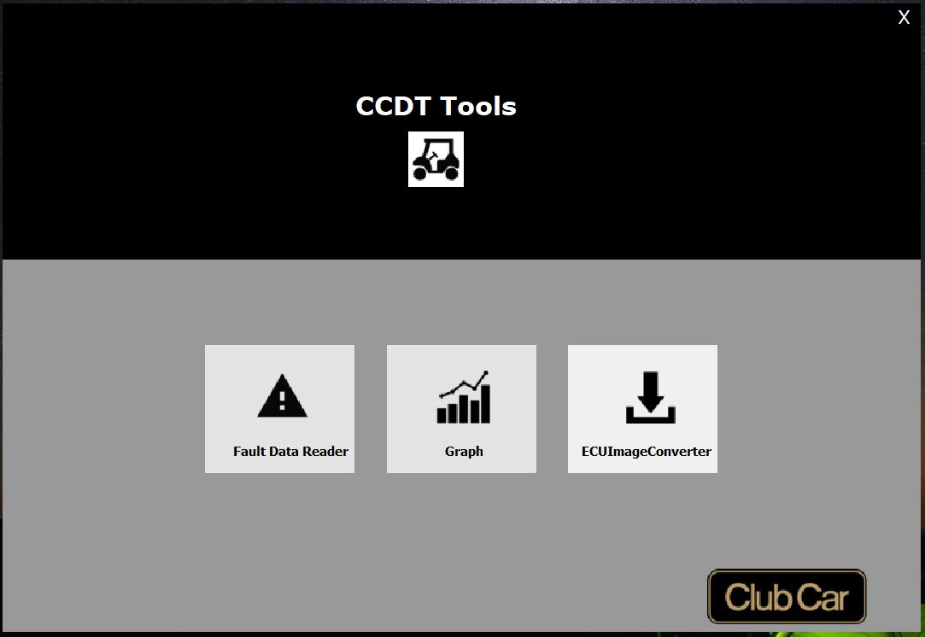
CCDT Tools
Home Screen

Slide 2
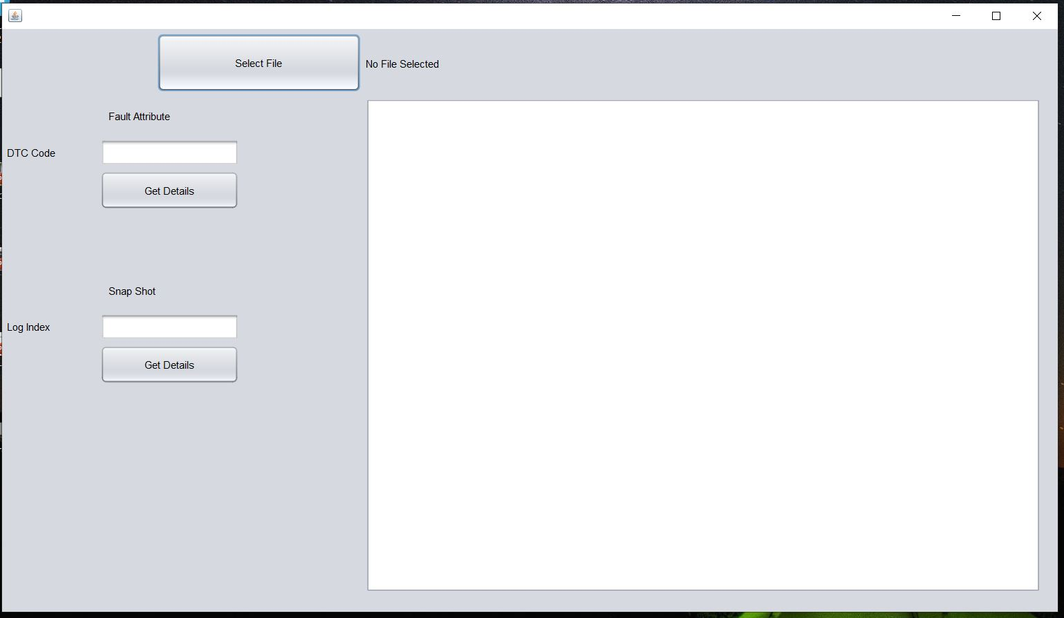
CCDT Tools
Fault Data Reader

Slide 3
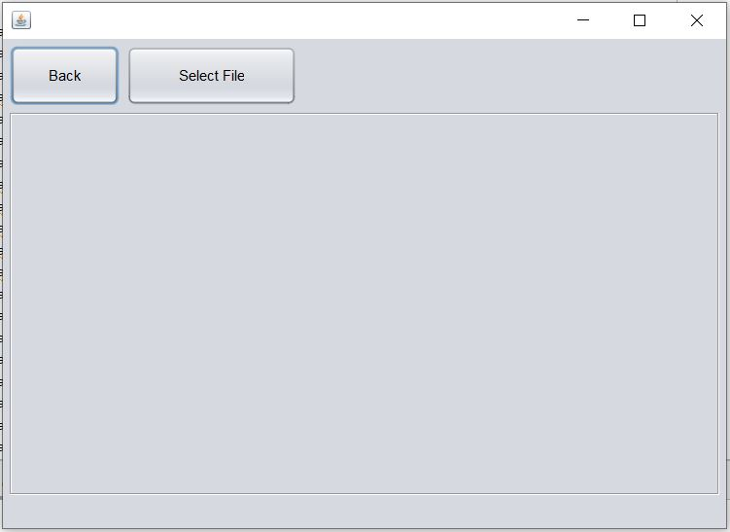
CCDT Tools
Graph data

Slide 4
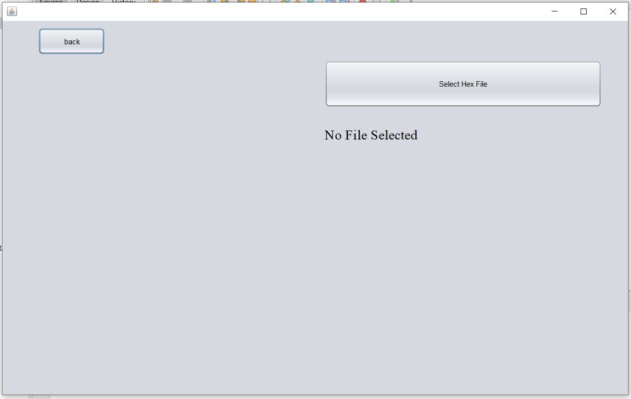
CCDT Tools
ECU Image/Hex file converter

