Slide 1


SEARCE × TATA STEEL UK
FY26 · Logistics cost transformation
From three spreadsheets
to one conversation.

Slide 2
The problem
Logistics cost you can’t see
Cost lives in three disconnected spreadsheets, emailed monthly — each a different shape.
Rail — DB Cargo
Road UK
Road EU — imports
1 row / movement
Costs split across haulage, fuel and cancellation
1 row / leg
Multi-leg orders; purchase vs sales cost
1 row / charge line
~4 lines per shipment; customer code ≠ shipment
Nobody can answer, across all three at once: what’s our cost per tonne, where is it leaking, are we paying to move air?
02

Slide 3
Before vs after
From 6 days to minutes
AFTER
BEFORE
check_circle One file drop — nothing else
check_circle Self-running cloud pipeline
check_circle Rail + UK road + EU road unified
psychology Ask in plain English (Gemini)
auto_awesome Minutes, fully hands-off
remove_circle_outline Three disconnected spreadsheets
remove_circle_outline Manual consolidation by an analyst
remove_circle_outline One feed viewed at a time
remove_circle_outline Static Power BI — look, don't ask
history ~6 days for monthly refresh
6 DAYS
arrow_downward
MINS
03

Slide 4
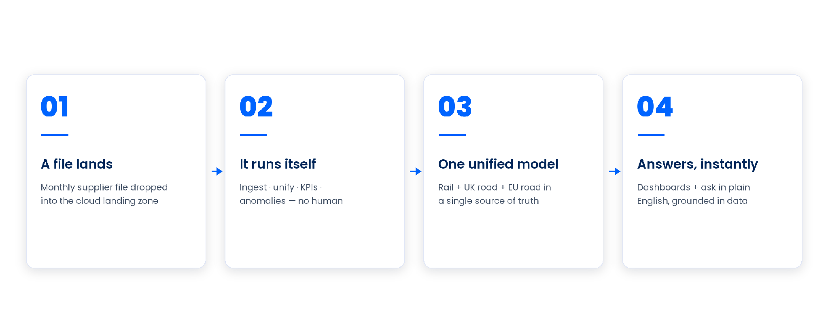
How it works
file in, knowledge out
04

Slide 5
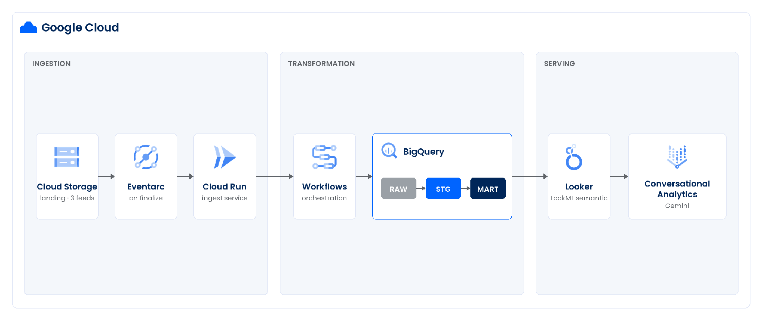
Architecture
Event-driven on Google Cloud
05

Slide 6
The demo
Watch it happen, live
01
Start blank The dashboard shows nothing
02
Drop a file Land a supplier file in the cloud landing zone
03
It runs itself Ingest, unify, KPIs, anomalies — no human
04
Ask in English Conversational Analytics answers from the model
06

Slide 7

The demo · ask anything
Ask in plain English — then drill deeper
Three questions, one flowing conversation — every answer grounded in the model, never invented.
01
START BROAD
“What’s our total logistics cost, split by mode and provider?”
Returns £81.4M across rail, UK road and EU road
02
GO DEEPER
“How does cost per tonne compare across rail, UK road and EU road?”
Returns EU road £55.31 vs rail £6.57 — 8.4× more per tonne
03
MAKE IT ACTIONABLE
“Which lanes and carriers drive the most of that cost?”
Returns Ranked targets to consolidate or renegotiate
07

Slide 8
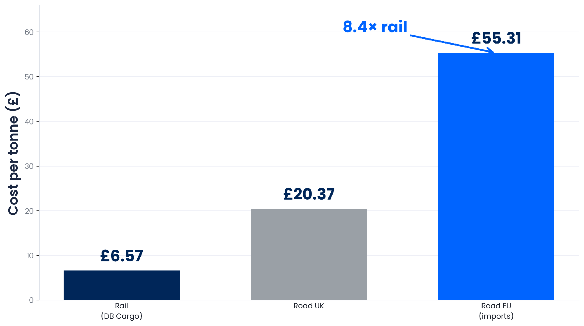
The demo · cost story
The insight that was hidden
European road freight costs
8.4× per tonne
what rail does.
Invisible while the three feeds lived apart — the most actionable cost fact on the table.
08

Slide 9
The close
One file drop. Answers in plain English.
The control panel for the cost you can actually move.
NEXT STEP
Productionize
IaC, scheduled supplier feeds, CI/CD
Broaden coverage
onboard more carriers & modes
Source-data quality
quarantine + alerting on gaps
09

Slide 10
Questions?
Thank you · Searce × Tata Steel UK

