Slide 1
Defect Reporting and Defect Life Cycle Management
Lesson1: Defect Free Defect Reporting

Slide 2
Lesson Objectives
To understand the following topics:
  What is Software Quality?
  Defect Definition
  Why find Defects?
  Impact of Defects
  Legal Implications
  Life-cycle workflow
  Life-cycle workflow - Enhancement
  Defect Report - Definition
  Defect Reporting – The Need
  Defect Report - Template
  Important Attributes
  Example on Severity & Priority

Slide 3
Lesson Objectives
To understand the following topics:
  Defective Reports - Certain Facts
  Importance of Effective Defect Reporting
  Defect Free Report - Recommendations
  Writing Defect Free Reports
  Preparation
  Reporting and Communication Process
  Guidelines
  Using Tools for Reporting - Advantages
  Project/Organization Level Process
  Project/Organization Level Process
  Defect Free Reports - Advantages
  Nine Commitments worth making to developers

Slide 4

1.1 Software Quality
What is Software Quality?
Quality of the developed software exhibits the following aspects :
  It is reasonably bug or defect free
  Delivered on time and within budget
  Meets requirements and is maintainable
ISO 8402-1986 standard defines quality as “Totality of features or characteristics of a product or service that bear on its ability to satisfy Stated and Implied needs
Acceptance criteria defines what minimum requirements should be met

Slide 5


1.2: Defect
Definition
A Software Engineer makes
an error…
….that creates a
defect in the software...
…that can cause
a failure in operation

Slide 6
1.2: Defect
Definition
Defect
  If AUT’s (Application Under Test’s) some feature or function is not working as per what is there in requirement it is called as defect
  A defect is a variance from a desired product attribute.
  A problem which, if not corrected, could cause an application to either fail or to produce incorrect results
Examples
  Car brakes stop working after crossing speed of 100 km/hr
  Billing software generates, prints, and mails bills showing amount payable as 0 Rupees
  A customer goes to withdraw $1000 from his account having a balance of $5000 and minimum bank balance require is $500. ATM Rejects the request saying “Insufficient Balance”
  Actual amount withdrawn from the ATM and the amount printed on print receipt shows difference

Slide 7
1.2: Defect
Why find Defects?
Increase confidence in the reliable operation of the system and get more business
Reduce the likelihood of loss or even life-threatening incidents
Obtain repeat and referral business from satisfied customer
Decrease overall system costs associated with quality problems

Slide 8
1.2: Defect
Impact of Defects
A single error can cause nothing or a lot
It can cause death or injury if it fails in case of safety critical applications
It can also cause huge financial loss to clients
And also lead to fine/penalties for us
Examples
  NYSE fined Waterhouse Investor Services US $225,000 for its web site failures - inability to file on-line stock orders and inadequate customer service
  An AA jet crashed in Colombia because the captain entered an incorrect one-letter computer command that sent the jet into a mountain killing 158 people aboard. When there is critical command, the software could have asked for confirmation or verified or have enough validation before processing the command.
  Hacker hacked into US government computers, including two agencies within the Defense Department, and defaced government Web sites. It shows the insufficient Security Testing.

Slide 9

1.2: Defect
Legal Implications
Under a contract, a buyer can sue a company if he/she did not get what he/she paid for or if the software did things it was not supposed to do
Buyer can also sue for Consequential damages - economic loss or injury to person or property
Acts like Data Protection Act also safeguard the security rights of the customer

Slide 10
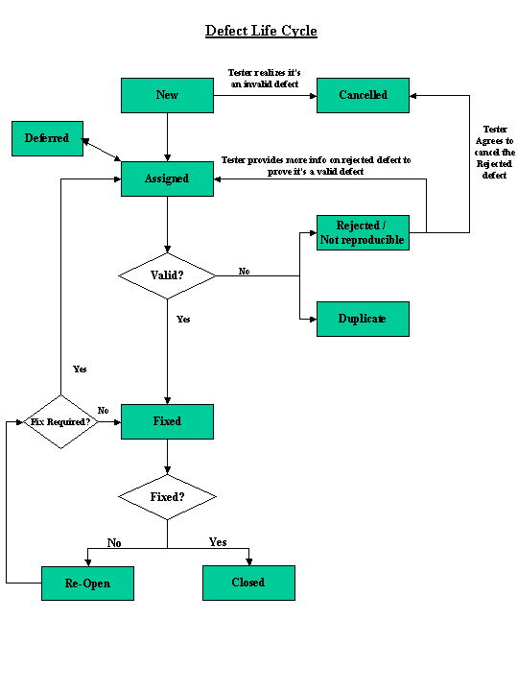
1.2 Defect
Life-cycle workflow
Notes:
New – When a Defect is logged and yet to be assigned to a developer. Usually Project Manager or Dev Lead will decide on which defects to be assigned to which developer.
Assigned – indicates that the developer who would fix the defect has been identified and has started analyzing and working on the defect fix.
Duplicate – Manager or Developer will update the status of a defect as “Duplicate” if this defect was already reported.
Rejected / Not Reproducible – This status indicates that the developer is not considering the defect as valid due to following reasons
a) Not able to reproduce
b) Not a valid defect and it is as per requirement
c) Test Data used was invalid
d) Defect referring to the Requirement has been de-scoped from the
current release, tester was not aware of this late changes.
Deferred – Defect fix has been held back because of time or budget constraints and project team has got approval from customer to defer the defect till next or future release.
Fixed – Developer has fixed the defect and has unit tested the fix. The code changes are deployed in test environment for verifying the defect fix.

Slide 11
Capgemini Internal
Notes:
Reopen – Status is changed to “Reopen” by a tester, when a tester finds the defect is Not fixed or partially fixed. Developer who fixed the defect looks into the comment that was provided by the tester at the time of reopening the defect. Developer will change the status to “Assigned” and starts working on the fix again. Incase the developer wants the tester to re-verify the defect then he/she will add a comment and will change the defect status to “Fixed”.
Closed – Tester verifies the defects that are in “Fixed” status and once they find the defect is fixed, they change the status to “Closed”. This is the last status of Defect Life Cycle.
Cancelled – This status indicates that the tester realized that the defect logged by him was invalid and agreed to cancel it.

Slide 12
1.2 Defect
Life-cycle workflow - Enhancement
A
Enhancement
Business reviews
Enhancement
Valid
Enhancement
Agreed to change
B
Deferred
Enhancement is kept in
Open Forwarded status
C

Slide 13
1.3: Defect Report
Definition
Defect report
  Is a document to maintain all the defects, that test engineer found while test execution
  The most important deliverables to come out of test. It will have more impact on the quality of the product than most other deliverables from test
  It is important to write effective defect reports

Slide 14
1.3: Defect Reports
Defect Reporting – The Need
Emphasize on continuous improvement
Defect report – an important deliverable
Inadequate Material
High impact of defective defect report

Slide 15
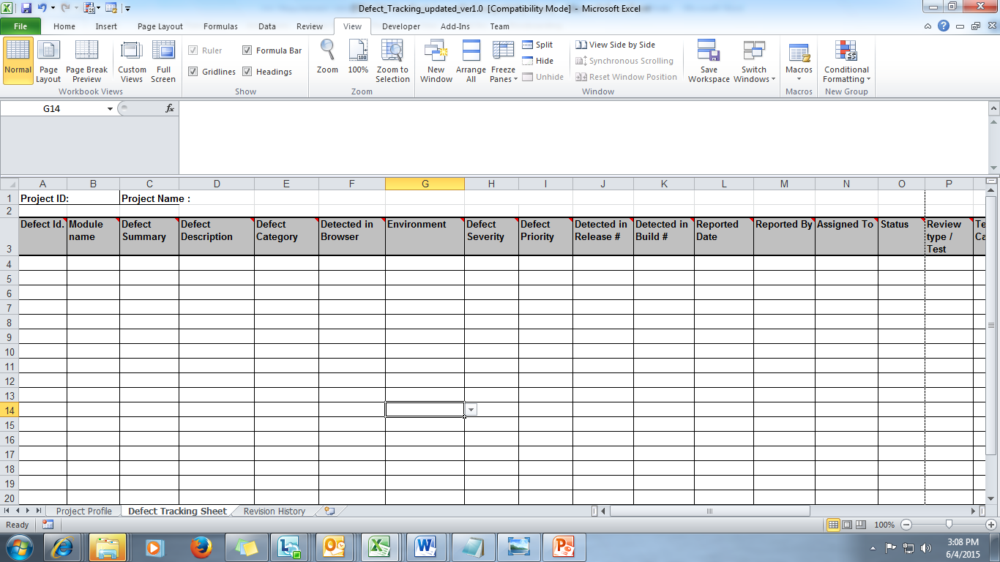
1.4 Defect Report
Template
Notes:
Defect ID - A unique number to each defect. This will help to identify the bug record. If you are using any automated bug-reporting tool then this unique number will be generated automatically each time you report the bug.
Module Name- It will contain the name of the module being tested.
Defect Summary- A short summary of the defect. It can be in 1 or 2 lines.
Defect Description- A detailed description of bug. It includes
Clearly mention the steps to reproduce the bug.
How application should behave on above mentioned steps.
What is the actual result on running above steps i.e. the bug behavior.
Defect Category- Categorizing the defect into the appropriate category. The categories considered are:
Coding: When the defect is found in the code.
Design :When the defect is found in the design
Enhancement: If the defect stated is actually an enhancement to the present requirement
New Requirement :If the defect stated is actually a new requirement
Query : is any question or doubt which might be raised by the tester, it need not be an actual defect.
Documentation: is any error found in the documents of the application like the help document etc.
Master Data: Is any error found in the master data received
Test Review: is while doing the testing any review comments which might be suggested by the tester ,again it may not be a defect itself.
DO – Documentation related defects
This includes all defects related to missing or misstated requirement in Functional specification
BD/PK/LD - Build / Package / Load
Change management, library, version control.
FN/LO (Coding)
Function/ Program Logic (Logic, pointers, loops, recursion, computation); Not functioning as per the design / requirement.
EN - Environment
Environment (Design, compile, test, or other support system problems)
OP
If the optimal usage is lacking or performance is not up to the mark. Design will adversely affect the product's performance
SG – Suggestion
If the defect reported is a suggestion.

Slide 16
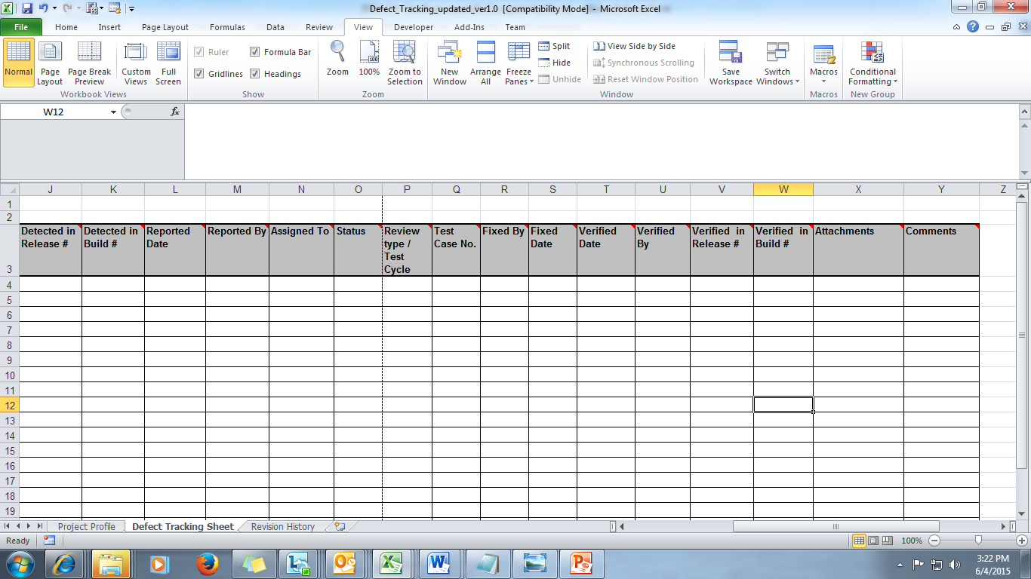
1.4 Defect Report
Template(contd.)
Notes:
Detected in Browser :The name of the browser the defect was found in (IE, Firefox ,etc.)
Environment: Mention the environment where the defect was found. It can be internal Dev,internal QA,External Dev or External QA.
Defect Severity : Impact of the defect on functionality of application. The values it can contain :
P0 defect is a defect wherein the main function of the software does not work. e.g. crash, hang, data corruption
P1 defect is a defect wherein a function does not work and a tedious work around exists. e.g. One of menu options does not work.
P2 defect is a defect wherein the software does useful work but a degree of inconvenience is caused. Correction is not deferrable and easy work around exists.
P3 defect is a tolerable defect as corrections are deferrable. E.g. cosmetic problems in user interface like spelling.
“High” severity defect is a defect wherein the main function of the software does not work. e.g. crash, hang, data corruption, some of the menu functions do not work
“Medium” severity defect is a defect wherein the software does useful work but a degree of inconvenience is caused. Correction is not deferrable and easy work around exists.
“Low” severity defect is a tolerable defect as corrections are deferrable. E.g. cosmetic problems in user interface like spelling.

Slide 17
1.4: Defect Reports
Important Attributes
Defect ID
Module name
Defect summary
Defect description
Defect Category
Detected in Browser
Environment
Defect Severity
Defect Priority
Detected in Release #
Detected in Build #
Reported Date
Reported By
Assigned To
Status
Review type / Test Cycle
Test Case No.
Fixed By
Fixed Date
Verified Date
Verified By
Verified in Release #
Verified in Build #
Attachments
Comments
Notes:
Priority – It indicates When bug should be fixed? The values are low, medium and high
High - This bug should be resolved as soon as possible in the normal course of development activity, before the software is released.
Medium - This bug should be repaired after serious Defects have been fixed.
Low - It can be resolved in a future major system revision or not be resolved at all.
Detected in Release # : Denotes the Release # in which the defect was detected.
Detected in Build #: Denotes the Build # in which the defect was detected.
Reported Date: The date on which the defect was reported. It need not be same as the date on which it was detected.
Reported By: Name of the person who reported the defect.
Assigned To: Name of the person the defect is assigned to , to fix it.
Status: Gives the status of the defect. It can contain the following values
Verified
Closed
Fixed
Active
CNR-Could Not be Reproduced
NOD: reported bug Not a Defect
REP: Repeated bug
Review type / Test Cycle: It can contain following values:
PPR-Peer to Peer Review
PR-Peer Review
SR-Self/Programmer Review
QPR-10% Quality Probe(Review)
RT-Random Testing
UTC-Using Test Cases

Slide 18
Capgemini Internal
Notes:
Test Case No: Mention the test case No that the defect was found while testing
Fixed By: Name of the person who fixed the defect
Fixed Date: Date on which the defect was fixed
Verified Date: Date on which the defect was verified
Verified By: Name of the person who will be verifying whether the defect has got fixed after the defect is being worked upon
Verified in Release #: Denotes the Release # in which the defect was verified
Verified in Build # :Denotes the Build # in which the defect was verified
Attachments: Attach the proofs showing the defect- screenshots, temp files, etc.
Comments: Should include all the comments made by all touching the defect on the defects till date .It should be captured date wise.

Slide 19
1.5: Defect Reports
Example on Severity & Priority
Think of the following type of problem:
A spelling error on a user-interface screen
  What severity and priority does this issue deserve?
Well, judging from our earlier definitions, it would seem that this is a low-severity item. After all, the server doesn’t crash due to a spelling error.
But is this truly a low-severity problem?
A spelling error will probably not hinder a customer’s ability to use the system, but it greatly affects the customer’s perception of the company that created the product and of the quality of the product. So from customer-relations and corporate-image points of view, the severity of this type of issue is indeed high. But the severity field doesn’t allow us to express that properly. So the need for the priority field becomes apparent. The priority field does allow product management to define this issue as high priority, but this creates the case where something is low severity but high priority.

Slide 20
1.5: Defect Reports
Example on Severity & Priority
Let’s consider another case:
The anomalous server crash. We’ve all seen this type of issue. A server crash that occurs on the first full moon of every leap year but that is not reproducible by any human means on a consistent basis.
So how would this issue be categorized within the defect tracking system?
Well, since it is a server crash, many would argue it should be a high-severity issue. After all, the system is inoperable until the server is restarted. But what is the impact to the customer? In this case, the impact is quite small. Since the customer may never see this issue present itself at all in a production environment, it would be given a low priority and high severity by Product Management

Slide 21
1.6 Defect Report
Users
Management
Maintenance Team lead
Maintenance Engineer
Testing Team Lead

Slide 22
1.6 Defect Report
Benefits for Maintenance Team Leads
Allocate the Defect to the appropriate team member as soon as possible
  Quickly understand the software version and component responsible for issue
Effectively prioritize defect for fixing
  Is it halting the testing process?
  Are other functionalities dependent on this?
  Is it important under part release?
  Expected fixing date
To accurately take corrective and preventive actions for future developments
  Category wise, severity wise Defect status (functionality, modules, layers)
  Average turn around time for Defect fixing
  Defect density

Slide 23
1.6 Defect Report
Benefits for Maintenance Engineer
Identify the application version (mainly for products)
  Isolate the application version when multiple versions are being maintained
Quickly get to the root cause
  Concentrate not on symptoms but root cause to isolate the component creating issue
Know reproducibility and environment/situation of reproducibility
  Else do not waste time, arrange for necessary dependencies/settings
Analyze the log file and get clear understanding about the issue
  Check the exact details - data entered, actions taken, results generated, tables updated (application log, database log)
Contact the tester who found the Defect
  To get a first hand information & clarification directly and quickly

Slide 24
1.6 Defect Report
Benefits for Testing Team Lead
Plan retesting efforts
  Tentative dates when defects are expected to be fixed
  Estimated defects
Analyze quality of Defect reporting process
  Defect Acceptance Rate, Defect Communication Effectiveness
Increase accuracy on future estimates
  Generate accurate summaries for status reporting
  Application module wise, Severity wise total/open defects
  Functionality wise, severity wise total/open defect counts
Monitor performance of the testers
  Tester wise metrics

Slide 25
1.6 Defect Report
Benefits for the Management
To know the status of the Defects
  Application module wise, severity wise defect summary of open and closed defects
  Category wise severity wise open and closed defects
  Expected dates for fixing and closing of high severity defects
To analyze the performance of the teams
  Team wise – team member wise metrics – count, productivity
Effective follow-up
  Generate exception reports – Actions due in next n days, Actions pending for more than n days
  To take go/no go decision for next cycle/phase/production
  Defect summary in conjunction with Test Case execution summary
To know the risks involved
  Summary and details of known defects (with impact)

Slide 26

1.7 Defect Management
Logging, Tracking & Analysis
A Good Defect Management process helps to gather and manage information during each defect workflow i.e. from initial discovery to final resolution or deferral.

Slide 27

1.7 Defect Management
Logging Defect
Get empty defect template
Specify available information; keep updating as information becomes available
Categories of Defect Information
  General information
  Defect detection information
  Resolution information
  Status information

Slide 28

1.7 Defect Management
Logging Defect – General Information
Basic information on nature of defect, its repair priority, etc. :
  Description - Brief text
  Priority
  Severity
  Cause keywords (For further analysis)
  Symptoms (Database corruption, visible data wrong, cosmetic etc.)
  Phase found in
  Date reported
  Actual date of closure

Slide 29

1.7 Defect Management
Logging Defect – Defect Detection Information
Specify information about testing data related to defect, environment who found it etc.
Description
Build, log, cycle, procedure, case in which defect was found
Reported By - Name, Company
Hardware, software - Platform on which defect found
Attached Information
Additional Information

Slide 30
1.7 Defect Management
Logging Defect – Resolution Information (Developer)
How the defect was resolved
  Resolution from a codified list
  Fixed in build / version
  Resolution description
  Modified software - components modified to resolve defect
  Additional information
  Additional attachments

Slide 31

1.7 Defect Management
Logging Defect – Status Information
Current status of a defect and status history
  Description
  Status history with rows containing
  Date
  Action
  Performed by
  Actual effort
  Resulting status
  Next step assigned to
  Estimated effort for next step
  Expected date of completion

Slide 32
1.7 Defect Management
Tracking Defect
Summary Information on defects not yet closed
  Defect Identification (name / number)
  Date Reported
  Expected date of closure
  Severity
  Priority
  Current state
  Assigned to
  Selection by “Assigned to”, “Priority”, or “severity”, etc.
  Sorting by various orders.

Slide 33
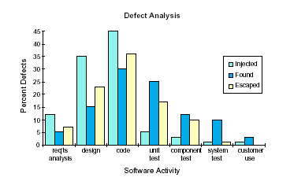
1.7 Defect Management
Defect Analysis (Cont.)
This chart shows the % defects found during each testing phase. Helps in analysis of the effectiveness of different phases in SDLC.

Slide 34
1.7 Defect Management
Defect Analysis
Defect Categorization
Missing Function
Memory
10%
5%
Syntax Error
Interface Error
40%
15%
Ambiguous
requirement
30%

Slide 35
1.8 Defective Reports
What is Defective Defect Report?
Defective defect Report
  The inaccurate, incomplete and unclear defects results into defective defect report
  Impact of Defective defect report
  Wastage of time that is precious in tight schedule
  Inaccurate / incomplete status leading to wrong / no decisions
  Inaccurate statistics leading to inaccurate corrective / preventive measures
  Frustration and ill feeling between development and testing teams

Slide 36
1.8 Defective Reports
The reasons for defective reports
Cannot reproduce
  If the maintenance engineer is not able to reproduce the bug, by using steps mentioned in defect report
Already reported (Duplicate)
Functionality is as per requirement
Some one else is responsible
Additional information needed – Error message detail, Data input, options selected, previous tasks executed etc
Details provided are not clear
Some attributes are not provided or not correct – Severity, Transaction Id, version, category etc
Is a new requirement or change in requirement
Notes:
For all above reasons the developer will change the status of the bug as rejected.

Slide 37
1.8 Defective Reports
Root causes for defective reports
An Assumption - Developer should be able to understand defect quickly and easily with little hint
Providing all the steps, test data etc. takes lot of time to report
Testers do not know the importance (usage) of details other than defect description
Providing evidences for the defect are not considered important
Informal communication process - through emails, verbal, and historical details are not maintained
Some defects gets unknowingly fixed due to fixing of other defects
Features of tool, process not known

Slide 38
1.8 Defective Reports
Other Influencing Factors
An Requirement of large testing team size
Large and Complex application architecture with Involvement of multiple development teams
Teams working from different countries in different time zones
Business users/testers and developers speaking different languages

Slide 39
1.9 Severe Defects
The Most Severe Defect
Wrong Severity is a severe defect
  Importance for go / no go decisions
  Importance for deferring the defect-fix to next release
  Credibility of development team is based on such defects

Slide 40
1.10 Defective Reports
Certain Facts
Quick fixing of some Defects would help first the testers themselves
  Show stoppers
  Dependencies and pre-requisites
Developers are human beings
  There are bound to be Defects in application
Varied interests and expectations – High defect count ->
  Good performance by test team but
  Bad performance by development team
The maintenance engineer is not the only user of the Defect report
  Maintenance team lead, Test team lead, Management

Slide 41

1.11 Defect Free Reports
Importance of Effective Defect Reporting
From the Development Perspective
  Real Defects in the system/program
  Clear but brief information about the bug
  Steps to easily reproduce the problem
  Proper description of the problem if they happened to be more general
  Developer should be able to isolate the problem reported
  Increased productivity – in fixing the problem with least amount of effort
  Expect reports that convey the proper message and simplifies the process

Slide 42
1.11 Defect Free Reports
Importance of Effective Defect Reporting
From the Test Perspective
  Reduce the defect life cycle
  Ensure that the defects get fixed by developers in the
  Agreed timeframe
  Improve the credibility of the test
  Enhance teamwork between development and test
  Get better response from the development team
  Reduce things like “Need more feedback”, “Works fine on my machine”

Slide 43

1.11 Defect Free Reports
Importance of Effective Defect Reporting
From the Management Perspective
  Improve productivity
  Get accurate information on the defects reported
  Reduce the time to market
  Get the correct metrics
  Take proper actions in timely resolution of the defects

Slide 44
1.12 Defect Free Reports
Recommendations
Increasing Awareness / Being conscious of
  Some realities in testing process
  Users of Defect report
  Importance of Defect report attributes to different users
Following process and guidelines
Preparation before starting the assignment
  Verify before recording defect
  Review Defect report before submitting
Use of tool with required features
Institutionalizing improvements

Slide 45
1.13 Writing Defect Free Reports
Preparation
Get complete understanding of Defect Tracking process and tool
  Guidelines for reporting, checking for duplicate defects, pre-defined definitions for severity, priority, categories etc
Establish / understand communication protocol
  Abbreviations and symbols, Providing references to documents, using standards
Acquire communication skill
  To provide clear, complete yet concise information about the defect

Slide 46
1.13 Defects
Reporting and Communication Process
Checking before Recording the defect
  It is really a Defect
  It is not yet reported
  It is a specific or a general issue

Slide 47
1.13 Defects
Reporting and Communication Process (contd.)
Finding and reporting
  The root problem
  The shortest way to recreate the Defect
  All the other information that can help
  All evidences – screen shots, references to other documents, correspondences etc
Ensuring
  CAN PIG RIDE??
Notes:
When in doubt report the defect - Primary objective is to get as less defects (if possible no defects) in production and not high Defect Acceptance Rate

Slide 48
1.13 Defects
Reporting and Communication Process (contd.)
Condense
Accurate
Neutralize
Precise
Isolate
Generalize
Recreate
Impact
Debug
Evidence
Notes:
Key points to make sure the next defect report you write is an effective one.
1. Condense - Say it clearly but briefly
2. Accurate - Is it a defect or could it be user error, misunderstanding, etc.?
3. Neutralize - Just the facts. No zingers. No humor. No emotion.
4. Precise - Explicitly, what is the problem?
5. Isolate - What has been done to isolate the problem?
6. Generalize - What has been done to understand how general the problem is?
7. Re-create - What are the essentials in triggering/re-creating this problem?
(environment, steps, conditions)
8. Impact - What is the impact to the customer? What is the impact to test?
9. Debug - What does development need to make it easier to debug?
(traces, dumps, logs, immediate access, etc.)
10. Evidence - What documentation will prove the existence of the error?
It is key to make sure that you have covered the essential items that will be of most benefit to the users of the defect report.

Slide 49
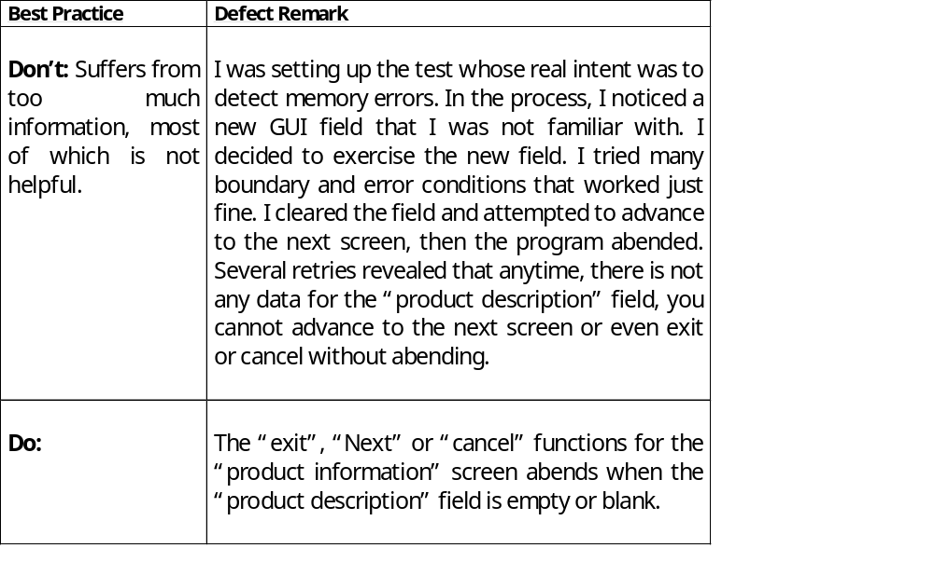
1.13 Reporting and Communication of Defects
Condense - Example

Slide 50
1.13 Reporting and Communication of Defects
Accurate - Example
Be extremely sure that what you are reporting is really a bug
Don’t lose credibility by reporting wrong Defects
Do your homework before you write a problem
Check with developer or Senior tester before reporting
Ask questions like,
  Is there something in the setup that could have caused this?
  Could this be a result of network or environmental problem?
  Do you really understand how this is suppose to work?
Notes:
Check with developer or senior tester before reporting.
Don't be afraid to report problems. Do your best to ensure they are valid problems.

Slide 51
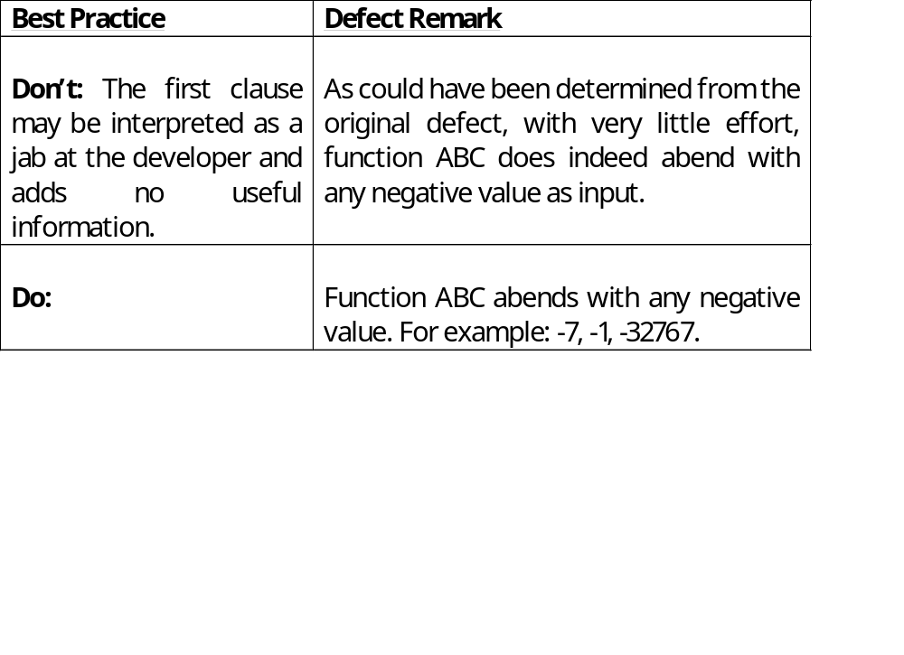
1.13 Reporting and Communication of Defects
Neutralize - Example
Notes:
1. State the problem Objectively
2. Don’t use humor or emotionally charged zingers.
3. Even if defects are rejected provide more information which will be
helpful to the developer. This will help in credibility in the long run.
Even if defects are returned back provide more information that will
be helpful to the developer. This added bit of professionalism will give
you respect and credibility in the long run
4. What you think funny may not be interpreted funny by the developer
who is working overtime and is stressed with deadlines. They just
create barriers to communication and teamwork.

Slide 52
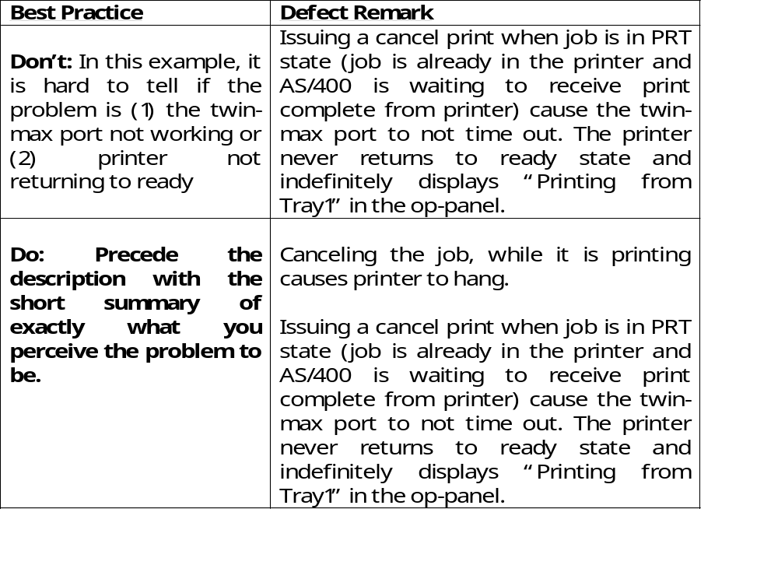
1.13 Reporting and Communication of Defects
Precise - Example

Slide 53
1.13 Reporting and Communication of Defects
Isolate - Example
Invest a reasonable amount of effort in isolating a problem
Try to find out shortest and easier steps to reproduce the problem
Ask yourself if anything external to the code is causing the problem for e.g. network, etc.
If doing an end-to-end testing can you specify which exact component is causing the failure
For testing multiple input conditions vary the input condition until you find the value which triggered the problem
Your ability to isolate in a large part defines your value-add as a tester
e.g. You found a problem while printing a postscript document, even if you think the problem occurs while printing the postscript document, specify the exact document that you used for printing

Slide 54
1.13 Reporting and Communication of Defects
Generalize - Example
Incorrect
  Date displayed on the Payment Screen is not in the format mm/dd/yy .
Correct
  Date displayed on the Payment Screen, Batch Screen, Billing Summary screen is not in the format, mm/dd/yy .
Notes:
Fixes are made often as per the problem is reported.
Identify if its a more general problem and needs a generic fix.

Slide 55
1.13 Reporting and Communication of Defects
Recreate - Example
If you can re-create the bug, you should explain clearly and concisely what is required to do the re-create.
List all steps, exact syntax, file name or sequences you en-counter to re-create the problem.
If you find more reliable and shorter methods while verifying/re-creating document it.
If you are not able to re-create it or suspect about it, gather all the relevant information and pass it on to the developer to see if they want to examine the system
Incorrect
  Assume that the problem cannot be re-created if you haven’t verified that it can be
Correct
  If you cannot or haven't re-created the problem it is important to note that in the defect remarks.

Slide 56
1.13 Reporting and Communication of Defects
Impact - Example
What is the impact if the bug was to surface in the customer/production environment?
If you think that the defect won’t get sufficient priority then state the potential impact and sell the defect.
Don't oversell, but make sure that the readers understand the probable impact on the customer.
Notes:
Example :
1. System crashes when I hit the enter key.
2. You may notice a typo error on a window. It may be a very minor, but
if that results to be a offensive word, then such typo errors need to be
fixed.

Slide 57
1.13 Reporting and Communication of Defects
Debug - Example
What will help the developer need to debug the problem? Are there any traces, dumps, logs, etc. that should be captured and made available along with the defect report.
Provide correct pointers in the logs, dumps that will help the developer to resolve the defect as fast as possible.

Slide 58
1.13 Reporting and Communication of Defects
Evidence - Example
What proves that the defect you report is an error? Have you provided both the expected and the actual results? Is there any documentation that supports your expected result?
Evidence may take the form of user guides, requirements, design, etc.
It also may be past comments from customers, de-facto standards, competing products
Don't assume everyone see things same as you do.
Don't assume that 3 weeks from now you will remember why this was a bug
Provide even more evidence when you think this situation may not be accepted as a bug.

Slide 59
1.14 Writing Effective Defect Reports
Guidelines
When you file a defect, it needs to be easily conveyed to the developer
You must provide clear information
  Fill out as many fields as you can
  Provide screen shots, log files, URL's and references to similar defects
  Include detailed steps to reproduce the issue
Notes:
Some more points to remember
Refer to requirements or design documents where appropriate.
When possible, check to see if the problem occurred in an earlier
build.
Include data like username, date, time, and details that make the
problem easier to find
If you checked a log file and find nothing, include a comment like
"Nothing in [log name].log."
You may want to try other scenarios and include the results.
Example of good Description:
On the bills page, some amounts have no decimal after the amount, others have two. Since this is currency, we should be consistent and always display two decimals (or whatever is standard) after the amount-- even if the last digit is a zero.
Example of a bad description:
went to page. decimals aren't right

Slide 60
Capgemini Internal
Notes:
STEPS TO REPRODUCE THE PROBLEM
Provide easy-to-follow steps that will reproduce the bug. Include any special setup steps, login information, account information, and any other information that will make it easy to see the problem.
Good example:
Login with username : “user1” and Passwd : “user1”
Click on “Bill details“
Select any order no, It will show you list of items in the order
Click on generate bill.
Bad example:
logged in and went to page. changed field. noticed decimals wrong.

Slide 61
1.15 Using Tools for Reporting
Advantages
With Primary features
  Built in validation checks
  Maintenance of history
  Generation of summarized information, metrics
  Ability to quickly search on specified criteria
  Multiple attachments
  Reduced other communication issues
  Online status
With other optional features
  Proactive notification when no action taken on due date
  Involvement of translator for translation when needed
  Understand number of items on which actions to be taken
  Change Request approval process

Slide 62
1.16 Project/Organization Level Process
Project/Organization Level Process
Competency Development of test team in
  Communication skills
  Defect management
Project specific familiarization process
  Communication protocol
  Defect reporting and tracking process
  Defect tracking tool
Summary / Metrics generation, sharing and monitoring
  Defect Acceptance Rate
  Defect Communication Effectiveness
    (Total Defects reported / Number of times Defects are communicated to Maintenance team) * 100

Slide 63
1.17 Defect Free Reports
Advantages
Improved project control
Improved quality of report
Improved productivity
Improved cycle time
Reduction in overall effort
On time delivery
Overall satisfaction
Improved predictability

Slide 64
1.18 Nine Commitments
Nine Commitments worth making to developers
We’ll test your code as soon as we can after it’s built.
We’ll test important things first, and focus on important problems.
We’ll write clear, thoughtful, and respectful problem reports.
We’ll try not to be a bottleneck for development.
We’ll tell you how we’re testing, and consider your suggestions.
We’ll look for ways to test better and faster.
We will not waste your time.
We will create order out of chaos.
We will always remember that collectively we win or loose as a team.

Slide 65
Summary
In this lesson, you have learnt:
  Defect report is an important deliverable since it gets referred by maintenance team, testing team, management
  The inaccurate, incomplete and unclear defects results into wrong decisions
  Follow process and guidelines
  People fixing defects are most likely to be different than original developers
  Institutionalizing process and building competencies for defect free defect reporting

Slide 66
Review Question
Question1: Which of the following will be entered by test engineer in the defect report
  Option 1: Reported By
  Option 2: Resolution Details
  Option 3: References
  Option 4: All of the above
Question 2: Before you log a defect it is not necessary to verify whether it is duplicate because it is time consuming.
  True/ False
Question 3: Adding attachments is easy if we are using any tool to log the defect
  True/ False
Notes:
Answers:
Question1: Option4
Question2: False
Question3: True

