Slide 1
Defect Reporting and Defect Life Cycle Management
Lesson 2: Overview of Defect Tracking Tools

Slide 2
Lesson Objectives
To understand the following topics:
Introduction to Defect Tracking Tool
Introduction to Bugzilla
Features of Bugzilla
Bugzilla – User Interface
Introduction to Redmine
Features of Redmine
Redmine – User Interface
Introduction to JIRA
Features of JIRA
JIRA – User Interface
Introduction to Mantis
Features of Mantis
Mantis – User Interface

Slide 3
Lesson Objectives
To understand the following topics:
Introduction to HP ALM
Features of HP ALM
HP ALM – User Interface
Introduction to IBM Rational ClearQuest
Features of IBM Rational ClearQuest
IBM Rational ClearQuest – User Interface
Introduction to Trac
Features of Trac
Trac – User Interface

Slide 4
1.1: Defect Tracking Tools Introduction to Defect Tracking Tool
Complex software systems typically have tens or hundreds or thousands of defects
Managing, evaluating and prioritizing these defects is a difficult task
Defect tracking systems are computer database systems that store defects and help people to manage them
A bug tracking system is a software application that is designed to help quality assurance and programmers keep track of reported software bugs in their work
It is a type of issue tracking system
They are termed as the “hallmarks of a good software team”
Bug tracking systems support the concept of the life cycle for a bug which is tracked through status assigned to the bug
A major component of a bug tracking system is a database that records facts about known bugs
The main benefit of a bug-tracking system is to provide a clear centralized overview of development requests and their state

Slide 5

1.1: Defect Tracking Tool Introduction to Bugzilla
Bugzilla is a popular development tool with issue tracking capabilities
Bugzilla is a web-based project management software that is being published as an Open Source Software
Bugzilla was originally created by the Mozilla Foundation to track bugs in the development
Bugzilla is powerful & commanding tool that will allow your team to get organized and communicate effectively
It is allow tracking the bugs & code changes efficiently
This Bug Tracking Tool is used many of top rated organizations like Mozilla, Facebook, NASA, Open Office, RedHat etc.

Slide 6
1.1: Defect Tracking Tool Features of Bugzilla
Sporting a number of advanced tools, from notifications to duplicate bug detection to shared searches, Bugzilla is certainly a more feature-rich option
Increased scalability and performance because of optimized structure of database
High security
Support advanced query tool & save the queries
Bugzilla incorporated with email notification facility
Bugzilla allow to setup email preferences based on user profiles and also user can add other email ids.
Excellent Permissions system
Bugzilla has an advanced search system along with a comprehensive reporting tool, capable of generating charts and automated scheduled reports
Bugzilla is extensible and customizable, both in the fields themselves as well as featuring the ability to create custom workflows for bugs
It also works with many database backends, and many different languages are supported out of the box

Slide 7
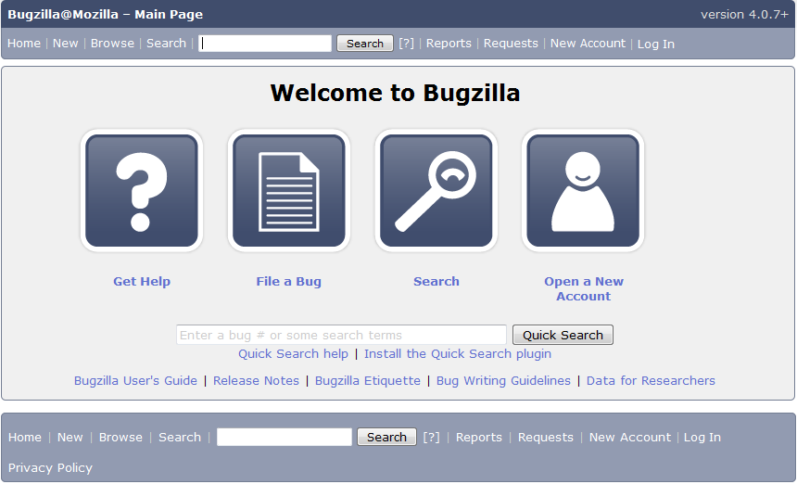
1.1: Defect Tracking Tool Bugzilla – User Interface

Slide 8

1.1: Defect Tracking Tool Introduction to Redmine
Redmine is a web based most commonly used project management tool.
Redmine is a popular issue tracking tool built on Ruby on Rails in 2006
Redmine is capable of managing multiple projects and integrates with a number of version control systems
In addition to basic issue tracking, Redmine also offers forums, wikis, time tracking tools, and the ability to generate Gantt charts and calendars to track progress
Redmine is fairly flexible in its setup, supporting numerous database backends and dozens of languages, and is customizable as well, featuring the ability to add custom fields to issues, users, projects and more
It can be further customized with a number of community-created plugins and themes
Redmine is licensed as open source under the GPL version 2, the source code can be found in the project’s subversion repository or mirrored on GitHub

Slide 9
1.1: Defect Tracking Tool Features of Redmine
It supports multiple projects on same time
Strong role based access control
Issue tracking system is more flexible
Gantt chart and calendar give support to the illustration of projects and their deadlines
Superior files and documents management
Email notifications based on projects
Efficient Time tracking
It support self-registration for users
Support Multiple languages
Support multiple platforms with multiple databases

Slide 10
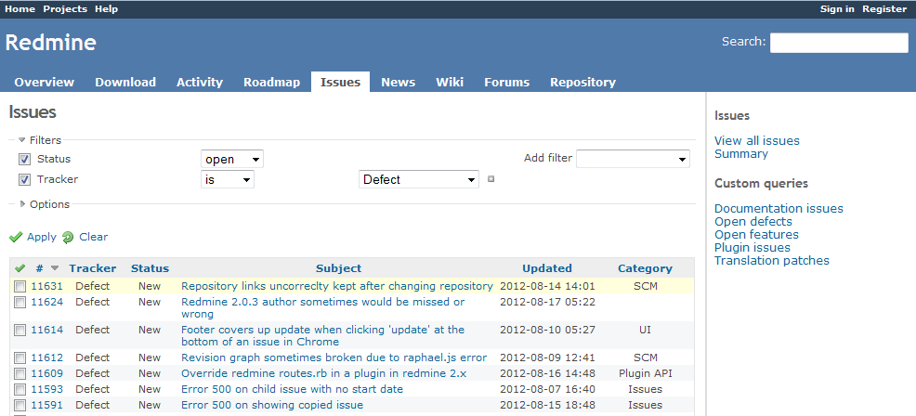
1.1: Defect Tracking Tool Redmine – User Interface

Slide 11

1.1: Defect Tracking Tool Introduction to JIRA
Atlassian JIRA, primarily an incident management tool is also commonly used for bug-tracking
It provides the complete set of recording, reporting, workflow and other convenience related features
It is a tool that integrates directly with the code development environments thus making it a perfect fit for developers as well
Also, due to its capability to track any and all kinds of issues, it is not necessarily concentrated to only software development industry and renders itself quite efficiently to help desks, leave management systems etc.
It supports agile projects also
It is a commercial licensed product with many add-ins that support extensibility

Slide 12
1.1: Defect Tracking Tool Features of JIRA
Agile at Scale - Scrum and Kanban improve project success and deliver value iteratively. JIRA and JIRA Agile scale Agile across your organization. JIRA also integrates with GitHub to link issues to commits.
Industry Leading Workflow Engine - Don't let your issue tracking software dictate your process. With JIRA's workflow engine you can easily build the process that fits your team.
Polished User Experience - Create, update, and work through issues using a fast and intuitive web interface with lightning-quick keyboard shortcuts.
Flexible Dashboards - Create a personalized view of JIRA. Share dashboards to track project status, create custom reports, and monitor team wallboards.
Powerful Searching and Reporting - Use JIRA's Query Language (JQL) with simple autocomplete to build advanced queries. Create a personalized view of JIRA and share dashboards to track project status, create custom reports, and monitor team progress with wallboards.

Slide 13
1.1: Defect Tracking Tool Features of JIRA
Deployment Options
Simple Windows and Linux installers are available for an OnPremise solution, or you can get started hassle-free with JIRA OnDemand. Easily switch between OnPremise or OnDemand as your organization evolves.
Integrate with Everything
Get more from JIRA with flexible REST and Java APIs – plus over 600 plugins and add-ons in the Atlassian Marketplace– to connect with the applications and tools you use every day.

Slide 14
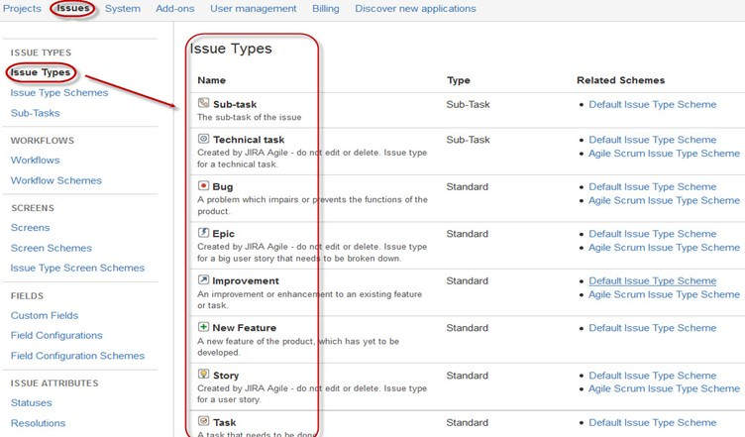
1.1: Defect Tracking Tool JIRA – User Interface

Slide 15

1.1: Defect Tracking Tool Introduction to Mantis
Mantis Bug Tracker is a open source web-based Bug Tracking System
It is written in PHP and works with multiple databases like MS SQL, MySQL, and PostgreSQL
Mantis has multiple items & dived into multi-level hierarchy as follows:
Projects -> Sub Projects -> Categories -> Bugs
Based on user access & permission rights user can contribute to each item
Mantis is powerful tool integrated with few applications like time tracking, chat, wiki, RSS feeds & many more
Another bug tracker with support for many different revision control systems and an event-driven notification system
Mantis is licensed as open source under the GPL version 2; you can browse its source code on GitHub or check out the self-hosted roadmap for future plans

Slide 16
1.1: Defect Tracking Tool Features of Mantis
Open source tool (GPL License)
Supports any platform that runs PHP (Windows, Linux, Mac, Solaris, AS400/i5, etc)
Customizable Issue Pages
Users can have a different access level per project
Support for Projects, Sub-Projects, and Categories.
Supports comprehensive Email notifications
Search and Filter – Simple/Advanced Filters, Full Text Search, Shared Filters (across users / projects)
Supported Reporting with reports and graphs
Multiple Projects per instance

Slide 17
1.1: Defect Tracking Tool Features of Mantis
Supports Custom Fields
Allow to Customize issue workflow
Allow to watch the Issue Change History
My View Page
Source Control Integration
Unlimited number of users, issues, or projects.
Setup the Anonymous Access
Supports Time Tracking management
Available in 68 localizations.
Changelog Support
Simple User Experience
Easy to evaluate
Allow to see Roadmaps
Easy to install (both internally and in hosted environments)

Slide 18
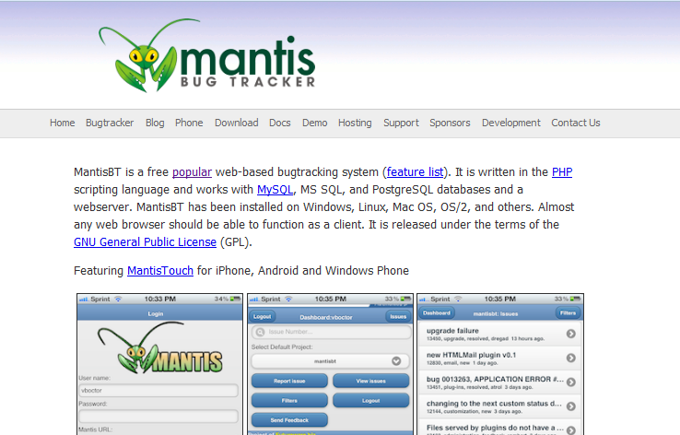
1.1: Defect Tracking Tool Mantis – User Interface

Slide 19

1.1: Defect Tracking Tool Introduction to HP ALM
HP ALM is an end-to-end test management solution with a robust integrated bug tracking mechanism within it
HP ALM’s bug tracking mechanism is easy, efficient and everything you can ask for
It supports Agile projects too
It is one of the pricey tools available in the market, which continues to be a prime source of criticism along with the fact that it is not very friendly with all the web browsers
Defect module in HP ALM not only helps users to post the defects but also enables them to track and gives the overall quality of the release at any stage of the development process

Slide 20
1.1: Defect Tracking Tool Features of HP ALM
HP ALM Defect module provides complete system for logging, tracking, managing, and analyzing application defects
HP ALM Defect tracking tools are organized into: Defects grid, Grid filter, Description, Attachments, History

Slide 21
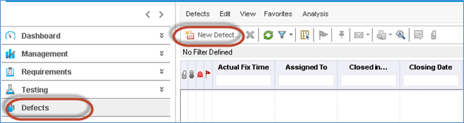
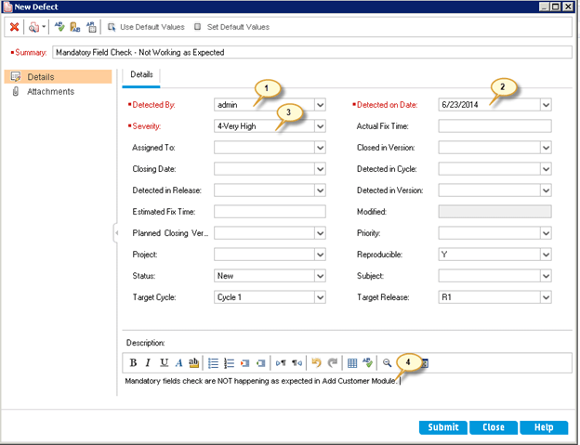
1.1: Defect Tracking Tool HP ALM – User Interface

Slide 22

1.1: Defect Tracking Tool Introduction to IBM Rational ClearQuest
IBM Rational ClearQuest is a fully customizable database workflow application development and production system
It provides flexible change and defect tracking, customizable processes, near real-time reporting and lifecycle traceability for better visibility and control of the software development lifecycle
IBM Rational ClearQuest provides scalable, multiplatform support to any size organization so you can continue to customize processes as your development needs evolve
It provides integration with various automation tools which can be considered an additional feature
Other than that, it has an end-to-end, customizable defect tracking systems
It is a commercial product and can seem a little costly, you can try it free for 30 days

Slide 23
1.1: Defect Tracking Tool Features of IBM Rational ClearQuest
Enhance software quality with built-in defect and change-tracking capabilities
Customize and automate workflows for greater efficiency and predictability
Simplify compliance management with tools that help you efficiently manage compliance processes and track approvals.
Gain visibility into projects with near real-time reports for better decision making
Exploit enhanced integrations with several other IBM lifecycle products

Slide 24
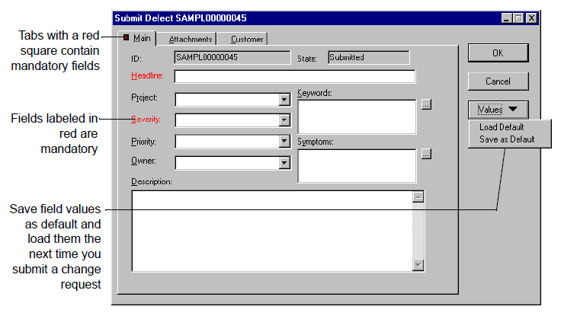
1.1: Defect Tracking Tool IBM Rational ClearQuest– User Interface

Slide 25
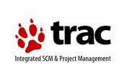
1.1: Defect Tracking Tool Introduction to Trac
The Trac is web based, open source software
Trac system is developed by Edgewall Software
Written in Python, Trac tightly integrates its bug tracking capabilities with its wiki system and a revision control system of your choice

Slide 26
1.1: Defect Tracking Tool Features of Trac
It supports multiple platforms like Linux, Unix, Mac OS X, Windows
Trac allows wiki markup in issue descriptions and commit messages, creating links and seamless references between bugs, tasks, changesets, files and wiki pages
It features project management capabilities like generating milestones and roadmaps, a customizable reporting system, timelines, support for multiple repositories, built-in spam filtering, and is available in many common languages
A timeline shows all current and past project events in order, making the acquisition of an overview of the project and defect tracking software progress very easy
The roadmap shows the road ahead, listing the upcoming milestones
It has a number of plugins available for it extending its base feature set even further
Trac is made available as open source under a modified BSD license, though older versions were released under the GPL

Slide 27
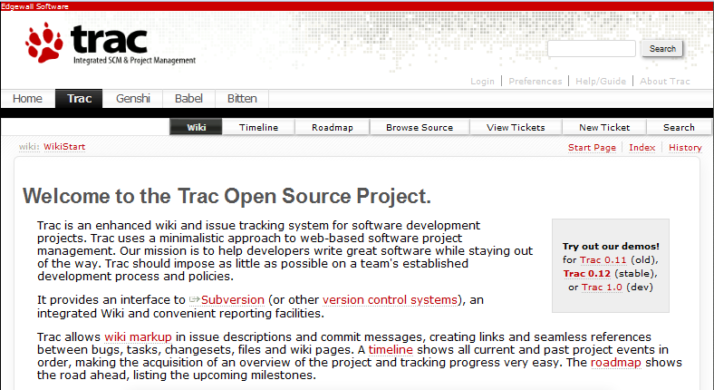
1.1: Defect Tracking Tool Trac– User Interface

Slide 28
Summary
In this lesson, you have learnt:
The introduction to Defect Tracking Tools
The importance of Defect Tracking tools
An overview of some popular and commonly used defect tracking tools
Notes:
Add the notes here.

Slide 29
Review Question
Question1: ___________ are computer database systems that store defects and help people to manage them
Question 2: Which of the following defect tracking tool is built on Ruby on Rails?
Redmine
Bugzilla
HP ALM
JIRA
Question 3: Adding attachments is easy if we are using any tool to log the defect
True/ False
Question 4: Which of the following is a commercial defect tracking tool?
Bugzilla
Trac
IBM Rational ClearQuest
None of the above

