Slide 1


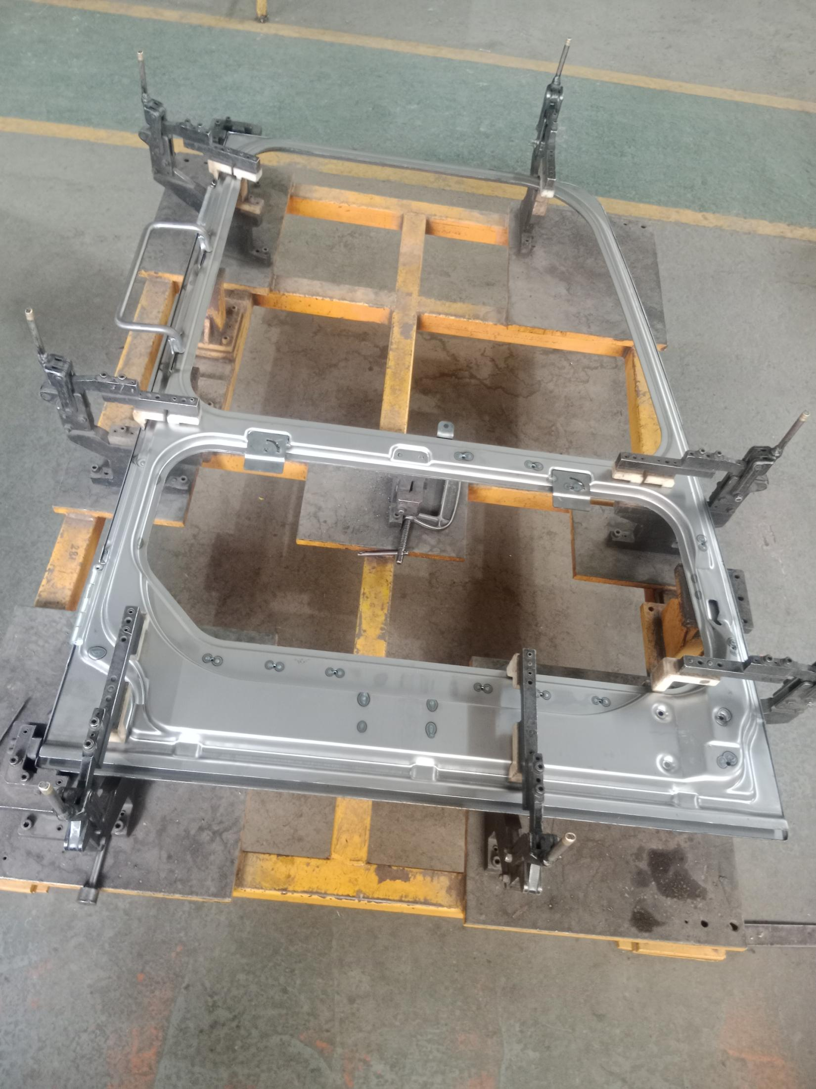
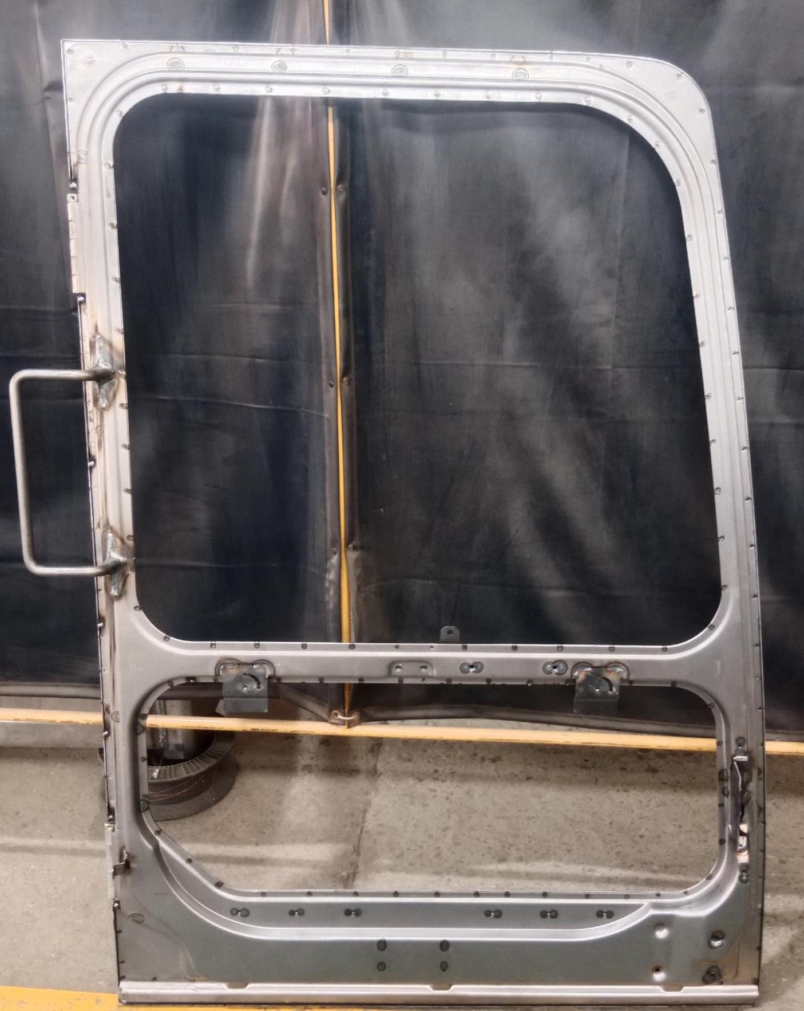
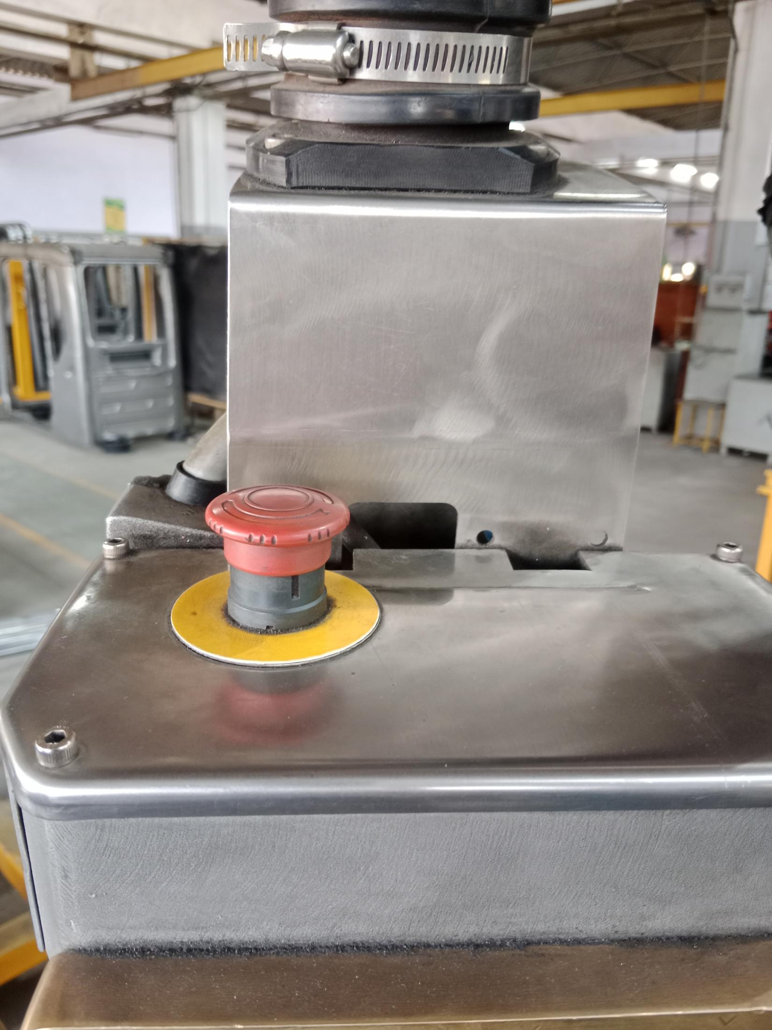
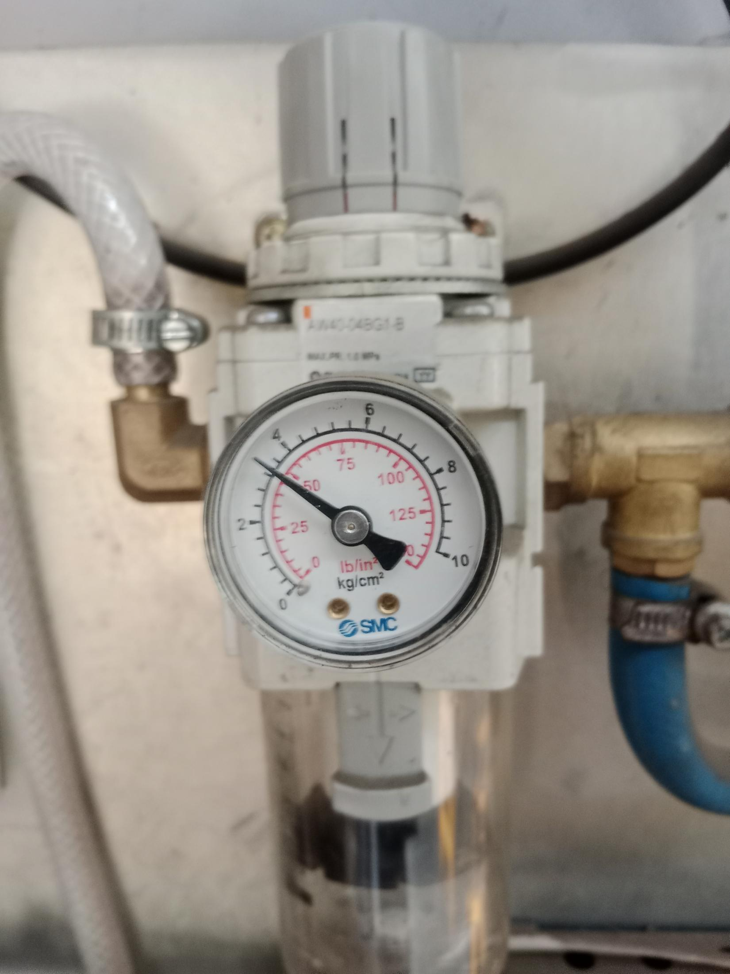
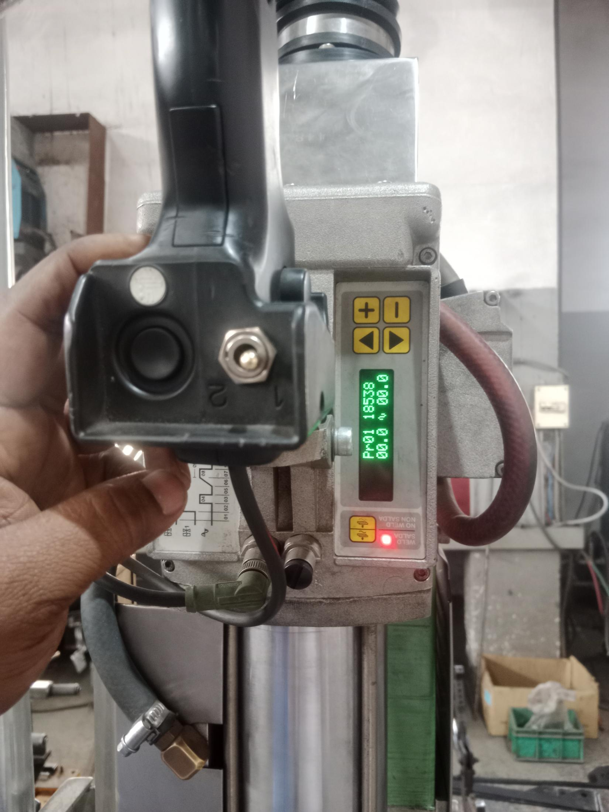
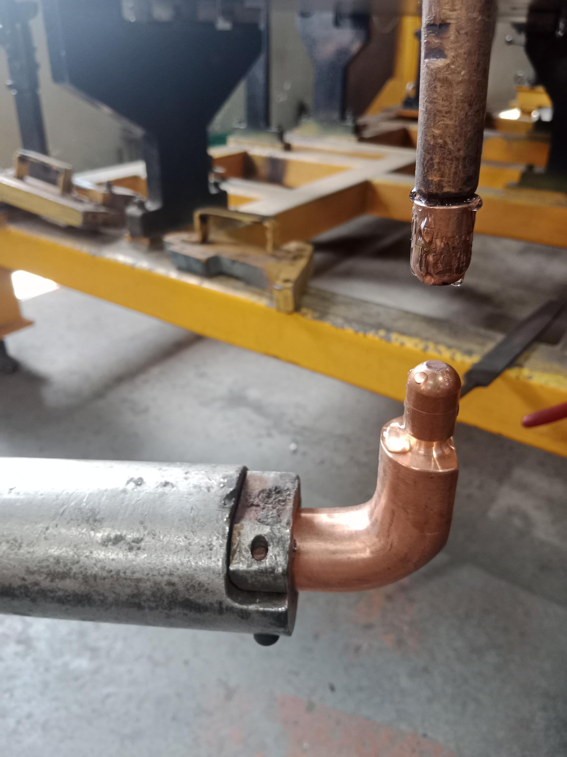
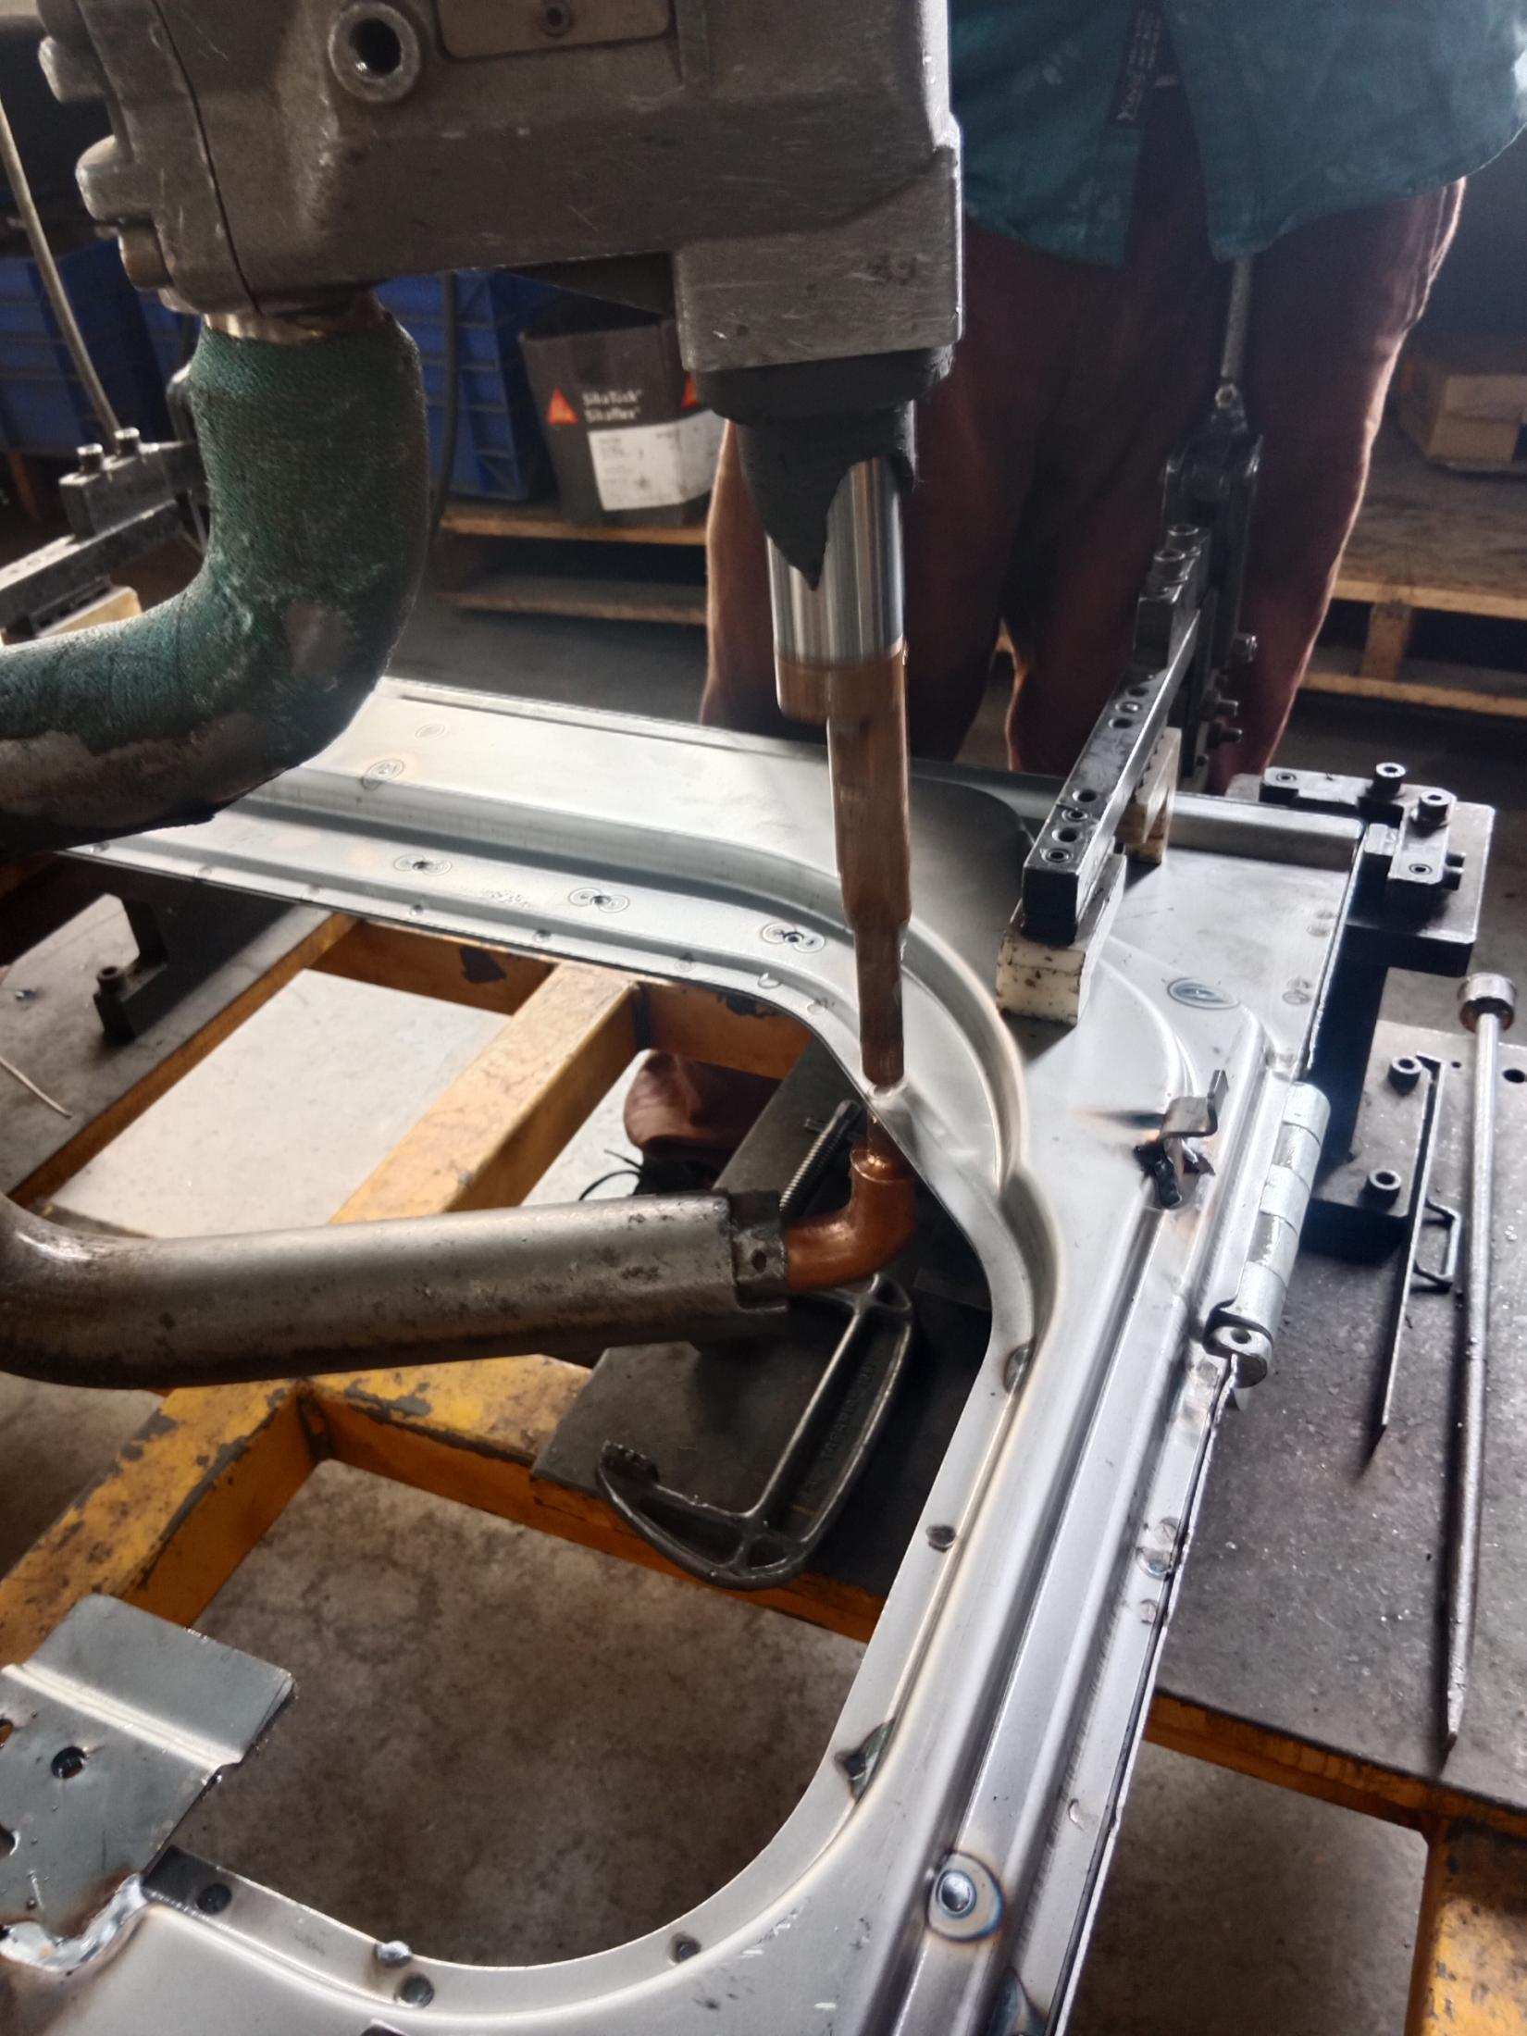
STANDARD OPERATING PROCEDURE
Product Name:VOLVO D5 CABIN Side Door |  | Part No: 14686566 Main part –14762190 |  |  |  |  | Customer Name: M/S VOLVO | SOP No: MAG/FAB/SD/08
Welding Station No: 8 |  | Station Name: WA Door Machine SL no.: 6346 |  |  |  |  | Process: Spot Welding – DOOR WA | Date: 05/04/2023
Process parameter | Spec | Unit |  | Process parameter | Spec | Unit | Quality Activities: Ensure Pitch and No of Spots Welding should be slightly inner from the Outer edge, No burn mark allowed. 5S Activities: Clean the fixture ,M/c before start the work Arrange all the parts before start the work After welding keep the parts in suitable place Safety Activities:1.Wear the proper safety shoes, goggles, Leather apron, hand gloves & Ear plug
Air Pressure | 3.4 - 4 | Kg/cm2 |  | Weld Time | 12.5 | Cycles
Working mode | IK |  |  | Current | 13.2 | KA
Control mode | NO |  |  | Impulse No. | 01 | Cycles
Squeeze1 | 00 | Cycles |  | Slope Down | 00 | Cycles
Squeeze | 34 | Cycles |  | Cold 3 | 00 | Cycles
Pre-weld | 5 | % |  | Post weld | 0 | Cycles
cold 1 | 0 | Cycles |  | Post Power | 5 | %
Slope up | 0 | Cycles |  | Hold time | 10 | Cycles
 |  |  |  | Off Time | 10 | Cycles
Prepared by : Mukesh |  |  |  |  |  |  | Approved by : R.Suresh
Fig-1
Fig-2
Procedure :
Turn on the key as Shown in Fig No.1 and check Air pressure 3.4 to 4 Kg/cm2 as shown in Fig No.2
Select the program no. PR01 and move program selection Knob at Number 01 as shown in Fig No.3
Ensure No water leakage.
Ensure the Top and bottom electrode free from sharp edge, Highpoints and welding ends filed and Flat.as shown in Fig No.4
Place the Door on the Fixture as shown in Fig No.5 and Do the spot welding by pressing the hand two Bottons at a time . No of spot and pitch should be as per shown in Fig No. 5, 6 and 7.
After completion remove the Door and Move to sandering process.
67 X (P70)
67 X (P70)
45 X (P70)
45 X (P70)
Fig-3
36 X (P70)
36 X (P70)
Fig-5
Fig-6
P70=No of Places X Pitch 70mm
Door Outer Peripheri spots =67 x P70
Door Top cut Inside spots=45 X P70
Door Bottom Cut Inside spots =36 x P70
Dressing Frequency: Once After Two Door Carbon test:Every set up
Filing Frequency : Once in one Door Chisel Test: Every set up
Note: For Door Outer Peripheri Spot welding use Flat tip electrode Bottom and Round Tip at Top side and Door inside weld use round tip electrode both side.
Fig-4
Fig-7

