Slide 1
Creating conditions for a coherent and connected Open Science infrastructure landscape
Start conference SPII programme; July 1, 2026

Slide 2
Programme
12.00 – 13.00 Walk-in & lunch
13.00 – 13.50 Plenary session
Pause
14.00 – 15.00 Break-out groups
Pause
15.30 – 16.30 Plenary session
16.30 – 17.30 Drinks
Opening plenary session:
Introduction (Darco Jansen)
OSNL infrastructure calls (Marta Teperek)
Reference model (Maurits v.d. Graaf)
Work method break-outs (Nida van Leersum)
Mentimeter questions and discussion
Closing plenary session:
Presentation and discussion results breakouts
Actions and next steps
Mentimeter questions and discussion

Slide 3
Introduction to SPII
By Darco Jansen (UNL)

Slide 4
National Open Science Ambitions
2022 End National Program Open Science (NPOS)
  All parties agree with 2030 ambitions: Open Science 2030 in the Netherlands - NPOS2030 Ambition Document and Rolling Agenda
Make Open Science possible through Open Infrastructures
2023 Regieorgaan Open Science (OSNL) - NWO
  Incentive financing, also for open infrastructures (work programme)
2023 Landelijk Bestuurlijk Overleg (BO) open science
  16 convenant parties: OCW, NWO, UNL, NFU, VH, SURF, KNAW, NWO-I, DANS, eScience Center, 4TUResearchData, Health-RI en SHB
  BO aims to facilitate the strategic dialogue at the national level

Slide 5
Many investments in OS-infra
Investments primarily from scientific disciplines
  both locally and in (inter)national partnerships
  e.g., via sectorplannen, via umbrella organizations
European Investments like EOSC, ERICs, dataspaces
  Memberships in Large European Infrastructures (portfolio)
Subsidies mostly as kick-offs / short- or long-term impulses
  Regieorgaan OSNL
  Groeifonds, e.g. Health-RI
  GWI

Slide 6
Towards a reference model for a coherent and connected Open Science infrastructure landscape
The responsibility to structurally embed Open Science practices within their organizations and among their employees lies with the knowledge institutions (and their umbrella organizations/associations).
Necessity of an integrated vision: how do we ensure that these investments are well aligned and can be sustainably continued?
SPII: Strategic Plan for Integrated Infrastructure for Open Science.

Slide 7
Stepping stones towards SPII
Summer 2024 - project idea: apply for grant or joint effort?
November 2024 – BO: agreement to develop joint project
February 2025 – BO: agreement on initial project plan
March 2025: developed project plan
Mid-July 2025: delivery of Part 1
August-September 2025: public consultation / national meeting 11-9-2025
Oktober 2025 – BO: discussion on feedback en priorities next phase
26 November 2026: dicussion with main stakeholders on next phase
2 February 2026 – BO: agreement to start with next phase
April 2026 – SPII 2026 started

Slide 8
Conditions for SPII 2026
Inclusive – community approach
Also in English
Keep it practical
Collaborative for existing infrastructure and new projects
Not too abstract – understandable – inviting
For now, the same steering group but a larger project group
Explicitly connected to the broad scientific field

Slide 9
SPII programme organisation
Steering group members:
Darco Jansen; UNL, chair
John Doove; SURF
Sarah Coombs; VH
Frans Oort; UvA
Core group members
Till Bey; SURF
Maurice Vanderfeesten; SURF
Jason Maassen; eScience Centre
Marcel Ras; VU
Patris van Boxel; DANS
Bolinda Hoeksema; SHB
Joost Elshof; VH
Louise Bezuidenhout; UL/CWTS
Josefien Schuurman; UvA/HvA
Sander Bosch; VU
Nida van Leersum; programme co-lead
Maurits van der Graaf; programme co-lead

Slide 10
Recap SPII results 2025
Maurits van der Graaf

Slide 11
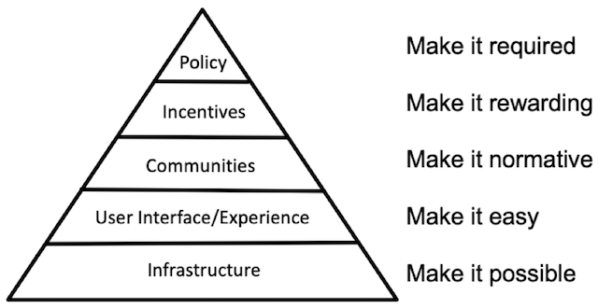
Why an Open Science infrastructure and what is it?
Why? Make Open Science possible and easy
What is it? The Open Science perspective on digital research infrastructure
Many of the existing infrastructures facilitate already Open Science
An integrated Open Science Infrastructure provides connection & cohesion and fills in gaps

Slide 12
Additional use-cases such as CS or OER → possible elaborations for the reference model
Reference model
Research administration & funding
Research tools
Research data management
Research software management
Publication & communication
Organisational aspects:
Governance
Organisation
Finances
In SPII 2025, we identified 7 types of infrastructures
Research information
Connection & collaboration infrastructural development projects (OSNL, TDCC, …)
Discovery
Tech developments check: what are the effects of AI and decentralisation developments?

Slide 13
Approach SPII 2026:
Developing a reference model

Slide 14
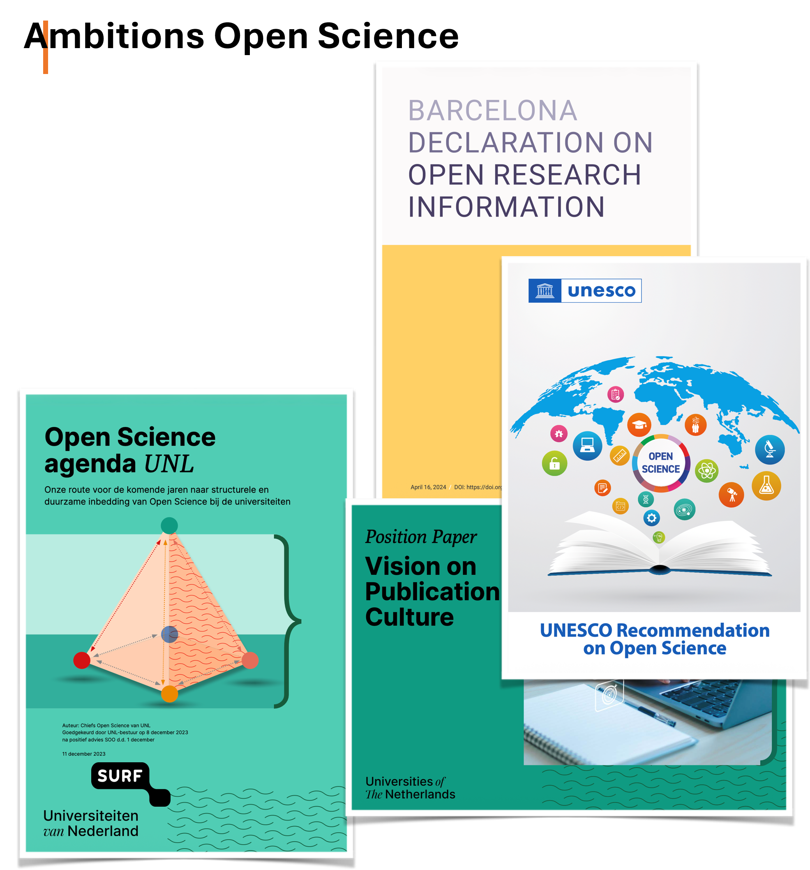
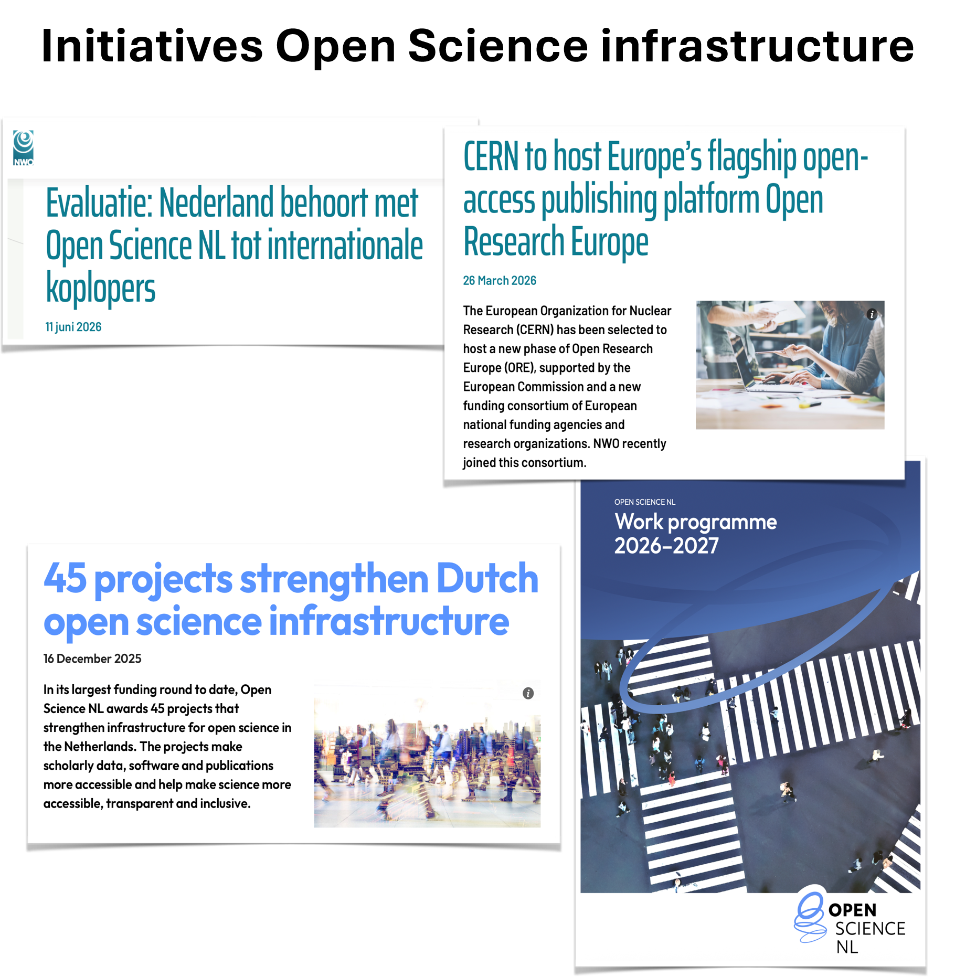

Slide 15

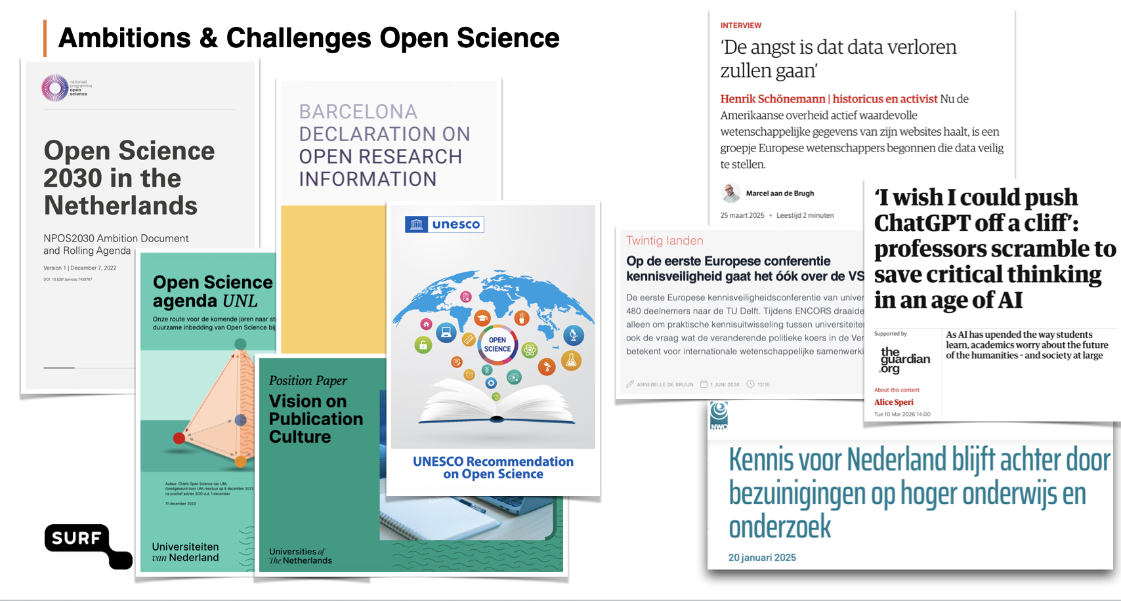
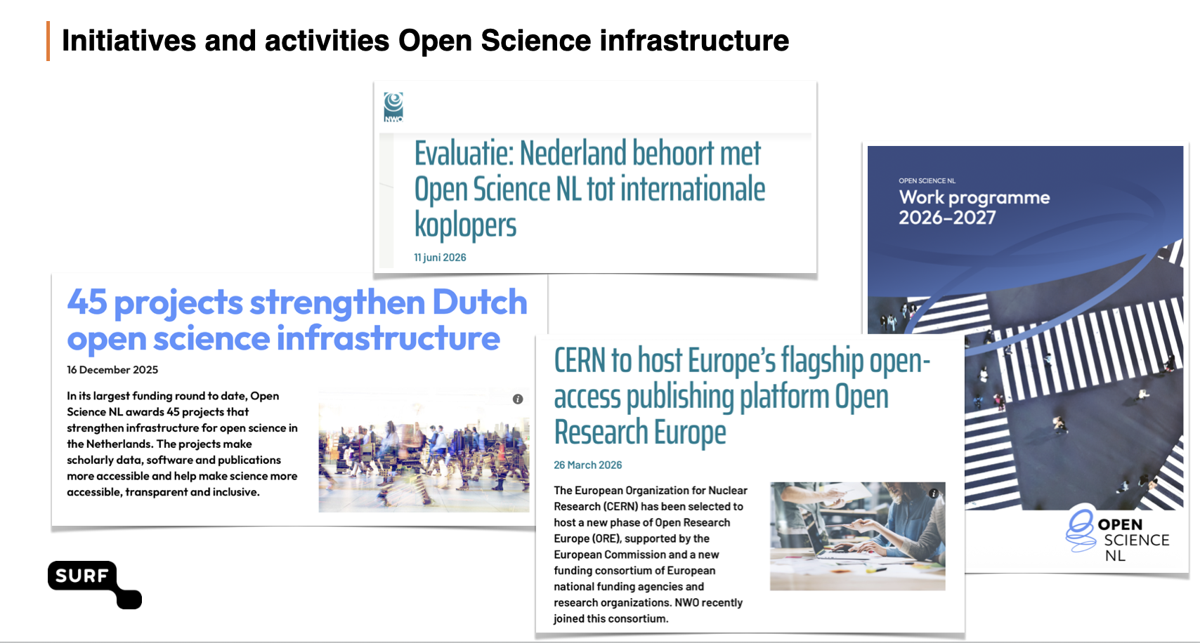

Reference model for Open Science infrastructure
Why change?
Preconditions
Reference model for Open Science infrastructure
Current and target situation
Guiding principles
Landscape model
Shared terminology
Interoperability framework
Collective actions
What we are doing

Slide 16
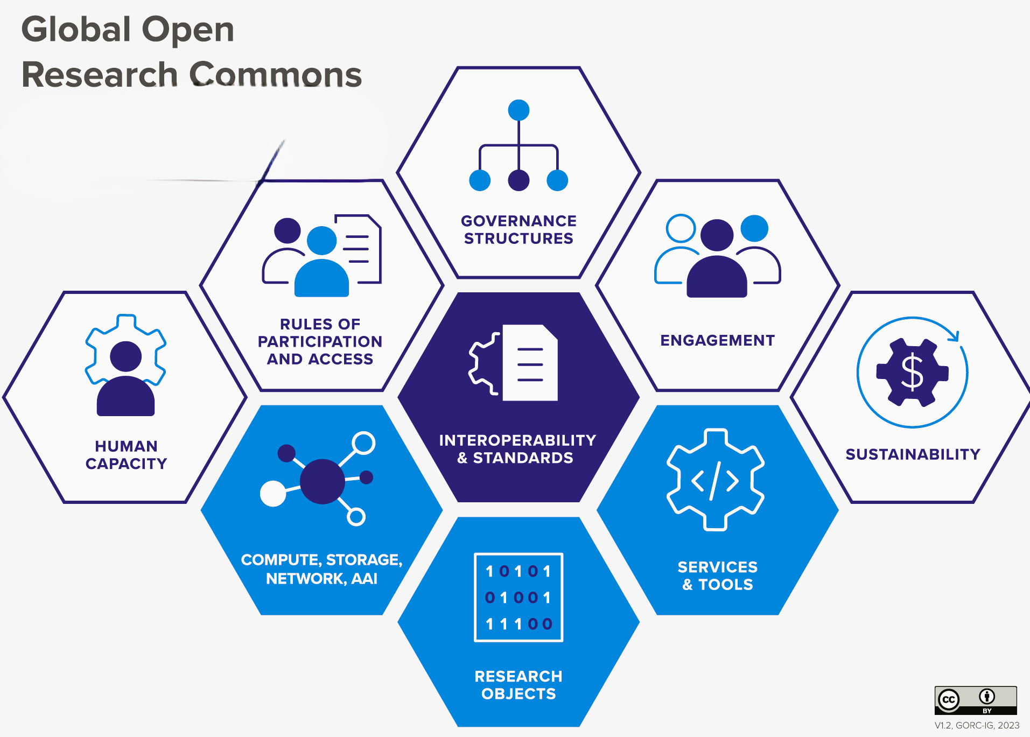
Focus and choices proposed for 2026
Development of models for governance, organisation and finances in November
Development of the reference model for technical aspects (July – December)

Slide 17
Development of the reference model for the technical aspects
Development together with stakeholders
Interactive with broad consultation
Alignment with existing infrastructures and infrastructures in development (OSNL-projects, TDCC-projects, EOSC-NL node, …)
Additional use-cases such as Citizen Science, Open Educational Resources and others to further inform and shape the reference model

Slide 18
Why a reference model?
Basis for working together
Support development
Tool for impact analysis
A common language
Identify areas of collaboration
Reuse solution patterns
Who works on what?
Mapping of existing state
Identify gaps and opportunities
Steering towards goal state
Exposure to risks
Consequences of decision
Uncover dependencies

Slide 19
Our proposal for the content of the reference model
Components
Values & principles
Landscape overview
Shared terminology
Interoperability framework
Why?
Exposure to risks
Consequences of decision
Uncover dependencies
Who works on what?
Identify gaps and opportunities
A common language
Reuse solution patterns
Identify areas of collaboration
Steering towards goal state
Make it actionable
Self assessment tool (versions of the tool to be developed and tested along the way)
Notes:
The reference model should give guidance to developments of existing and new infrastructures on how to fit in the bigger picture. We propose to develop a self assessment tool to make the reference model actionable for all stakeholders.

Slide 20
Proposed approach to develop the reference model
Reference model Open Science Infrastructure
Values & principles
Landscape overview
Shared terminology
Interoperability framework
Additional
use-cases
July
Focus this conference
Aug
Online consultation
Sept
Dedicated workshop
Dedicated workshop
Workshop CS
Workshop OER
Self assessment tool test
Oct
Review & discuss reference model as a whole - workshop at Open Science Festival (14 Oct; submitted)
Nov
Additional workshops t.b.d.
Dec
Interim report
Jan
Feb 10
Next steps conference February 10

Slide 21
Values & principles – questions for the break out groups

Slide 22
Values & principles for an integrated Open Science Infrastructure what we prepared
Values UNESCO as starting point
Quality and integrity
Collective benefit
Equity, fairness, diversity & inclusion
Guiding principles for OSI
Openness
Autonomy
Sustainability
Interoperability
Subprinciples
Transparent processes
…
Enduring access and availability
Seamless user-experience
Enablers/ practices/ [consequences/ actions]
Develop all software as open source
…
…
Reuse open standards
Notes:
Values can be seen as shared commitments. Principles and subprinciples as actionable guidelines. We already discussed these and filled in the results of our discussions. We hope that you can add or change the principles and subprinciples and then discuss how to make these principles operational. Please note that on the poster these are called consequences/ actions, but later we thought that the terms enablers and practices are better.

Slide 23
Break-out groups
Questions:
Add or change the principles and subprinciples
What are the potential enablers/practices supporting the (sub-) principles?
Any other comment
Practicalities:
7 per group
Handout and worksheet available
This room and room 2.01 (max 3 groups) or spaces in the corridors
Restart here at 15.30h for plenary discussions

