Slide 1










ROUND 2 · PROBLEM STATEMENT 1
AI surface defect detection
Catch every strip defect where it is born, not where it is shipped
AI surface inspection that finds, grades and routes every stainless strip defect to the process that caused it.
90%
4.7%
~₹6.7 cr
7 months
of defects caught on real mill
strip it had never seen
of clean strip wrongly flagged,
fewer than 1 in 20
a year at stake per line, at a
1% downgrade rate
to shadow mode on one line,
go / no-go at month 7
REAL OUTPUT FROM OUR SYSTEM, ON STEEL IMAGES IT HAD NEVER SEEN
TRY THE LIVE DEMO
surface-vision.github.io
Runs in your browser. Nothing leaves the page.
TEAM Futuristic | Krishna Kanta Mondal · Prathmesh Walimbe | IIT Bombay
Photo: Methem, Wikimedia Commons (public domain)
Notes:
Cover. The six images are real output from our system on steel images it had never seen. The QR opens the live demo in the judge's browser. Four numbers tell the story: on real mill strip it catches 9 in 10 defects and wrongly flags fewer than 1 in 20 clean images; each line has about INR 6.7 crore a year at stake from downgrades even at a conservative 1%; and one line reaches shadow mode in seven months, with a go/no-go before anything touches the mill.

Slide 2






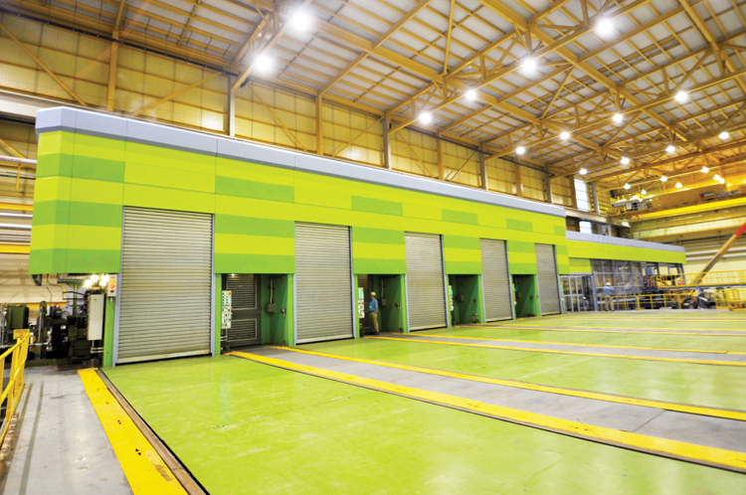
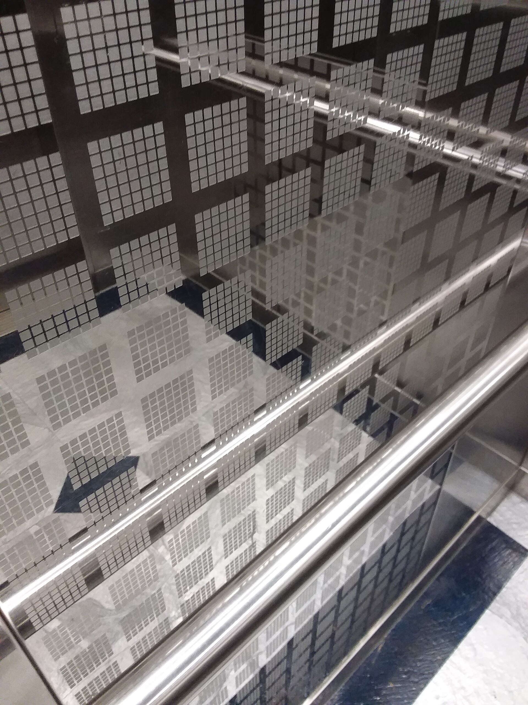



1 Problem
2 Insights
3 Solution
4 Implementation
5 Impact
Team Futuristic
IIT Bombay
A defect born at the caster is paid for at every later stage, but today it is found only at the end
Where stainless surface defects are born, and where they are seen today
VALUE ADDED KEEPS RISING →
Melt & cast
Hot rolling
Anneal & pickle
Cold rolling
Final anneal / BA
Finish & despatch
SMS
HSM
HRAP
CRM
CRAP / BA
Slit, cut
Inclusions, slivers
Scale, pits, edge cracks
Pickling patches
Scratches, roll marks
Stains, BA marks
Found here, or by the customer
NOT SEEN
NOT SEEN
SPOT CHECK
SPOT CHECK
SAMPLED
CLAIMS
PROBLEM · WHY NOW
Why it hurts more on stainless
Why now
Cost of quality: where AI moves the money
India demand, Mt +84% in 5 yrs
1.73 Mt imports
spend moves from failure to prevention
FY25; anti-dumping probe on cold-rolled 300/400, Sep 2025
Prevention
Internal failure
IS 6911 mandatory
defect sent to its owner in minutes
caught before more value is added
300 m/min
₹126k-165k
No repair
BIS certification for sheet and strip, since Aug 2024
Appraisal
External failure
too fast for the eye to see
of nickel in a tonne of 304
2B/BA damage can't be polished out
2.67 MTPA
100% of the surface, every coil
fewer escapes to customers
JSL cold rolling by FY28, up from 2.05
Poor quality costs ~15% of sales in manufacturing (IISE).
Sources: AMETEK/Ternium; ASSDA; IISE; ASTM A240; LME nickel USD 16,402/t at INR 95.8 (22 Sep 2026); ISSDA; DGTR (Sep 2025); BIS QCO 2024. Photos: Wikimedia Commons (notes).
The problem is not that defects exist. They are found late, by sampling, and nobody is told which process caused them.
Notes:
Problem. Walk the ribbon left to right: a sliver born at the caster is only seen at finishing, after hot rolling, annealing, pickling and cold rolling have been paid for. Why stainless hurts more: every tonne of 304 carries INR 126,000-165,000 of nickel, and a 2B or BA mill finish cannot be polished back. Why now: Indian stainless demand grew 84% in five years to 4.8 Mt and is heading to 6.8 Mt by FY30, led by rail and metro coaches; imports hit 1.73 Mt in FY25 and DGTR opened an anti-dumping probe on cold-rolled 300/400 series in September 2025, so quality is the domestic producer's moat; BIS certification to IS 6911 has been mandatory for sheet and strip since August 2024; and JSL is adding cold-rolling capacity. The cost-of-quality frame is the output: inspection moves spend from failure to prevention. Photo credits: cold-rolling mill, ThyssenKrupp Steel USA (Free Art License); coil, Methem (public domain); stainless lift interior, Shwun Vounwun3 (CC BY-SA 4.0); all via Wikimedia Commons.

Slide 3
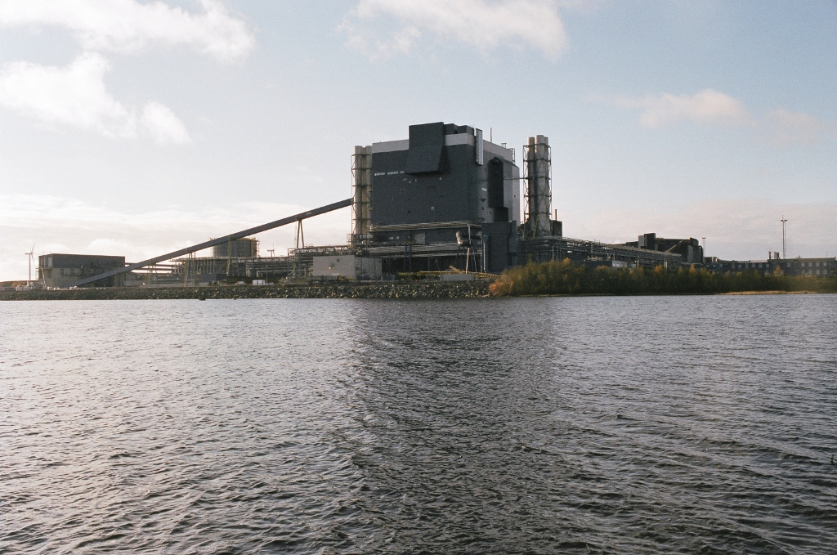
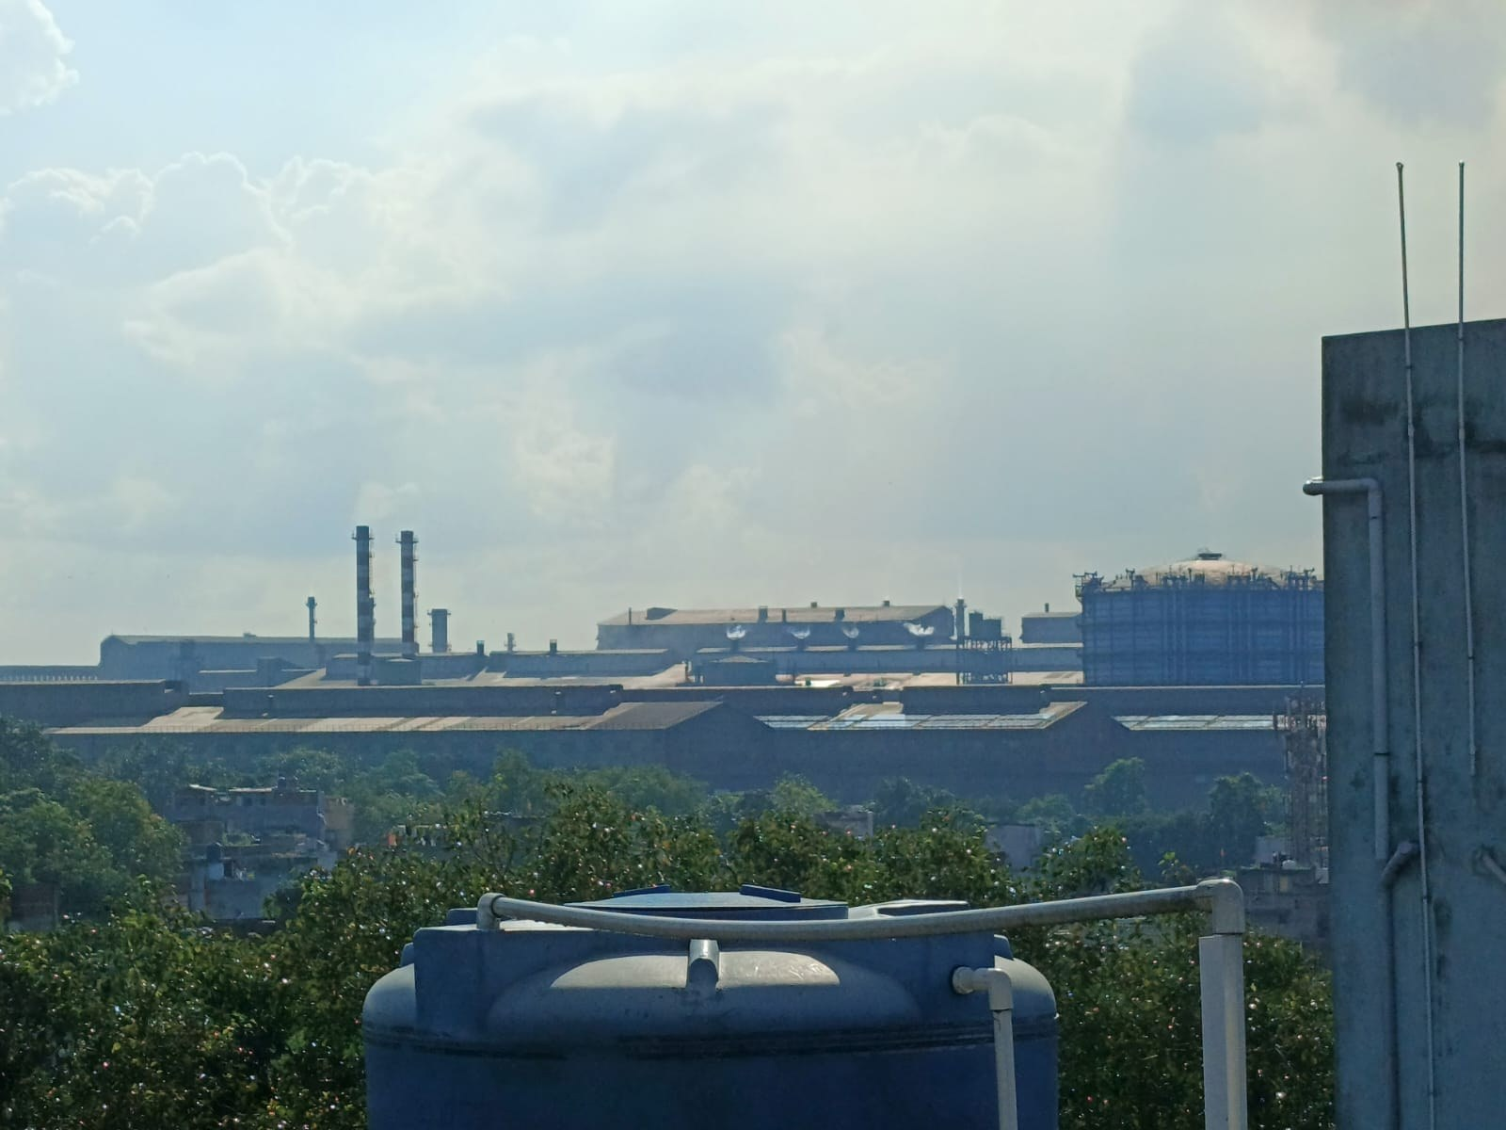

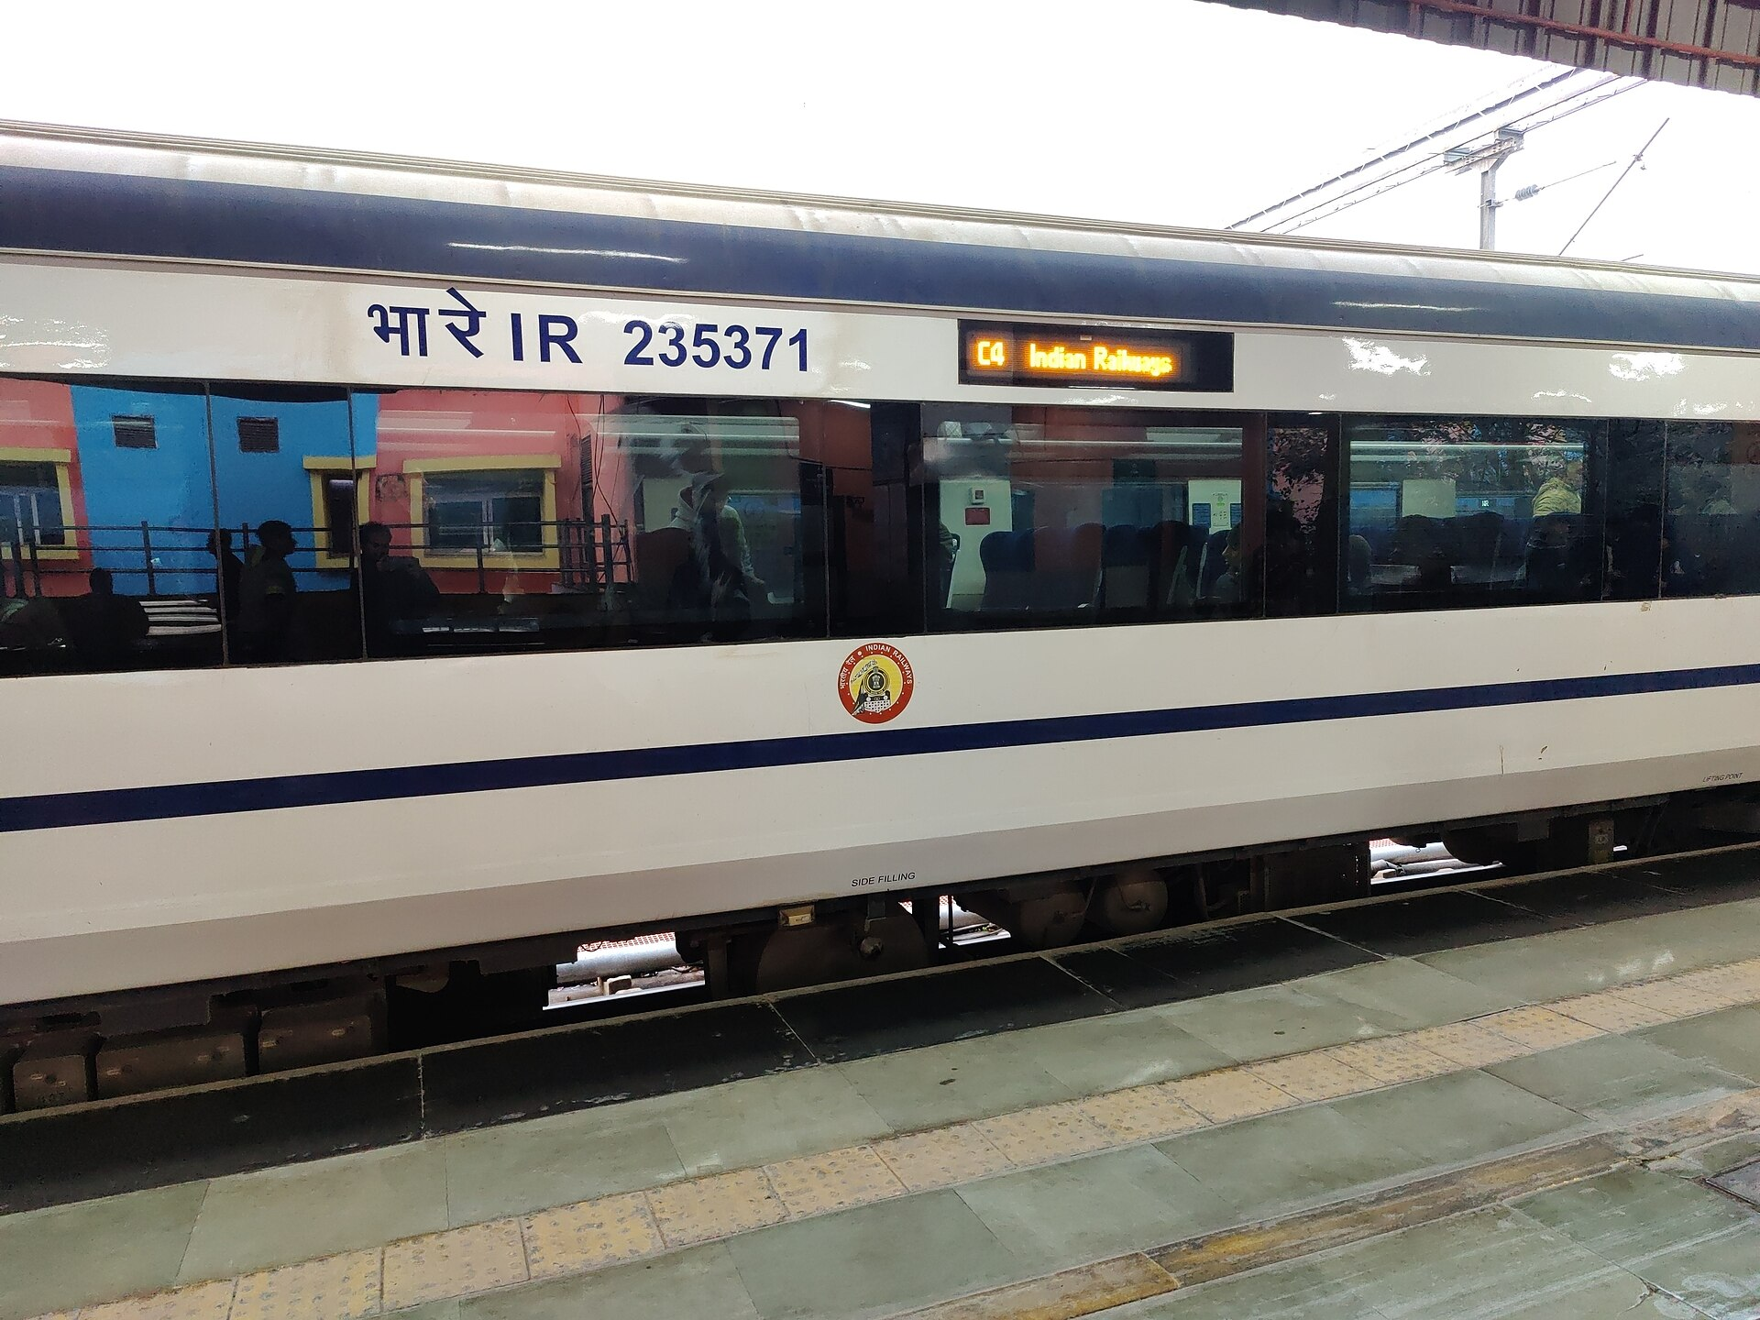
1 Problem
2 Insights
3 Solution
4 Implementation
5 Impact
Team Futuristic
IIT Bombay
On stainless the surface is the product, so every defect type must reach the process that caused it
Six defect families, each traced to the process that caused it (real output from our system)
Born: Caster
Born: Reheat, hot rolling
Born: Hot rolling
Born: Reheat, pickling
Born: Anneal & pickle
Born: Cold rolling, handling
Owner: SMS
Owner: HSM
Owner: HSM
Owner: HSM / pickling
Owner: Pickling line
Owner: CRM / logistics
Fix: Tundish level, mould flux
Fix: Reheat and coiling temperature
Fix: Descaler pressure, nozzles
Fix: Furnace atmosphere, over-pickling
Fix: Acid strength, line speed
Fix: Guides, rolls, coil handling
INSIGHTS · OWNERS · PRECEDENT
Stainless-only types to add with JSL data:
Roping
Ridging (ferritic 430)
Orange peel
Anneal colour
BA stains
Lamination
Precedent: who already does this, and what we copy
Grade-by-defect risk: which defects to train for first
Grade | Slivers | Scale | Scratches | Edge cracks | Ridging
200 series (Cr-Mn) | M | M | H | M | L
300 series (304, 316) | H | M | H | L | L
400 series (409, 430) | H | M | M | M | H
Duplex (2205) | M | H | M | H | L
Outokumpu AI inspection live since 2024
Tata Steel video analytics, cold-rolled strip
Parsytec bright + dark-field light on stainless
Pilot grade: 300 series
exposed surfaces, most nickel
Copy: offline, multi-site
Copy: in-house team owns it
Copy: optics spec
Images: our system on held-out frames. Sources: Nortal/Outokumpu 2024; Tata Steel; Parsytec; Leão 2021; Steel in Translation. Photos: Commons (notes). Owners: team hypothesis. Grade risks: team hypothesis.
Classify, don't just alarm: a typed defect becomes a work order for a named owner. The pilot belongs on 300-series cold-rolled strip.
Notes:
Insights, stainless-specific. The six images are real output from our system on images it had never seen; each family is born at a different stage, so a typed detection goes straight to the right owner as a work order. The owner mapping needs a JSL metallurgist's sign-off in P0. Precedent: Outokumpu, Europe's largest stainless producer, switched on an AI surface inspection system at Tornio in October 2024, built to run without internet and scale across sites; Tata Steel Kalinganagar, India's first WEF Lighthouse, uses video analytics for surface defects on cold-rolled products; Parsytec systems on stainless lines use 170 micron cameras with bright and dark field light and make a decision per coil. We copy the offline edge design, an in-house team that owns the system, and the optics spec. The grade matrix output is the pilot grade: 300 series. Photo credits: Outokumpu Tornio mill, Methem (CC BY 3.0); Tata Steel plant, Kharbaan Ghaltaan (CC BY-SA 4.0); Vande Bharat coaches, Ravi Dwivedi (CC BY-SA 4.0); all via Wikimedia Commons. The Vande Bharat photo illustrates a 300-series exposed-surface use; JSL supplies stainless for these coaches.

Slide 4


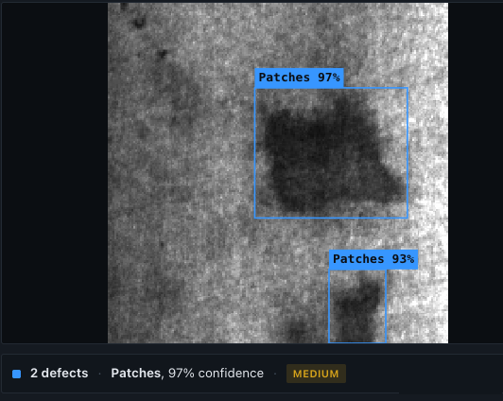




1 Problem
2 Insights
3 Solution
4 Implementation
5 Impact
Team Futuristic
IIT Bombay
Four design choices that make the system work on a real line
1 Alarms you can act on
2 One verdict per coil, not a stream of alarms
ACCEPT
DOWNGRADE
90%
4.7%
one coil, both faces: every defect with its type, size and position
HOLD
Limits per grade and finish: a light scratch passes on 2B tubes, downgrades a BA panel.
258 of 288 caught
defect: flagged
14 of 300 flagged
clean: no alarm
So we: prove it on JSL's own clean and defective strip before any alarm is trusted.
So we: agree accept, downgrade and hold limits per grade and finish with JSL Quality in P0.
INSIGHTS · DESIGN CHOICES
3 Image detail sets what is seen, and the hardware bill
4 Operators act only on alarms they can trust
0.2 mm per pixel
0.5 mm per pixel
1.28 mm per pixel
Evidence on every alarm
4 weeks of shadow mode
~18 processors
~3 processors
1 processor
sees defects from ~0.5 mm
sees defects from ~1.3 mm
fine scratches vanish (~3 mm)
Every override reviewed
1.28 m strip at 250 m/min. Processors scale with pixels; a defect needs 2-3 pixels.
So we: fix the image resolution with JSL first, then size the hardware.
So we: earn trust on the shift floor before the system is allowed to act.
Results measured by us on public steel data the system had never seen. Hardware sizing derived from our line-speed benchmark.
Success is decided on the line, not in the lab: JSL's own strip, the right image detail, coil-level rules and operator trust.
Notes:
Four design choices. One: alarms you can act on. On real mill strip it catches 258 of 288 defects and wrongly flags only 14 of 300 clean images; the pilot repeats this on JSL's own strip before any alarm is trusted. Two: one verdict per coil. Every defect rolls up into accept, downgrade or hold, with limits agreed per grade and finish with JSL Quality. Three: image detail decides what can be seen and what the hardware costs; full detail at 250 m/min needs about 18 processing units, so resolution is a day-one decision with JSL. Four: trust is earned on the shift floor, with evidence on every alarm, four weeks of shadow mode and a weekly review of every override. Images: a real mill-strip defect our system flagged, and a clean mill-strip image that raised no alarm, both from the held-out test set; the screenshot is the live demo's alarm view. Lift photo: Shwun Vounwun3 (CC BY-SA 4.0).

Slide 5





1 Problem
2 Insights
3 Solution
4 Implementation
5 Impact
Team Futuristic
IIT Bombay
Detect on the strip, decide at the coil, route to the owner, and learn from every correction
How it works: six stages from camera to corrective action
Capture
Check
Detect
Score
Decide
Act & learn
Both faces, bright + dark-field light, 0.2 mm detail
Is it usable steel? If not, skip it
Find and classify every defect
Confidence, severity 0-100, coil position
Accept, downgrade or hold, per grade
Alert, hold, work order; operator feedback improves it
TO BUILD
BUILT
BUILT
BUILT
PARTIAL
TO BUILD
At the line: cameras, lights
Edge server beside the line, runs offline
Plant network (IEC 62443)
People: screen, work orders
Running today
What JSL gets that a standard system does not
Build vs buy
SOLUTION · HOW IT WORKS
Upload a strip image, get:
• box on the defect
• defect type
• confidence
• severity score
Cost per line
Proven at speed
Tuned to JSL grades
JSL owns the system
Commercial
Alarms you can act on
Root-cause routing
proven; the vendor owns it
4.7% false alarms
a work order per alarm
Fully in-house
JSL owns it; slow to prove
16 samples built in, including clean mill strip. Or drop your own photo.
Hybrid (recommended)
vendor cameras, JSL software
One verdict per coil
JSL owns the system
strong
partial
weak
surface-vision.github.io runs in the browser
accept · downgrade · hold
no vendor lock-in
Output: hybrid is never weak.
BUILT = working in our prototype today, live at surface-vision.github.io.
Buy proven cameras, own the software: vendor-grade capture, tuned to JSL's grades and wired to JSL's process owners.
Notes:
Solution. Stages 2 to 4 are built and running today in the browser demo. Stage 5 has coil rules built, but grade- and finish-specific limits need JSL input. Stages 1 and 6 are the plant-side pilot work. The strip underneath shows where each stage runs: cameras at the line, an edge server beside it that works offline, the plant network behind IEC 62443 zones, and people on screens and work orders. What JSL gets that a standard system does not: alarms it can act on, routing to the owning process, one verdict per coil, and ownership of its own system. Build vs buy: commercial systems are proven but closed and vendor-owned; fully in-house is slowest to prove; hybrid is never weak.

Slide 6

1 Problem
2 Insights
3 Solution
4 Implementation
5 Impact
Team Futuristic
IIT Bombay
It already works on public steel data; the pilot's job is to prove it on JSL's own strip
Tested on three public steel datasets
How well it finds each defect type (accuracy, held-out images)
Patches
0.94
Inclusion
0.80
Scratches
0.79
Pitted surface
0.76
NEU-DET
Severstal
GC10-DET
1,800 images, 6 types
12,568 real mill frames
2,294 frames, 10 types
Rolled-in scale
0.60
University benchmark, hot-rolled strip
Production strip from a steel mill
Full-width line-scan camera frames (roll marks shown)
Crazing
0.58
SOLUTION · PROOF
published range
Headline results
Known weak spots, and the fix for each
Weak spot | Today (0-1) | Fix in the pilot
Low-contrast texture: crazing, rolled-in scale | 0.58-0.60 | Angled lighting; JSL labels in P1
Real mill frames are harder than the lab benchmark | 0.57 vs 0.75 | Prove it on JSL's own strip in P1
Roll marks and edge cracks: few examples | 0.20 | Edge cameras; targeted labelling with JSL
178 of 180
Live
~10,100
test images: the right defect type named
anyone can test it now at surface-vision.github.io
Lab 1,800
Mill strip 6,001
Line-scan 2,294
Datasets: NEU-DET (Northeastern Univ.); Severstal steel defects (Kaggle); GC10-DET (Lv et al. 2020, CC BY 4.0). All scores on held-out images the system had never seen.
Strong on four of six defect families today. Every weak spot is known, and each has a fix in the pilot plan.
Notes:
Proof. Three public datasets, about 10,100 images, all scored on images the system had never seen. Per defect, four of six families sit at or above the published range; crazing and rolled-in scale are low-contrast textures and are weaker. The honest headline is the second weak spot: on real mill frames the score is 0.57 against 0.75 on the lab benchmark, which is exactly why the pilot starts on JSL's own strip before anything is trusted. Roll marks score 0.20 because public data has only a few dozen examples; edge cameras and targeted labelling with JSL fix that.

Slide 7







1 Problem
2 Insights
3 Solution
4 Implementation
5 Impact
Team Futuristic
IIT Bombay
Seven months to shadow mode on one line, and nothing touches the mill until trust is earned
Stage-gate roadmap (months)
Pilot scope: in and out
m0
m4
m8
m12
m16
m20
◆ EXIT GATE
P0
Instrument one line
Optics fixed; Pragati L2 data linked
One 300-series cold-rolled line
P1
Learn JSL strip
Clean alarms ≤ 25%, recall ≥ 90%
IN THE PILOT
LATER
P2
Shadow mode: advises only
≥ 90% operator agreement
Both faces, 2B + BA
Hot end, caster side
P3
Auto-hold on severe defects
Holds trusted; downgrade measured
6 defect families
Edge cracks
Read-only until P3
Other plants
P4
Second line and grade
Fleet decision on measured value
Owner: JSL Quality Integration: Pragati team
IMPLEMENTATION · ROADMAP · RISK
pilot go / no-go
Top risks: where they sit, and when each is retired
Pilot KPIs: how JSL will know it works
3
1
1
Misses on JSL's strip at first
retire P1
≥ 90%
≤ 25%
100%
High
2
Mirror-like BA/2B hides defects
retire P0-P1
defects flagged
clean strip flagged
coils mapped
Med
4
2
3
Rare defects missed
retire P1-P3
now 89.6%
now 4.7%
target
4
Operators ignore alarms
retire P2
< 0.2 s
≥ 90%
↓
Low
5
6
5
Plant network, heat, fumes
retire P0
6
Quality slips after an update
retire P2+
to the operator
operator agreement
downgrade rate
Low
Med
High
target
in P2
in P3
likelihood ↑ impact →
Pragati: JSL's digitalisation programme; Phase 2 brings Level-2 process data at Jajpur. KPI targets to be agreed with JSL Quality in P0.
Commit one line for seven months. The month-7 go/no-go is decided on JSL's own alarm and recall numbers.
Notes:
Implementation. Five phases, 20 months, with a hard go/no-go at month 7 after shadow mode. The system never acts on the mill until P3; before that it only reads data and advises. The pilot scope is deliberately narrow: one 300-series cold-rolled line, both faces, 2B and BA finishes, the six defect families plus unclassified defects. The hot end, edge cracks, automatic process correction and other plants wait until the pilot has proved itself. JSL Quality owns every go/no-go; the Pragati team owns integration, because Pragati Phase 2 already brings Level-2 process data at Jajpur. Mirror-like BA and 2B finishes are handled the way stainless lines already do it: bright and dark-field light, with deflectometry for BA. The plant network is protected by IEC 62443 zones and the system runs offline. Every update must beat the live system on a fixed JSL test set before it ships. Photo: cold-rolling mill, ThyssenKrupp Steel USA (Free Art License), Wikimedia Commons.

Slide 8



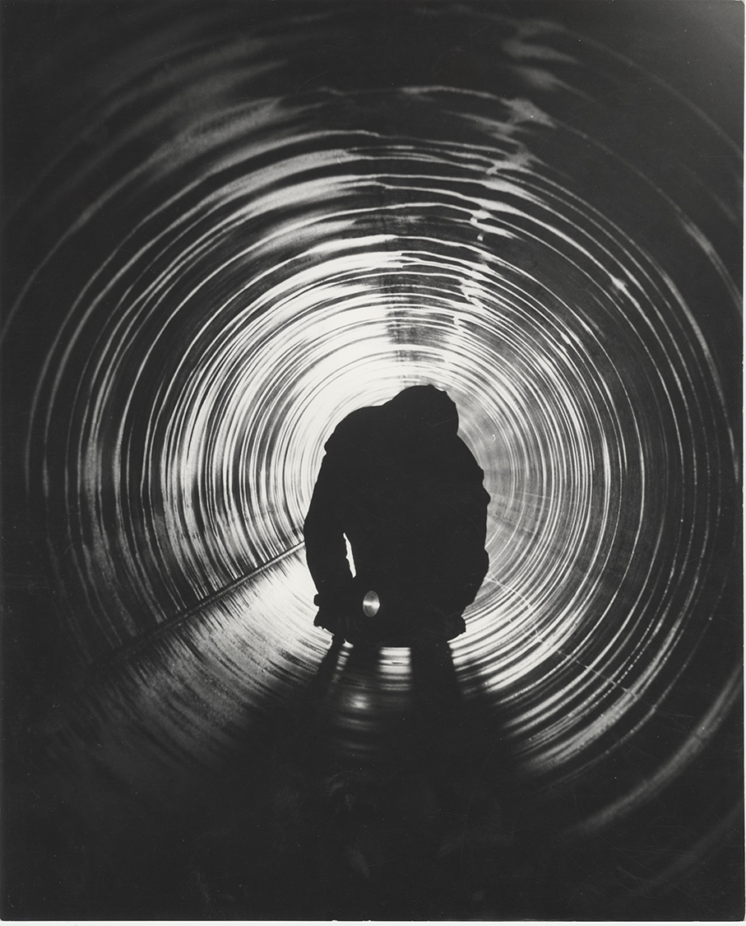
1 Problem
2 Insights
3 Solution
4 Implementation
5 Impact
Team Futuristic
IIT Bombay
At a conservative 1% downgrade rate, each line has ~₹6.7 cr a year at stake; ~₹43 cr across the fleet
Loss pool per line, ₹ cr a year
Where the value comes from, and how the pilot measures it
0.4 Mt × downgrade rate × price discount × ₹167,407/t
Fewer downgrades
measure: downgrade rate by line and grade
Downgraded | 10% off | 15% off | 20% off
0.5% of volume | 3.3 | 5.0 | 6.7
1.0% of volume | 6.7 | 10.0 | 13.4
2.0% of volume | 13.4 | 20.1 | 26.8
~₹6.7 cr
a year at stake
per line
Fewer customer claims
measure: claims per 1,000 t shipped
Less rework
measure: rework tonnes per month
Faster root-cause fixes
measure: hours from defect to fix
Base case (dark): ₹6.7 cr a year per line, ~₹43 cr across 2.57 Mt. Non-prime coil sells 10-30% below prime.
Premium orders
measure: share of exposed-finish orders
IMPACT · VALUE · ASK
Impact beyond the P&L
WHAT WE ASK OF JSL
One 300-series cold-rolled line, 7 months
Vendor quotes for cameras and lighting in P0
Downgrade rate by line and grade
A metallurgist at 20% for root causes
Coverage
Customers
Process
Safety
Sustainability
People
In return: the measured downgrade rate, the value captured, and a go / no-go at month 7.
every coil, both faces
a defect map per coil
defect tied to its heat
hold before a strip break
less rework and remelt
inspectors decide, not search
Inputs: JSL FY26 (INR 167,407/t; 2,565,902 t sold). Base case: a 0.4 Mt line, 1% downgraded at a 10% discount. Value at stake, not a savings forecast: JSL's own data sets the real figure.
Recommendation: approve a 7-month pilot on one 300-series cold-rolled line. JSL's own downgrade rate decides fleet rollout.
Notes:
Impact. We size the prize, not the price. At a conservative 1% of volume downgraded at a 10% discount, one 0.4 Mt line puts about INR 6.7 crore a year at stake; across JSL's 2.57 Mt it is about INR 43 crore. Non-prime coil typically sells 10-30% below prime, so the discounts are conservative. The value comes through five levers: fewer downgrades, fewer customer claims, less rework, faster root-cause fixes, and premium exposed-finish orders. Each has a measure the pilot tracks, so the fleet decision rests on JSL's own numbers rather than our assumptions. Beyond the P&L: coverage, customers, process, safety, sustainability and people. Close on the ask. Proof points for the tiles: JSL supplies Vande Bharat and metro coach steel; defect families map to owners on slide 3; strip-break avoidance is the Ternium business case; JSL emission intensity was 1.76 tCO2e per tonne in FY26; JSL's HR AI assistant resolves over 95% of routine queries. Photo credits: coaches, Ravi Dwivedi (CC BY-SA 4.0); mill, ThyssenKrupp Steel USA (FAL); Outokumpu Tornio, Methem (CC BY 3.0); inspector in a pipe, Italsider archive (CC BY-SA 4.0); coil, Methem (public domain).

