Slide 1
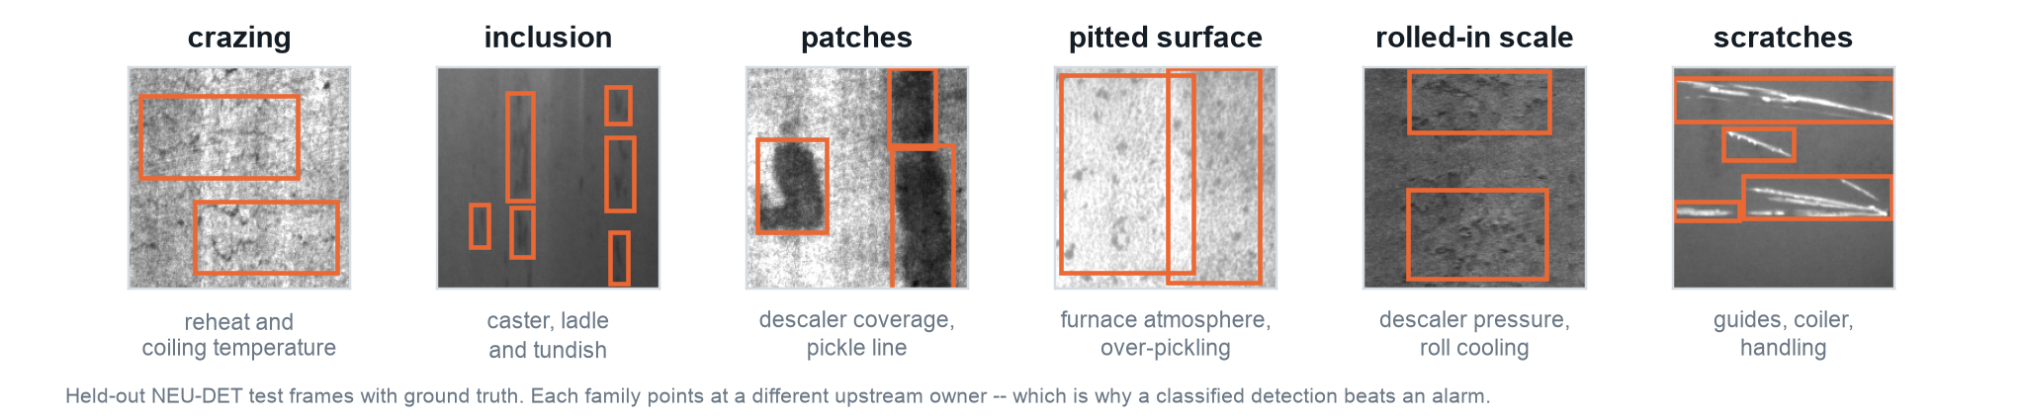

Defects are found after the value has already been added
PROBLEM UNDERSTANDING AND OBJECTIVES
RUNS LIVE IN YOUR BROWSER surface-vision.github.io
1
Surface defect detection on stainless strip, at line speed, on the rolling and finishing lines
Why this is worth solving
— A defect born upstream travels the whole route -- crazing at reheat or coiling, inclusions at the caster, rolled-in scale at the descaler. By the time it is graded, melting, rolling, annealing and pickling have all been paid for.
— On stainless the loss is heavier. Nickel is 8-10% of 304 by mass at INR 1,500-2,000/kg, so a downgraded tonne of 304 destroys several times the value of a downgraded tonne of carbon steel.
— Manual inspection samples. It cannot cover the whole surface of a moving strip, and two inspectors do not grade the same coil the same way.
— Cost of poor quality in manufacturing averages about 15% of sales, range 5-35% (IISE). Up to 60% of quality-relevant surface defects start in the slab (ISRA, vendor claim) -- so inspect early, and classify rather than merely alarm.
Objectives, and how we will know
SUCCESS INDICATOR
TARGET
MEASURED, NEU-DET
Detection quality on a split never tuned on
mAP50 >= 0.70
0.7524
Defective frames flagged at the operating point
>= 90%
92.2%
Defect-free steel raising a box
<= 25%
<= 23.7%
Wrong-class detections among missed labels
0
0 of 168
Model small enough to sit at the line
< 10 MB
6.22 MB
"The steel strip passes in front of the quality inspector at 300 metres per minute, so it is impossible for the human eye to inspect the whole surface."
AMETEK Surface Vision, Ternium Pesqueria PLTCM case study, 2020
Per-line recalibration inside one shift
< 8 h
0.6 h
OPEN IT WHILE YOU READ
surface-vision.github.io
The real detector, not a recording: the 12.1 MB ONNX export of the shipped weights runs in your tab on the WASM backend. No install, no sign-in, nothing uploaded. Twelve held-out frames built in, or drop your own.
MEASURED is the shipped checkpoint, in production today, and it is the checkpoint the QR code opens. A joint checkpoint ships alongside it, scoring 0.7642 on the same split while fixing a cross-domain false-alarm problem -- see slide 3.
Sources: reports/model_study.json - reports/false_alarm.json - reports/gap1_cross_domain_fix.md - site/verify/parity_browser.json - deck/build/live_demo_check.json (live page, HTTP 200, 2026-09-10) - docs/research_notes.md s2a (AMETEK/Ternium, [HARD]), s2b (ISRA, [VENDOR]), s4a (IISE, [HARD] / stainless pricing [SECONDARY]).
Notes:
Before anything else, point at the QR code and say the URL out loud: surface-vision.github.io. It
opens in a phone or a laptop browser, there is nothing to install and nothing to sign into, and it
is not a recording -- it is the shipped 6.22 MB checkpoint, exported to a 12.1 MB ONNX file, running
on the judge's own machine through onnxruntime-web. Twelve of the held-out test frames on this
slide are built into the page as one-click samples, and any image can be dropped onto it. If a
judge opens it while I am talking, everything on slides 3 and 4 can be checked in the room.
Two honest details if asked. It runs on the WASM backend, single-threaded, 30-50 ms a frame in
Chrome on the machine we measured (site/verify/parity_browser.json median 31.7 ms, deck/build/
live_demo_check.json median 49.1 ms -- the same harness, 1.6x apart between runs); your machine
will differ, and
the page times itself rather than repeating our number. And the first load pulls a 12.1 MB model
once, so on hotel wifi give it a few seconds -- after that it is instant, and it works offline.
Open on the mill, not the model.
The one sourced sentence that carries this slide is the Ternium quote: a vendor and a mill both
saying, in public, that human inspection cannot cover a strip moving at 300 m/min. That is the
Pickling Line Tandem Cold Mill at Ternium Pesqueria, five stands, six-high, 6,000 tonnes a day,
four cameras installed just after pickling. Their business case was not cosmetics -- it was strip
breakages damaging mill equipment, and the system was wired to the PLC to slow the mill before the
first bite. That is the shape of the system we are proposing.
On the stainless angle: nickel at 8-10% of 304 by mass at INR 1,500-2,000/kg is the reason yield
loss hurts more here than on commodity carbon steel. The input prices are sourced (trade listings,
[SECONDARY] in research_notes s4a); the multiple versus HRC is my own estimate and is flagged as
such -- do not quote a number for it.
The COPQ range 5-35%, average about 15%, is IISE and is directly sourced. The commonly quoted
"ASQ says 15-20% of sales" is everywhere but I could not verify it on asq.org, so it is not on the
slide. The "up to 60% of defects originate in the slab" line is ISRA VISION's own marketing and is
labelled a vendor claim on the slide. Do not upgrade it in the room.
The objectives table: every "measured" column is a number from a report file in this repository, and
each was reproduced from a clean run. The one to be careful about is the false-alarm row -- it is
"<= 23.7%", not "23.7%", and slide 3 explains why. If someone asks why the targets look modest:
0.70 mAP50 is the bottom of the credible published band for this dataset, and a 90% detection floor
is what a line would actually accept. Setting a target of 0.95 would tell a reader who knows
NEU-DET that we do not.
The six images are real held-out test frames with their ground-truth boxes. The point of the caption
row is that each family points at a different upstream owner: crazing at reheat and coiling
temperature, inclusion at the caster, rolled-in scale at descaler pressure. That is why we detect
and classify rather than just alarm -- a classified detection is a work order. The metallurgical
attributions for crazing and patches are reasoned rather than sourced (research_notes s5 flags
both) and need a Jindal metallurgist's sign-off before they go in front of operators.

Slide 2
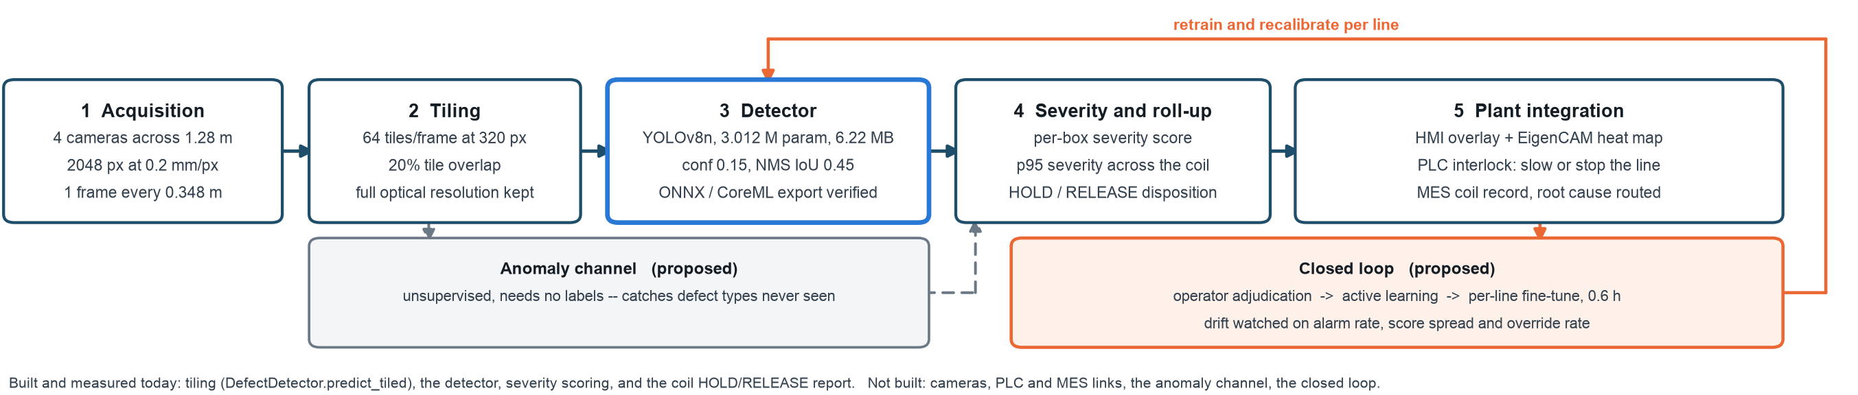
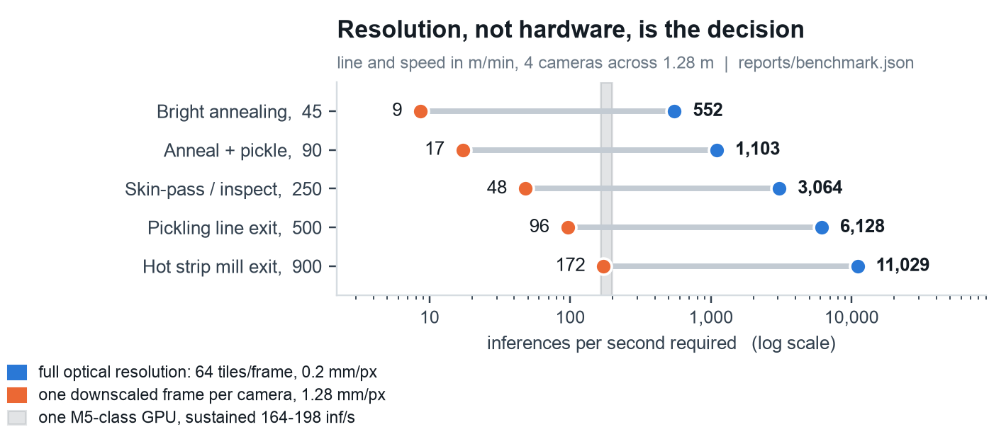
Detect at the tile, decide at the coil, close the loop
PROPOSED SOLUTION
RUNS LIVE IN YOUR BROWSER surface-vision.github.io
2
Architecture, methodology, and the arithmetic that decides the bill: at 250 m/min, full optical resolution costs about 3,064 inferences/s -- roughly 18 accelerators
Methodology, in the order the decisions were made
1 Split first. 1,800 NEU-DET images to 1,440 / 180 / 180, verified content-hash disjoint: 0 duplicate images across splits.
2 Train two capacities on one recipe. YOLOv8n and YOLOv8s, same seed and split, 150 epochs at 320 px, batch 32.
3 Choose inference size and test-time augmentation on validation only. 256 px won; TTA lost 0.0061 mAP50 for 2.39x the latency, so it is off.
4 Choose the alarm threshold on validation against a cost model with a 90% detection floor. That floor, not the economics, sets conf 0.15.
5 Score the held-out test split once, at the end. Nothing in the configuration was chosen on it.
Ships today: the checkpoint and its cross-domain-fix twin, calibrated confidence, an OOD gate, a verified ONNX/CoreML export, a Streamlit console, a coil report, 540 passing tests, and this detector stage running client-side at surface-vision.github.io.
Sources: reports/benchmark.json (mill.geometry, mill.deployment, mill.scenarios) - reports/model_study.json - reports/operating_point.json - reports/export_summary.json - reports/calibration.md - reports/ood_guard.md - site/verify/parity_report.json - `.venv/bin/python -m pytest tests/ -q` -> 540 passed, 8 skipped. Live: https://surface-vision.github.io
Notes:
The architecture diagram is drawn from measured configuration, not from a whiteboard. The camera
geometry, the 64 tiles per frame at 320 px and the 20% tile overlap all come out of
reports/benchmark.json mill.geometry. The model line comes from model_study.json, the operating
point from operating_point.json, the export claim from export_summary.json.
Two boxes are labelled "proposed" and must be read that way: the unsupervised anomaly channel and
the closed loop. Neither is built. They are on the diagram because a real installation runs an
unclassified-defect bucket -- the Ternium case study says so explicitly -- and because a detector
that is never retrained will drift. The one number inside the closed-loop box that IS measured is
the 0.6 h per-line fine-tune: 15.24 s/epoch median at 320 px over 135 epochs, from
models/yolov8n_neudet/results.csv.
The methodology list is the part a technical judge will probe. The order matters. Split first, so
nothing downstream can leak. Two capacities on one recipe, so the comparison is the one a
deployment actually faces. Inference size and TTA chosen on validation only. Threshold chosen on
validation. Test scored once. If asked "did you ever look at test before the end" -- the honest
answer is that the nano-versus-small ordering was visible in train_summary before the bootstrap was
designed, so that comparison is not pre-registered. That caveat is in reports/model_study.md and I
will give it if asked.
The throughput chart is the strongest engineering argument in the deck. Read the two dots as the
same line inspected two ways. Full optical resolution at 0.2 mm/px means 64 tiles per camera frame;
downscaling to one frame per camera costs one inference but throws away 6.4x the linear resolution,
which changes the smallest detectable defect. At 250 m/min that is 3,064 inferences/s against 48.
Divide by the measured sustained throughput of one M5 GPU and you get about 18 accelerators tiled
against one accelerator serving 15 cameras downscaled.
Be careful with the accelerator count. It is ceil(3064 / 179.6) = 18 using the stored sustainable
figure. Across the full observed throughput band, 234-283 f/s peak times a 70% utilisation ceiling,
the honest range is 16 to 19. Say "about 18" and give the band if pressed. Never quote a single FPS
number for this machine -- the same measurement moved by more than a factor of two between sessions.
One line on the "ships today" strip, because it is easy to skim past: the detector stage of this
diagram is running right now at surface-vision.github.io. Same weights, same conf 0.15 and NMS IoU
0.45, same 256 px input, same calibration table, same tiling with one global NMS -- boxes 1, 2 and 3
of this architecture, with no server behind them. Two things it deliberately does not carry: the OOD
gate, which is vendor/ood_guard.py in the Python console and was not ported, so the page will score a
photograph of anything; and boxes 4 and 5, the plant side -- no PLC, no MES, no coil record. The page
says both of those about itself, in its own limitations panel.
If asked why 320 px is the tiling reference when we ship at 256: 320 was chosen on validation as a
size within 95% of the best, and it is what the capacity model uses. And the accuracy curve behind
it was measured on 200x200 crops; a 320 px tile at 0.2 mm/px covers 64 mm of strip, and nothing in
this project measures whether accuracy transfers across that change of magnification. That caveat
is in benchmark.json accuracy_note.

Slide 3
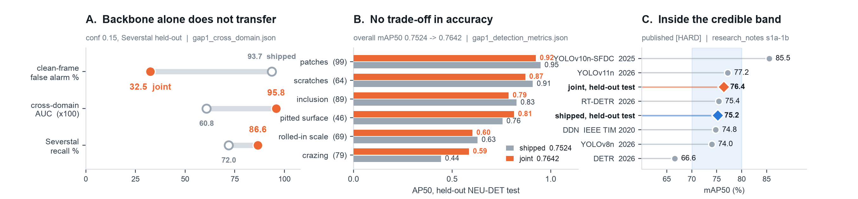
0.752 to 0.764 mAP50 -- false alarms fixed on real clean steel
VALIDATION AND FEASIBILITY
RUNS LIVE IN YOUR BROWSER surface-vision.github.io
3
Two checkpoints, held out once, against published baselines -- GC10 thin classes and the 640px finding shown honestly
Two checkpoints, one split, scored once
— Shipped yolov8n at 256 px, held-out test: mAP50 0.7524, mAP50-95 0.3967, precision 0.696, recall 0.687 -- the model in production today.
— Joint yolov8n at 256 px, same split, ships alongside (not replacing) the shipped model: mAP50 0.7642, mAP50-95 0.4008, precision 0.695, recall 0.706 -- in-domain accuracy rose, it did not fall.
— 640 px was tested, not skipped on a bad number: yolov8n_640 scores 0.7338 at its own best size, inside the +/-0.0254 noise band. Real cost is 65 s/epoch (~2.7 h for 150 epochs), correcting an earlier false '11 min/epoch' claim.
— Input pipeline: lossless padding (no resampling) was tested against scaling to 256 px and lost by 0.024-0.052 mAP50 on every checkpoint and split -- scaling stays.
— Re-runnable live: the ONNX export of these same weights, at surface-vision.github.io, reproduces the PyTorch reference on 40 of 40 detections over 12 held-out frames, max box error 0.14 px.
The cross-domain fix -- the headline result
— The shipped model has never seen clean steel: on 505 held-out Severstal frames it flags 93.7% as defective, AUC just 0.608 -- backbone features do not transfer on their own.
— Joint training on real Severstal positives and negatives fixes it: false alarms 93.7% -> 32.5%, cross-domain AUC 0.608 -> 0.958, defect recall 72.0% -> 86.6% -- with no cost in-domain (left column).
— A verified-clean coil the shipped model HOLDs (55.2% defect rate, 101 'inclusion' frames) is DOWNGRADEd by the joint model (4.8%, 0 triggers) at the same threshold -- not yet ACCEPT.
— Not yet the default: severity tiers for the four new Severstal classes are unset, so it ships alongside resolve_weights()'s pick, not in place of it.
GC10 coverage, and what stays a proxy
— Roll marks (rolled_pit, crease) now have a trained detector: mean AP50 0.203 on 24 held-out instances -- weak and thin: one flip moves recall 8-9 points, and 4 of 11 live rolled_pit images produce zero detections.
— Edge family (crescent_gap, waist_fold): mean AP50 0.880 on 61 instances -- strong, but a proxy for edge geometry, not for cracks. No crack class exists in any dataset used here.
— The <=23.7% clean-crop figure on slide 1 is a ceiling on a NEU-DET proxy population, not a rate on real clean coil -- the middle column is the real measurement; this proxy is superseded, not wrong.
— No absolute frame rate reproduces on this host between sessions (234-283 f/s for the same model). Bands and ratios only.
Sources: reports/gap1_cross_domain_fix.md (in-domain, cross-domain, coil disposition) - reports/gap1_cross_domain.json - reports/gap1_detection_metrics.json - reports/resolution_study.md - reports/input_pipeline_decision.md - reports/gc10_coverage.md - reports/model_study.json - reports/false_alarm.json - site/verify/parity_browser.json (40/40 in Chrome, at https://surface-vision.github.io). Reproduction commands for the headline numbers are in the speaker notes.
Notes:
This slide carries two numbers, not one, and the room needs to know which is which. 0.7524 is the
shipped yolov8n checkpoint, at 256 px, held-out test, in production today -- reproduces to four
decimals from a single ultralytics val call, I have run it:
.venv/bin/python -c "from ultralytics import YOLO; YOLO('models/yolov8n_neudet/weights/best.pt')
.val(data='data/neu-det/data.yaml', split='test', imgsz=256, device='mps')". 0.7642 is a
second checkpoint, yolov8n_joint, jointly trained on NEU-DET plus real Severstal steel, scored on
the identical 180-image split through a data yaml proven metric-identical to the canonical one
(the warm-started, untrained transplant reproduces the shipped model's metrics to eight significant
figures, so the comparison is apples to apples). Reproduce it with
.venv/bin/python -m src.train_joint crossdomain -- --weights models/yolov8n_joint/weights/best.pt.
It ships ALONGSIDE the shipped model, not in place of it -- resolve_weights() and DEFAULT_IMGSZ are
untouched.
Panel A is the one to spend the most time on, because it corrects a claim the previous version of
this deck got wrong: that backbone features transfer unchanged across domains. They do not. On 505
held-out, certified defect-free Severstal frames and 191 masked-defective ones, the shipped model's
cross-domain ROC AUC is 0.608 -- indistinguishable from a coin -- and it flags 93.7% of clean frames
as defective. Joint training on real Severstal positives AND negatives together (not negatives
alone -- section 2 of the report shows that trap: negatives-only collapses defect recall to 0.057
and never moves the AUC, because the model just learns "not NEU-DET" rather than "not defective")
takes cross-domain AUC to 0.958, clean-frame false alarms to 32.5%, and Severstal defect recall to
86.6%. In-domain AUC gives back a little (0.968 -> 0.940) but the confidence intervals overlap
substantially, so that cost is not established. This is the strongest result in the deck.
Panel B shows there is no trade-off to explain away: four classes lose 2-4 points of AP50, but the
two weakest classes -- crazing and rolled-in scale -- both improve, and overall mAP50 rises
0.7524 -> 0.7642. The mechanism: 1,190 certified-clean training crops teach the model to stop
carpeting low-contrast texture with boxes, which is exactly crazing's failure mode.
Panel C: both checkpoints sit inside the 0.70-0.80 credible band for well-run NEU-DET baselines,
75.2 and 76.4 respectively, against seven published results, all [HARD] in research_notes s1b.
If asked about the disposition chain: a verified-clean Severstal coil that the shipped model HOLDs
today (55.2% defect rate, 101 zero-tolerance "inclusion" frames -- an obvious, expensive false
alarm) is DOWNGRADEd by the joint model at the same threshold (4.8% defect rate, zero
zero-tolerance triggers). Not yet ACCEPT -- at conf 0.40 the defect rate clears the 2% limit but one
frame sits in the high-severity band, and four of the five surviving detections are Severstal
classes whose severity tier is genuinely unknown (the competition never published semantic names
for them, and DEFECT_INFO does not invent one). That is why this ships alongside the default and
not in place of it -- section 10 of the report lists the remaining blockers.
640 px (bottom of the left column): tested properly this time, not waved off on a false number. The
project's own README used to say 640 px training costs ">11 minutes per epoch" -- that was a
batch-32 memory cliff on this machine, not arithmetic. At batch 16 it trains fine: 65 s/epoch
median, 2.7 h for 150 epochs. The resulting model scores 0.7338 mAP50 at its own best test size,
against the shipped 0.7524 -- a gap of -0.0186, entirely inside the +/-0.0254 bootstrap noise band
computed on model_study.json's own resamples. Skipping 640 px as the shipped size was still the
right call (4.3x the training time, 4x the inference pixels, no measured benefit) -- but not for
the reason originally given.
Input pipeline, one line: lossless padding (the source pixels, verbatim, in a grey border) was
tested head-to-head against the shipped bilinear scaling to 256 px, at the same tensor size, on
both checkpoints and both splits. Scaling wins every time, by 0.024 to 0.052 mAP50. A
nearest-neighbour arm proved this is not about fidelity -- it is byte-exact and lossless too, and it
is the WORST arm of all five tested. Magnification and kernel smoothness matter; raw pixel
preservation does not. Nothing about DEFAULT_IMGSZ changes.
GC10 (right column): the brief's roll-marks and edge-cracks gap is now half-closed, honestly. Roll
marks (rolled_pit, crease) are a direct match but thin and weak -- 24 test instances, mean AP50
0.203, and a live sweep shows 4 of 11 rolled_pit images produce nothing at conf 0.15. The edge
family (crescent_gap, waist_fold) scores a strong 0.880 on 61 instances, but it is edge GEOMETRY --
a scalloped bite, a folded edge -- not a crack, and no crack class exists anywhere in this project's
data. Report both numbers with their instance counts attached or not at all; do not average them
into one "edge/roll coverage" headline.
The old clean-crop false-alarm proxy (<=23.7%, slide 1) is not wrong, but it is now superseded as
the best available false-alarm evidence: it was always a ceiling on a NEU-DET population that
cannot contain a genuinely clean frame, and the cross-domain numbers in the middle column are a
real measurement on certified clean and defective steel from a different dataset entirely.
The last row of the left column is the one a sceptical judge can check without trusting us. The
same weights, exported to ONNX and served at surface-vision.github.io, were run against the Python
ultralytics reference two ways: the decode module under onnxruntime-node, and the published page
itself driven headless in real Chrome. Both agree with PyTorch on 40 of 40 detections across the 12
held-out frames, with a maximum box difference of 0.14 px and a maximum confidence difference of
0.0016 -- inside a 2 px and 0.01 tolerance, 0 discrepancies, verdict PASS in both
site/verify/parity_report.json and site/verify/parity_browser.json. The 0.14 px is not noise in the
model, it is the JPEG decoder: hold the source pixels constant and the two paths agree almost
exactly; let the browser decode the JPEG itself and a box can move 9.5 px, which is why the harness
holds the decoder constant and says so.
No absolute frame rate anywhere on this slide: GPU throughput on this host moved between 234 and
283 f/s across sessions for the same model. Bands and ratios only, same discipline as before. The
browser figure obeys the same rule -- 30-50 ms is one machine, one thread, one frame, and the same
harness on the same 12 frames returned medians of 31.7 ms and 49.1 ms in two recorded runs.

Slide 4
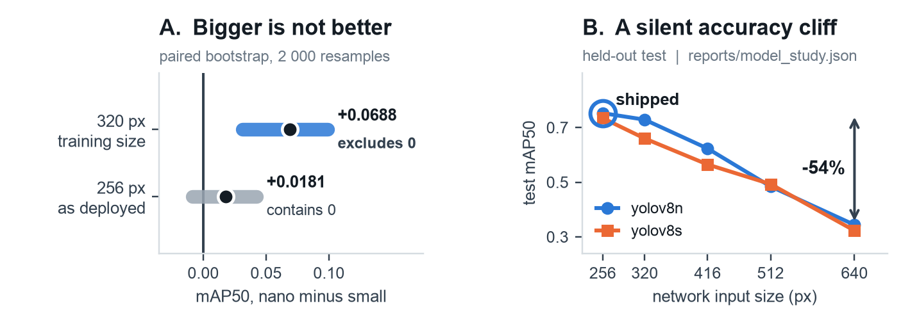
What is different here is the discipline, not the architecture
INNOVATION, DIFFERENTIATION, ASSUMPTIONS AND LIMITS
RUNS LIVE IN YOUR BROWSER surface-vision.github.io
4
Everyone benchmarks on NEU-DET. Almost nobody reports what happens when the numbers are held out
Assumptions and limitations
Dataset. NEU-DET is 1,800 grayscale 200x200 hot-rolled carbon-steel images under one lighting rig. Nothing here is measured on stainless, your cameras, or your illumination -- a capability demonstration, not a prediction.
Domain shift. Confirmed and partly fixed. Cross-domain AUC was 0.608 (chance); joint training fixed it to 0.958 (slide 3) but ships alongside the default -- severity tiers for the four new classes remain unset.
False alarms. Three different measurements, not one. The NEU-DET clean-crop proxy (<=23.7%) is a ceiling: effective n 179 of 771, a 5.8%-48.8% mixture by class. The legacy definition reads 59.4%. Slide 3 real clean-steel numbers are the ones to trust.
GC10 thin classes. Roll marks (rolled_pit, crease) score mean AP50 0.203 on 24 test instances -- one flip moves recall 8-9 points, and 4 of 11 live rolled_pit images produce zero detections. The edge family (AP50 0.880, 61 instances) is a strong proxy for edge geometry, not cracks.
Cost model. Defect prevalence (5% of frames) and the miss-to-false-alarm price (12:1) are assumptions, not measurements, and only their combination is identifiable. conf 0.15 is set by the 90% detection floor, not by the economics.
Timing. No absolute latency on this host is reproducible between sessions. Every speed statement here is a band or a ratio, never a line rate -- the browser demo included: two recorded runs of the same 12 frames median 31.7 ms and 49.1 ms.
Not measured. Training-seed variance. Three seeds per architecture is about 6.5 h on this machine and would upgrade the nano-versus-small claim from 'these weights' to 'this architecture'.
Mill geometry. Line speed, strip width and pixel pitch are a sourced proxy (Ternium at 300 m/min; ISRA at 170 um/px), not Jindal's own figures.
Magnification. The accuracy curve was measured on 200x200 crops; a 320 px tile at 0.2 mm/px covers 64 mm of strip, and transfer across that scale change is unmeasured. Phase 0 measures it.
Not built. The unsupervised anomaly channel and closed loop (slide 2) are proposed, not built. Severity tiers for the joint model's four Severstal classes are also unset -- none is invented.
Money. Every rupee figure on slide 5 is arithmetic on a swept assumption, with the inputs printed beside it. Read it as a shape, not as a forecast.
Innovation and differentiation
1 Held-out discipline, not validation scores. Most published NEU-DET figures are validation numbers. The size of that gap is visible in our own run: at 320 px yolov8s reads 0.7237 on val and 0.6598 on test.
2 Capacity matched to the data. At each model's own best input size, the 3.7x larger model is not better: +0.0181 mAP50 to nano, 95% CI [-0.0084, +0.0424]. The honest claim is 'not worse, and 3.5x cheaper in FLOPs' -- and that is enough to decide a deployment.
3 Cross-domain robustness, measured AND fixed. Shipped AUC 0.608 (chance) on real clean Severstal steel; joint training takes it to 0.958 and lifts in-domain mAP50 to 0.7642.
4 Input size pinned as an accuracy parameter. The same weights lose 54% of mAP50 at 640 px, silently -- and a proper 640 px retrain, now tested, only ties within noise.
5 Explainable, calibrated, and gated. EigenCAM shows what fired; calibration cuts ECE 0.142 -> 0.046; an OOD gate withholds verdicts on non-steel input, 0 false rejections on 3,200 frames.
6 YOLO by argument, not by default. On this dataset the published out-of-the-box transformer numbers are DETR 25.2 and RT-DETR 55.0 mAP50 against YOLOv11's 71.6.
7 Deployable where the data is. The detector is 6.22 MB as PyTorch, 12.1 MB as ONNX, and runs client-side at surface-vision.github.io -- real Chrome, WASM, one thread, 30-50 ms per frame, 40 of 40 detections identical to PyTorch within 0.14 px. No strip image leaves the plant, no cloud, no per-inference cost, no cold start. A proof of deployability, not a proposal to inspect coil in a browser tab.
Sources: reports/model_study.json (bootstrap, runs, limitations) - reports/gap1_cross_domain_fix.md - reports/calibration.md - reports/ood_guard.md - reports/gc10_coverage.md - reports/false_alarm.json - reports/operating_point.json - site/verify/parity_browser.json and site/verify/parity_report.json (browser parity, timings) - deck/build/live_demo_check.json (https://surface-vision.github.io, live, 27 requests, 0 uploads) - docs/research_notes.md s1c, s2a, s6a-6b.
Notes:
The framing sentence is the title. Nothing in the architecture is novel -- it is a stock YOLOv8n.
What is different is that every number has been held out, bounded, or refused, and that now
extends past NEU-DET itself: cross-domain robustness, confidence, and out-of-scope input are all
measured, not assumed.
Panel A is the finding I would spend the most time on. Train two capacities on one recipe and the
3.7x larger model does not win. At the training size the gap is +0.0688 mAP50 to nano with a 95%
interval of [+0.0309, +0.0990] that excludes zero, and nano wins 99.95% of 2,000 paired resamples.
But that is not the comparison a deployment faces, because each model has its own best inference
size. At each model's own best size -- both 256 px, both chosen on validation -- the gap collapses
to +0.0181 with an interval of [-0.0084, +0.0424] that contains zero. So the honest claim is not
"nano is the better detector". It is "nano is not worse, and it is 3.7x smaller and 3.5x cheaper in
FLOPs", which is more than enough to decide what ships.
Be ready for the strongest counter-argument, and give it before it is given to you: on
ultralytics' own fitness metric, the criterion that selected both checkpoints, yolov8s at 256
actually wins, 0.4389 against 0.4323. No accuracy metric picks nano. The recommendation rests on
cost, and it says so.
The mechanism is visible in the loss curves rather than the mAP. At the end of training yolov8s
sits at train classification loss 0.823 against validation 1.090, a generalisation gap of +0.267.
yolov8n's gap is -0.061. 1,440 training images do not support the larger model's capacity. That is
the transferable lesson for any small industrial dataset, including Jindal's first labelled batch.
Panel B is the deployment discipline point and it is not academic. The same weights lose 54% of
mAP50 between 256 px and 640 px -- 0.7524 to 0.3438 -- because a detector can only regress boxes at
the scale it was trained on. Innovation item 4 now carries a second half: a proper 640 px model was
also trained from scratch (150 epochs, 65 s/epoch, not the ">11 min/epoch" the README used to
claim) and it ties the shipped model within noise (0.7338 vs 0.7524, inside +/-0.0254). Two
different findings, both now measured: the shipped weights collapse if you change imgsz at
inference; a from-scratch 640 px model does not collapse, it just does not help either.
Innovation item 3 replaces the deck's previous, wrong claim that backbone features transfer
unchanged across domains. They do not: cross-domain ROC AUC was 0.608, indistinguishable from
chance, on 505 held-out certified-clean Severstal frames. Joint training on real target-domain
positives and negatives together (not negatives alone -- that traps into a domain classifier with
defect recall 0.057) fixes it to AUC 0.958, cuts clean-frame false alarms 93.7% -> 32.5%, and raises
in-domain mAP50 0.7524 -> 0.7642 at the same time. Full detail and the remaining ship blockers are
on slide 3 and in reports/gap1_cross_domain_fix.md section 10.
Innovation item 5's two additions are both measured, not aspirational. Calibration: isotonic
regression, fit on val only, evaluated once on test, cuts ECE 0.1418 -> 0.0461 while leaving mAP50
provably unchanged (rank-invariant by construction; verified numerically at 0.707986 before and
after under this module's own AP50 implementation). The OOD gate: 0 false rejections across 3,200
genuine NEU-DET and Severstal frames, correctly withholds a verdict on logo, white-frame and
cartoon input, and scores 13/15 on a held-out synthetic-negative suite (the two misses are
wood_grain and a radial gradient, both textures that resemble a real surface).
On limitations, do not soften any of them. NEU-DET is hot-rolled carbon steel under one lighting
rig -- still true, still the first thing to say. Domain shift is now "confirmed and partly fixed"
rather than purely a warning: the fix is real and measured, but it ships as a second checkpoint,
not a replacement, because severity tiers for the four new Severstal classes are genuinely unset
(the competition never published names for them) and inference.py's dual-checkpoint path is not
yet unified. GC10 is the newest limitation: roll marks are real but thin (24 test instances, one
flip moves recall 8-9 points) and the edge family, while strong at 0.880 AP50, is a geometry proxy,
not a crack detector -- no crack class exists in any dataset used anywhere in this project.
Innovation item 7 is the newest one and it is the one to make an argument out of, not a demo of. A
mill will not casually ship strip imagery to a cloud -- it is process data, and it is the kind of
thing a plant IT policy simply refuses. So the fact that this whole detector is a 12.1 MB file that
runs inside a browser tab is not a consolation prize for not having a server, it is the deployment
story: no image leaves the plant, no cloud dependency, no per-inference cost, no cold start, and
the same ONNX artefact that runs in the tab runs on a mill-floor industrial PC through the same
runtime. We checked what the page actually does on the network rather than asserting it: driving
the live page in Chrome logged 27 requests, every one a GET for a static file -- the HTML, the CSS,
five scripts, two runtime modules from jsDelivr, the model, the sample JPEGs -- zero non-GET and
zero requests carrying a body (deck/build/live_demo_check.json). There is no upload path in the
page at all.
Give the boundary before anyone asks for it. This demonstrates deployability; it is not a claim
that production inspection should run in a web browser. The page is single-threaded WASM handling
one frame at a time at 30-50 ms; slide 2's arithmetic says a real line at full optical
resolution needs about 3,064 inferences a second. The browser is the operator console and the
proof that the artefact is small enough and portable enough; the line runs the same ONNX on
accelerators. What transfers between the two is exactly what parity proves: identical detections.
Also worth having ready: the transformer point in innovation item 6 is not a swipe. On a dataset
this small with objects this small, published out-of-the-box DETR scores 25.2 and RT-DETR 55.0
mAP50 against YOLOv11's 71.6, from the same comparative study. Choosing YOLO was an argument, not a
default -- and the same argument says a mill with 200,000 labelled frames should revisit it.

Slide 5
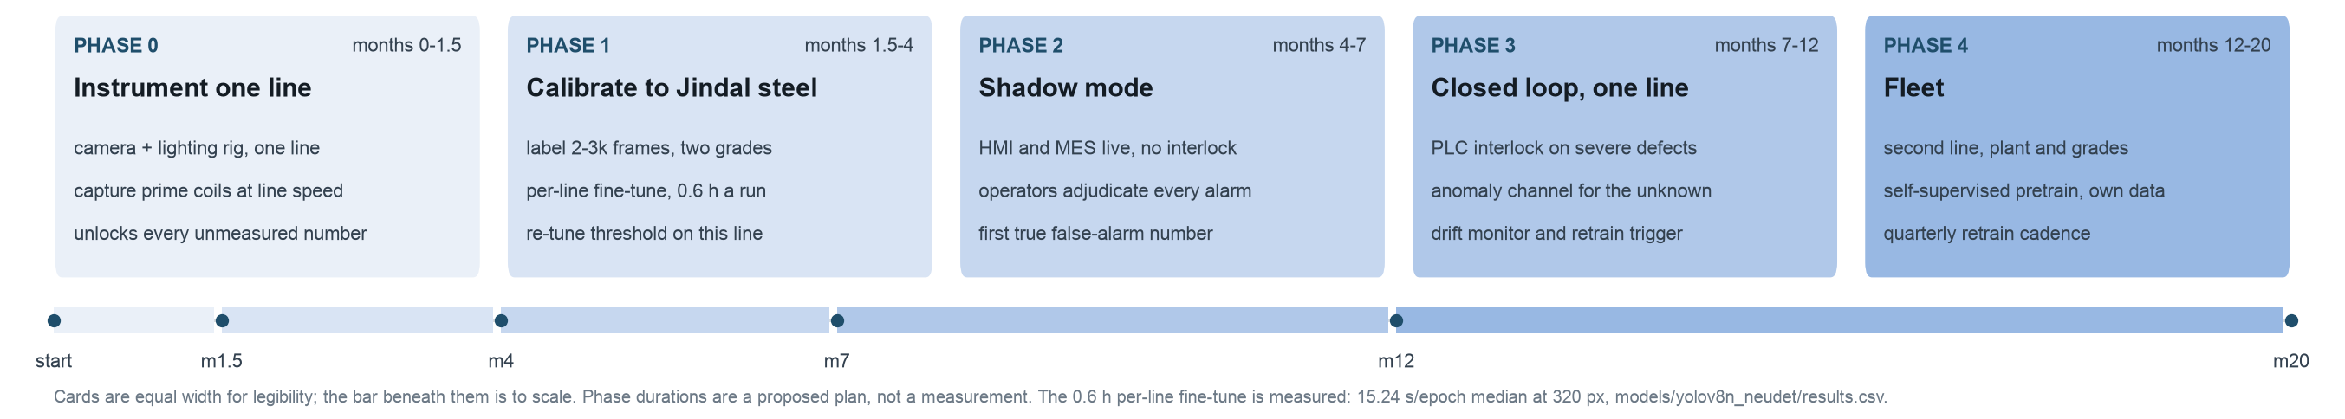
What it changes, what it is worth, and how it scales
EXPECTED IMPACT AND ROLLOUT
RUNS LIVE IN YOUR BROWSER surface-vision.github.io
5
A phased plan whose first phase exists to measure the things this deck could not
Expected impact
Technical. A 6.22 MB, 3.0 M parameter detector with a verified ONNX and CoreML export (max absolute deviation 7.1e-04, identical detections). ONNX Runtime is 1.66-1.76x faster than PyTorch on the same CPU. At 250 m/min one accelerator serves 15 camera streams downscaled, or a fraction of one stream at full optical resolution -- so the design question is tiling versus resolution.
Operational. Every square millimetre inspected instead of sampled, with a coil-level HOLD or RELEASE and a p95 severity, and the defect class routed to the owner who can actually fix it. Inspectors move from looking to adjudicating.
Deployment. The verified ONNX export also runs client-side: surface-vision.github.io loads the 12.1 MB model once and infers in the tab, uploading nothing -- a live check of the published page logged 27 requests, all GETs for static files, none carrying a body. No cloud dependency, no per-inference cost, no cold start.
Sustainability. Yield recovered is melting, rolling, annealing and nickel not spent twice. We deliberately do not put a tonne-of-CO2 figure on this slide: it needs Jindal's own specific energy per tonne, which is not public.
Commercial, illustrative
Scaling across grades and products
Transfers unchanged: the tiling and serving architecture, the severity and MES plumbing, and the training recipe -- not the backbone: shipped cross-domain AUC was 0.608 (chance) until joint training fixed it to 0.958.
Needs re-labelling: each new grade, surface finish and illumination, plus any defect the taxonomy does not yet name.
Active learning: label only frames the model is unsure about or the operator overrode, not a uniform sample. Proposed practice; no NEU-DET-specific study exists to cite.
Unseen defects: an unsupervised anomaly channel in parallel with the detector, feeding the unclassified bucket that real installations already run.
Labelling cost: self-supervised pretraining on the mill's own unlabelled imagery: published SimSiam reached 0.768 mAP50 against 0.773 for ImageNet and 0.280 from random init -- ImageNet-level, with no labels.
Monitoring: alarm rate per class, score drift and operator override rate; override rate doubles as the ground-truth trickle that triggers a retrain.
Value at risk from surface-driven downgrade, INR crore/year. Columns are the prime-to-secondary discount. Volume 2,565,902 t and realisation INR 167,407/t are Jindal FY26 reported figures; the other two inputs are swept, not known.
Downgrade rate
10%
15%
20%
0.5% of volume
21
32
43
1.0% of volume
43
64
86
2.0% of volume
86
129
172
Worked mid case. 1.0% of volume downgraded at a 10% discount is INR 43 cr/yr at risk. Recovering 30% of it is INR 13 cr/yr, against roughly INR 21 cr for one line's system (USD 2.4M at INR 88/USD, an unsourced order of magnitude). Payback about 1.6 years.
The ask. The downgrade rate is not public. It is the one input we need from Jindal's MIS; everything else here is reported or swept.
Sources: reports/export_summary.json - reports/export_summary_320.json - reports/benchmark.json - reports/gap1_cross_domain_fix.md (cross-domain AUC, backbone transfer) - models/yolov8n_neudet/results.csv - docs/research_notes.md s3a (Jindal FY26 [HARD]), s4c (ROI sweep, [DERIVED], inputs on slide), s6b (self-supervised [HARD]) - deck/build/live_demo_check.json. The USD 2.4M system cost is [SUSPECT], order of magnitude only. Try it: https://surface-vision.github.io
Notes:
The roadmap is a proposal, not a measurement, and Phase 0 is the honest centre of it. Every figure
this deck had to bound rather than state -- the real false-alarm rate, the accuracy on stainless,
the transfer across magnification -- becomes measurable the moment there is a camera on one line
capturing prime coils at line speed. Six weeks of instrumentation buys more certainty than any
amount of further work on NEU-DET.
The only measured number inside the roadmap is the 0.6 h per-line fine-tune: 15.24 s/epoch median
at 320 px over 135 epochs on this laptop GPU, from models/yolov8n_neudet/results.csv. An overnight
retrain per line is affordable, which is what makes per-line calibration a plan rather than a wish.
On the commercial column, be explicit that this is arithmetic on a swept assumption, and show the
inputs. Volume 2,565,902 t and blended realisation INR 167,407/t are derived directly from Jindal's
own FY26 reported figures -- consolidated net revenue INR 42,955 cr, sales volume 2,565,902 t --
so those two are unattackable. Reported EBITDA works out at about INR 21,669 per tonne. The
downgrade rate and the prime-to-secondary discount are not public, so they are swept across a 3x3
grid and the whole grid is on the slide. The mid case is 1.0% at a 10% discount: 2,565,902 t x 1.0%
x INR 167,407/t x 10% = INR 43 cr/yr at risk. Recover 30% and that is INR 13 cr/yr.
The capex side is the weakest number on the slide and I will say so unprompted. USD 2.4M for a
multi-camera, both-surfaces, PLC-integrated surface inspection system on one line traces only to an
AI-generated SEO content farm. The order of magnitude is plausible and consistent with what such a
system involves, but it has no attributable source, so it is presented as an order of magnitude and
nothing more. Payback of about 1.6 years follows: INR 21 cr against INR 13 cr/yr. That is a good
but not miraculous number, and presenting it that way is deliberate. The upside cases in the grid
reach payback in under five months, and they rest entirely on the unsourced downgrade rate -- which
is why the ask is on the slide.
Deliberately not monetised, because there is no defensible source: avoided strip breakage and mill
damage (which was the actual Ternium business case), reduced customer claims, inspector
redeployment, and root-cause feedback to the caster and descaler. Name them; do not put rupees on
them.
On sustainability, the same discipline. Recovered yield is melting, rolling, annealing and nickel
not spent twice, and on 304 the nickel content makes that materially larger than on carbon steel.
A tonne-of-CO2 figure would need Jindal's specific energy per tonne, which is not public, so there
is no CO2 number on this deck.
On scaling: the honest split is that the serving architecture, the severity and MES plumbing and
the training recipe transfer unchanged, while every new grade, finish and lighting setup needs its
own labelled frames -- and, per slide 3, the backbone by itself does NOT transfer unchanged: it
measured chance-level (AUC 0.608) on real clean Severstal steel until joint training on real
target-domain positives and negatives fixed it to 0.958, while also lifting in-domain mAP50
0.7524 -> 0.7642. Budget a joint fine-tune with real negatives for every new grade or camera, the
same way the Severstal fix was done, not a frozen backbone plus new labels alone. Active learning
is proposed practice -- I searched and found no
NEU-DET-specific active-learning study to cite, and the slide says "proposed". The
self-supervised result is properly sourced and is the strongest labelling-cost argument available:
SimSiam pretraining on 20,272 unlabelled images reached 0.768 mAP50 against 0.773 for ImageNet
pretraining and 0.280 from random initialisation. A mill's own unlabelled coil imagery is a free
asset, and that is a genuinely differentiating thing to say in this room.
The deployment line in the impact column is the cheapest thing on this slide to verify and the
easiest to underrate. Zero infrastructure is not a rhetorical flourish: there is no server to
procure, no GPU to rent, no inference bill that scales with coils inspected, and no data-egress
conversation with plant IT, because the model goes to the data instead of the data going to the
model. The same artefact is what would be installed on a mill-floor PC. It does not replace the
serving design on slide 2 -- it is what makes phase 0 cheap to start.
Close on the ask: give us one line, one camera rig, six weeks, and the downgrade rate from your MIS.
And leave the URL on the screen -- surface-vision.github.io -- so the room can keep poking at it
after the questions stop.

