Slide 1
Chapter 6: Transport Layer and protocol

Slide 2
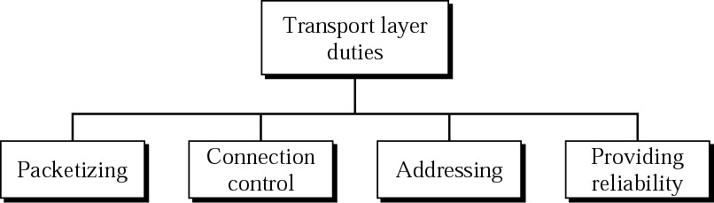

Slide 3
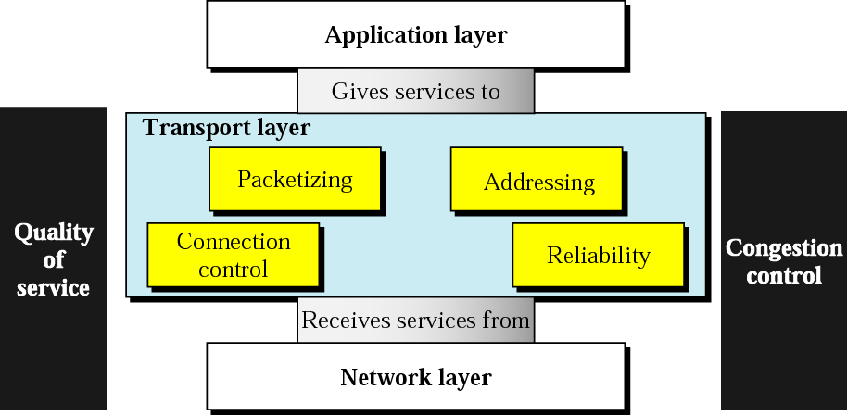
Transport Layer : Duties ??
<number>
Notes:
<number>

Slide 4
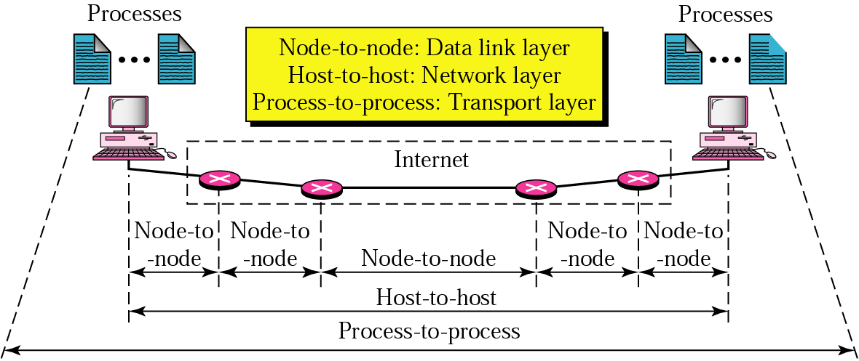
Transport Layer : Type of Data Deliveries
<number>
Notes:
<number>

Slide 5
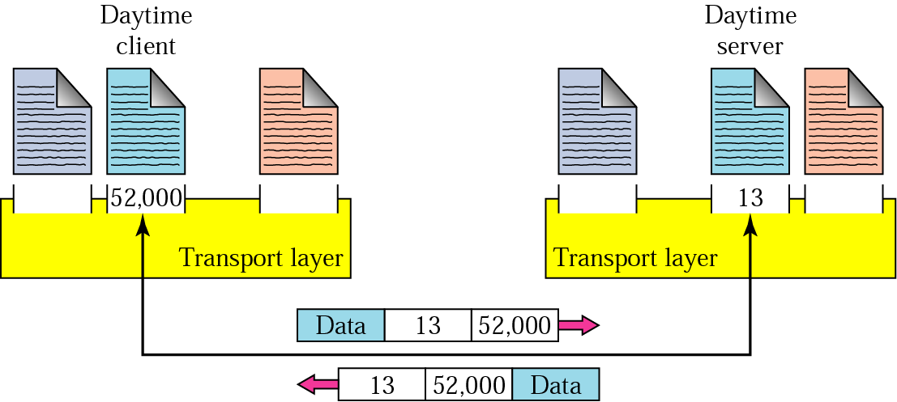
Transport Layer : Port Numbers
<number>
Notes:
<number>

Slide 6
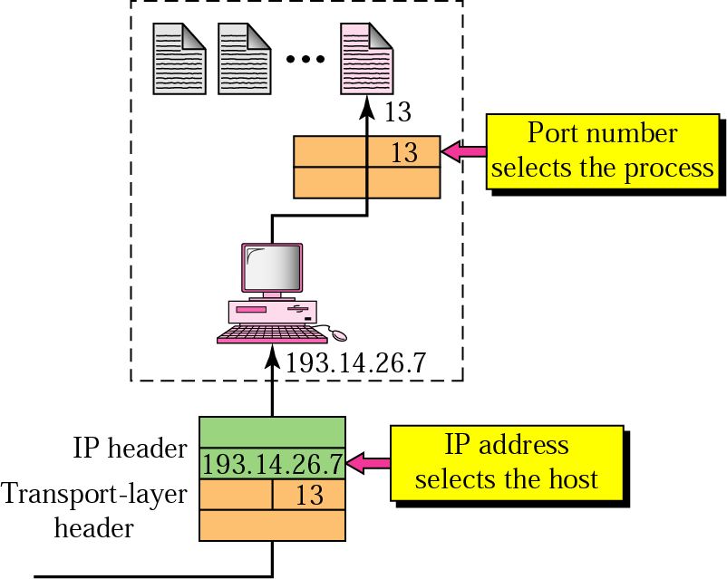
Transport Layer : IP VS Port Numbers
<number>
Notes:
<number>

Slide 7
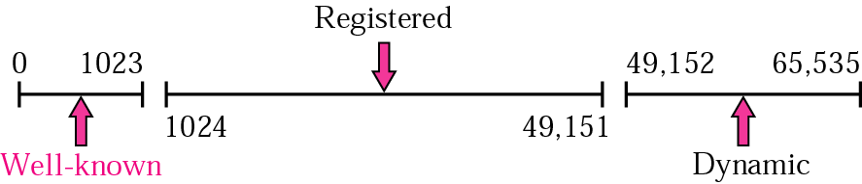
Transport Layer : Port Numbers (IANA Range)
<number>
Notes:
<number>

Slide 8
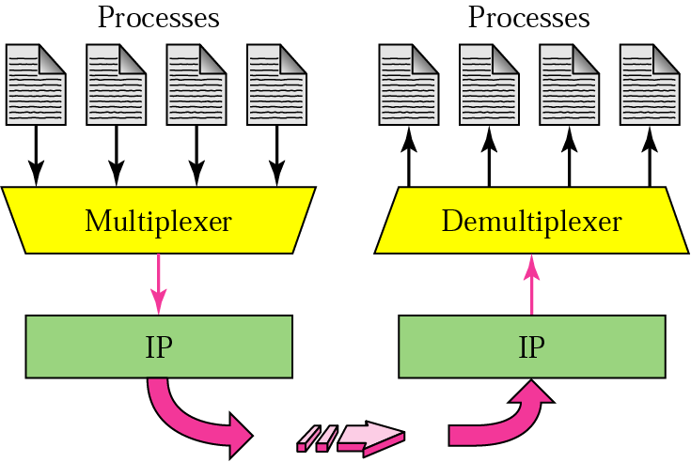
Transport Layer : Multiplexing and Demultiplexing
<number>
Notes:
<number>

Slide 9
Transport Layer : Multiplexing and Demultiplexing
The technique to combine two or more data stream in one session is called Multiplexing. When a TCP client initializes a connection with Server, it always refers to a well-defined port number which indicates the application process. The client itself uses a randomly generated port number from private port number pools.
Using TCP Multiplexing, a client can communicate with a number of different application process in a single session. For example, a client requests a web page which in turn contains different type of data (HTTP, SMTP, FTP etc.) the TCP session timeout is increased and the session is kept open for longer time so that the three-way handshake overhead can be avoided.
This enables the client system to receive multiple connection over single virtual connection. These virtual connections are not good for Servers if the timeout is too long.

Slide 10
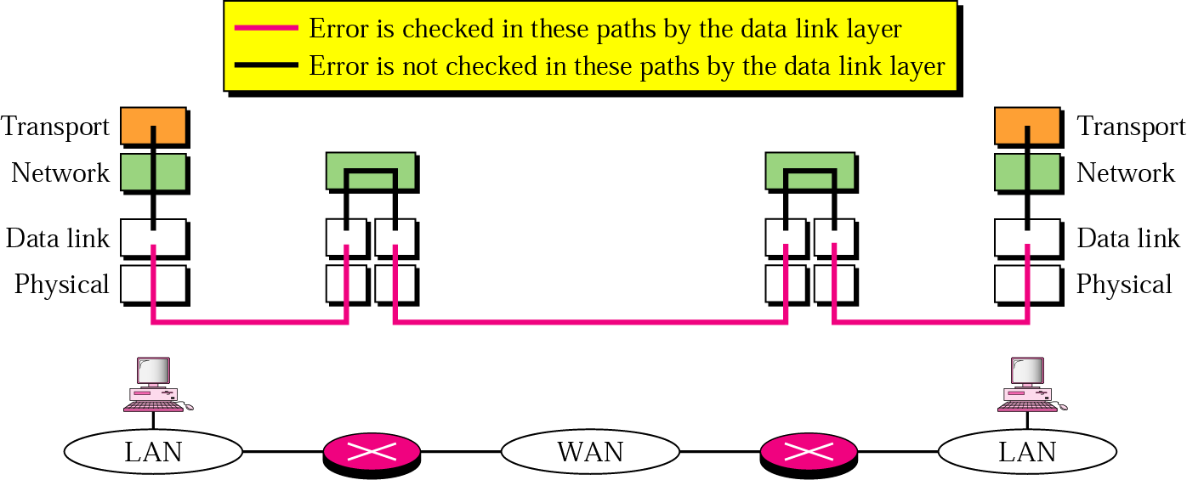
Error Control in Transport Layer

Slide 11
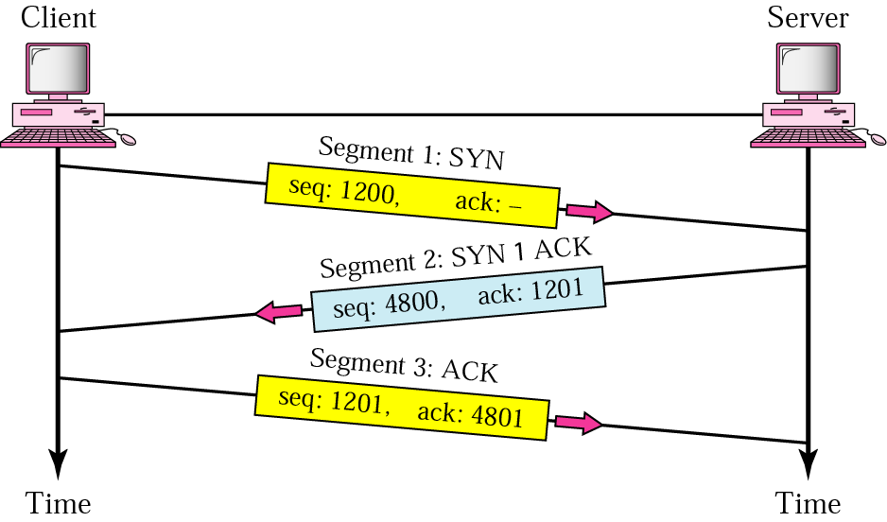
Transport Layer : Three Step Connection Establishment: Handshaking
<number>
Notes:
<number>

Slide 12
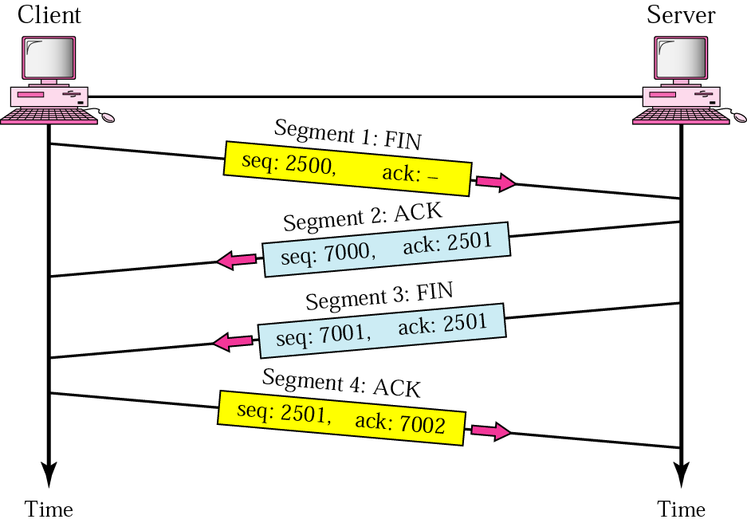
Transport Layer : Four Step Connection Termination, Handshaking
<number>
Notes:
<number>

Slide 13
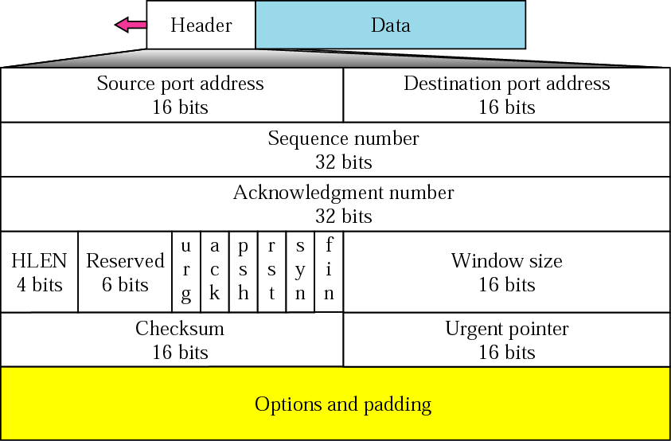
Transport Layer : TCP Segment Format
<number>
Notes:
<number>

Slide 14
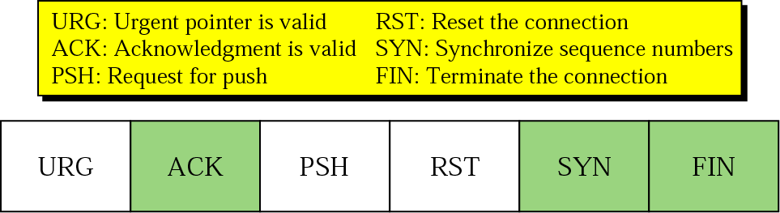
Transport Layer : TCP Segment Format (Control Fields)
<number>
Notes:
<number>

Slide 15
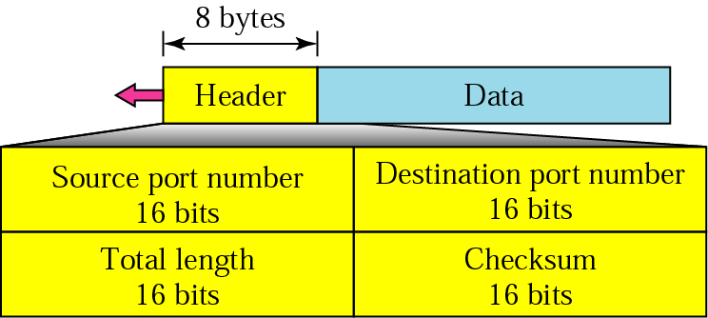
Transport Layer : UDP Segment Format
<number>
Notes:
<number>

Slide 16
TCP Services
TCP is reliable protocol, that is, the receiver sends an acknowledgement back to the sender, of each packet it receives. Sender is now confirmed that packet has been received and can process further packets in its queue.
TCP ensures that data has been received in the order it was sent.
TCP is connection oriented. TCP requires that connection between two remote points be established before sending actual data.
TCP provides error-checking and recovery mechanism.
TCP provides end-to-end communication.
TCP provides flow control and quality of service.
TCP operates in Client/Server point-to-point mode.
TCP provides full duplex server, i.e. it can act like receiver and sender.

Slide 17
UDP Services
UDP is used when acknowledgement of data does not hold any significance.
UDP is good protocol for data flowing in one direction.
UDP is simple and suitable for query based communications.
UDP is not connection oriented.
UDP does not provide congestion control mechanism.
UDP does not guarantee ordered delivery of data.
UDP is stateless.

Slide 18
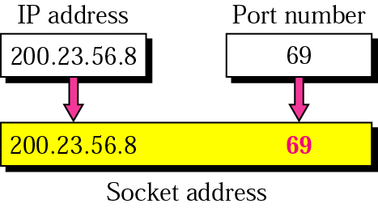
Socket
<number>
Notes:
<number>

Slide 19
Socket
A socket is one endpoint of a two-way communication link between two programs running on the network.
A socket is bound to a port number so that the TCP layer can identify the application that data is destined to be sent.
Normally, a server runs on a specific computer and has a socket that is bound to a specific port number.
The server just waits, listening to the socket for a client to make a connection request.
On the client-side: The client knows the hostname of the machine on which the server is running and the port number to which the server is connected.
To make a connection request, the client tries to make contact with the server on the server's machine and port.

Slide 20
Socket
SOCKET PROGRAMMING
CLIENT SIDE PROGRAMMING
SERVER SIDE PROGRAMMING

Slide 21
Client side socket programming
Socket client;
try{
client = new Socket("127.0.0.1",5001);
}
catch(Exception ae1)
{
//Unable to Create Socket
}

Slide 22
SERVER SIDE PROGRAMMING
ServerSocket(Port No)
try{
ServerSocket server=new ServerSocket(5001);
}
catch(Exception ae1)
{
// Cannot Start the Server
}

Slide 23
Congestion Control in TCP
TCP assumes that the cause of a lost segment is due to congestion in the network.
If the cause of the lost segment is congestion, retransmission of the segment does not remove the cause—it aggravates it.

Slide 24
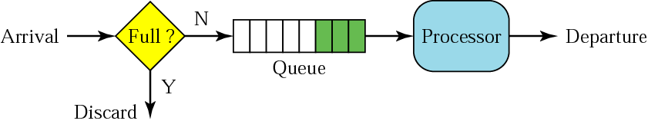
FIFO queue

Slide 25
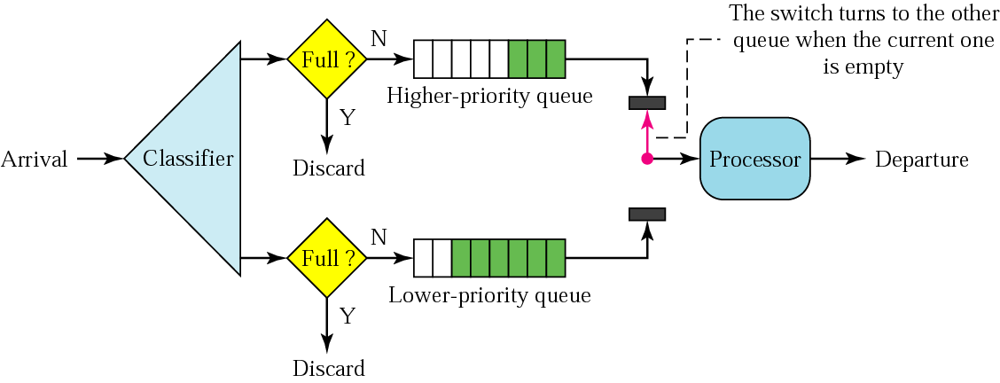
Priority queuing

Slide 26
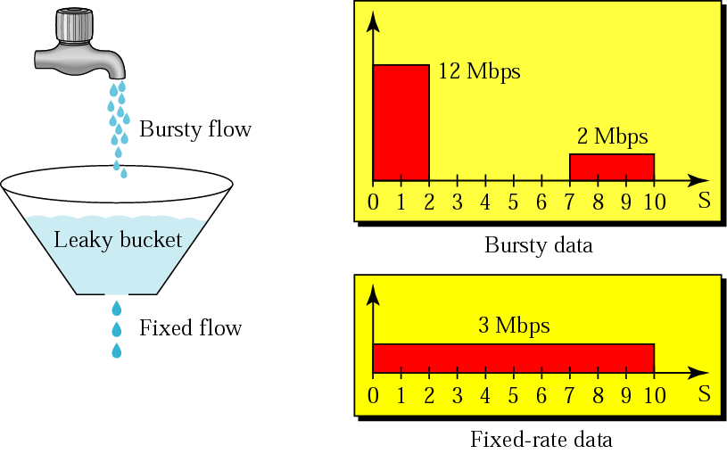
Leaky bucket

Slide 27
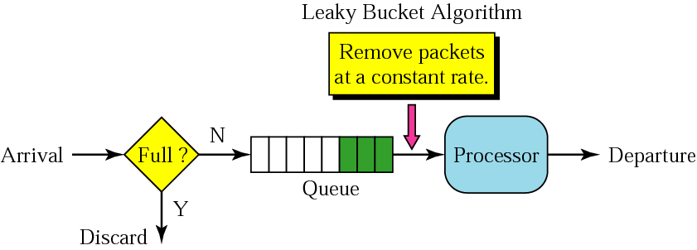
Leaky bucket implementation

Slide 28
A leaky bucket algorithm shapes bursty traffic into fixed-rate traffic by averaging the data rate. It may drop the packets if the bucket is full.

Slide 29
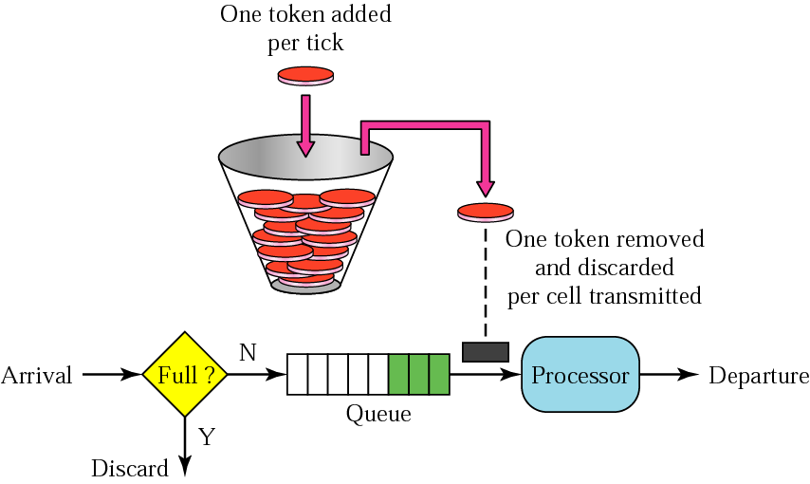
Token bucket

Slide 30
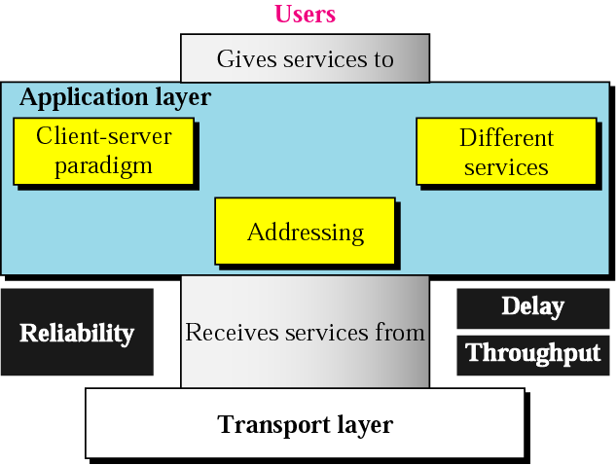
Application Layer : Duties ??
<number>
Notes:
<number>

Slide 31
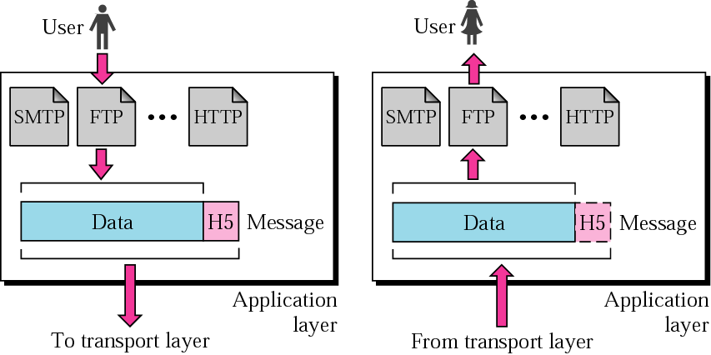
Application Layer : Application Services
<number>
Notes:
<number>

Slide 32
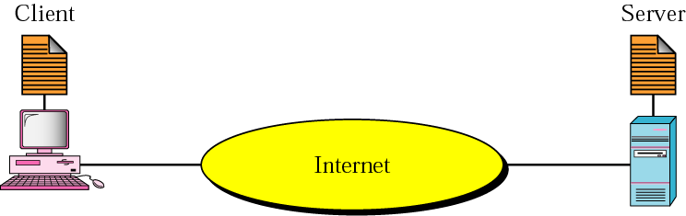
Client Server Model : Generic Diagram
<number>
Notes:
<number>

Slide 33
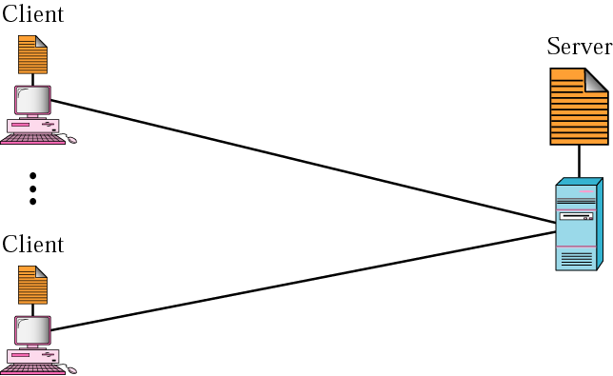
Client Server Relationship
<number>
Notes:
<number>

Slide 34
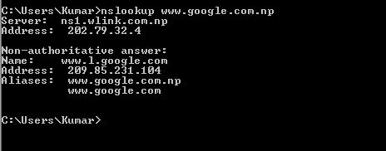
DNS : Domain Name System
<number>
Hierarchical Naming System Built on a Distributed Database.
Responsible to Translate Human Address into IP Address.
Example => How To Verify ??
Notes:
<number>

Slide 35
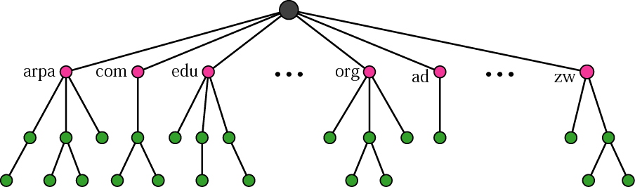
Domain Name System : Hierarchical Naming
<number>
Notes:
<number>

Slide 36
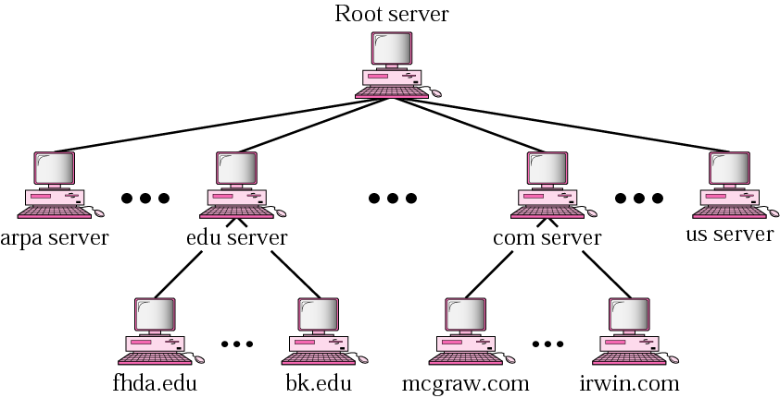
Domain Name System : Hierarchy of Name Servers
<number>
Notes:
<number>

Slide 37
Domain Name System : Types
<number>
Root Name Servers
Contracts Authoritative Name Server if Mapping Not Found.
Gets Mapping.
Returns Mapping to Local Name Server.
Top Level Domain Servers
Responsible for com, org, net.
All top level Country domains like us, uk, fr, np, in.
Authoritative Domain Servers
Organization’s DNS Servers.
Notes:
<number>

Slide 38
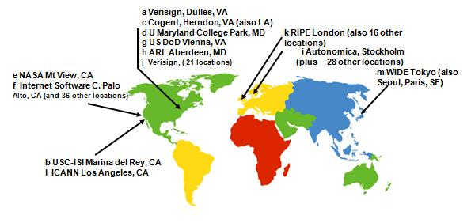
Domain Name Space : Root Name Servers
<number>
13 Root Name Servers Worldwide
Notes:
<number>

Slide 39
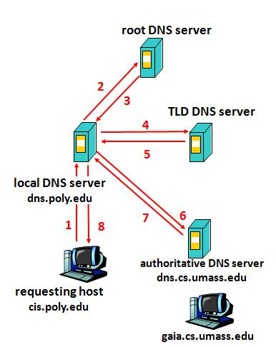
DNS Name Resolution : Iterated Query
<number>
Notes:
<number>

Slide 40
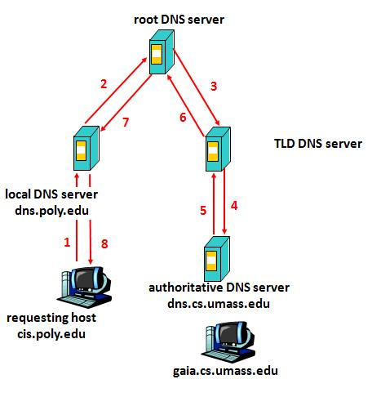
DNS Name Resolution : Recursive Query
<number>
Notes:
<number>

Slide 41
FTP : File Transfer Protocol
<number>
Protocol used to Copy File from One Host to Another.
It uses the Services of TCP.
It needs Two TCP Connections.
The Well Known Port 21 is used for Control Connection.
The Well Known Port 20 is used for Data Connection.
Notes:
<number>

Slide 42
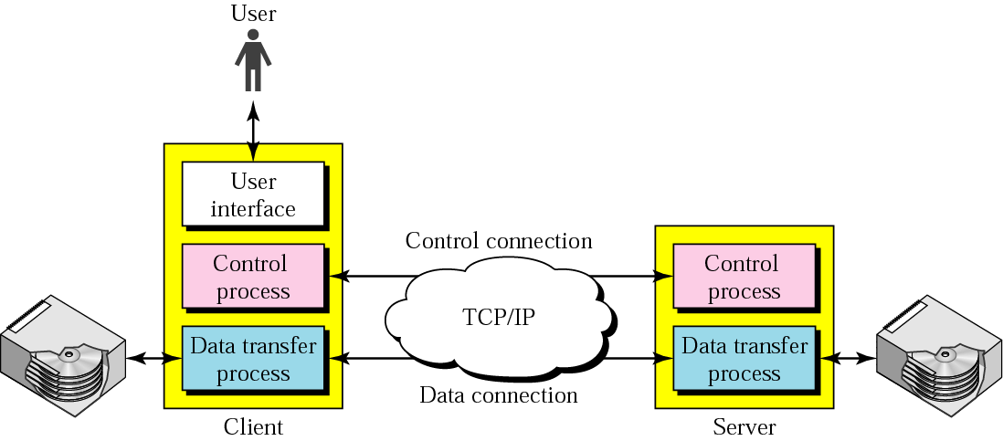
FTP : File Transfer Protocol
<number>
Notes:
<number>

Slide 43
HTTP : Hyper Text Transfer Protocol
<number>
Foundation of Data Communication For World Wide Web.
HTTP Functions as Request/Response Protocol in Client Server Computing Model.
Web Browser : Client
Web Server : Apache Web Server
HTTP is “Stateless” => No Information of Past Client Requests.
HTTP Connections => Non Persistent and Persistent.
Notes:
<number>

Slide 44
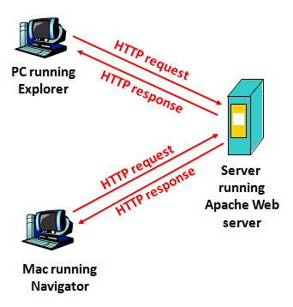
HTTP : Request/Response Protocol
<number>
Notes:
<number>

Slide 45
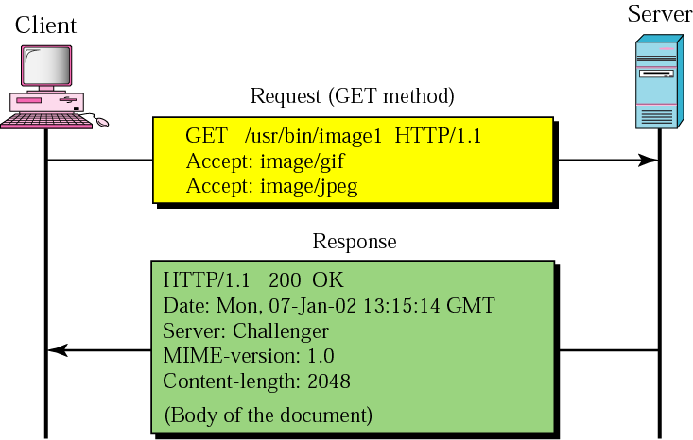
HTTP : Request/Response Example
<number>
Notes:
<number>

Slide 46
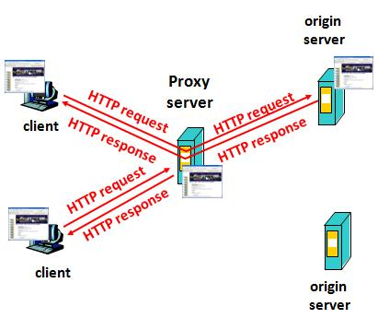
Proxy Server : Web Caching
<number>
Satisfy Client Request without Involving Origin Server
Notes:
<number>

Slide 47
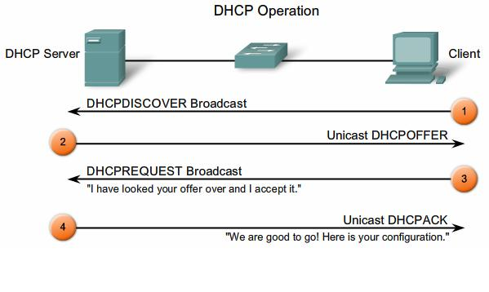
DHCP : Dynamic Host Configuration Protocol
<number>
Notes:
<number>

Slide 48
SMTP : Simple Mail Transfer Protocol
<number>
Internet Standard for Electronic Mail Transmission.
It is Specified for Outgoing Mail Transport.
Uses TCP Port No 25.
For Receiving Messages Clients Use IMAP or POP.
IMAP : Internet Message Access Protocol
POP : Post Office Protocol
Notes:
<number>

Slide 49
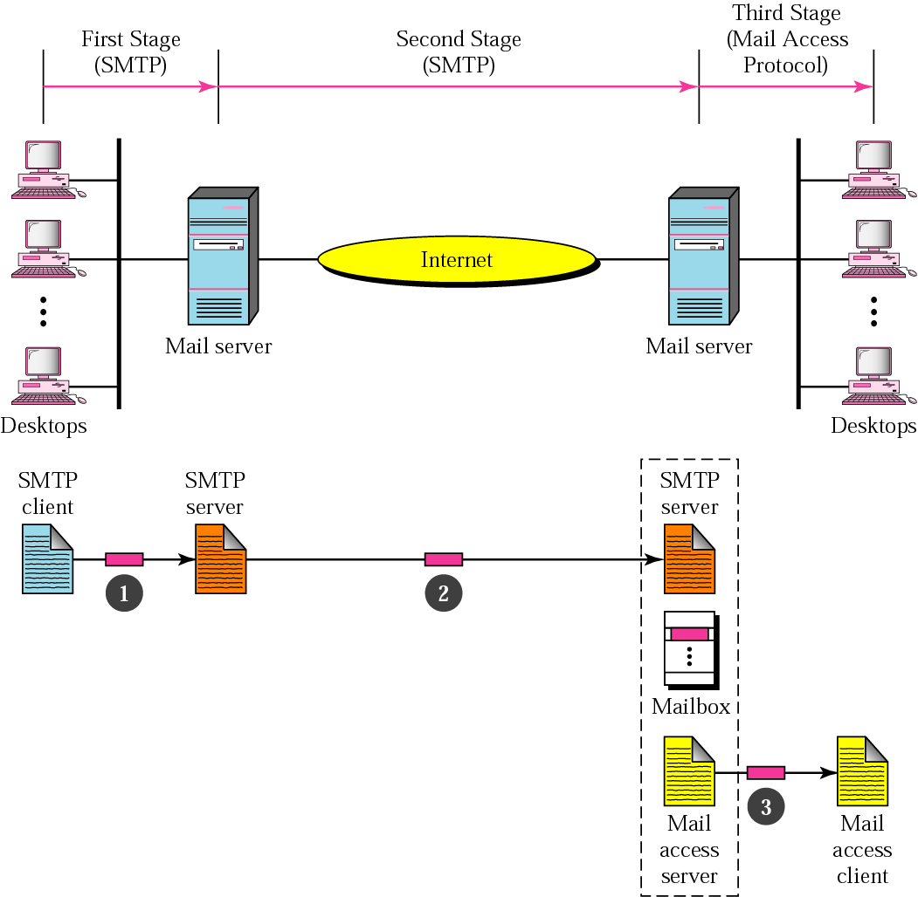
SMTP : Example
<number>
Notes:
<number>

Slide 50
POP : Post Office Protocol
<number>
Application Layer Protocol used by Email Clients to retrieve Email From Remote Server.
POP Version 3 is referred as POP3.
A POP3 Servers Listens on Well Know Port 110.
Encryption Communication for POP3 Using SSL.
It uses Well Known TCP Port 995 (Eg. Google Gmail).
Notes:
<number>

Slide 51
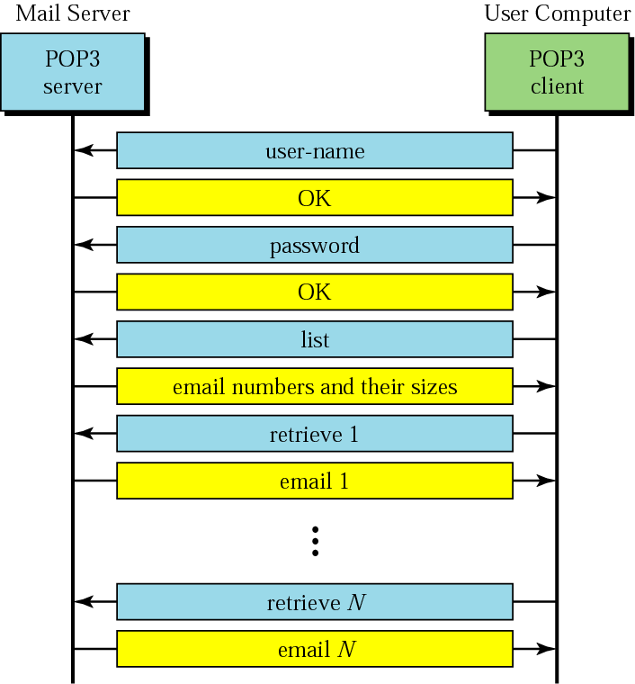
POP3 : Post Office Protocol Version 3 (Steps)
<number>
Notes:
<number>

Slide 52
IMAP : Internet Message Access Protocol
<number>
It is one of the Prevalent Application Layer Protocol for Email Retrieval.
All Modern Email Clients and Servers Supports IMAP.
An IMAP Server Listens at Port 143.
IMAP4 is referred as IMAP Version 4.
Multiple Clients can Simultaneously connect to Same Mailbox.
It allows Connected and Disconnected Mode of Operation.
Multiple Mailboxes on the Server.
Notes:
<number>

Slide 53
Tools For Client Server:
<number>
Web Servers and Clients
Apache Tomcat
Microsoft IIS
Oracle Web Tier
Internet Explorer
Google Chrome
Mozilla Firefox
Email Servers and Clients
Microsoft Exchange Server
Horde
WorldClient
Microsoft Outlook Express
Thunderbird
Notes:
<number>

Slide 54
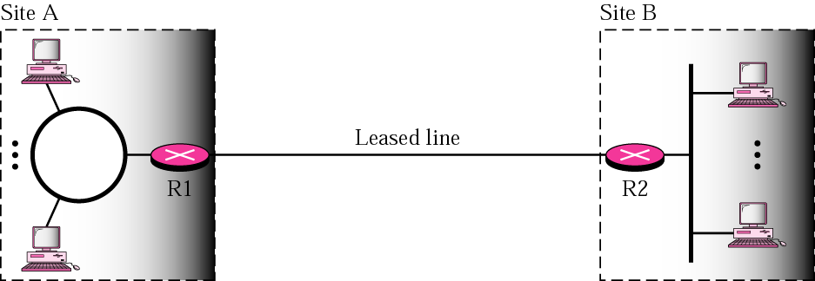
Private Networks
<number>
Notes:
<number>

Slide 55
Hybrid Networks : What it is ??
<number>
Two Links => Private and Public
Private Link => Leased Line or Optical Fiber
Private Link for Intranet
Public Link for Internet.
All Intraorganization data are routed through the Private Link.
All Interorganization data are routed through the Public Link.
Notes:
<number>

Slide 56
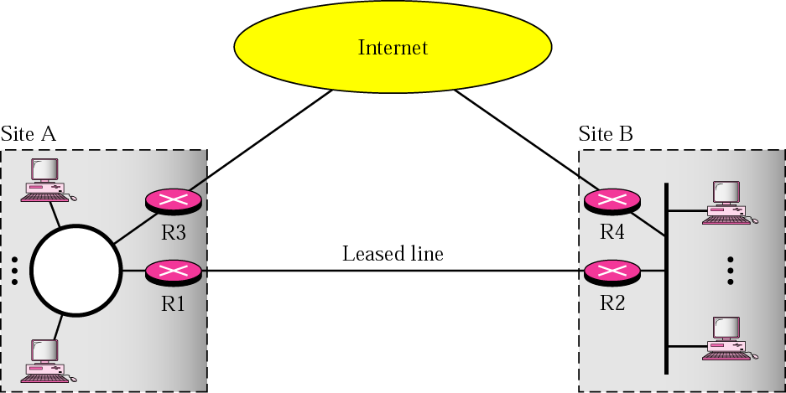
Hybrid Networks
<number>
Notes:
<number>

Slide 57
VPN : Virtual Private Networks
<number>
Both Private and Hybrid Networks are Expensive.
Solution to use global Internet for both Private and Public Communication => VPN
VPN Creates a Network that is Private but Virtual.
It is Private because it guarantees Privacy inside the Organization.
It is Virtual because it does not use Real Private WANs.
The Network is Physically Public but Virtually Private.
VPN Use IPSec in the Tunnel Mode to Provide Authentication, Integrity and Privacy.
Notes:
<number>

Slide 58
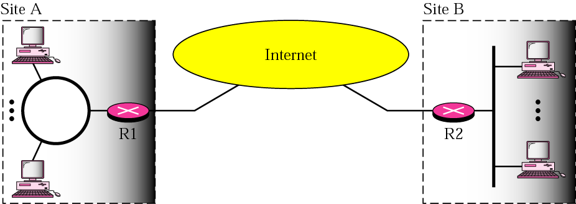
VPN : Virtual Private Networks
<number>
Notes:
<number>

Slide 59
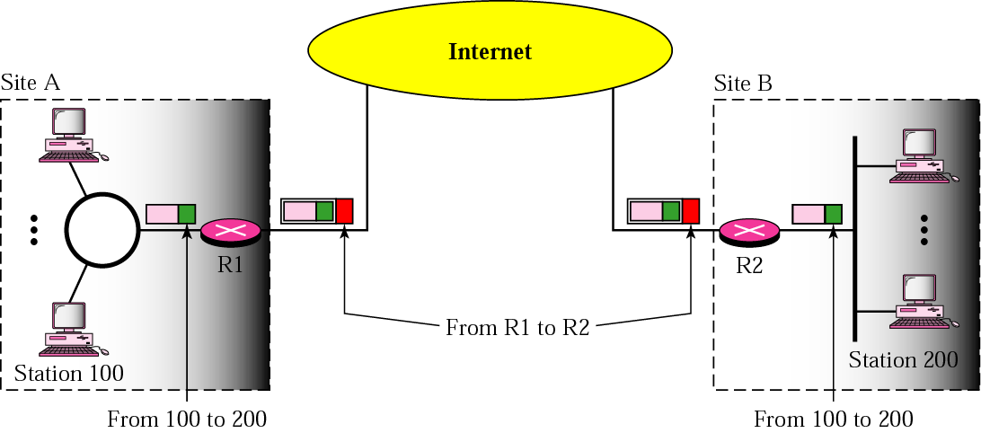
Addressing in VPN
<number>
To use IPSec in Tunneling mode VPN need to use Two sets of Addressing
Notes:
<number>

Slide 60
<number>
Thank You

