Slide 1
Introduction to OpenCV
David Stavens
Stanford Artificial Intelligence Lab

Slide 2
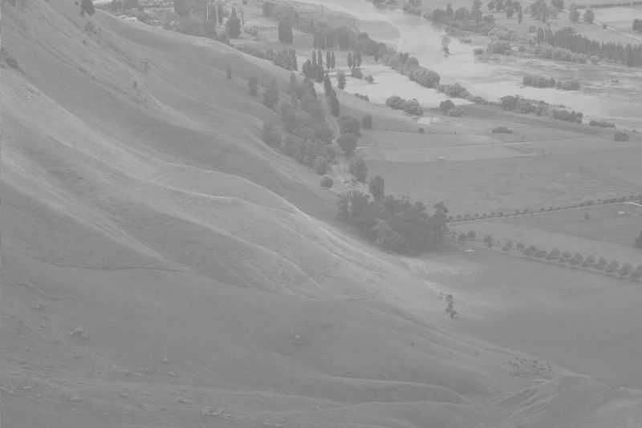
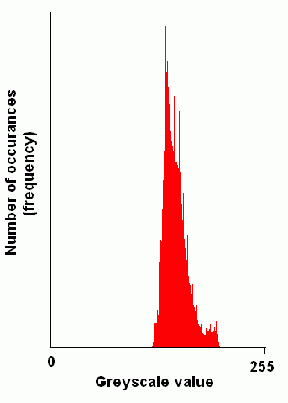
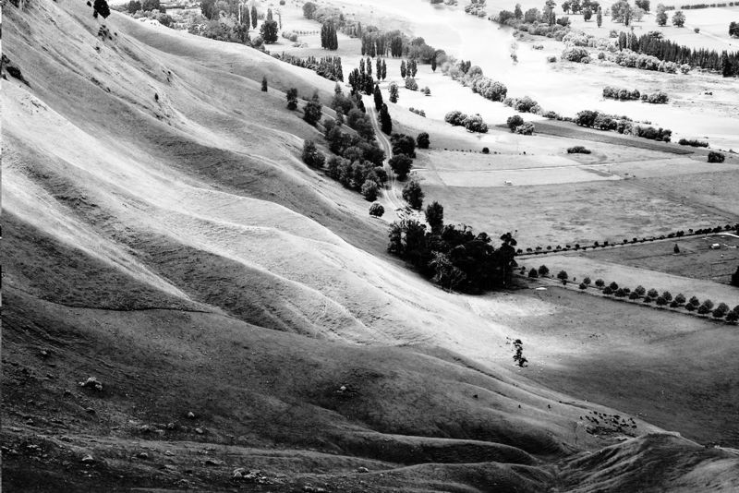
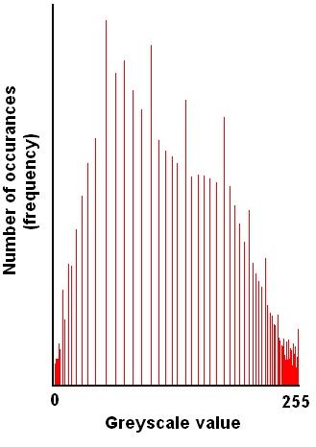
Aside: Histogram Equalization
Images are from Wikipedia.

Slide 3
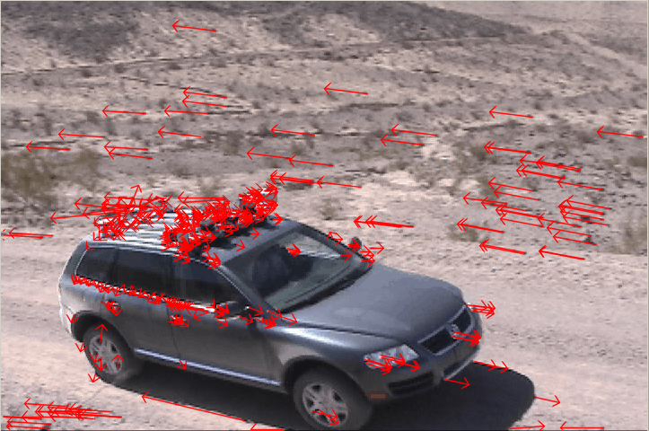
Today we’ll code:
A fully functional sparse optical flow algorithm!

Slide 4
Plan
OpenCV Basics
  What is it?
  How do you get started with it?
Feature Finding and Optical Flow
  A brief mathematical discussion.
OpenCV Implementation of Optical Flow
  Step by step.

Slide 5

What is OpenCV?
Created/Maintained by Intel.
Really four libraries in one:
  “CV” – Computer Vision Algorithms
    All the vision algorithms.
  “CVAUX” – Experimental/Beta
  “CXCORE” – Linear Algebra
    Raw matrix support, etc.
  “HIGHGUI” – Media/Window Handling
    Read/write AVIs, window displays, etc.
Check out the samples directory!

Slide 6
Installing OpenCV
Download from:
  http://sourceforge.net/projects/opencvlibrary/
Be sure to get Version 1.0.0.
Windows version comes with an installer.
Linux: (Install ffMPEG first!)
  gunzip opencv-1.0.0.tar.gz; tar –xvf opencv-1.0.0.tar
  cd opencv-1.0.0; ./configure --prefix=/usr; make
  make install [as root]

Slide 7
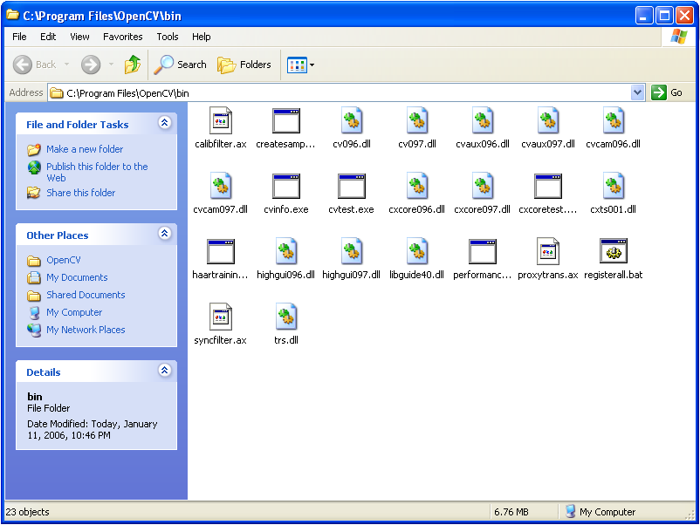
Copy all the DLLs in \OpenCV\bin to \WINDOWS\System32.

Slide 8
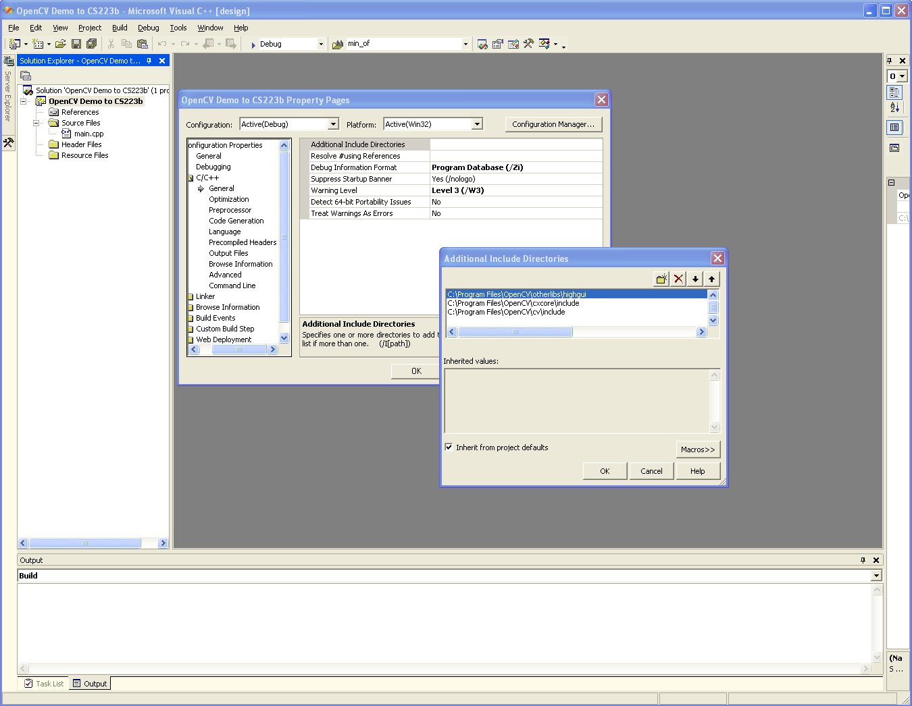
Tell Visual Studio where the includes are. (Import a C file first.)

Slide 9
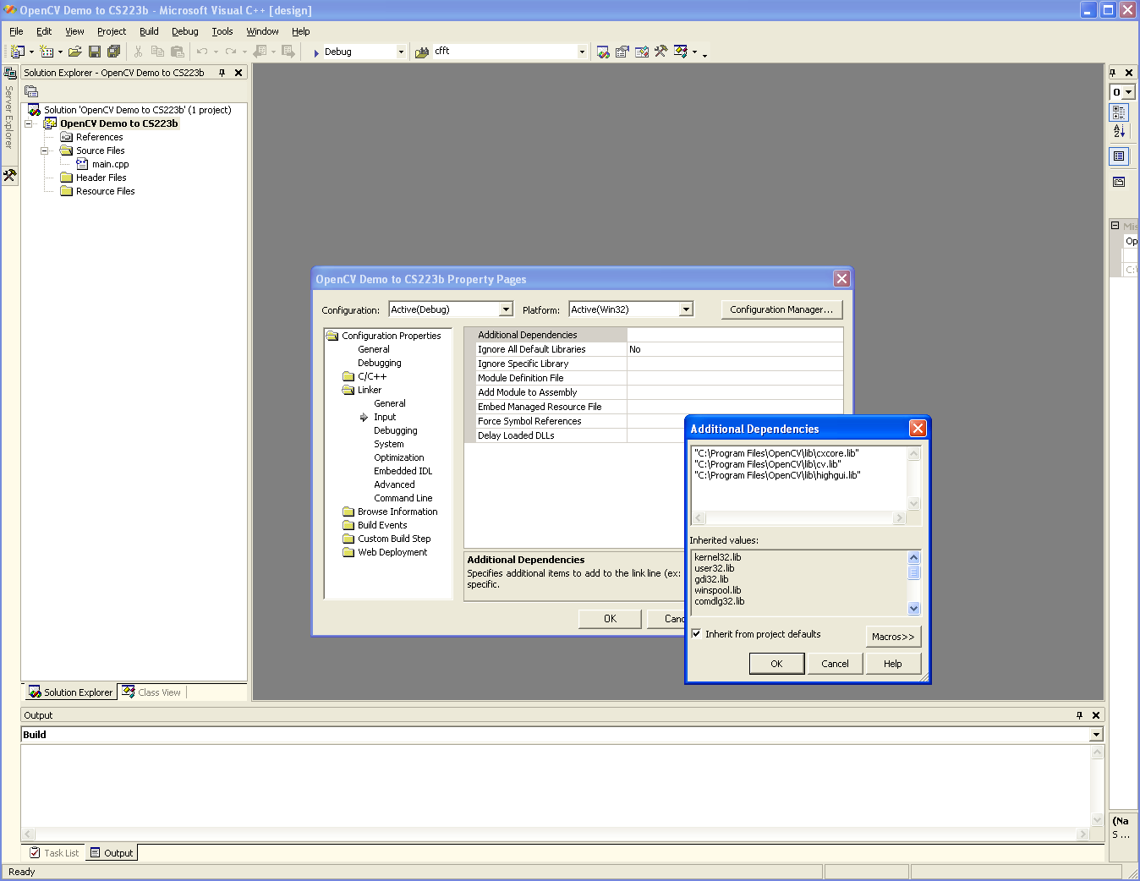
Tell Visual Studio to link against cxcore.lib, cv.lib, and highgui.lib.

Slide 10
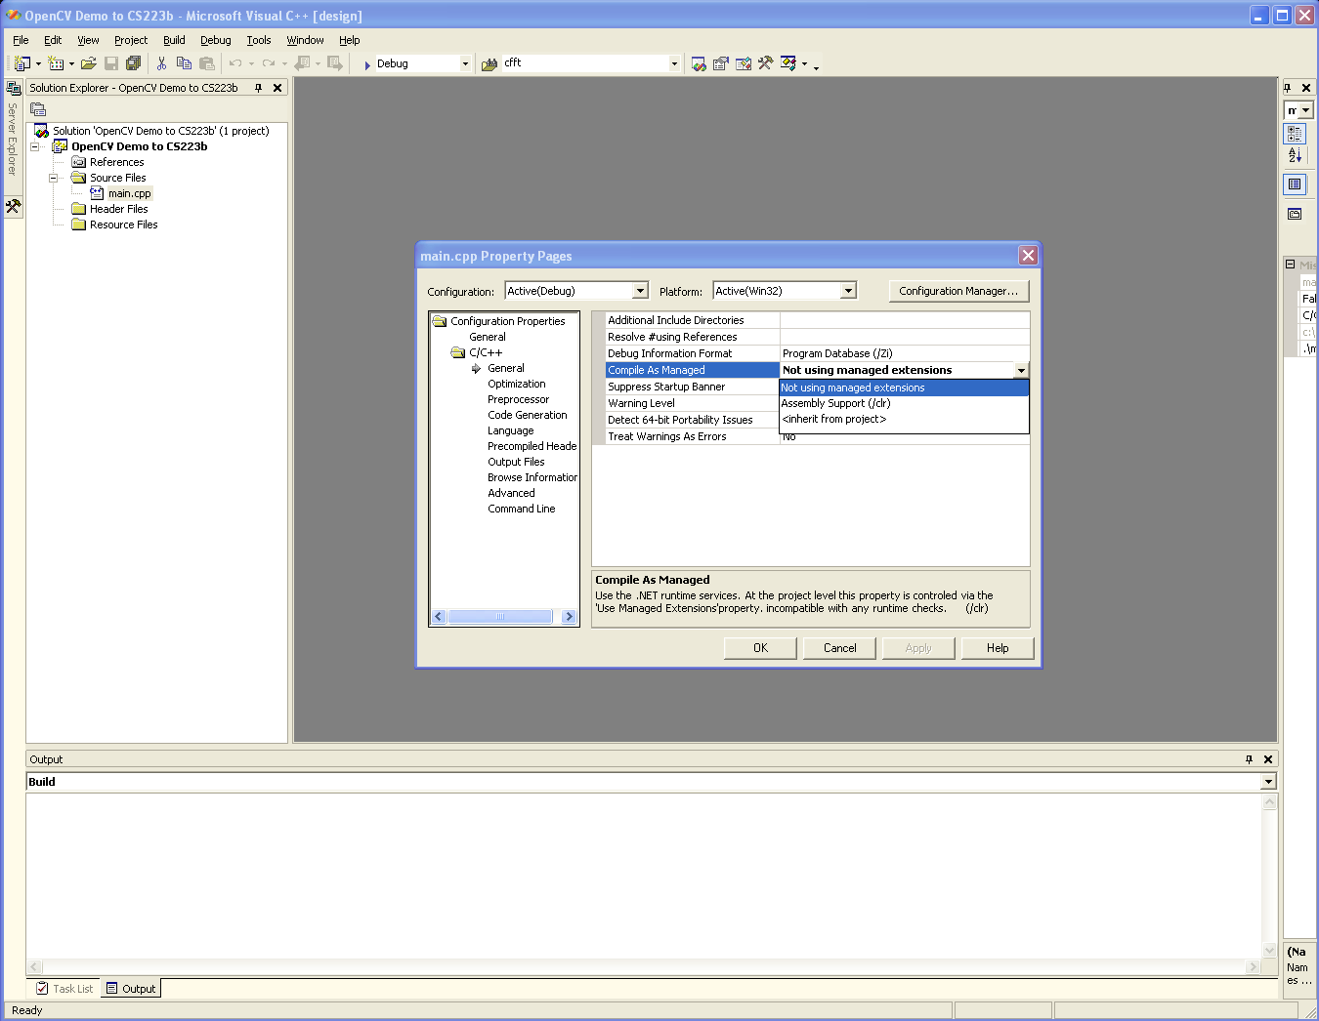
Tell Visual Studio to disable managed extensions.

Slide 11
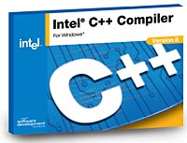

Better Performance: ICC and IPL
Intel C/C++ Compiler
Intel Integrated
Performance Primitives
~30 – 50% Speed Up

Slide 12
Plan
OpenCV Basics
  What is it?
  How do you get started with it?
Feature Finding and Optical Flow
  A brief mathematical discussion.
OpenCV Implementation of Optical Flow
  Step by step.

Slide 13
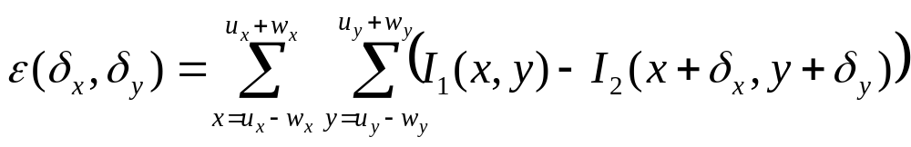
Optical Flow: Overview
Given a set of points in an image, find those same points in another image.
or, given point [u_{x}, u_{y}]^{T} in image I₁ find the point [u_{x} + δ_{x}, u_{y} + δ_{y}]^{T} in image I₂ that minimizes ε:
(the Σ/w’s are needed due to the aperture problem)

Slide 14
Optical Flow: Utility
Tracking points (“features”) across multiple images is a fundamental operation in many computer vision applications:
  To find an object from one image in another.
  To determine how an object/camera moved.
  To resolve depth from a single camera.
Very useful for the 223b competition.
  Determine motion. Estimate speed.
But what are good features to track?

Slide 15
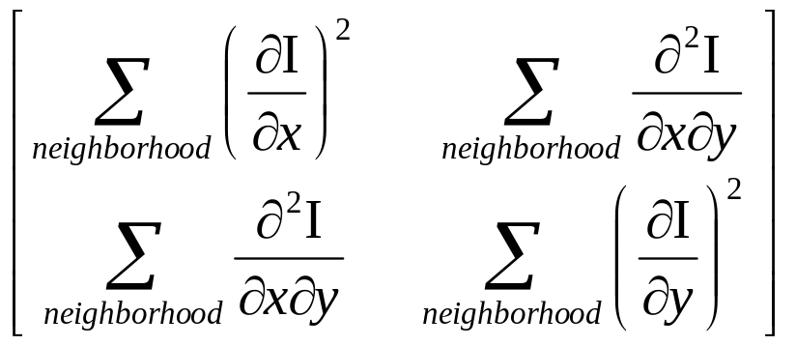
Finding Features: Overview
Intuitively, a good feature needs at least:
  Texture (or ambiguity in tracking)
  Corner (or aperture problem)
But what does this mean formally?
Shi/Tomasi. Intuitive result really part of motion equation. High eigenvalues imply reliable solvability. Nice!
A good feature has big eigenvalues, implies:
  Texture
  Corner

Slide 16
Plan
OpenCV Basics
  What is it?
  How do you get started with it?
Feature Finding and Optical Flow
  A brief mathematical discussion.
OpenCV Implementation of Optical Flow
  Step by step.

Slide 17
So now let’s code it!
Beauty of OpenCV:
  All of the Above = Two Function Calls
  Plus some support code :-)
Let’s step through the pieces.
These slides provide the high-level.
  Full implementation with extensive comments:
    http://ai.stanford.edu/~dstavens/cs223b

Slide 18
ai.stanford.edu/~dstavens/cs223b
Three versions of the code:
  optical_flow_demo.cpp.windows
    For Windows, full functionality.
  optical_flow_demo.cpp.linux.limited_api
    OpenCV for Linux missing some functions.
  optical_flow_demo.cpp.linux.full_api
    For Mac OS X? Full functionality?
    Also for Linux if/when API complete.

Slide 19
Step 1: Open Input Video
CvCapture *input_video =
  cvCaptureFromFile(“filename.avi”);
Failure modes:
  The file doesn’t exist.
  The AVI uses a codec OpenCV can’t read.
    Codecs like MJPEG and Cinepak are good.
    DV, in particular, is bad.

Slide 20
Step 2: Read AVI Properties
CvSize frame_size;
frame_size.height =
  cvGetCaptureProperty( input_video,
  CV_CAP_PROP_FRAME_HEIGHT );
Similar construction for getting the width and the number of frames.
  See the handout.

Slide 21
Step 3: Create a Window
cvNamedWindow(“Optical Flow”,
CV_WINDOW_AUTOSIZE);
We will put our output here for visualization and debugging.

Slide 22
Step 4: Loop Through Frames
Go to frame N:
  cvSetCaptureProperty( input_video,
  CV_CAP_PROP_POS_FRAMES, N );
Get frame N:
  IplImage *frame = cvQueryFrame(input_video);
  Important: cvQueryFrame always returns a pointer to the same location in memory.

Slide 23
Step 5: Convert/Allocate
Convert input frame to 8-bit mono:
  IplImage *frame1 =
    cvCreateImage( cvSize(width, height), IPL_DEPTH_8U, 1);
  cvConvertImage( frame, frame1 );
Actually need third argument to conversion: CV_CVTIMG_FLIP.

Slide 24
Step 6: Run Shi and Tomasi
CvPoint2D32f frame1_features[N];
cvGoodFeaturesToTrack(
  frame1, eig_image, temp_image,
  frame1_features, &N, .01, .01, NULL);
Allocate eig,temp as in handout.
On return frame1_features is full and N is the number of features found.

Slide 25
Step 7: Run Optical Flow
char optical_flow_found_feature[];
float optical_flow_feature_error[];
CvTermCriteria term =
  cvTermCriteria( CV_TERMCRIT_ITER |
  CV_TERMCRIT_EPS, 20, .3 );
cvCalcOpticalFlowPyrLK( … );
  13 arguments total. All of the above.
    Both frames, both feature arrays, etc.
  See full implementation in handout.

Slide 26
Step 8: Visualize the Output
CvPoint p, q;
p.x = 1; p.y = 1; q.x = 2; q.y = 2;
CvScalar line_color;
line_color = CV_RGB(255, 0, 0);
int line_thickness = 1;
cvLine(frame1, p,q, line_color, line_thickness, CV_AA, 0);
cvShowImage(“Optical Flow”, frame1);
CV_AA means draw the line antialiased.
0 means there are no fractional bits.

Slide 27
Step 9: Make an AVI output
CvVideoWriter *video_writer =
  cvCreateVideoWriter( “output.avi”,
  -1, frames_per_second, cvSize(w,h) );
(“-1” pops up a nice GUI.)
cvWriteFrame(video_writer, frame);
  Just like cvShowImage(window, frame);
cvReleaseVideoWriter(&video_writer);

Slide 28
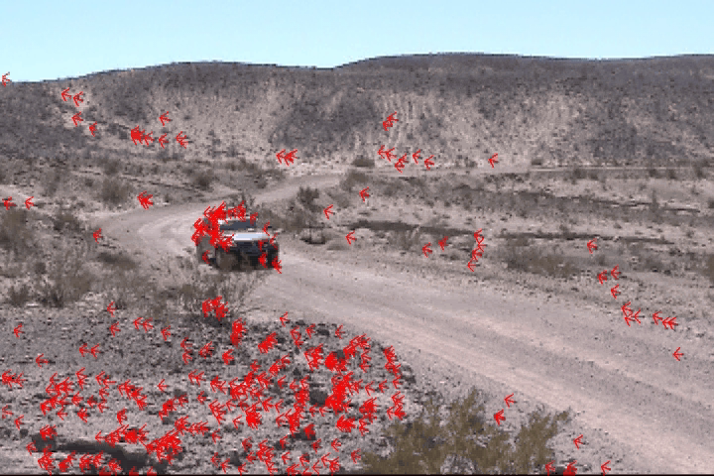
Let’s watch the result:
(Stanley before turning blue.)

Slide 29
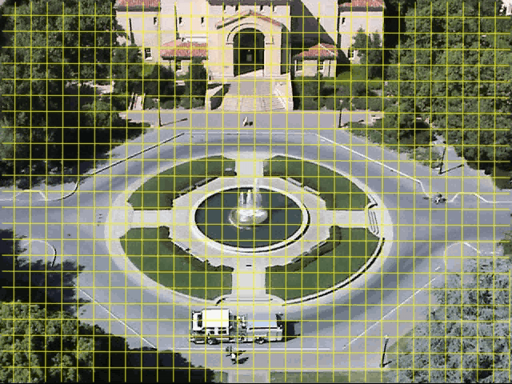
That’s the first step for…
Stavens, Lookingbill, Lieb, Thrun; CS223b 2004; ICRA 2005

Slide 30
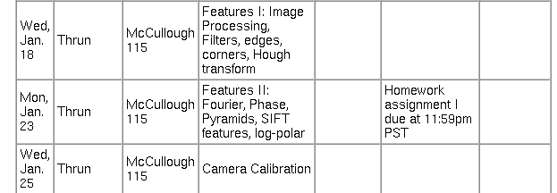
Corresponding functions…
cvSobel, cvLaplace, cvCanny, cvCornerHarris, cvGoodFeaturesToTrack,
cvHoughLines2, cvHoughCircles
cvWarpAffine, cvWarpPerspective,
cvLogPolar, cvPyrSegmentation
cvCalibrateCamera2,
cvFindExtrinsicCameraParams2,
cvFindChessboardCorners,
cvUndistort2, cvFindHomography,
cvProjectPoints2

Slide 31
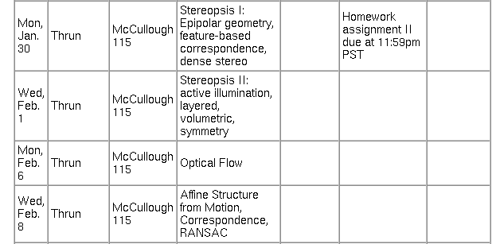
Corresponding functions…
cvFindFundamentalMat,
cvComputeCorrespondEpilines,
cvConvertPointsHomogenious,
cvCalcOpticalFlowHS,
cvCalcOpticalFlowLK
cvCalcOpticalFlowPyrLK,
cvFindFundamentalMat (RANSAC)

Slide 32
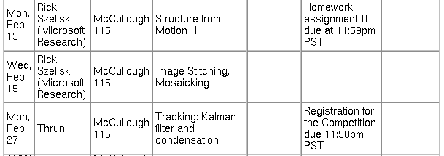
Corresponding functions…
cvMatchTemplate, cvMatchShapes, cvCalcEMD2,
cvMatchContourTrees
cvKalmanPredict,
cvConDensation, cvAcc
cvMeanShift, cvCamShift

Slide 33
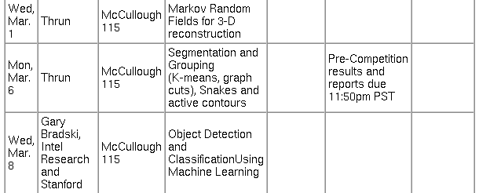
Corresponding functions…
cvSnakeImage, cvKMeans2,
cvSeqPartition, cvCalcSubdivVoronoi2D,
cvCreateSubdivDelaunay2D
cvHaarDetectObjects

Slide 34
A few closing thoughts…
Feel free to ask questions!
  david.stavens@ai.stanford.edu
  My office: Gates 254
Good luck!! 223b is fun!! :-)

