Slide 1

SMART INDIA HACKATHON 2026
TERRA-DELTA
Problem Statement ID – SIH260009
Problem Statement Title- Change detection due to human activities.
Theme- Space Technology
PS Category- Software
Team ID-
Team Name (Registered on portal)- Team Respawn

Slide 2
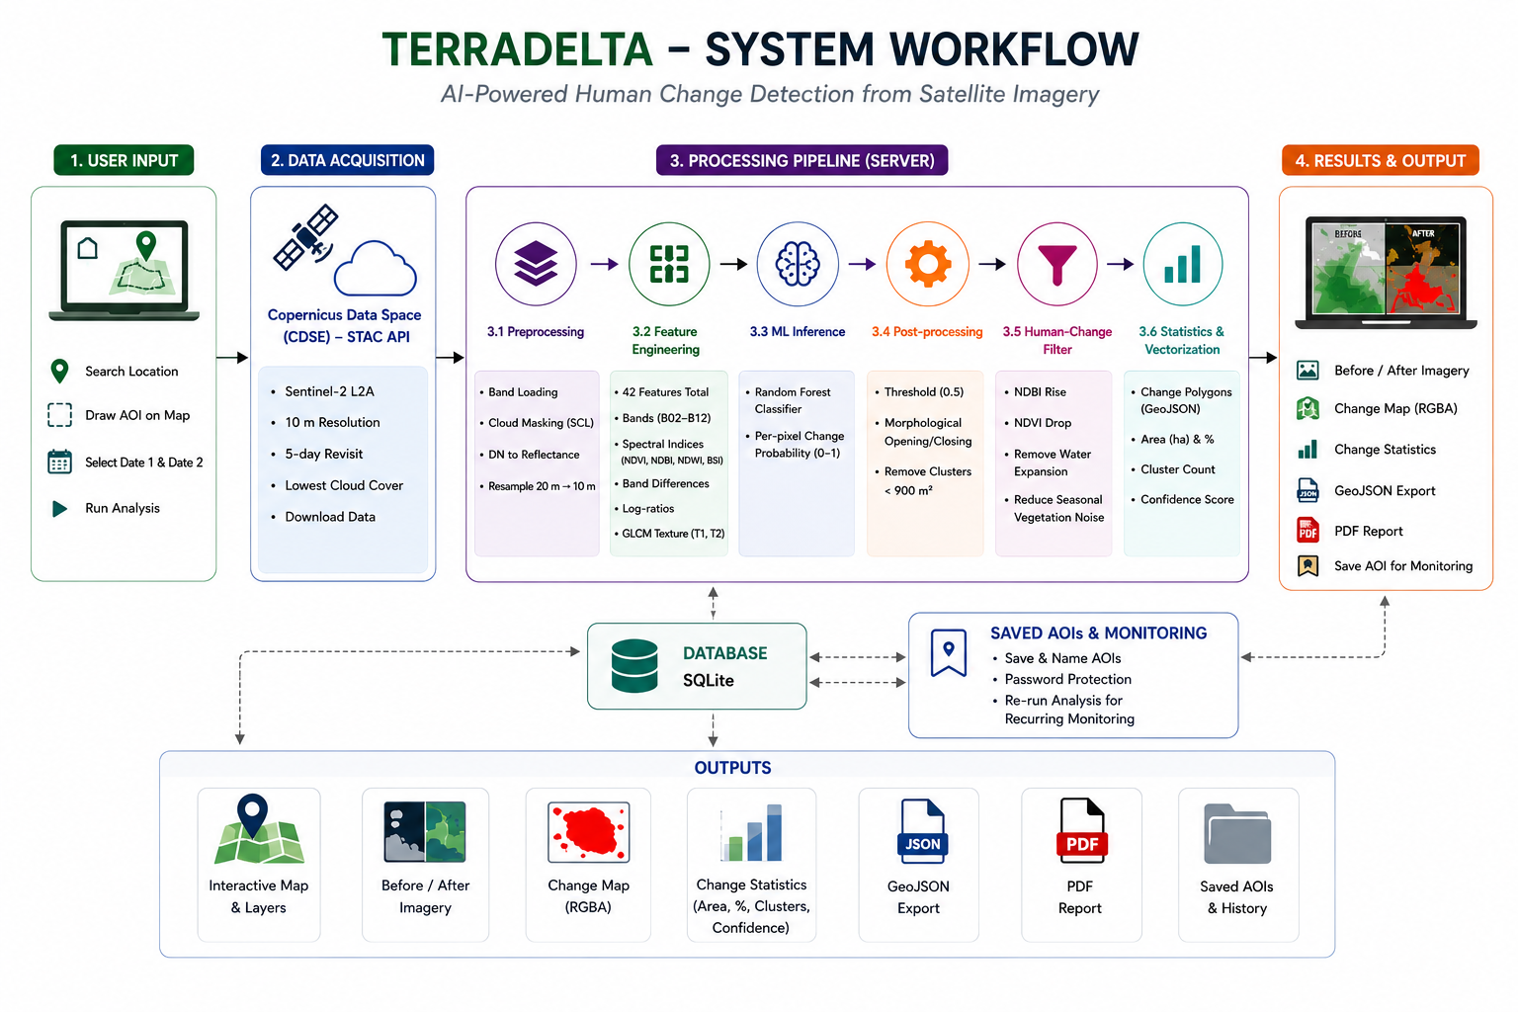
TERRA-DELTA
TEAM RESPAWN
PROPOSED SOLUTION
SYSTEM ARCHITECTURE
TerraDelta MVP
• No accessible, automated tool converts raw Sentinel-2 imagery into actionable human-change intelligence for non-GIS users.
• User selects location, draws AOI, picks two dates → AI pipeline returns change map, statistics, and PDF report in under 90 seconds.
• Data: ESA Sentinel-2 L2A — 10 m resolution, free, global, 5-day revisit via Copernicus Data Space.
• AI: Random Forest classifier on 42 spectral, texture and temporal features; Siamese ResNet-18 as comparison path.
• Human-change filter: NDBI, NDVI, BSI rules isolate built-up signals and suppress floods, crop cycles and seasonal noise.
• Outputs: Before/After imagery, RGBA change mask, GeoJSON polygons, changed area (ha), change %, cluster count, confidence score, PDF report.
UNIQUE VALUE PROPOSITION
DETECT → UNDERSTAND → MONITOR → DECIDE
• DETECT — Automated human-activity change detection from free Sentinel-2; no GIS expertise or manual digitisation.
• UNDERSTAND — Change Explorer: development, vegetation and environmental shifts with real Before/After context.
• MONITOR — Protected Area Monitoring: save and password-protect AOIs for recurring, team-accessible monitoring without redrawing.
• DECIDE — Quantified outputs (area, %, confidence, clusters, PDF) feed directly into planning, compliance, insurance and infrastructure decisions.
WEBSITE LINK: terradelta.vercel.app

Slide 3
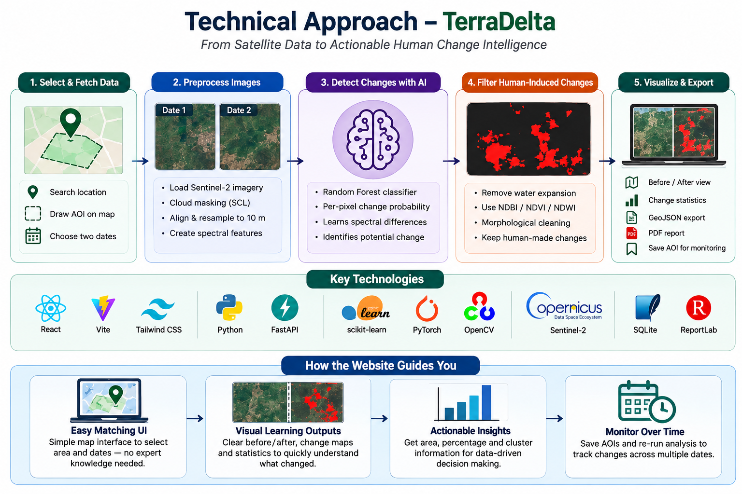
TECHNICAL APPROACH
TEAM
RESPAWN
TECHNOLOGICAL STACK
• Frontend — React 18, Vite, Tailwind CSS, React-Leaflet: interactive map, AOI drawing, layer toggle, timeline chart.
• Backend / API — Python, FastAPI, SQLite, SQLAlchemy: async job queue, result persistence, static file serving.
• AI / ML — scikit-learn Random Forest, PyTorch Siamese ResNet-18 comparison, NumPy: change-probability inference.
• Geospatial / Image — Rasterio, OpenCV, scikit-image, SciPy, GeoPandas, Shapely: band prep, GLCM texture, morphology, vectorisation.
• Reporting / Deploy — ReportLab, Docker, Render + Vercel: automated report generation and cloud deployment.
MVP MODEL
• Primary: Random Forest on 42 engineered features — CPU-only, interpretable feature importances, no GPU required, suitable for student-scale deployment.
• Comparison path: Siamese ResNet-18 patch classifier — built, under evaluation; trained on synthetic data. Real-data training and F1 benchmarking against RF are validation work, not a deployed production model.
• Both models use synthetic Sentinel-2-like data for demo; OSCD real-data training is the next milestone.

Slide 4
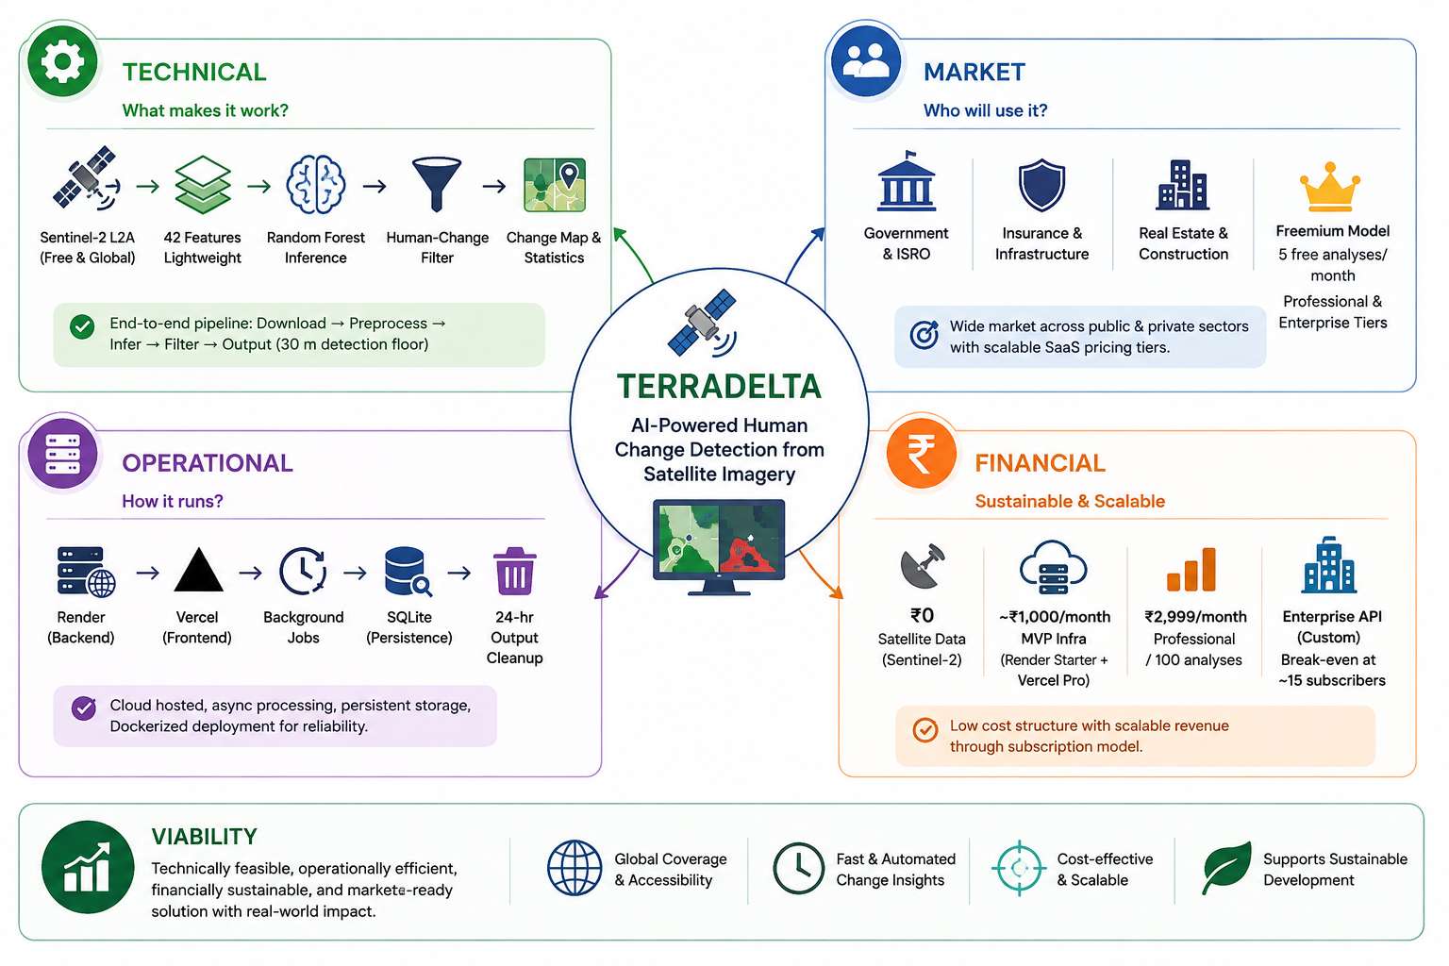
FEASIBILITY AND VIABILITY
TEAM
RESPAWN
FEASIBILITY
CHALLENGES / CURRENT CONSTRAINTS
• Sentinel-2 10 m resolution limits detection to objects ≥30 m.
• Spectrally ambiguous pixels can misclassify irrigated bare soil vs construction.
• Demo model uses synthetic data; real-world F1 not yet validated on held-out labelled scenes.
• CDSE free-tier download latency and persistent cloud cover can limit availability.
• Concurrent long jobs may queue; single background worker is a scale bottleneck.
VIABILITY
1. End-to-end pipeline is built and tested;
2. Free satellite data removes the largest scaling cost barrier;
3. Protected Area Monitoring + PDF reporting encourage institutional repeat use;
4. Modular design supports RF → U-Net upgrades;
5. Aligns with the stated change-detection need.

Slide 5
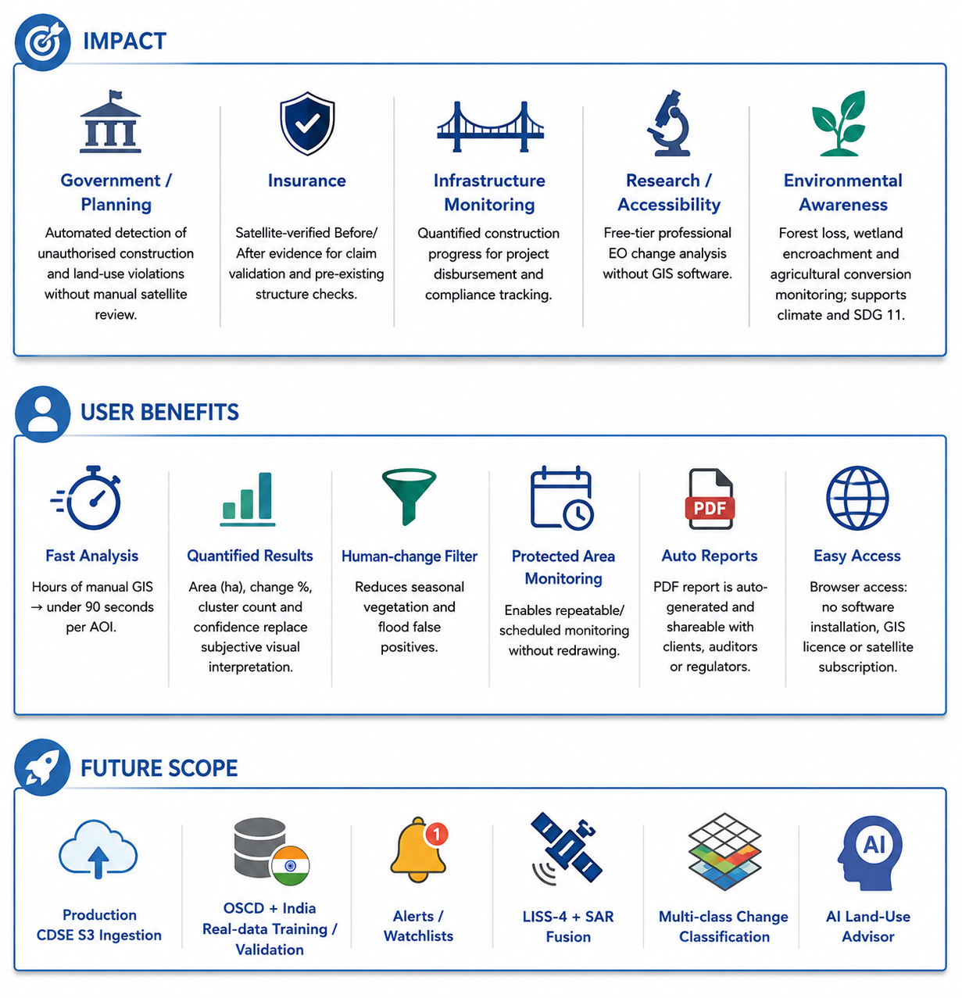
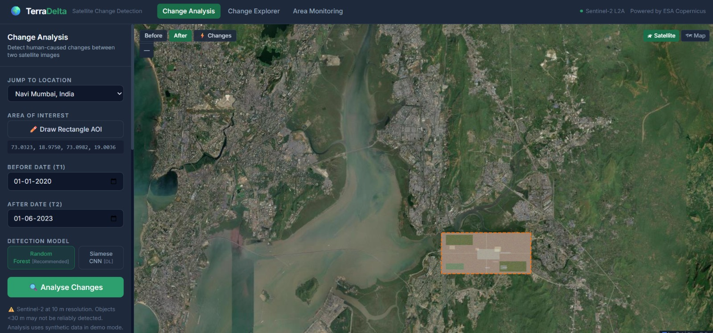
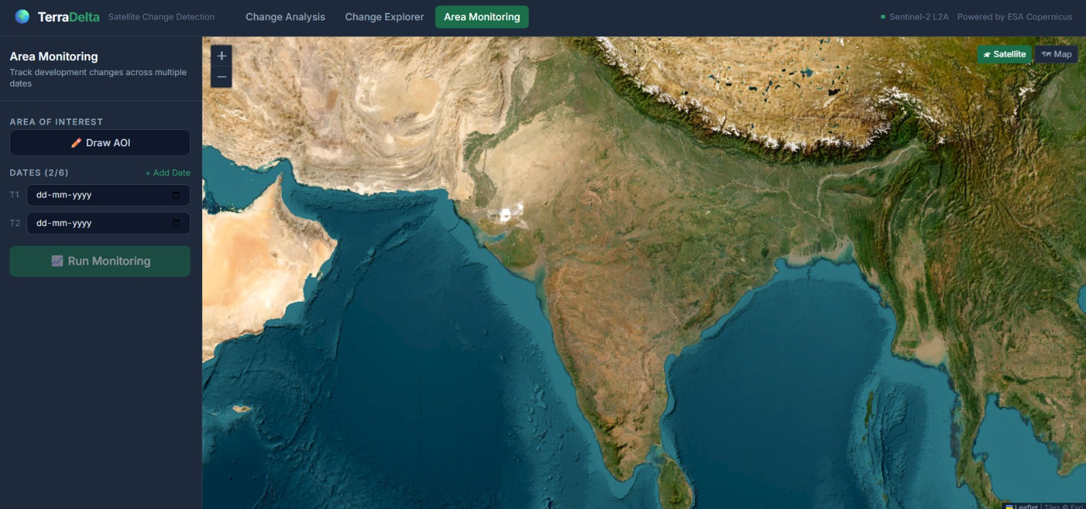
IMPACT AND BENEFITS
TEAM
RESPAWN
WORKING PRODUCT
PASTE WEBSITE SCREENSHOT 1
PASTE WEBSITE SCREENSHOT 2

Slide 6
RESEARCH AND REFERENCES
TEAM
RESPAWN
RESEARCH / REFERENCES
COMPETITIVE COMPARISON
Research Base
ESA Sentinel-2 Mission — Level-2A Surface Reflectance Product Guide (sentinel.esa.int).
Copernicus Data Space Ecosystem STAC API & S3 Data Access (dataspace.copernicus.eu).
Daudt, H.M.C. et al. — Fully Convolutional Siamese Networks for Change Detection (IEEE ICIP, 2018).
OSCD — Onera Satellite Change Detection Dataset (24 labelled Sentinel-2 city pairs).
Bruzzone, L. & Prieto, D.F. — Automatic Analysis of the Difference Image for Unsupervised Change Detection (IEEE TGRS, 2000).
ISRO / NRSC — Bhuvan Geoportal and Resourcesat-2 LISS-4 Data Access (bhuvan.nrsc.gov.in).
UN DESA — World Urbanization Prospects 2022.
Google Earth Engine — Cloud-based geospatial analysis platform overview.
Parameter | TerraDelta | Google Earth Engine | ISRO Bhuvan | Planet Explorer
Primary Focus | Human change detection + decision support | General geospatial analysis platform | Indian EO data portal & visualisation | Commercial high-res imagery subscription
AOI + Date Workflow | Draw AOI → pick dates → automated pipeline | Custom scripting required | Manual visual exploration | Manual or API (paid)
Automated Change Detection | ✔ Built-in (RF + filter) | Available via scripting (requires GIS expertise) | Not a core automated feature | Available via paid analytics add-on
Area / % / Confidence | ✔ Auto-computed, report-ready | Requires custom script to compute | Not automated | Available in paid tiers
Human-Change Interpretation | ✔ Spectral filter separates human vs environmental change | Not built-in; user-defined logic | Not available | Not available
Recurring AOI Monitoring | ✔ Protected Area Monitoring (save + revisit) | Possible via scripting | Not a core feature | Available (paid subscription)
No-code / No-GIS Access | ✔ Browser, no software needed | Requires JavaScript/Python coding | Browser viewer; limited analysis | Browser; analysis requires paid plan
Data Access Model | Free Sentinel-2 + Freemium | Free (GEE quota-limited) | Free (ISRO datasets) | Paid subscription (Planet imagery)
FINAL POSITIONING — TerraDelta is a focused, automated Earth-change decision-support layer built on freely available EO data; it is not a general-purpose GIS platform or a replacement for commercial high-resolution imagery. Its value is converting raw satellite data into quantified, human-change-specific intelligence for planners, insurers and developers without geospatial expertise.

