Slide 1

Discover R

Slide 2
Welcome to Discover R!
Introducing our teaching team:
Hayam Mahmoud-Ahmed
Simon Leger
Aaron Newman
Danny Godfrey
Jordan Gardiner Murwan Bashir

Slide 3

Equity, Diversity, & Inclusion
SURGE is a safe space where everyone should feel welcome and included, free to pursue opportunities, and free express divergent opinions in the spirit of productive academic exchange.

Slide 4
Recognition of Mi’kmaq Territory
Dalhousie University is located in Mi’kma’ki, the ancestral and unceded territory of the Mi’kmaq. We are all Treaty people.

Slide 5
Code of Conduct
In addition to Dalhousie’s Code of Student Conduct, in Discover Coding we employ the Carpentries’ Code of Conduct:
Use welcoming and inclusive language
Be respectful of different viewpoints and experiences
Gracefully accept constructive criticism
Focus on what is best for the community
Show courtesy and respect towards other community members
https://docs.carpentries.org/topic_folders/policies/code-of-conduct.html

Slide 6
SURGE

Slide 7
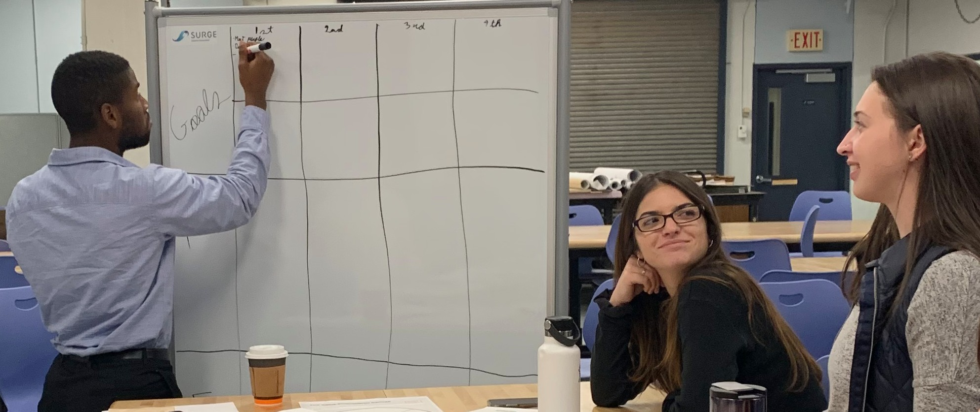
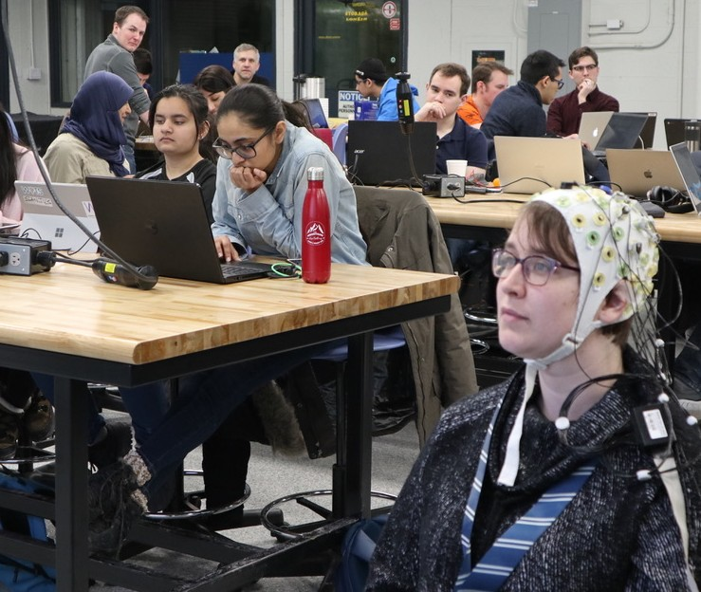
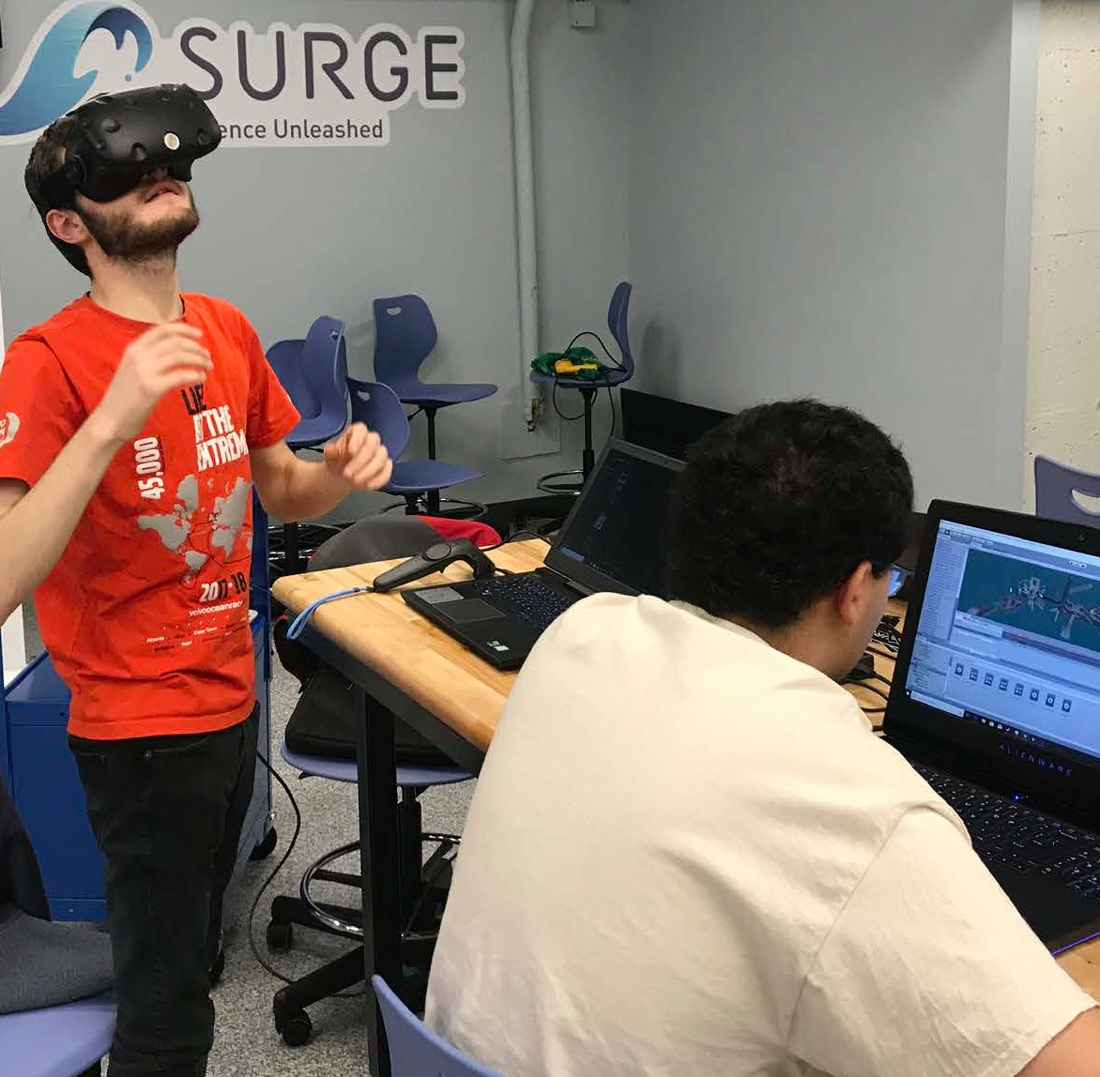
What is SURGE?
▸ One of the NS innovation sandboxes
▸ Provides experiences in:
▸ Applying science to real world problems
▸ Creativity, innovation, design thinking
▸ Entrepreneurship
▸ Leadership

Slide 8
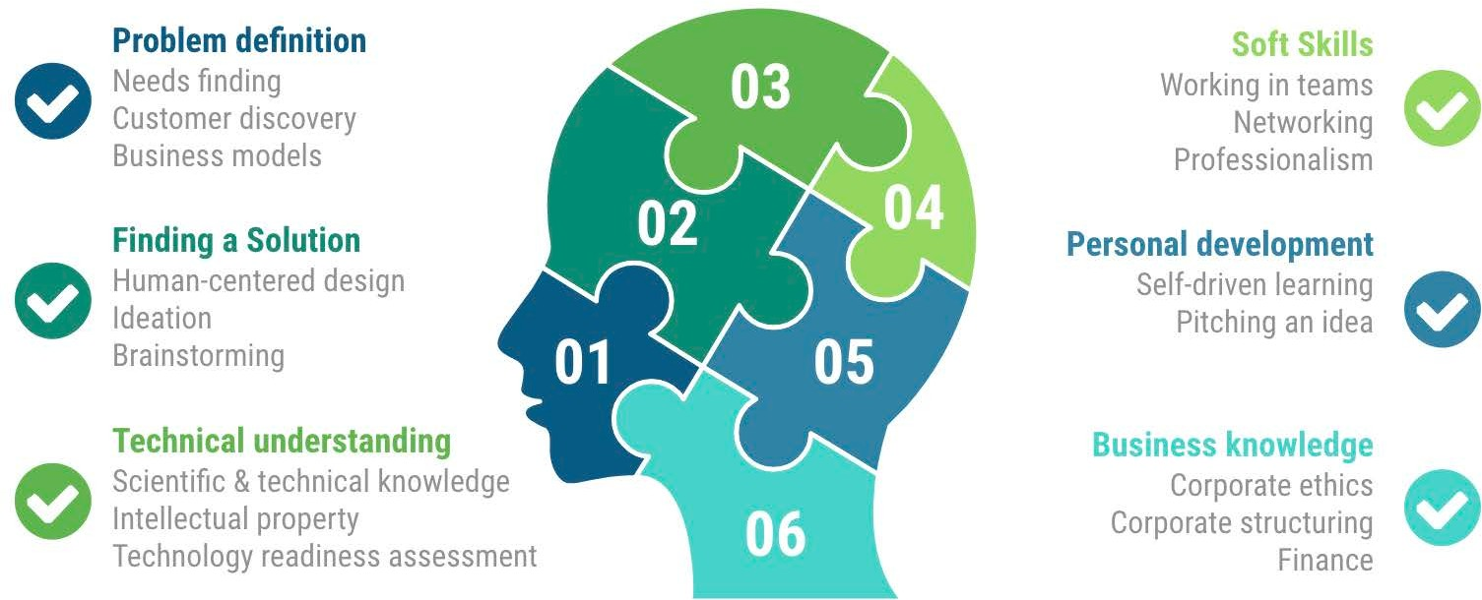


What We Teach

Slide 9
About Discover R

Slide 10
Discover R: Our Approach
Goal: teach people working in science how to use R as a tool for working with data:
learning the fundamentals of R
using R for data science, including:
reading data
manipulating/processing data (e.g., extracting specific data, splitting data according to variables, applying functions, combining data)
exploratory data analysis
basic statistical analyses of data sets

Slide 11
What is data science?
“…an umbrella term to describe the entire complex and multistep processes used to extract value from data.” (Wing, 2019)
The ability to “bring structure to large quantities of formless data and make analysis possible” (Davenport & Patil, 2012, p.73)
Storage, manipulation, visualization, filtering, and preparation of data, as well as statistics to derive conclusions from existing data, and machine learning to make predictions from data that will generalize to other data
Also the “back end”: engineering, hardware, databases to support data science

Slide 12
Learning Objectives
Upon completing this workshop, you will be able to:
understand and use variables
work with common R data types
import datasets and perform basic preprocessing
obtain basic summary statistics from data files
manipulate and extract data from datasets
visualize data using R gglot2 package, and customize these plots

Slide 13
Origins
The Carpentries (carpentries.org) teaches foundational coding, and data science skills to researchers worldwide.
Provide an open-source set of workshops, under Software Carpentry, Data Carpentry, and Library Carpentry
A diverse, global community that includes Instructors, helpers, Trainers, Maintainers, Mentors, community champions, member organisations, supporters, workshop organisers, staff and more
Discover R is based on Library Carpentries’ Introduction to R workshop
Adapted for our platform and based on our experience
Uses open-source datasets

Slide 14
Datasets in this workshop
University of Houston–Clear Lake Integrated Library System in 2018
Life expectancy data by country
Other datasets from the UCI Machine Learning Repository
Open source, accessible, relatively easy to understand

Slide 15
Tools

Slide 16

Open-source programming language and cross-platform
Robert Gentleman and Ross Ihaka from the University of Auckland in 1995
“a language for data analysis and graphics”
Under continuous development by large community
Widely used in science and data science

Slide 17
Great for reproducibility
Interdisciplinary and extensible
Works on data of all shapes and sizes
Large and welcoming community

Slide 18
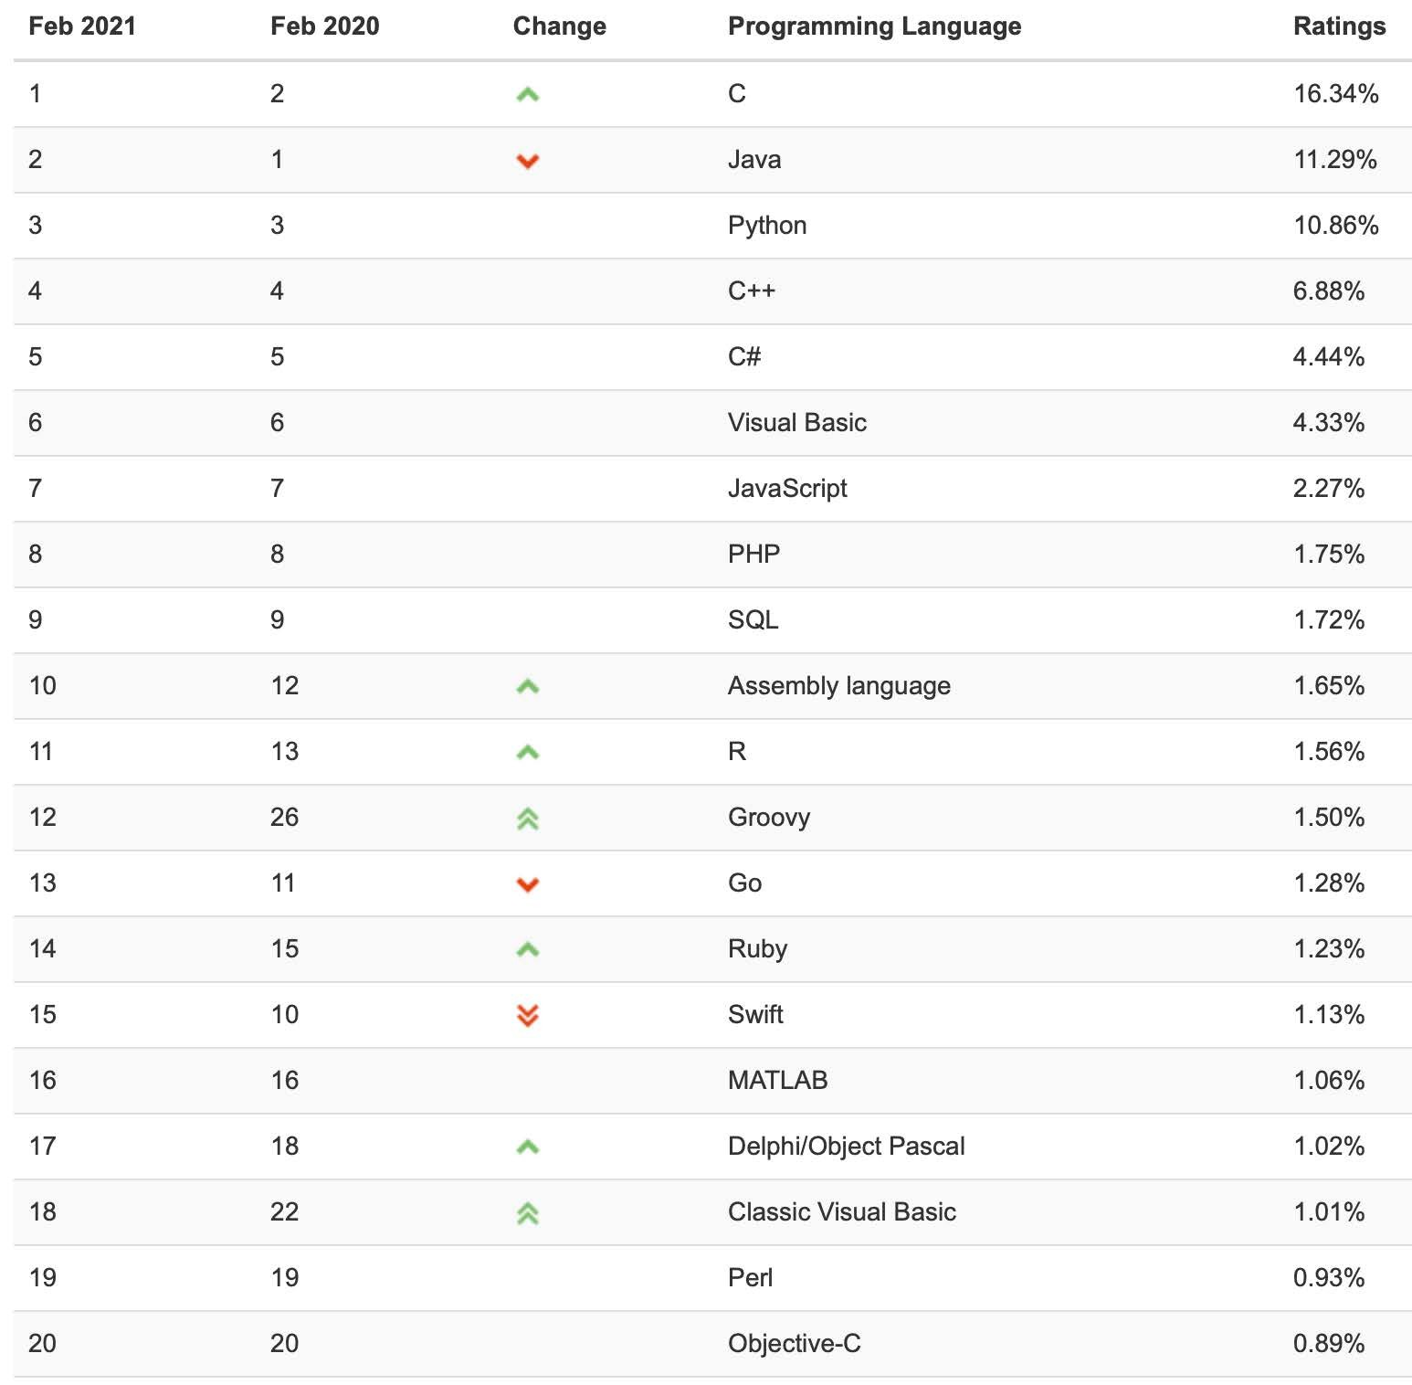
TIOBE Programming Community Index
Indicator of the popularity of programming languages.
Ratings based on the number of skilled engineers world-wide, courses and third party vendors.
Popular search engines such as Google, Bing, Yahoo!, Wikipedia, Amazon, YouTube and Baidu are used to calculate the ratings
https://www.tiobe.com/tiobe-index/

Slide 19
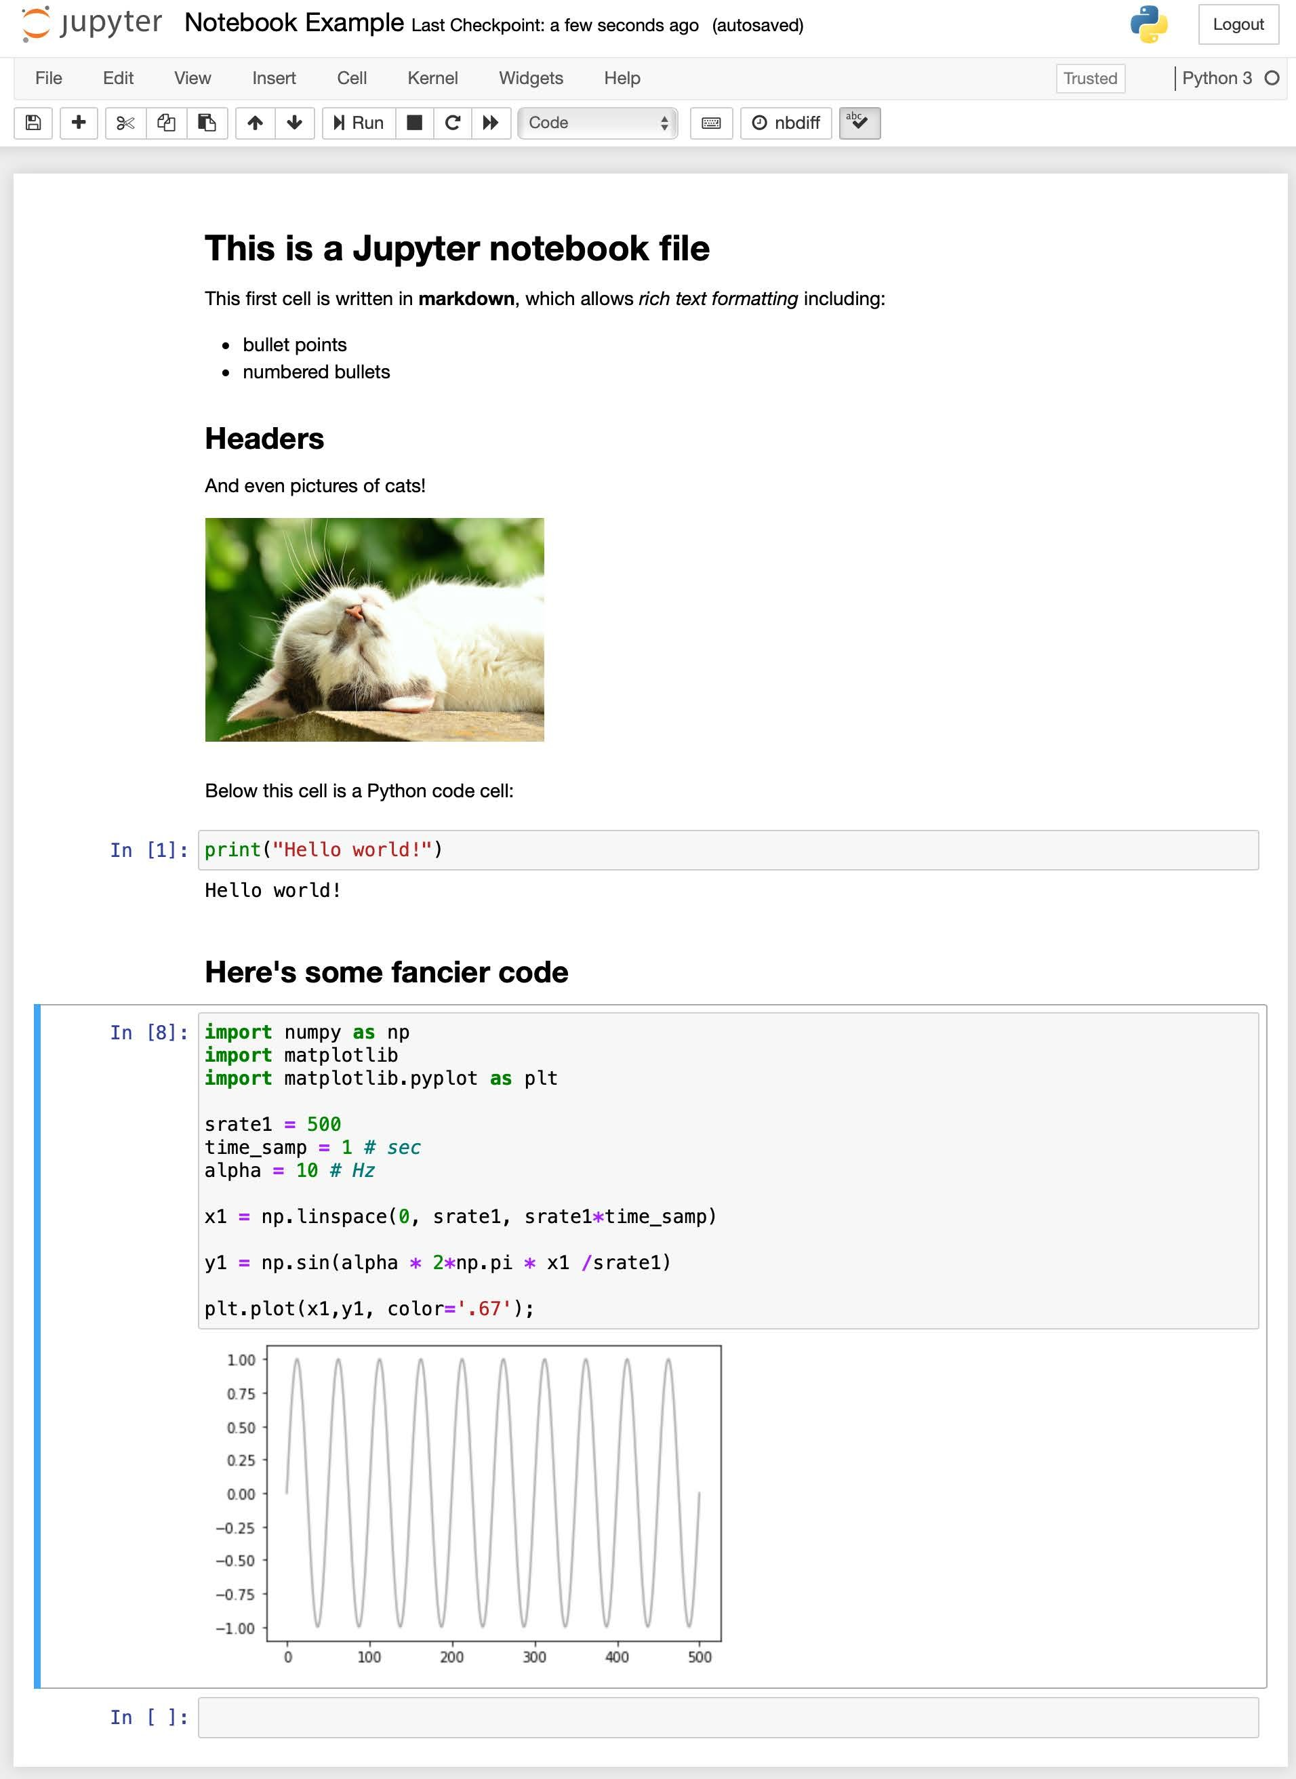

A “notebook” environment for data science
Code, output, and commentary all in one document
Excellent for reproducible, open science

Slide 20

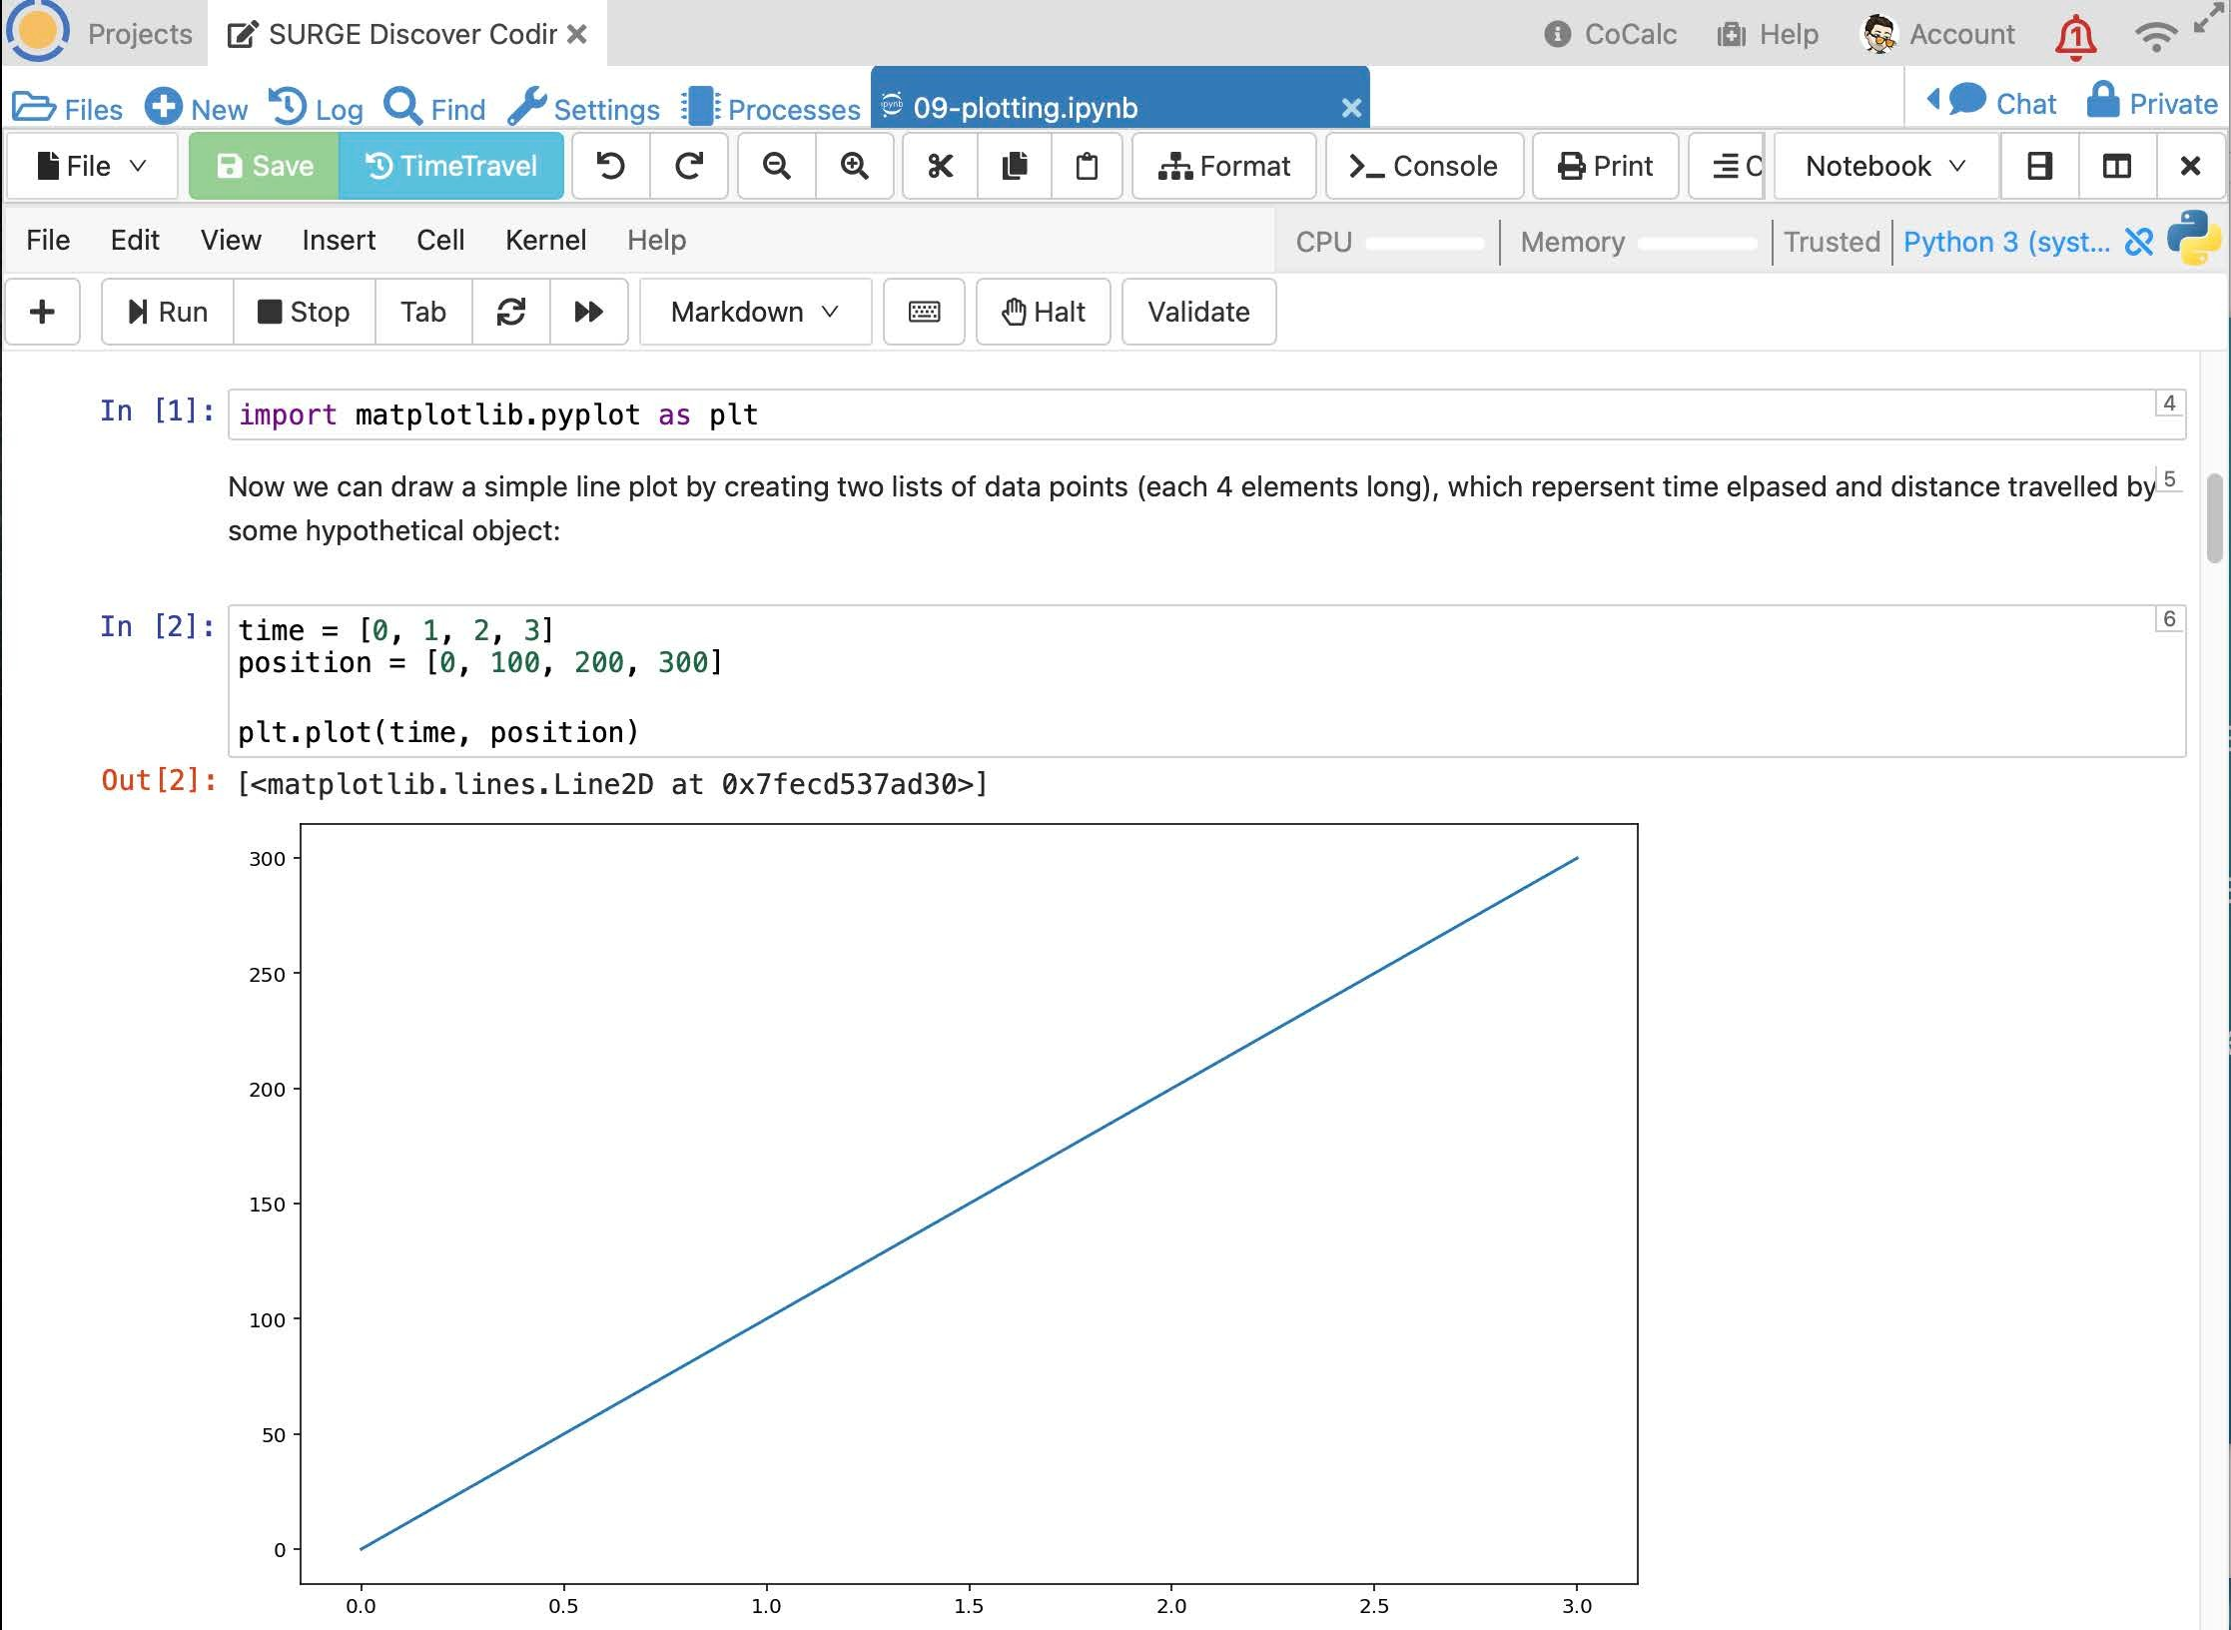
Cloud-based Jupyter environment
Nothing to install
Designed for teaching
Teaching team and “jump in” and view your work to provide help

Slide 21
Workshop Mechanics

Slide 22
We will be testing out things
Thank you in advance for patience…☺
Feedback is also greatly appreciated

Slide 23
Section 1 : Before we start
Section 2 : Introduction to R
Section 3 : Starting with data
Section 4 : Data transformation and preprocessing
Section 5 : ggplot plotting
Section 6 : Crash course in R Studio

Slide 24
Type code yourself
Don’t cut and paste
Learning is deeper if you type the code
Learn from your mistakes
Parse/analyze the code better

Slide 25
Getting Help
Helpers are here to… help!
Type “HELP” into the chat
A helper will send you a direct message in the Zoom chat
We will do regular check-ins
Ask the instructor
Use the helpers for help with your code
Ask the instructor content/theory/conceptual questions
Raise hand (Zoom reaction) or post question in the chat
Ask during check-ins

Slide 26
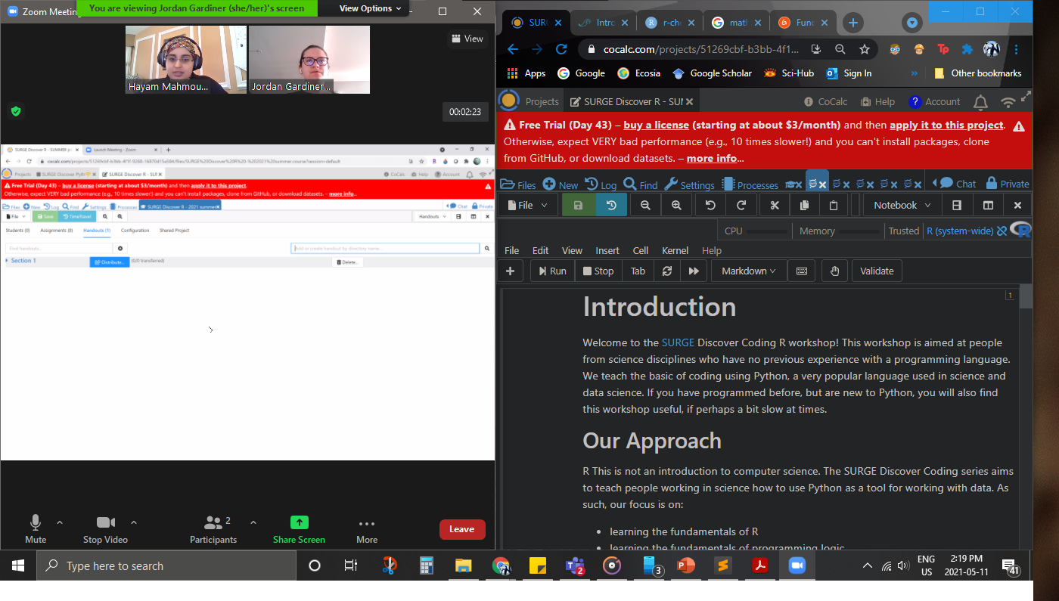
Notes:
Suggested layout

