Slide 1

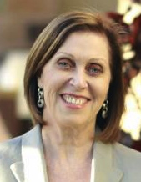

WORKSHOP INVITATION FOR BRIDGE TEACHERS
Presenter: Joan Butts
ABF National Teaching Coordinator
www.abf.com.au
A professional development day for practising bridge teachers who have completed an ABF Teacher Training Program and who wish to update their skills for intermediate to advanced lessons.
When: 10.00 am – 4.00 pm
Sunday 21 September 2014
Where: Peninsula Bridge Club
Jackson Street, Warriewood
Sydney
Join us for the following:
modern teaching techniques and recommended content
interactive lessons with teacher and student exercises
topics covering Competitive Bidding, Popular Conventions, Declarer Play and Defence.
Lunch provided
All materials provided by the ABF.
For more information, please contact Cath Whiddon, the head of bridge education at Peninsula Bridge Club.
Email: cathwhiddon@live.com
Completion of this workshop will offer points towards ABF Teacher Accreditation.
ABF CONTINUING PROFESSIONAL DEVELOPMENT PROGRAM

