Slide 1
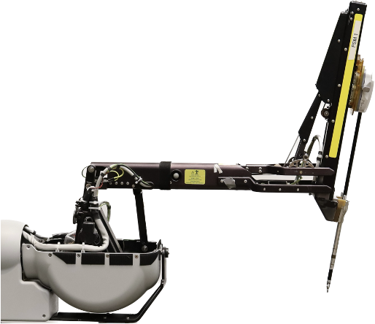
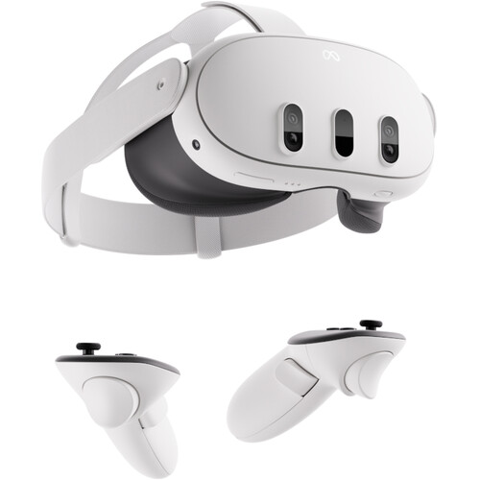
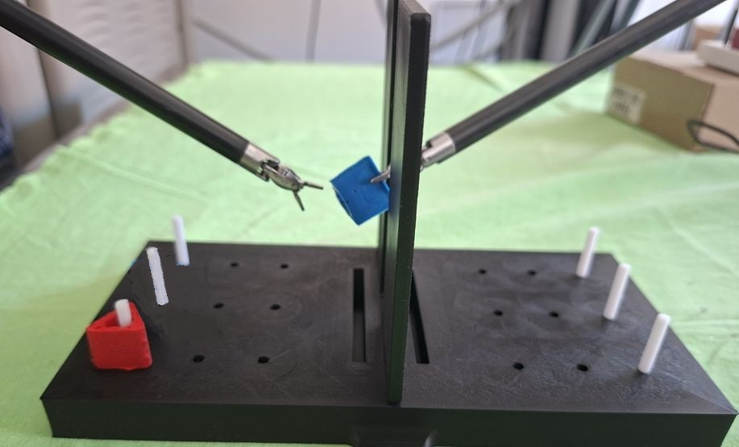
Human Teleoperation Challenge
Autonomous AI Challenge
Play the game to compete for a prize!
No experience or preparation needed
For a bigger challenge and reward
Registration required (see below)
Data
Use this HMD to teleoperate two of these robots to perform this task (real or sim)
Develop AI for two of these robots to autonomously perform this task (real or sim)
*
* Data recorded with informed consent

