Slide 1
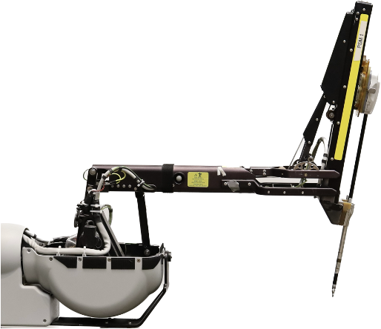
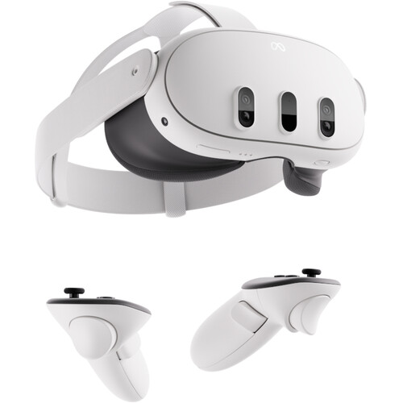
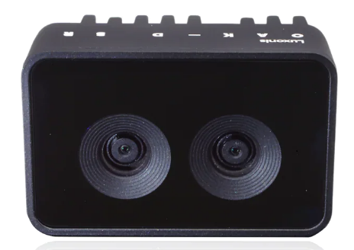
OAK-D-SR
stereo camera
Quest 3 HMD
PSM 1
PSM 2
USB-C
dVRK Controller
dVRK Controller
Video PC
FireWire
USB-C
Ethernet
dVRK PC
USB-to-Eth
USB-to-Eth
USB-C
Ethernet
Competitor PC
Ethernet switch

