Slide 1

Remembering what you did:
Automated reports with R Markdown
Sur Herrera Paredes
2022-04-23
Data management for publishing
Jasper Ridge Biological Preserve

Slide 2
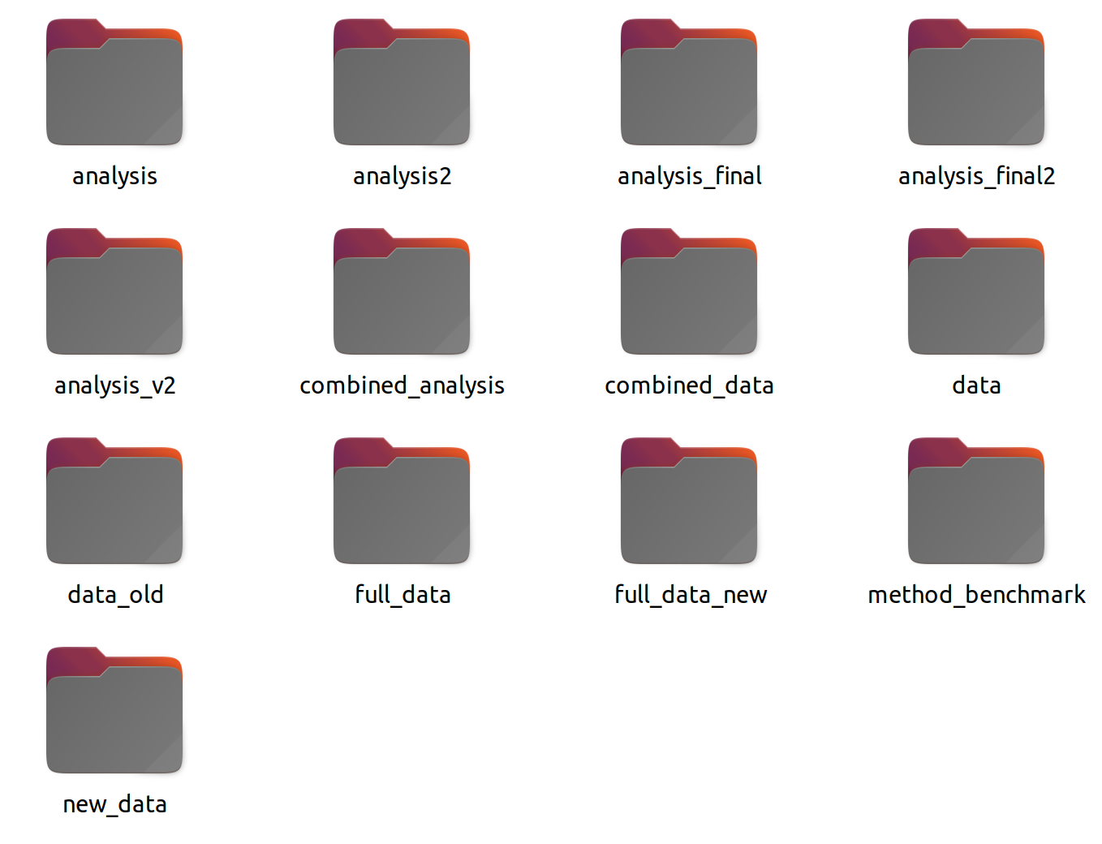
A (hopefully not) familiar organizational structure

Slide 3
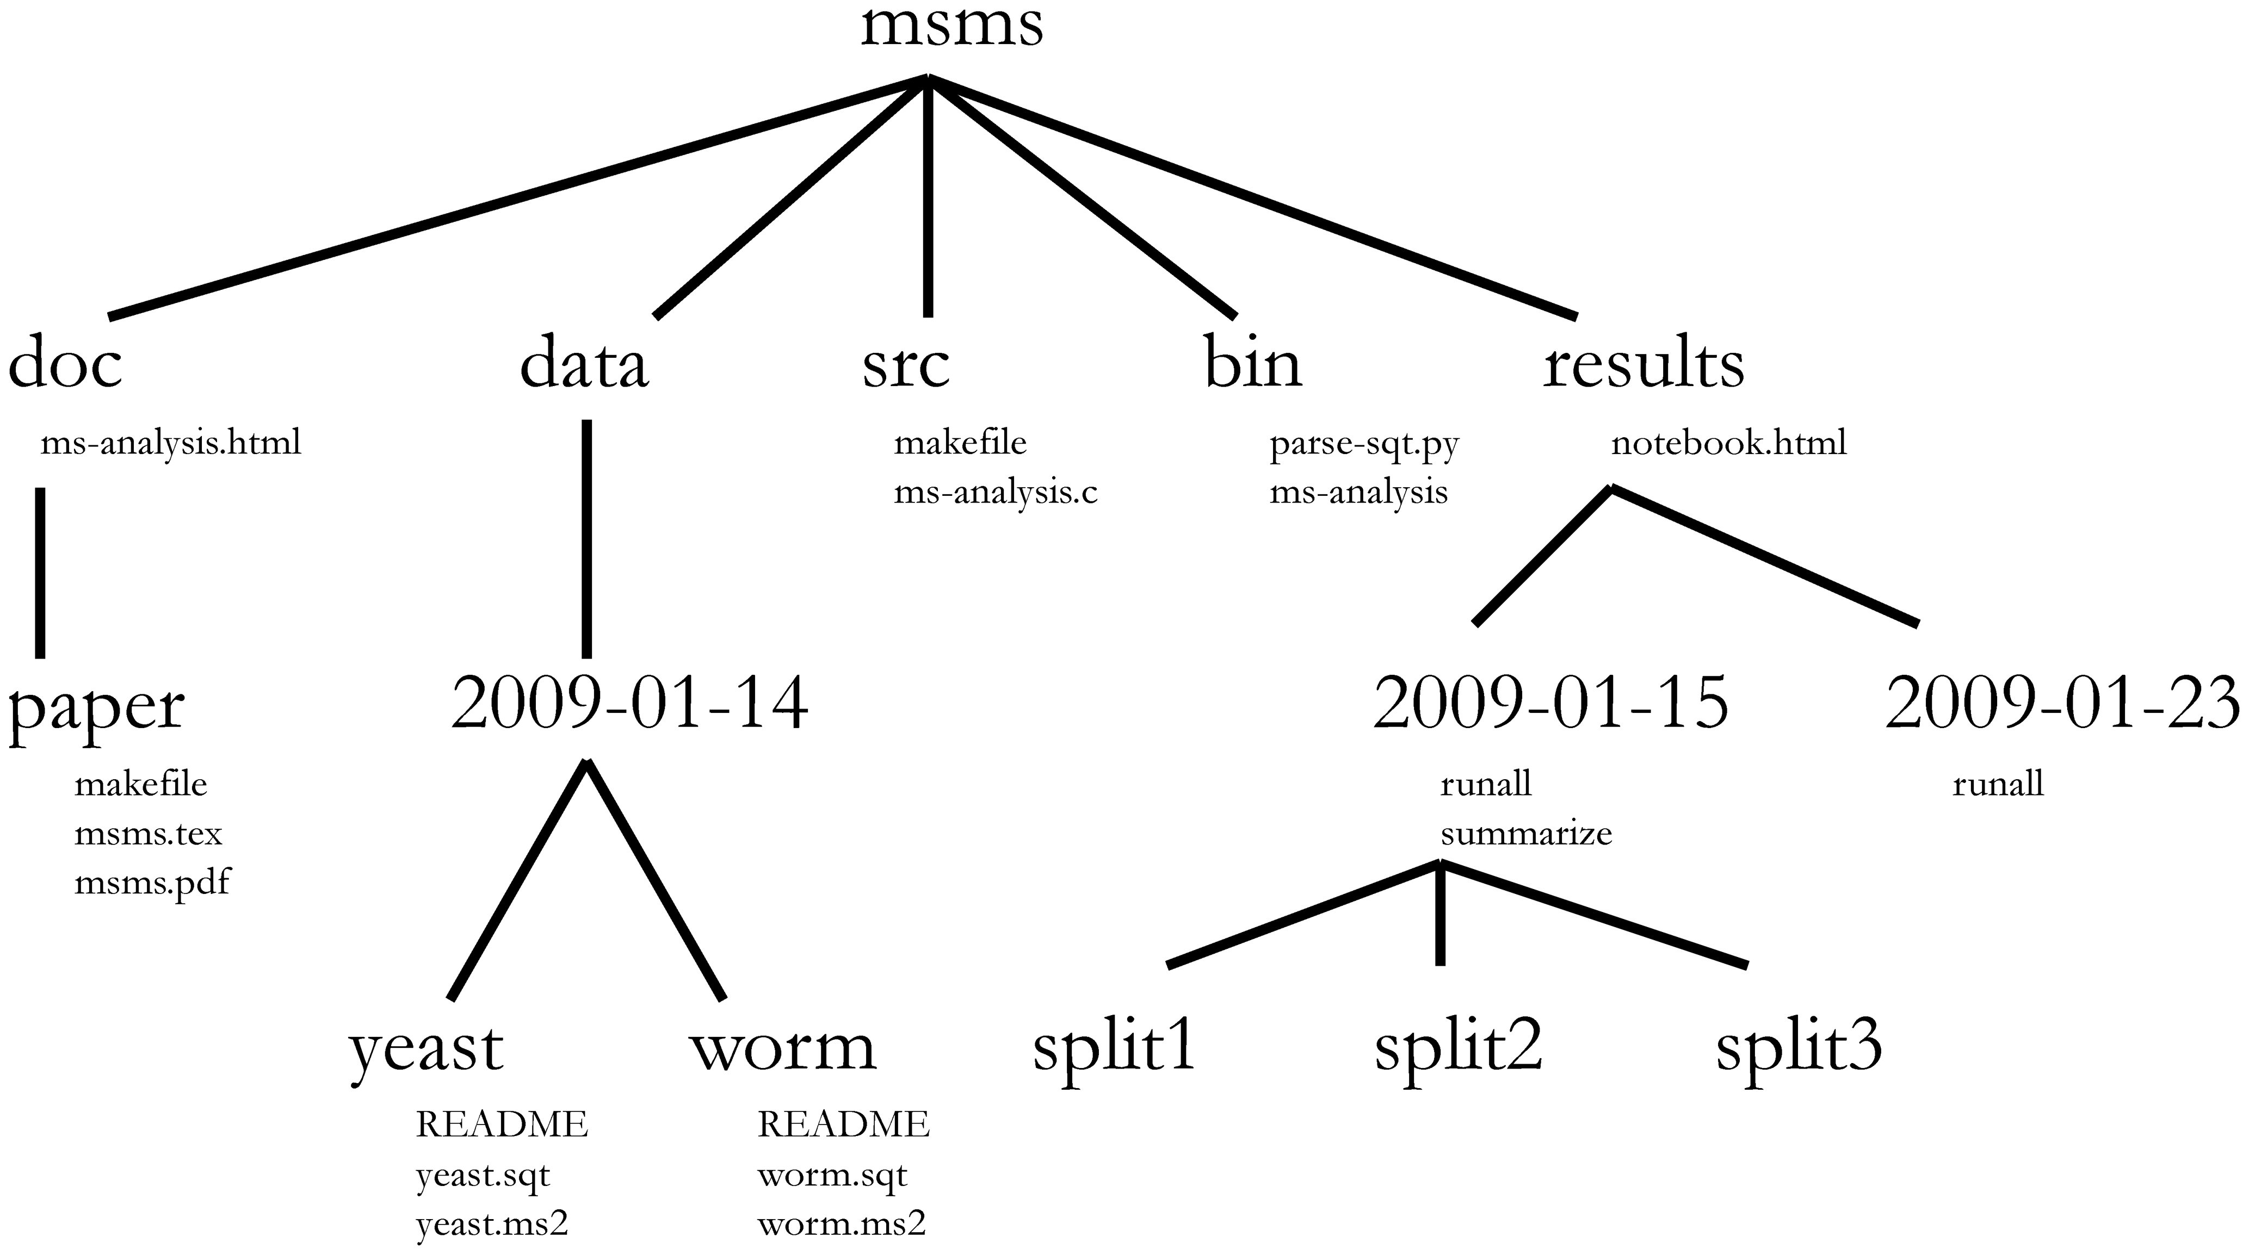
Thinking about organization: types of files
Keep different types of digital objects (e.g. data, code, exectuables, analysi) separate.
Establish rules for different types of digital objects (i.e. files)
Be consistent!
Noble, «A quick guide to organizing computational biology projects».

Slide 4
Thinking about organization: types of files
Keep different types of digital objects (e.g. data, code, exectuables, analysi) separate.
Establish rules for different types of digital objects (i.e. files)
Be consistent!
Noble, «A quick guide to organizing computational biology projects».

Slide 5
Organize your analysis chronologically
You never know where your results will take you...yay Science!
Organizing your results chronologically ensures that you can keep the organization consistent
Noble, «A quick guide to organizing computational biology projects».

Slide 6
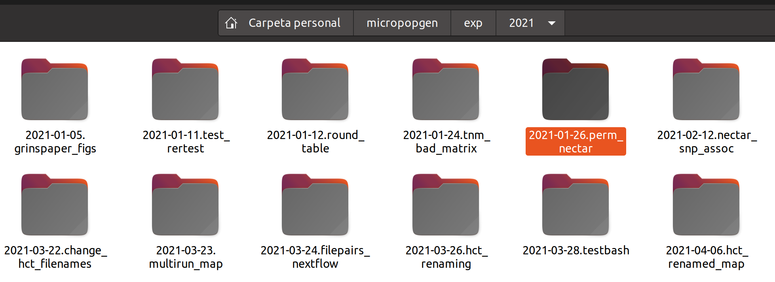
Create a digital lab notebook: chronoligical order
Don’t forget to add a small informational name to the directory names

Slide 7
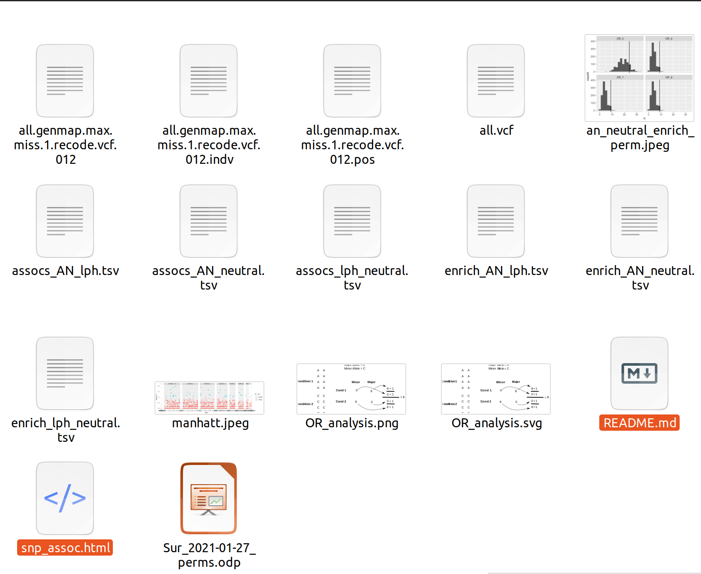
Create a digital lab notebook: A self-contained record of every analysis

Slide 8
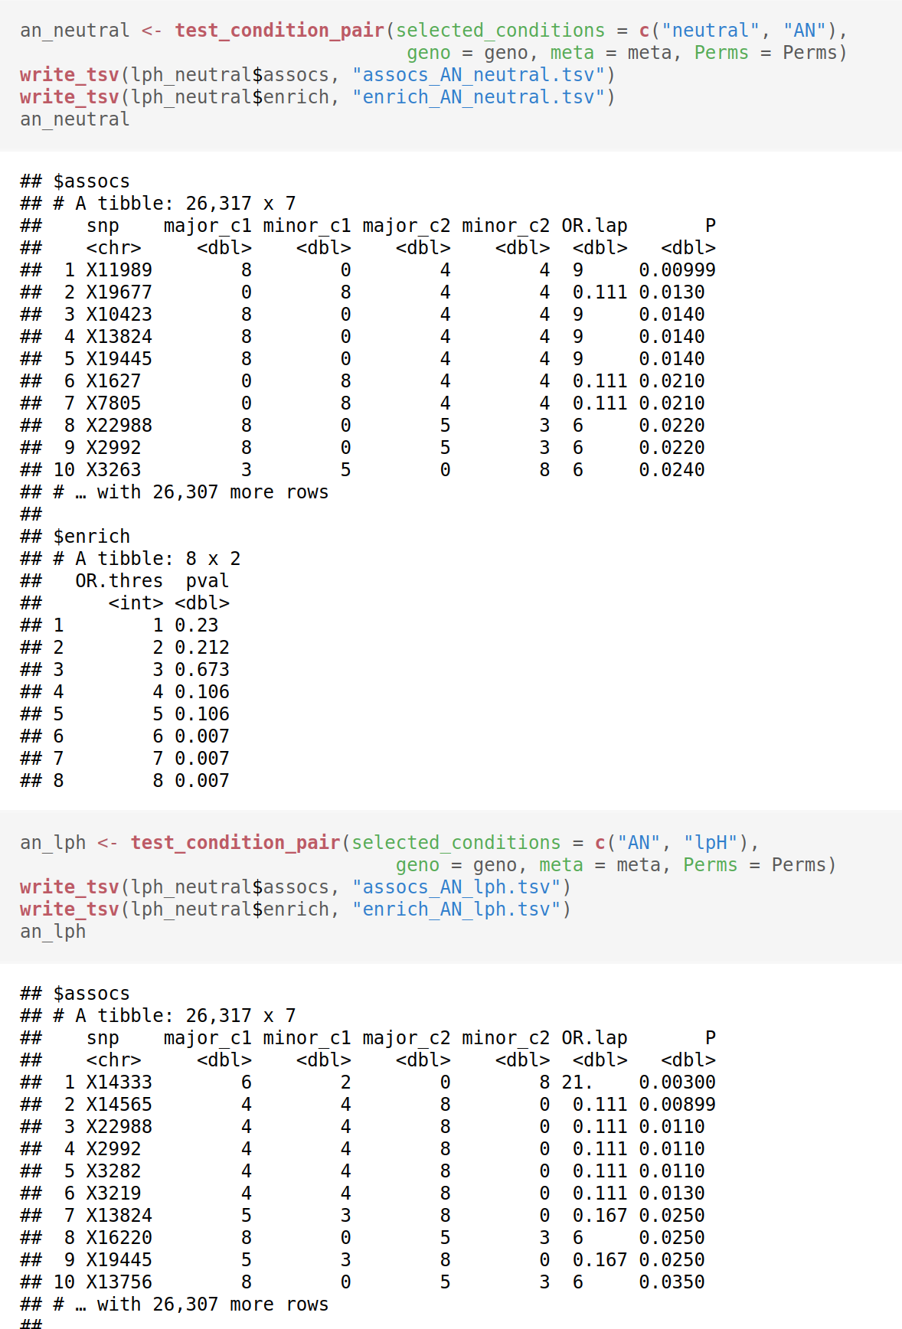
Create a digital lab notebook: save the code and output together
That’s where that table came from

Slide 9
Create a digital lab notebook: the README is your notebook
In the wet lab nothing is more important than having a lab notebook. The same is true in the dry lab

Slide 10
Create a digital lab notebook: a simple approach
Organize analysis chronologically
Add a simple tag to each analysis directory
Save the code together with the output that it produced.
Keep a README inside every analysis
Recreate don’t overwrite

Slide 11
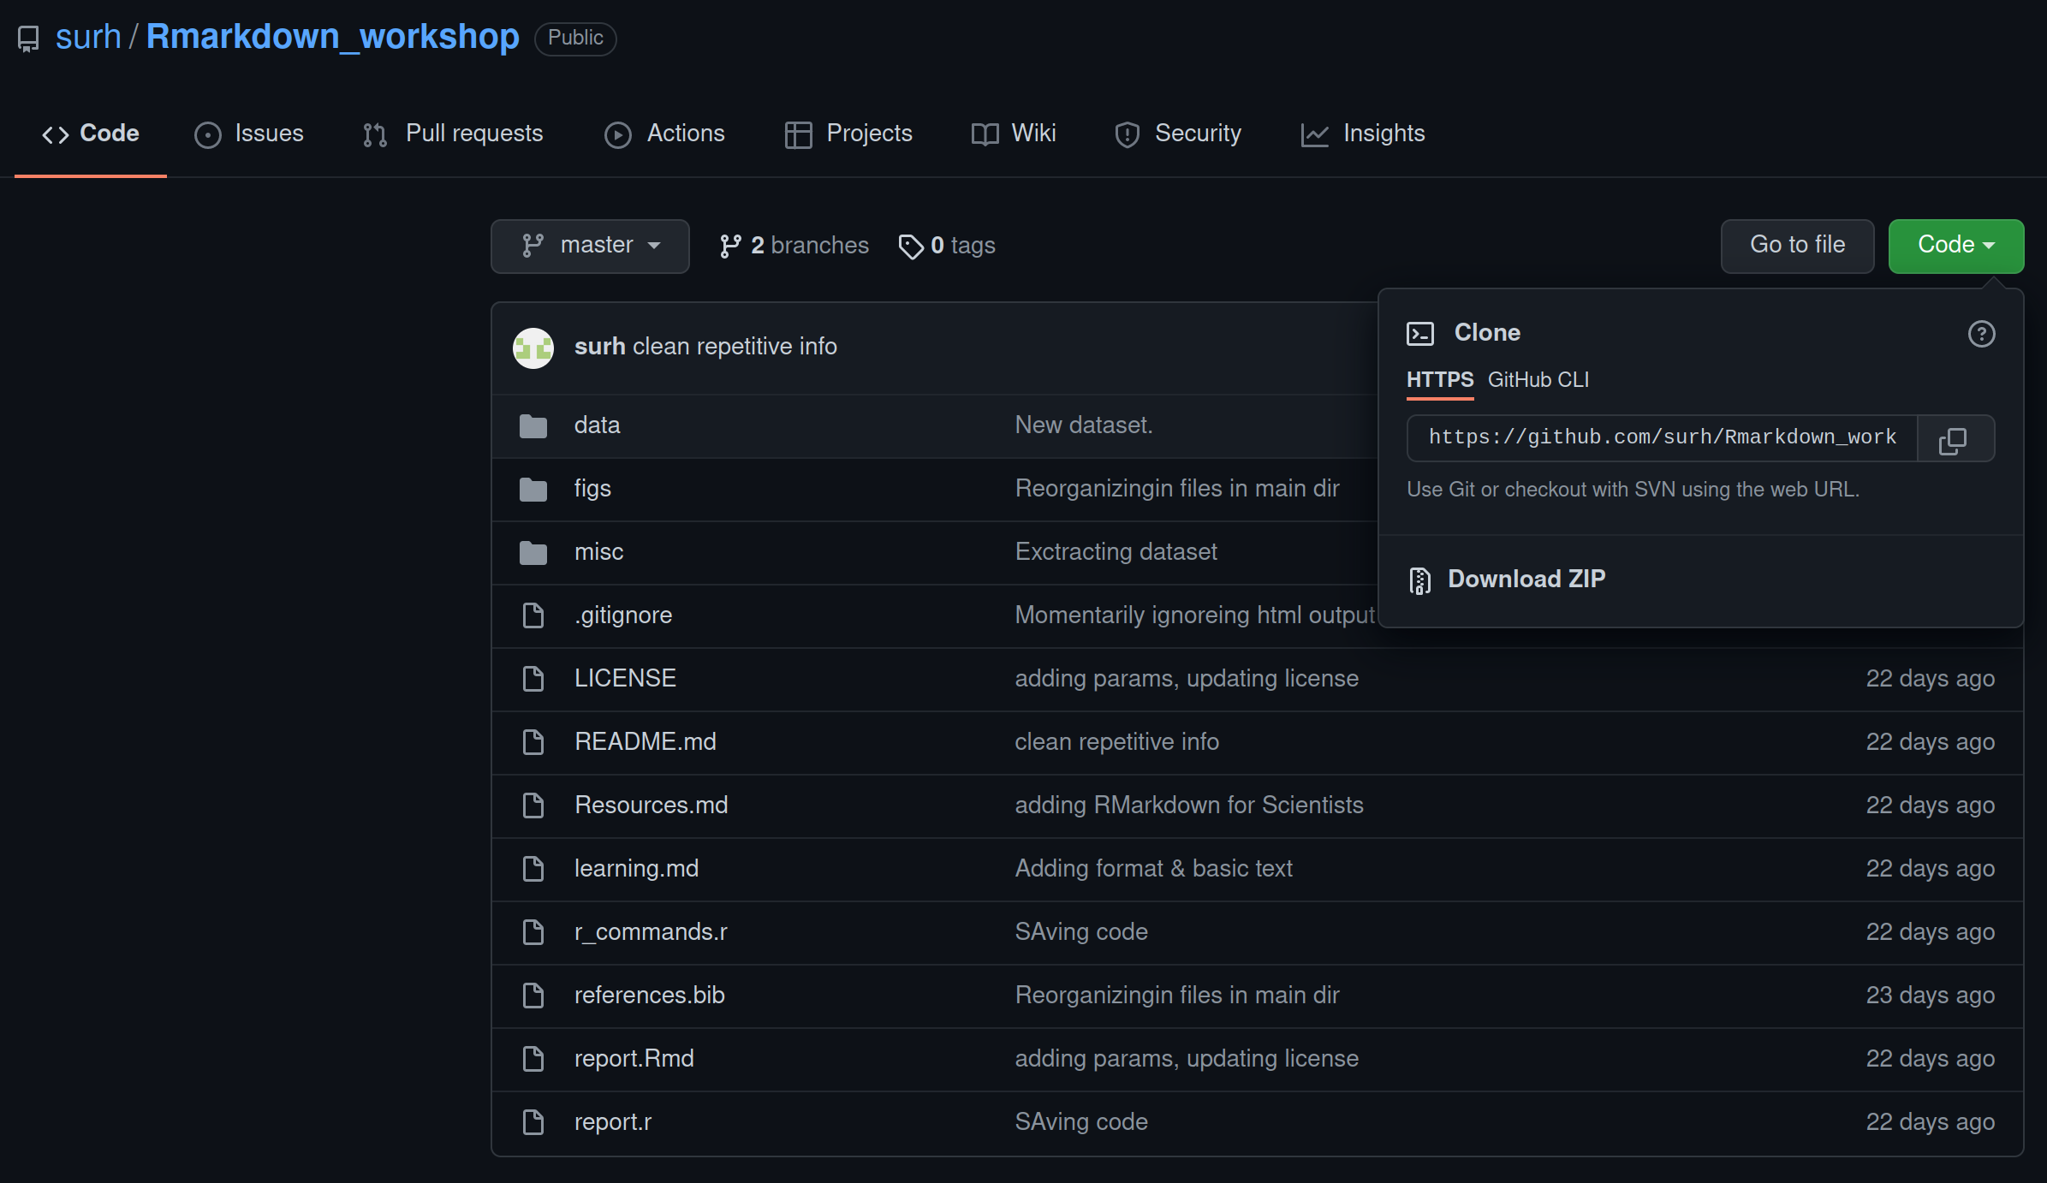
https://github.com/surh/Rmarkdown_workshop

