Slide 1
International Students in Australia
Surinder Singh
20th Jan, 2021

Slide 2
Description
It is a well known fact that international students form a major chunk in Australian Universities. They are also a significant contributor to Australian economy.
This project provides an insight into various statistics related to the international students in Australia.
The analysis is mainly based on following parameters:
Total Number of Students.
Country of Residence.
Distribution in Australian States/Territories.
Total Enrolments & Commencements.
Major Sector of Study etc.
The analysis becomes more important as Covid-19 has impacted globally including international studies.

Slide 3
Data Source
The analysis is based on below mentioned data sources which are available on Department of Education, Skills and Employment website.
studentsPublic.csv: This provides data for total number of students from year 2002 to 2020 as per their Nationality and Australian State/Territory in which they are based.
https://internationaleducation.gov.au/research/datavisualisations/Pages/Student-number.aspx
nationalitySummary.csv: This dataset provides students enrolments, commencements, sector of education etc. for year 2019 and 2020.
https://internationaleducation.gov.au/research/datavisualisations/Pages/nationalitySummary.aspx

Slide 4
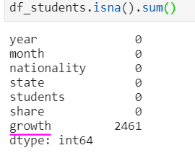
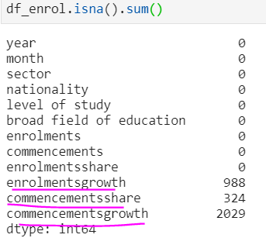
Data Inspection & Cleaning
The source is a pre-processed dataset available on the Department of Education website. So, as expected it was mostly clean apart from few columns having missing/Null values.
On further analysis it is found that a column is null for an year where there is no data for the previous year. Hence it is reasonable to fill the missing values with 0 for the columns highlighted above.

Slide 5
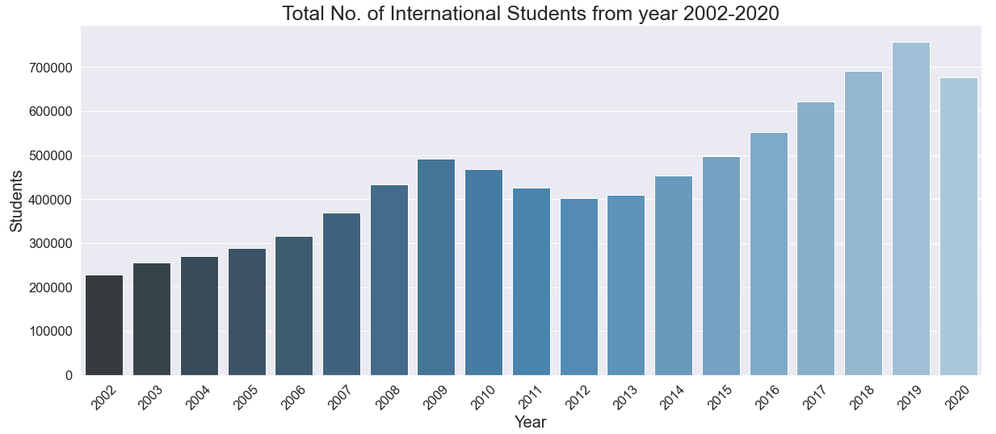
Data Analysis: Questions Answered
How many students came to Australia each year from 2002-2020?
We can see from the above visualisation that number of students were growing steadily from 2012 till 2019 and there is small decrease in 2020. This could be attributed to COVID-19 and data for Nov and Dec'2020
The average number of students per year from 2020-2020 : 453572

Slide 6
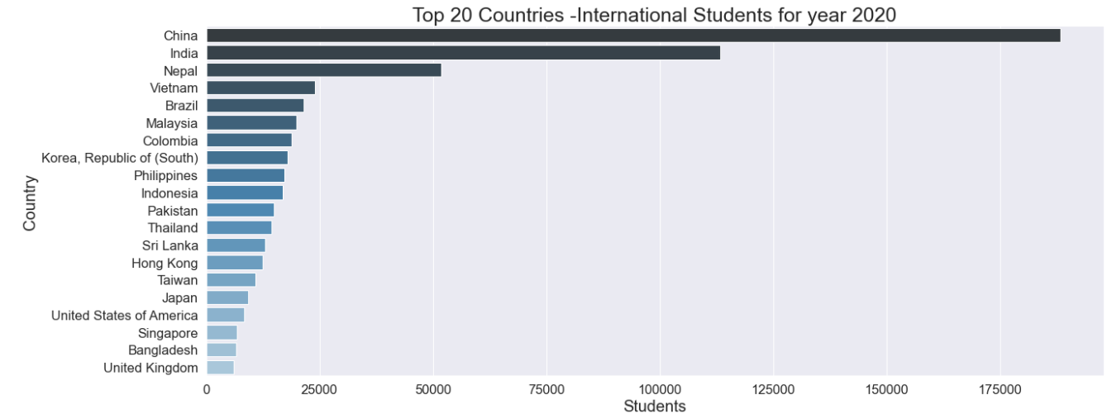
Data Analysis: Questions Answered… cont.
Which are the top 20 countries as per nationality of international students for the year 2020?
We can see from the above bar chart that China has highest number of students in 2020 followed by India and Nepal.

Slide 7
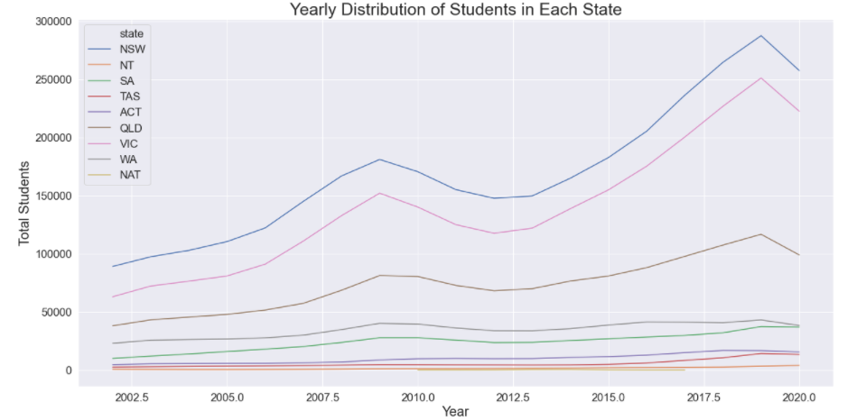
Data Analysis: Questions Answered… cont.
Which are the States/Territories where international students reside?
We can see from the above line chart that NSW has highest number of students for all the years followed by Victoria and Queensland.

Slide 8
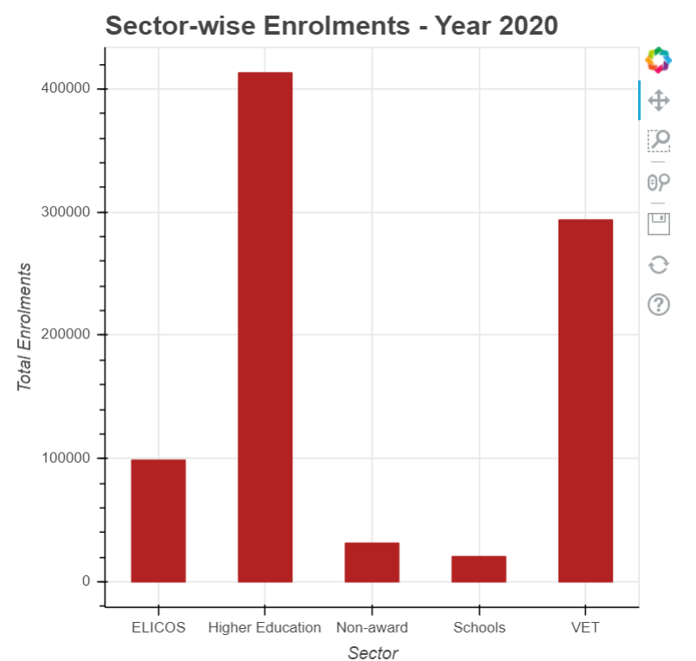
Data Analysis: Questions Answered… cont.
Which sector has the highest enrolments in the year 2020?
We can see from the above table that highest number of enrolments in 2020 are in Higher Education sector followed by VET (Vocational Education & Training).

Slide 9
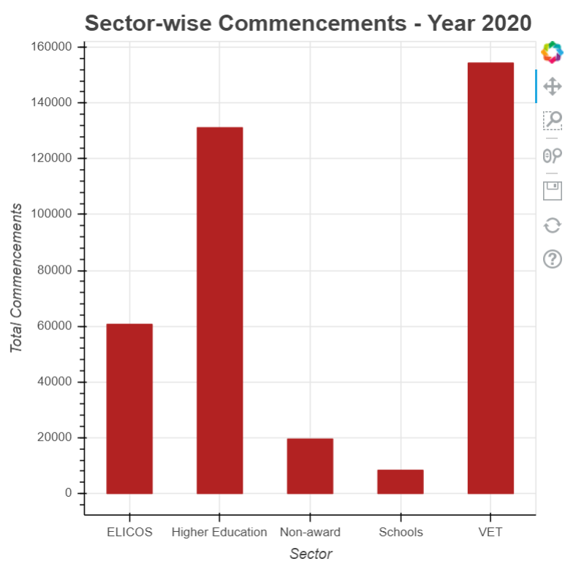
Data Analysis: Questions Answered… cont.
Which sector has the highest commencements in the year 2020?
We can see from the above chart that highest number of commencements in 2020 are in VET followed by Higher Education.

Slide 10
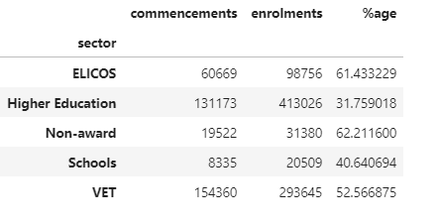
Data Analysis: Questions Answered… cont.
Which sector has the highest %age of commencements vs enrolments in the year 2020?
It is interesting to know that Higher Education has lowest %age of commencements although the enrolments are highest.

Slide 11
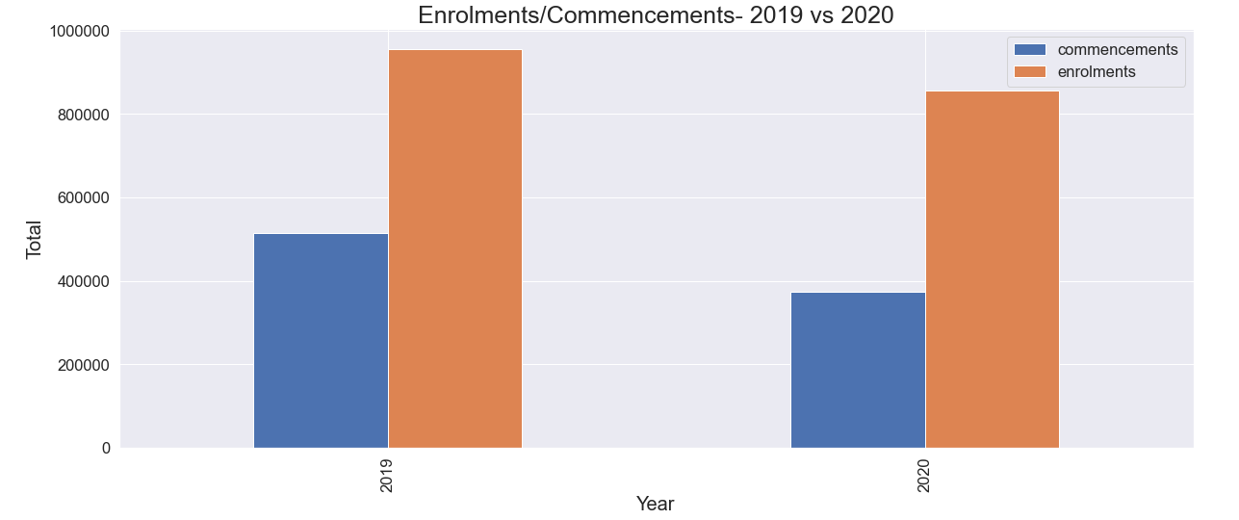
Data Analysis: Questions Answered… cont.
Comparison of enrolments and commencements for year 2019 and 2020?
It is clear from the above bar chart that there is a drop in total enrolments and commencements in 2020 as compared to 2019.

Slide 12
Conclusion & Future Work
The data analysis provides an important insight into various statistics related to the number of students, their nationality, sector of study etc.
It is observed that there is a slight drop in the year 2020 which could be attributed to Covid-19 or data for Nov & Dec which is not available at this point of time.
The future work on this project can be carried out to analyse various other parameters e.g.:
Broad field of education.
Migration pathways for the students.
Region wise distribution of students.
Employability etc.

Slide 13
Thank You

