Slide 2


FORMAL VERIFICATION CONTRACT BASED MICRO ARCHITECTURAL ANALYSIS OF SERVER SoC’s
Authors
Surinder Sood : surinder.sood@intel.com
Harshal Mumbaikar : harshal.Mumbaikar@intel.com
Manoj Munigala : manoj.k.munigala@intel.com
Madhusudan, K N : madhusudhan.k.n@intel.com

Slide 3

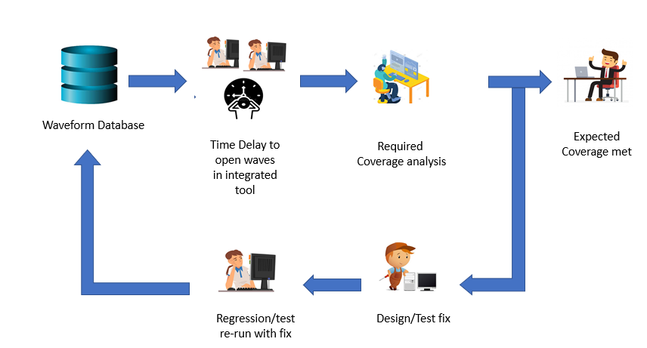
Motivation & Problem Statement
Figure 1. SoC coverage analysis using traditional waveform debug approach

Slide 4
Motivation & Problem Statement
Client and server System on Chip(SoC) are power and performance greedy designs. Consequently, micro analysis of such SoC’s hold prominence
Such analysis with existing validation infrastructure cannot be achieved because of the following issues:
Enabling all assertions at SoC leads to increase in simulation time and test run logs have huge data which are difficult to analyze
One test takes huge amount of time for simulation to complete with all assertions enabled
Moreover, selective assertions enablement is not seamless in validation infrastructure
Functional coverage analysis of such features must be timing accurate from IP to SoC, such type of coverage analysis is not done in standard Soc coverage paradigm

Slide 5
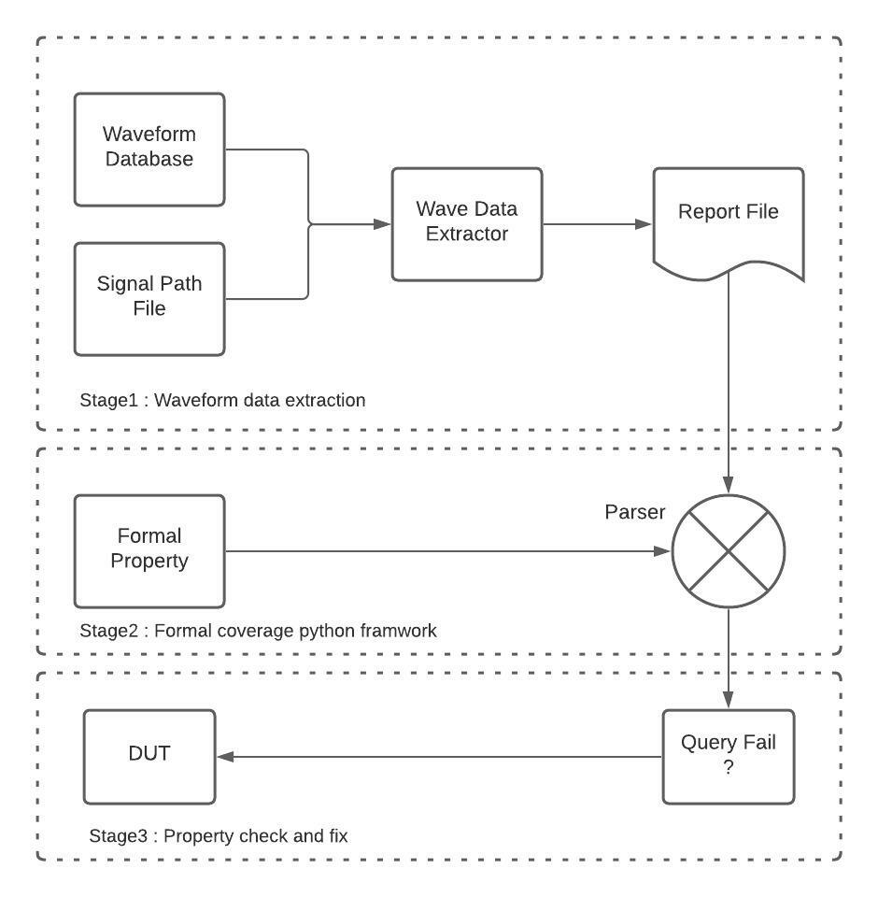
Main Idea
Figure 2. The overall Methodology for formal property verification
using simulation dumps

Slide 6
Main Idea
It is an offline formal verification of Timed Linear temporal logic (LTL)[1] properties against SoC waveform database
A Synopsys API is used to extract the provided signal details with respect to the time from a given simulation wave database
Parser parses the Timed LTL properties (which uses Python STL-API) and justifies against the provided waveform database data
Each formal property provides the coverage fail time stramp if property is failed and pass time stramp if property is passed. Hence it guarantees the timing accuracy of given property
[1] Amir Pnueli. “The temporal logic of programs”. In: 18th Annual Symposium on Foundations of Computer Science (sfcs 1977). 1977, pp. 46–57

Slide 7
Case Study : SOC Package-C states Entry Exit
Cover Points w.r.t functionality and timing:
Each IP save start and complete behavior within specified latency
Each IP Restore start and complete behavior within specified latency
Low power entry and exit flow of each IP respecting architectural timing flows
Debuggability: The stimulus is correct if these cover points are respected, consequently, the test should pass
Remarks:
PKG-C Entry and Exit scenarios are complex in soc, and they need regressive interaction with many Ips/Component.
Figure 3. SOC package-C Entry Exit Flow.

Slide 8
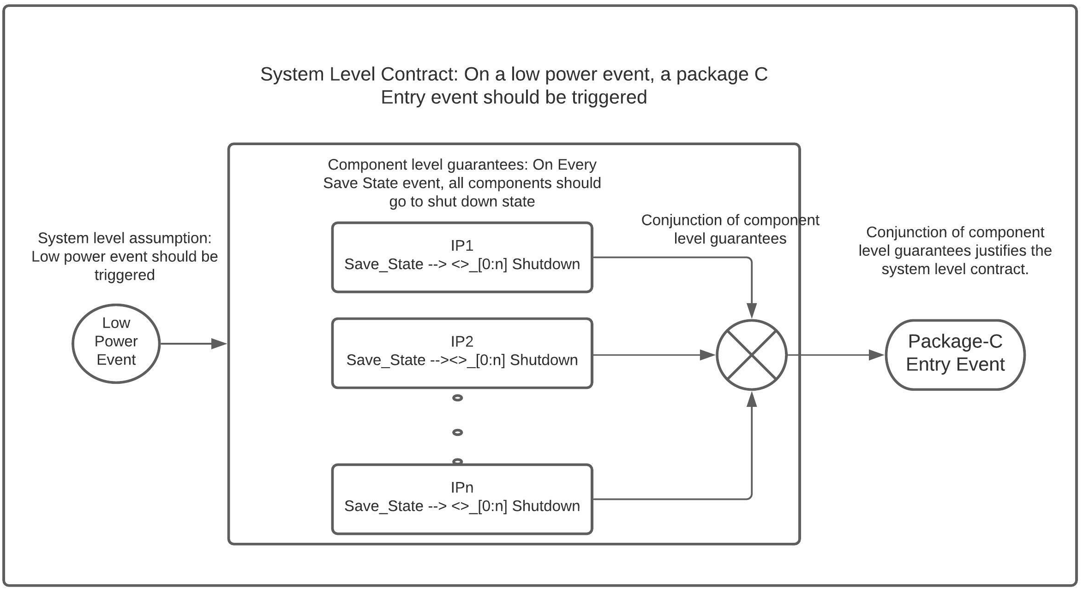
Evidence
Figure 4. Contract composition[2] of SOC package-C Entry Exit Flow.
[2] Cimatti, Alessandro, and Stefano Tonetta. "Contracts-refinement proof system for component-based embedded systems." Science of computer programming 97 (2015): 333-348.

Slide 9
Evidence
Low power event is signal which is assumed to be high in a package-C test
Save_State signal trigger on low power event for each IP. This enables every IP to save its context to ROM
Eventually every IP move in shutdown state within [0: n] time units
Conjunction of all these component level guarantees should trigger package-c entry event, which is realised as assertion of punit_rst_b and xx_pwrgood
Similarly package-C exit contract can be defined

Slide 10
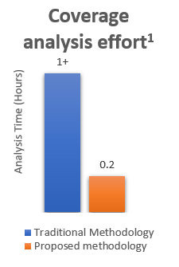
Results and Future work
Improved coverage analysis effort with the proposed Semi-formal based approach over traditional coverage analysis method, details are in the Figure 5
This approach give first level of quick failure analysis and aids in closing SOC coverage within expected Architecture and Micro-architecture timing ranges
Figure 5. Coverage analysis effort

Slide 11
Future Work
Scale up the contract compositional framework for features like SoC Security
Post-Silicon use cases coverage analysis

