Slide 1
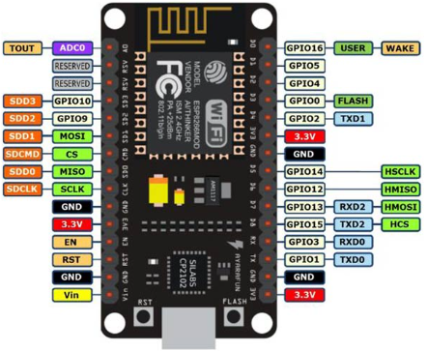
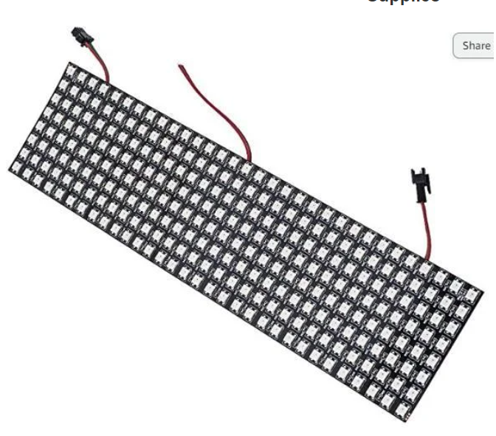
Red -> 3.3V
Black -> GND
Green -> D2(GPIO4)
Power supply:
Vin -> 5V – 12V
GND -> Ground
connect
Any power supply 5V – 12V including an USB charger

