Slide 1
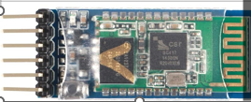
Device 1
Bluetooth Module 1
Bluetooth Module 2
Device 2
Serial
Wireless
Serial
Serial
Serial

Slide 2
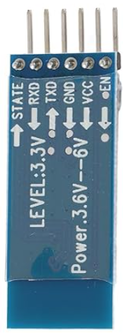
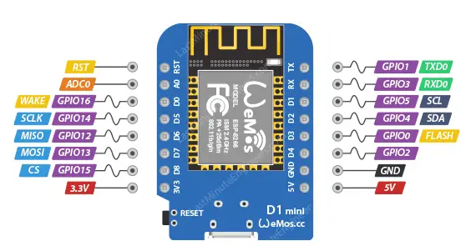

not used but could be used later as an indicator for connection status
to D5/GPIO14
to D6/GPIO12
to GND
to 5V
to 5V only during configuration, otherwise not connected
Connecting Bluetooth to Wemos

