Slide 1
Academic in service
Angioedema

Slide 2
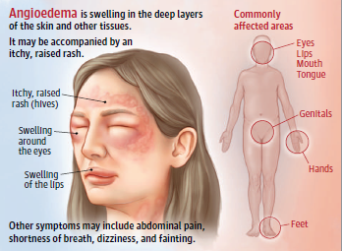
Angioedema
แองจิโออีดีมา (Angioedema) เป็นการบวมของชั้นหนังแท้และชั้นไขมันใต้ผิวหนัง เพราะมีการขยายตัวของหลอดเลือดและของเหลวออกมา อยู่ภายนอกหลอดเลือด ทําให้เห็นผื่นบวมลึกขอบเขตไม่ ชัดเจน สีเดียวกับผิวหนัง มักเป็นบริเวณที่เป็น loose tissue เช่น ตา รอบปาก รอยโรคมักบวมอยู่นานเกินกว่า 24 ชั่วโมงและมีอาการเจ็บร่วมด้วย
1

Slide 3
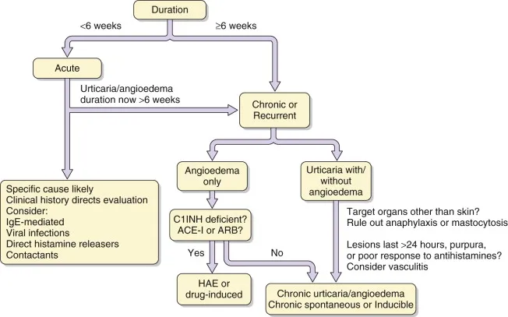
Diagnostic algorithm for urticaria/angioedema
2
ที่มารูปภาพ : https://obgynkey.com/urticaria-and-angioedema-3/

Slide 4
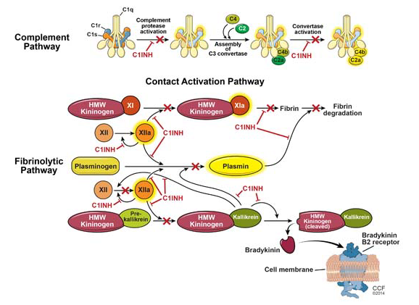
Hereditary Angioedema
Pathophysiology
3
ที่มารูปภาพ : https://www.clevelandclinicmeded.com/medicalpubs/diseasemanagement/allergy/hereditary-angioedema/

Slide 5
Hereditary Angioedema
HAE should be considered in patients who demonstrate one or more of the following:
Recurrent episodes of angioedema without urticaria (ie, wheals) or pruritus, lasting two to five days (without treatment).
Unexplained recurrent episodes of self-limited, colicky, abdominal pain (typically lasting one to three days), especially in patients who also have had cutaneous angioedema.
Unexplained upper airway edema (even a single episode).
Recurrent episodes of angioedema in patients younger than 30 years of age.
Angioedema episodes in the absence of angiotensin-converting enzyme (ACE) inhibitors, nonsteroidal anti-inflammatory drugs (NSAIDs), or history to suggest an allergic cause.
Angioedema that persists or worsens following the administration of therapy for mast cell- and histamine-mediated angioedema (antihistamines, glucocorticoids, or epinephrine)
Angioedema episodes that occur more frequently during puberty, pregnancy, or while taking estrogen-containing medicines.
A family history of angioedema.
A low complement C4 level (typically <50 percent of normal) in a patient with angioedema
3

Slide 6
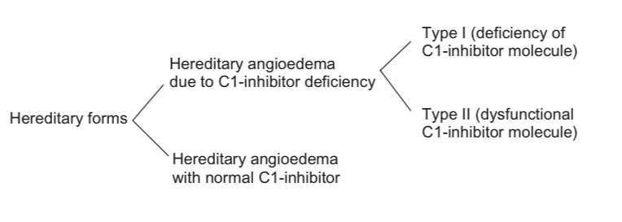
Hereditary Angioedema
4

Slide 7
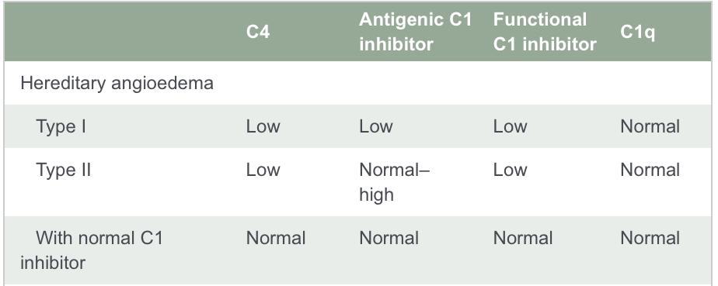
Complement Levels in Hereditary Angioedema
5

Slide 8
C1-Esterase Inhibitor Deficiency
Hereditary angioedema (HAE) caused by C1-esterase inhibitor deficiency is an autosomal-dominant disease resulting from a mutation in the C1-inhibitor gene. Although HAE is an inherited disorder, 25% of cases arise from spontaneous mutations
Mutations in the C1-inhibitor gene located on chromosome 11 cause 2 major forms of HAE: type I and type II
6

Slide 9
Hereditary angioedema type I
In HAE type I (up to 85% of all patients), there is a deficiency in the amount of C1 INH protein present in the plasma. This is the result of only one gene functioning. However, plasma values are usually 5–30% of normal rather than the 50% value that might be expected. Increased catabolism of C1 INH, even in asymptomatic patients, and possibly decreased production, are likely factors. There is also some evidence that certain amino acid substitutions found in type I HAE affect the intracellular transport of C1 INH and result in a marked reduction or the total impairment of protein secretion
7

Slide 10
Hereditary angioedema type II
HAE type II results from the presence of a dysfunctional C1-INH protein, which is present in normal or elevated amounts. This type of HAE is found in about 15 percent of affected families. Upon testing, C1-INH function is low, but protein levels are normal or elevated. Protein levels may be elevated because the defective C1-INH is unable to form complexes with proteases, resulting in an increased plasma half-life
8

Slide 11
Prophylaxis and Treatment
Intervention | Therapy | Dosage (adult) | Dosage (children) | Monitoring tests
Long-term prophylaxis | Attenuated androgens | Danazol 200 mg once or twice per day; up to 400 mg/day in <20% of cases | [Only if indicated (very rare), see text] Danazol 100–200 mg/day (use lowest effective maintenance dose, consider alternate-day or 2× weekly regimen) | Six-monthly: liver function tests
 |  | Stanozolol up to 5 mg once or twice per day | Danazol 100–200 mg/day (use lowest effective maintenance dose, consider alternate-day or 2× weekly regimen) | Annual: lipid profile
 |  | Oxandrolone 2·5–20 mg divided dose 2–4 times per day (use lowest effective maintenance dose, consider alternate-day or 2× weekly regimen) |  | Biennial: hepatic ultrasound (annual after 10 years’ treatment)
 | Tranexamic acid | Starting dose 1–1·5 g 2–3 times per day, reducing to 0·5 g once or twice per day | 1–2 g per day; dosage depends on age and size; general guide is 50 mg/ kg/day (use lowest effective maintenance dose, consider alternate-day or 2× weekly regimen) | Six-monthly: liver function tests
9
Notes:
Gompels MM, Lock RJ, Abinun M, Bethune CA, Davies G, Grattan C, Fay AC, Longhurst HJ, Morrison L, Price A, Price M, Watters D. C1 inhibitor deficiency: consensus document. Clin Exp Immunol. 2005 Mar;139(3):379-94.

Slide 12
Prophylaxis and Treatment
Intervention | Therapy | Dosage (adult) | Dosage (children)
Short-term prophylaxis (e.g. for dental work) | C1 inhibitor concentrate | 500–1500 U up to 24 h prior to procedure | <10 years old 500 U, >10 years old 1000 U up to 24 h prior to procedure
 | Attenuated androgens | Danazol 100–600 mg/day for 48 h before and after procedure | Danazol 300 mg/day for 48 h before and after procedure
 |  | Stanozolol 2–6 mg/day for 48 h before and after procedure
 | Tranexamic acid | 1 g given four times daily for 48 h before and after procedure | 500 mg given four times daily for 48 h before and after procedure
10

Slide 13
Prophylaxis and Treatment
Intervention | Therapy | Dosage (adult) | Dosage (children) | Monitoring tests
Emergency care for acute attacks | C1 inhibitor concentrate | 500–1500 U; additional infusion and reassessment if symptoms persist for >2 h | <10 years old 500 U, >10 years old 1000 U | Baseline: liver function tests, hepatitis virology
 | Attenuated androgens | Danazol up to 1 g/day
 |  | Stanozolol up to 16 mg/day
 | Tranexamic acid | 1 g given four times daily for 48 h
 | Fresh frozen plasma | 2 units (only for use where C1 INH concentrate not available) |  | Baseline: liver function tests, hepatitis virology
 | Pain relief | As appropriate
11

Slide 14
Prophylaxis and Treatment
Intervention | Therapy | Dosage (adult) | Dosage (children) | Monitoring tests
Pregnancy | Attenuated androgens | Contraindicated
 | Tranexamic acid | May be used with caution
 | C1 inhibitor concentrate | Emergency care as above. Severe cases may require regular replacement
12

Slide 15
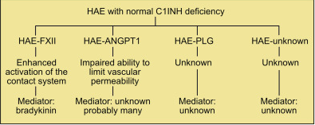
Hereditary Angioedema with normal C1-Esterase Inhibitor
Symptoms of HAE type III are similar to other types of HAE recurrent skin swelling, abdominal pain attacks, swelling of the tongue and pharynx. There are no associated wheals
13

Slide 16
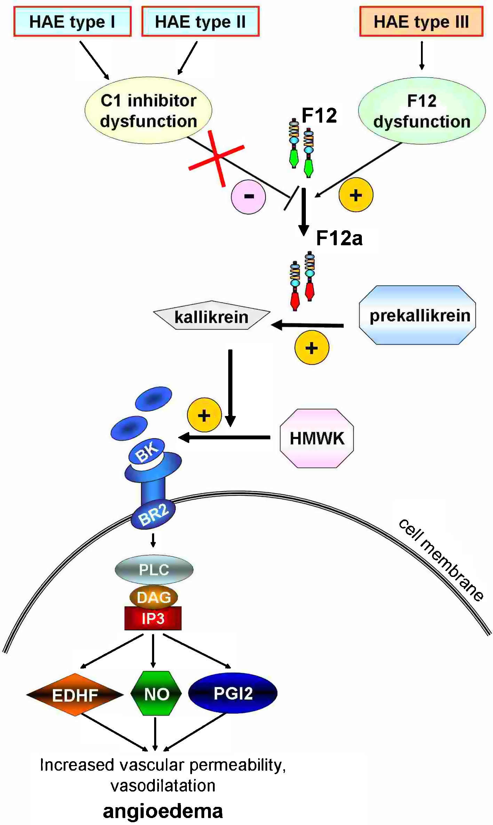
Mutation of F12 gene hereditary angioedema
14
Recurrent European missense mutation in the F12 gene in a British family with type III hereditary angioedema
Notes:
HAE with normal C1INH levels had mutations in exon 9 of the F12 gene (which codes for FXII) that cosorted with disease activity. The relevance of these F12 mutations for contact system activation and bradykinin generation has been substantially advanced. One of the F12mutations, p.Thr309Lys, was shown to cause enhanced susceptibility of the contact system to become activated both ex vivo and in vivo.
The F12 mutations were also shown to enhance susceptibility of FXII to activation by plasmin, providing a potential explanation for the efficacy of antifibrinolytic medications in the treatment of HAE with normal C1INH levels, including HAE-FXII. Unfortunately, only 20% to 25% of patients with HAE with normal C1INH levels in Europe have a F12 mutation. Although HAE-FXII has been found in other regions in addition to central Europe, it is notable that HAE-FXII appears to be very rare in the United States.

Slide 17
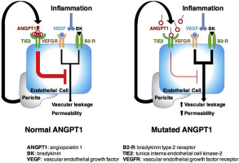
Mutation of the angiopoietin-1 gene (ANGPT1) hereditary angioedema
Mutation of the angiopoietin-1 gene (ANGPT1) associates with a new type of hereditary angioedema
15
Notes:
This gene encodes a secreted glycoprotein that belongs to the angiopoietin family. Members of this family play important roles in vascular development and angiogenesis. All angiopoietins bind with similar affinity to an endothelial cell-specific tyrosine-protein kinase receptor. The protein encoded by this gene is a secreted glycoprotein that activates the receptor by inducing its tyrosine phosphorylation. It plays a critical role in mediating reciprocal interactions between the endothelium and surrounding matrix and mesenchyme and inhibits endothelial permeability. The protein also contributes to blood vessel maturation and stability, and may be involved in early development of the heart. Mutations in this gene are associated with hereditary angioedema

Slide 18
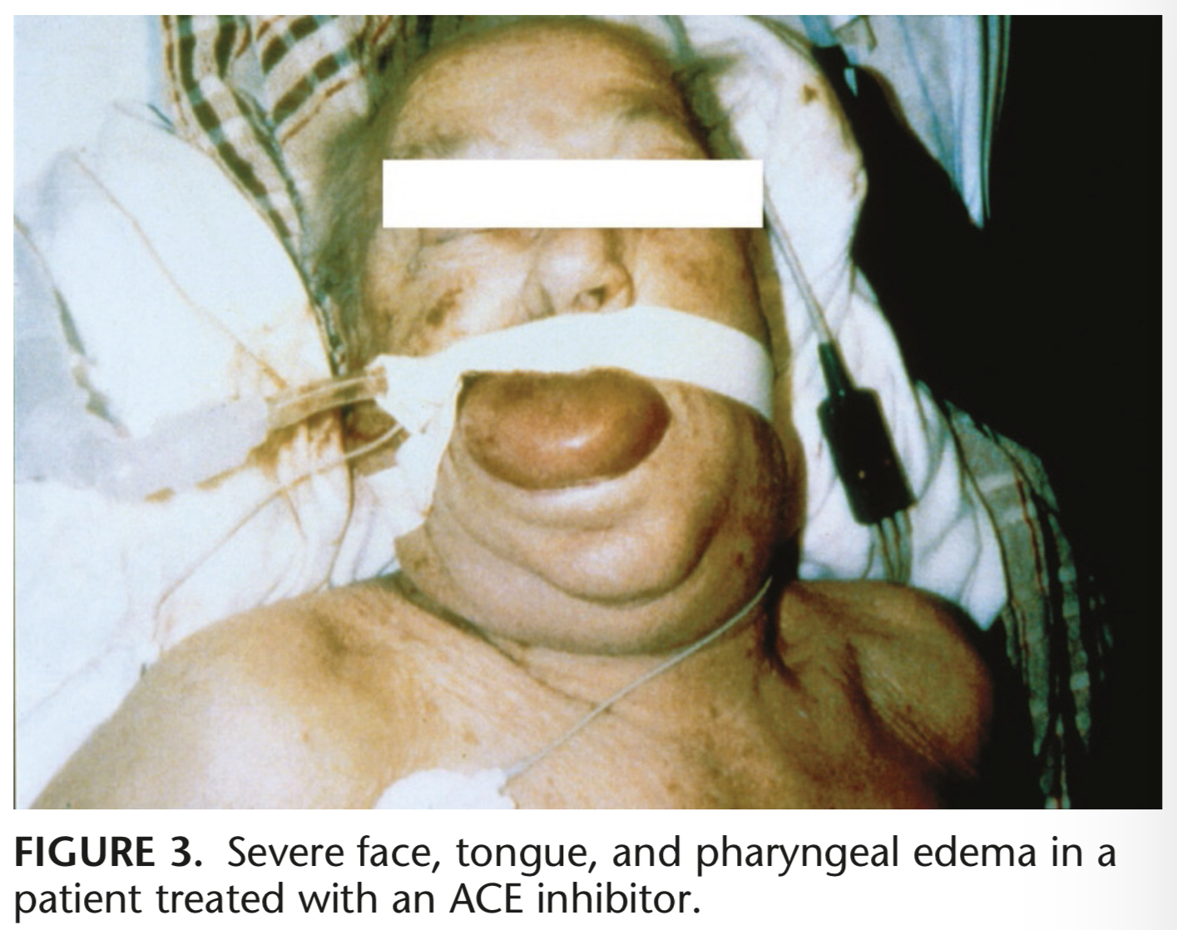
ACEI-Induced angioedema
The ACE inhibitor-induced angioedema ไม่เกี่ยวข้องกับขนาดของยา อย่างไรก็ตามอาจเกิดขึ้นเกือบจะในทันทีหลังการให้ยาครั้งแรก หรืออาจเป็นมีอาการเมื่อผ่านไปเป็นเดือน หรือเป็นปี โดยไม่ผ่านระบบภูมิคุ้มกันของร่างกาย และผลของ ACE inhibitor ทำให้ความดันโลหิตลดลงและระดับของ bradykinin เพิ่มขึ้น
16

Slide 19
Epidemiology
อุบัติการณ์การเกิด ACE-induced angioedema มีการรายงานว่าประมาณ 0.1% to 0.2% และพบได้บ่อยในชาวอเมริกันเชื้อสายแอฟริกัน 5 เท่ามากกว่าผู้ป่วยที่ผิวขาว ACE inhibitor angioedema เป็นสาเหตุที่พบได้บ่อยที่สุดของ acute angioedema ในแผนกฉุกเฉินในโรงพยาบาล (17% - 38%), และมากถึง 20% อาจเป็นอันตรายถึงชีวิตโดยไม่คำนึกถึงอายุและเพศ
17

Slide 20
ACEI-Induced angioedema
Angioedema is the result of leakage of fluid out of blood vessels beneath the skin.
Once fluid is in the subcutaneous tissues, the fluid is reabsorbed over time
ACEI angioedema is due to excessive bradykinin.
Genetic variations in bradykinin metabolism may explain why a subset of patients on ACE inhibitors develop angioedema.
Patients with lower activity of various alternative clearance pathway may be at increased risk of bradykinin accumulation while taking ACE inhibitors and developing ACEI angioedema.
18

Slide 21
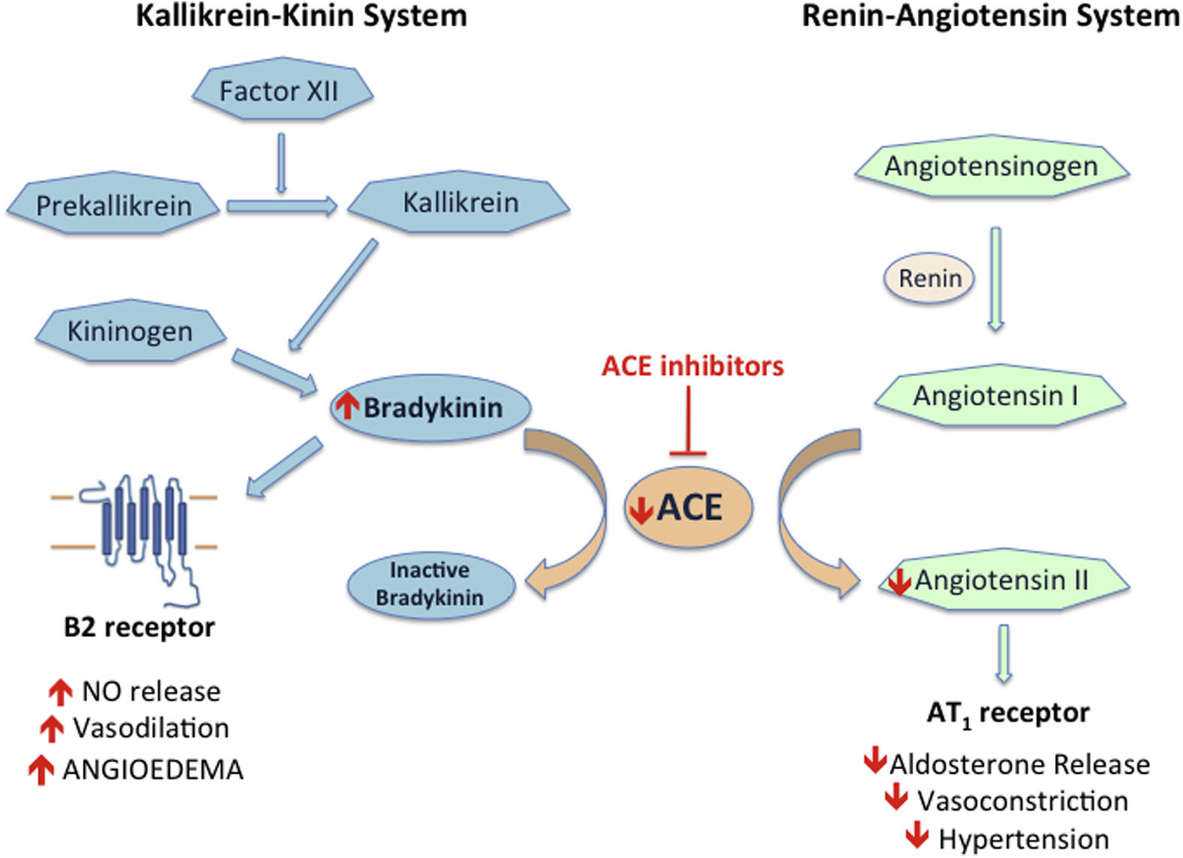
19
Notes:
การยับยั้ง ACE inhibition ส่งผลให้เกิดการสะสมของ bradykinin และ interacts with vascular B-2 receptors และทำให้เกิดการขยายตัวของหลอดเลือดและเพิ่มการซึมผ่านของหลอดเลือดด้วยการเพิ่มของ cyclic guanosine monophosphate และเกิดการหลั่ง nitric oxide ร่วมกัน
เมื่อเกิดการยับยั้ง ACE การกระตุ้น bradykinin จะขึ้นอยู่กับ plasma carboxypeptidases (CpN or in serum, CpU) ซึ่งกำจัด C-terminal Arg, ทิ้ง octapeptide ที่อยู่ในภาวะการอักเสบเรื้อรัง สามารถ interact with B-1 receptors.

Slide 22
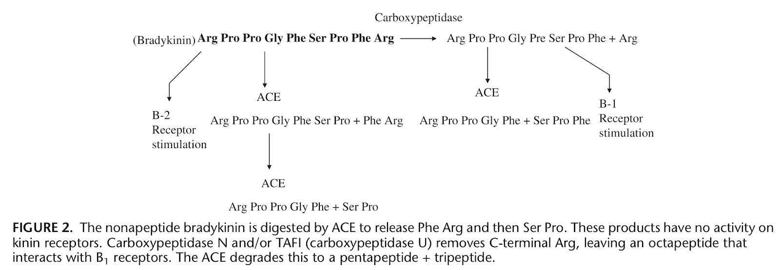
20
Notes:
การยับยั้ง ACE inhibition ส่งผลให้เกิดการสะสมของ bradykinin และ interacts with vascular B-2 receptors และทำให้เกิดการขยายตัวของหลอดเลือดและเพิ่มการซึมผ่านของหลอดเลือดด้วยการเพิ่มของ cyclic guanosine monophosphate และเกิดการหลั่ง nitric oxide ร่วมกัน
เมื่อเกิดการยับยั้ง ACE การกระตุ้น bradykinin จะขึ้นอยู่กับ plasma carboxypeptidases (CpN or in serum, CpU) ซึ่งกำจัด C-terminal Arg, ทิ้ง octapeptide ที่อยู่ในภาวะการอักเสบเรื้อรัง สามารถ interact with B-1 receptors.

Slide 23
Treatment of
ACEI-Induced Angioedema
This condition is not responsive to standard treatment for allergic angioedema (e.g. epinephrine, steroid, antihistamines)
Fresh Frozen Plasma (FFP) contains multiple enzymes which degrade bradykinin therapy treating the underlying disorder in ACEi angioedema
Consider the early administration of 2-4 units FFP.
21
Notes:
ผู้ป่วยควรหลีกเลี่ยงการใช้ ACEI

Slide 24
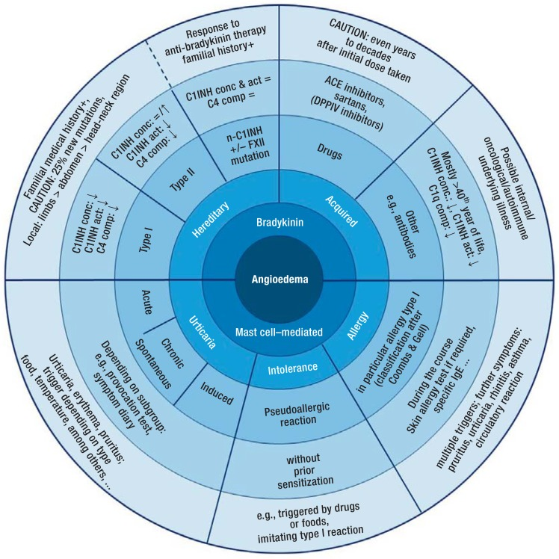
Mast cell–mediated angioedema
22

Slide 25
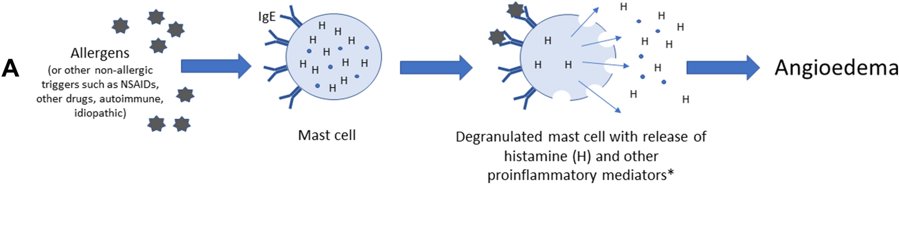
Mast cell–mediated angioedema
Specific cell ที่อาศัยอยู่ในผิวหนังเรียกว่า mast cell ผลิตและหลั่งฮีสตามีน ซึ่งจะนำไปสู่การอักเสบของเนื้อเยื่อรอบข้าง ทำให้เกิดลมพิษและบวม
สาเหตุของ histamine-mediated angioedema ได้แก่ อาหาร ยา การติดเชื้อ และแมลงกัดต่อย อย่างไรก็ตาม ในหลายกรณีไม่สามารถระบุสาเหตุได้
23
Notes:
Recognition and Management of Hereditary Angioedema: Best Practices for Dermatologists

Slide 26
Mast cell–mediated angioedema
Mast cells mediators แบ่งออกเป็น 3 กลุ่ม:
preformed mediators stored in the cytoplasmic granules released by degranulation (i.e., histamine, tryptase, chymase, carboxypeptidase A and proteoglycans)
newly generated proinflammatory lipid mediators (i.e., prostaglandins, leukotrienes, and platelet activating factor (PAF))
newly synthesized growth factors, cytokines, and chemokines
24

Slide 27
Main mediators of mast cells possibly involved in angioedema and their effects
Mediator | Possible effects
Preformed mediators
Histamine | Vasodilation and edema, mucus secretion, nerve stimulation, bronchoconstriction, reduced myocardial contractility (H1 receptor), increased myocardial contractility (H2 receptor)
Tryptase | Vasodilation and edema, tissue degradation, amplification of allergic response, leukocyte migration and activation, bronchoconstriction, and cell proliferation
Chymase | Vasodilation and edema, tissue degradation, mucus secretion, and leukocyte activation.
Heparin | Vasodilation and edema by initiating the formation of bradykinin, anticoagulant, and anti-inflammatory
Newly generated over minutes
Prostaglandins, mainly PGD₂ | Vasodilation and edema, bronchoconstriction, mucus secretion, and nerve stimulation
Cysteinyl leukotrienes, mainly LTB₄, LTC₄, LTD₄, LTE₄ | Vasodilation and edema, mucus secretion, bronchoconstriction, and leukocyte recruitment
PAF | Platelet activation/μ thrombi, leukocyte migration, histamine release, reduce myocardial contractibility. Poorly involved directly in vasodilation and edema.
Newly generated over hours
Cytokines and chemokines | Poorly involved directly in angioedema.
Anaphylatoxins (C3a, C4a, C5a) | Complement activation products, mast cell degranulation, vasodilation and edema, and smooth muscle contraction.
25

Slide 28
Definition, triggers, and symptoms of urticaria/angioedema
Urticaria/Angioedema | Duration of symptoms | Triggers | Symptom
Acute, spontaneous | <6 weeks | Often idiopathic, infections, drugs, foods, allergy, intolerance | Urticaria can affect the entire integument, angioedema affecting in particular the face, head-neck region; occasionally abdominal symptoms, dyspnea, dysphagia, pruritus
Chronic, spontaneous | >6 weeks | Foods, infections, inflammations, allergy, intolerance, (auto)antibody
Inducible/physically triggerable urticaria (eg, cold urticaria, pressure urticaria, vibratory urticaria) | Specific triggering physical mechanism | Exogenous physical factors (cold, such as cold drinks), light, mechanical pressure | Efflorescences often limited to site of contact, but can generalize depending on subtype; occasionally extracutaneous symptoms such as fever, dizziness, nausea, headache, pruritus, dyspnea, dysphagia
26

Slide 29
Definition, triggers, and symptoms of allergy/anaphylaxis
Allergy
Type-I reaction | Within seconds or minutes: IgE mediated immunologic reaction to allergen | For example, foods, insect bites, drugs; after prior sensitization | For example, conjunctivitis, rhinitis, bronchial asthma, angioedema, urticaria
Anaphylaxis
 | Complication/aggravation/maximum variant of allergic reaction | For example, foods, insect bites, medications; after prior sensitization | The classification follows the most severe symptoms experienced (no symptom is obligatory)
Grade I | Symptoms limited to skin |  | Acute urticaria and angioedema, erythema, flushing, pruritus
Grade II | Mild systemic reactions |  | Additionally: obstructed airway (rhinorrhea, cough, stridor, dyspnea), tachycardia, hypotension, arrhythmia, gastrointestinal symptoms (nausea, vomiting)
Grade III | Severe systemic reactions |  | Additionally: defecation, laryngeal edema, bronchospasm, cyanosis, shock
Grade IV | Life-threatening reactions |  | Additionally: respiratory arrest, circulatory arrest
27

Slide 30
Acute treatment of angioedema
Histamine mediated angioedema
Urticaria | Allergy/anaphylaxis
Acute form: Mostly self limiting, responds well to antihistamines and glucocorticoids | – Adrenaline (i.m./i.v.) – Fast acting antihistamine (p.o./ i.v.) – Glucocorticoids (eg, prednisolone) [β 2- sympathomimetic (eg, salbutamol)]
Physical form: Avoidance of triggers/stopping exposure, patient needs to be informed
28

