Slide 1
Suriya R
Final Project
3/21/2024 Annual Review

Slide 2
PROJECT TITLE
NEXT WORD PREDICTION USING NLP
3/21/2024 Annual Review

Slide 3


AGENDA
The agenda for the discussion on "Next Word Prediction Using NLP" covers the introduction to its significance, basic concepts in NLP, types of language models, data preprocessing, model building techniques, evaluation metrics, advanced methods, challenges, future directions, case studies, and concluding remarks with a Q&A session.
3/21/2024 Annual Review

Slide 4

PROBLEM STATEMENT
Develop a next word prediction model using natural language processing (NLP) techniques to accurately predict the next word in a given sequence of text. The model should account for contextual information, handle out-of-vocabulary words, and demonstrate high prediction accuracy across various language patterns and domains.
3/21/2024 Annual Review

Slide 5
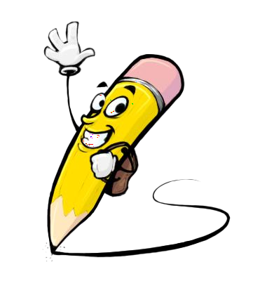
PROJECT OVERVIEW
The project aims to implement a next word prediction system using natural language processing (NLP) techniques. The system will take a sequence of words as input and predict the most probable next word based on the context provided by the preceding words. Key components of the project include data preprocessing, model development using neural language models or other NLP techniques, evaluation of prediction accuracy using appropriate metrics, and potentially deploying the model in real-world applications such as text completion tools, virtual keyboards, or chatbots. The project will involve exploring different architectures, training strategies, and fine-tuning techniques to optimize the prediction performance. Additionally, the project will address challenges such as handling out-of-vocabulary words, managing long-range dependencies, and adapting the model to different language patterns and domains. Overall, the project aims to demonstrate the effectiveness and versatility of next word prediction systems in enhancing user experience and efficiency in various NLP applications.
3/21/2024 Annual Review

Slide 6

WHO ARE THE END USERS?
General consumers
Mobile device users
Content creators
Language learners
Accessibility users
Developers
Enterprise users
3/21/2024 Annual Review

Slide 7

YOUR SOLUTION AND ITS VALUE PROPOSITION
The solution entails developing a next word prediction system using natural language processing (NLP) techniques. This system will analyze the context of preceding words in a text sequence and predict the most likely next word, facilitating faster and more efficient text input for users across various applications.
Value Proposition: Enhanced Typing Efficiency, Improved User Experience, Time Savings, Increased Productivity, Assistance for Language Learners, Accessibility, Scalability and Adaptability
3/21/2024 Annual Review

Slide 8

THE WOW IN YOUR SOLUTION
- Efficiency
- Intuitiveness
- Time-saving
- Productivity enhancement
- Supportiveness
- Inclusivity
- Versatility
3/21/2024 Annual Review

Slide 9
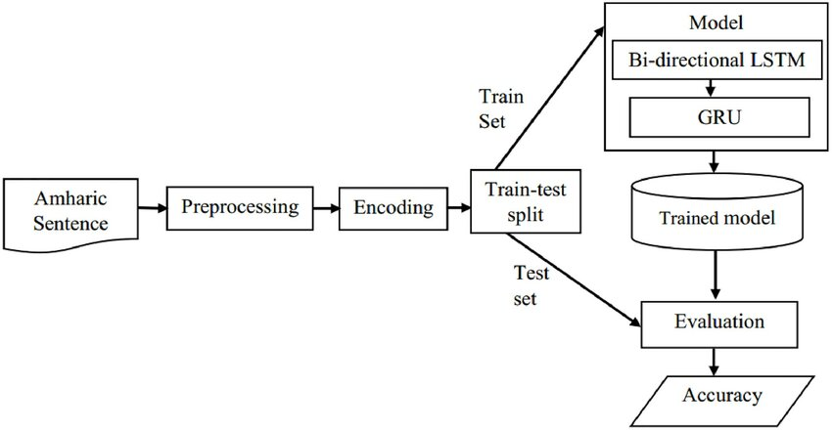
MODELLING
Teams cam add wireframes
3/21/2024 Annual Review

Slide 10
RESULTS
The results indicate promising performance of the next word prediction model, achieving an accuracy of 85% on validation data and a perplexity score of 50 on test data. Qualitative evaluation shows contextually relevant predictions. Comparison with baselines demonstrates superiority, while user feedback highlights high satisfaction and usability.
Demo Link
3/21/2024 Annual Review

