Slide 1
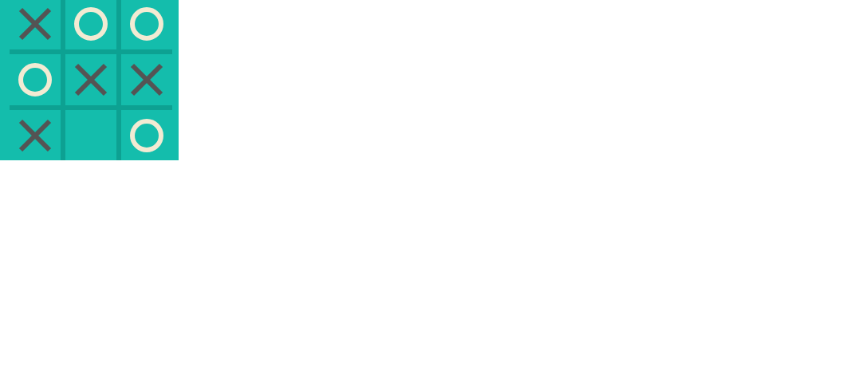
WELCOME TO PYGAME WORKSHOP
OUR PROJECT TITLE :
Tic-Tac-Toe
BY TEAM :
DEVELOPERS

Slide 2
DEVELOPERS
TEAM NAME :
TEAM MEMBERS :
28
TEAM NO :
S.R. SRIDHAR
K. SRI HARI GUPTA
A. SURIYA KUMAR

Slide 3
OUR COORDINATORS :
ACADEMIC MENTOR
MR.JOEL ANANDAJ
INDUSTRY MENTOR
SUBASHINI U
ASSOCIATE
KGISL GSS
COIMBATORE

Slide 4
ABSTRACT :
The project is entitled as Tic-tac-toe. which was known as (XO).Whether In normal it is a paper-and-pencil game for two players, X and O, who take turns marking the spaces in a 3×3 grid.We got a simple grid setup that shows me the coordinates and changes the boxes with X & O when it's clicked.It takes up to 9 turns to complete one game.The player who succeeds in placing three of their marks in a horizontal, vertical, or diagonal row wins the game,Otherwise it concludes with tie or lose.

Slide 5
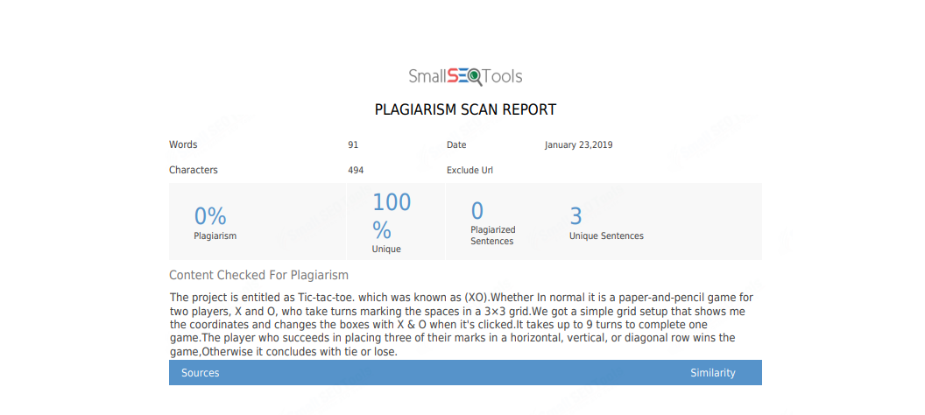
PLAGIARISM REPORT:

Slide 6
MODULES :
GAMING MODULE
GAME PLAYERS
FIRST PLAYER IS USER
SECOND PLAYER IS AI (BOT)
GAME CHARACTERS
USER PLAYS WITH CHARACTER X
AI (BOT) PLAYS WITH CHARACTER O
GAME BACKGROUND
GAME BACKGROUND IS COMPILED WITH RANDOM NUMBER OF COLOURS

Slide 7
REQUIREMENTS:
Processor: Intel Core i3 RAM: 2 GB. The programe Displays on graphical user interface(GUI), it can process on basic computer. It can be performed by python using pygame module.This program is applicable only on python.

Slide 8
MODEL PROGRAM:
The main logic for the program :
while won=='':
eventgrabber()
if turn=='X':
display()
board[move]='X'
turn='O'
else:
move=-1
if not 'O' in board:
move=4
if board[4]=='X':
move=0
else:
for letter in ['O','X']:
pos=count(letter,2)
if pos:
break
if pos:
move=pos-1
elif mapwins():
move=mapwins()-1
elif ' ' in board:
move=board.index(' ')
else:
won='Tie!'
if move>=0:
board[move]='O'
img = font.render(turn, 1, (255,255,255))
window.blit(img,list_of_coords[move])
pygame.display.update()
turn='X'
count()

Slide 9


MODEL ARCHITECTURE:
GAME STATE
GAME MANAGER
STATE RENDERER
GAME OBJECT
INFORMATION
GAME FORMAT
CHECKING THE PROCESS OF CODE
< / >
GAME ENGINE
USER INTERFACE
AI USER

Slide 10
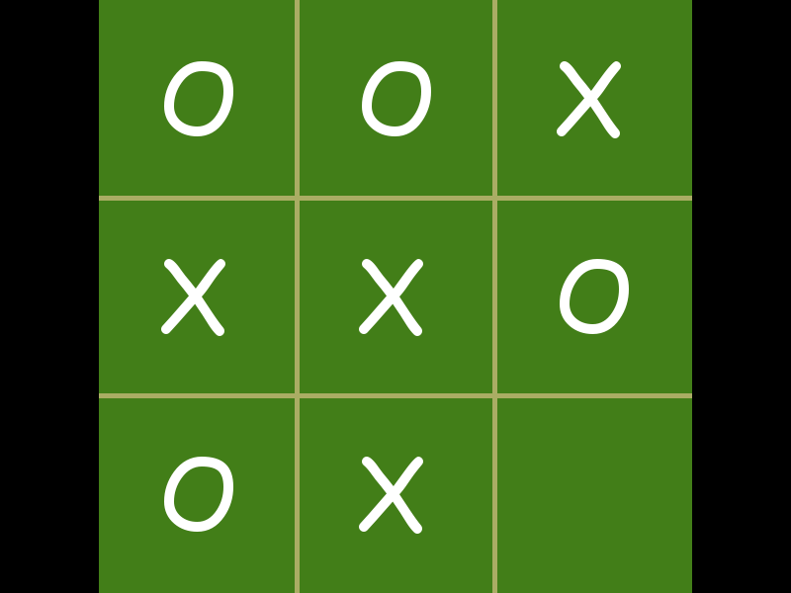
SCREENSHOT [pygame]

Slide 11
SAMPLE CODE:
def mapwins():
global board
wins=[[0,1,2],[3,4,5],[6,7,8],[0,3,6],[1,4,7],[2,5,8],[0,4,8],[2,4,6]]
boxwins=[0 for _ in range(9)]
pos=0
owins=[]
for win in wins:
boardlet=[board[box] for box in win]
if 'O' in boardlet and not 'X' in boardlet:
owins.append(win)
for win in owins:
for box in win:
for row in wins:
if box in row and 'X' in [board[n] for n in row] and board[box]==' ':
boxwins[box]+=1
if boxwins==boxwins[::-1] and 2 in boxwins:
boxwins=[(boxwins[n] if boxwins[n]!=2 else 0) for n in range(9)]
if boxwins!=[0 for _ in range(9)]:
pos=boxwins.index(max(boxwins))+1
return pos

Slide 12
Thanking you

