Slide 1
Internet Usage Analysis of
Personal Computers
RADHIKA GAONKAR 2010A7PS193G
SURIYADEEPAN R 2013H112045G
Software Engineering and Management

Slide 2


Slide 3
Objective
Why packet analysis ?
Understanding network characteristics
Learning who is on a network
Determining who or what is utilizing available bandwidth
Identifying peak network usage times
Identifying possible attacks or malicious activity
Finding unsecured and bloated applications

Slide 4
Scope
Employee Monitoring
Web Usage Tracking
At School
At home
Internet cafe

Slide 5
Literature Survey
Track4Win
Monitor all computer users simultaneously.
Single PC tracking or networked computers monitoring
Real-time PC monitoring and Internet usage tracking
Screen capture from remote computers
Browser history tracking
Remote deployment/installation for Monitor program
Support MS Access, MS SQL, MSDE, Oracle and ODBC
Abundant reports, ease of use, small size, fast running speed, and good interface

Slide 6
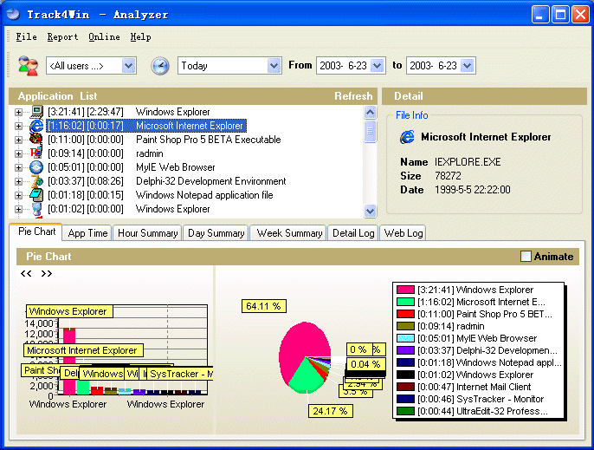
Time analysis charts

Slide 7
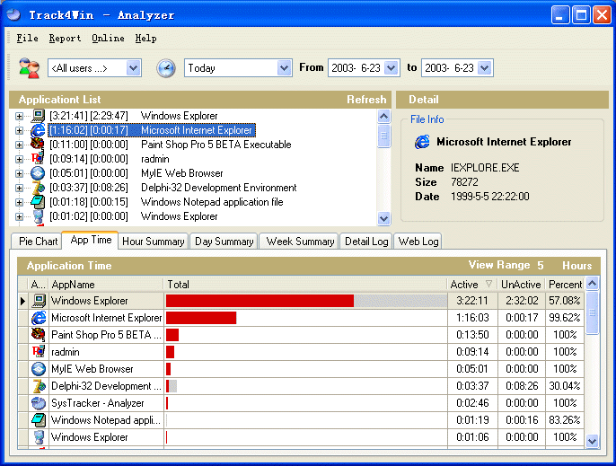
Active and Inactive Time

Slide 8
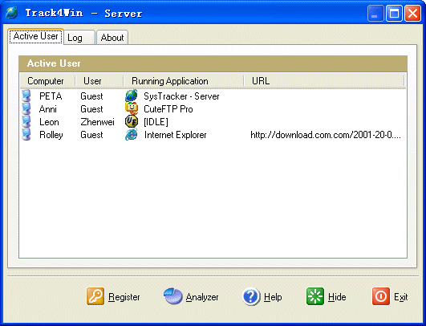
Multi-user Real Time Monitor

Slide 9
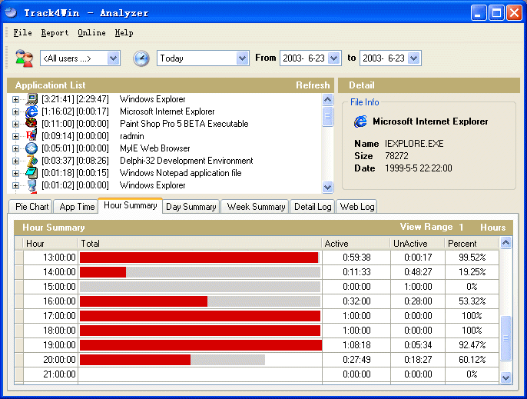
Summary Report

Slide 10
Other softwares
SpyAgent
WebWatcher
PC Pandora
Spector Pro
eBlaster
Elite Keylogger
SniperSpy
InterGuard

Slide 11
Wireshark
Available for UNIX , Windows , Mac
Capture live packet data from a network interface
Open files containing packet data captured with tcpdump/WinDump Wireshark, and a number of other packet capture programs
Import packets from text files containing hex dumps of packet data
Display packets with very detailed protocol information
Save packet data captured
Export some or all packets in a number of capture file formats
Filter packets on many criteria
Search for packets on many criteria
Colorize packet display based on filters
Create various statistics

Slide 12
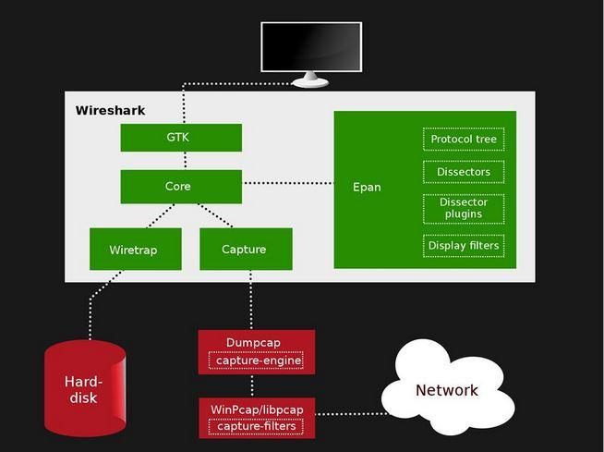
Wireshark - Block Diagram

Slide 13
Advantages of Wireshark
Supported Protocols
User friendliness
Cost
Program Support
Operating System Support

Slide 14
Development Tools
Sniffer
LIBPCAP - packet capture library
Database
MySQL - Relational Database Management System
Statistical Analysis
R - Statistical Computing and Graphics

Slide 15
New Features
Preventing : downloading, installation and use of illegally obtained software and music
Alert : spurious conversations via chat and instant messaging clients
Vulnerabilities : viruses , malicious software , unusual activities
Block : keyword updates integrated into the system
Remote control : disable or enable software, restart the computer , update keywords to block
Throughput : different protocols e.g. TCP , UDP, IPV4
Reporting methods : easy to navigate , multiple report features, perform custom searches

Slide 16
No server web-log analysis . Client side software
Extracting patterns from network traffic analysis
Clustering of websites according to content
Get analysis on peak times for browsing
Updates on bandwidth usage
Recommend websites to users based on web usage , page content , time of browsing
Lighter on the system
Efficient use of system resources

Slide 17
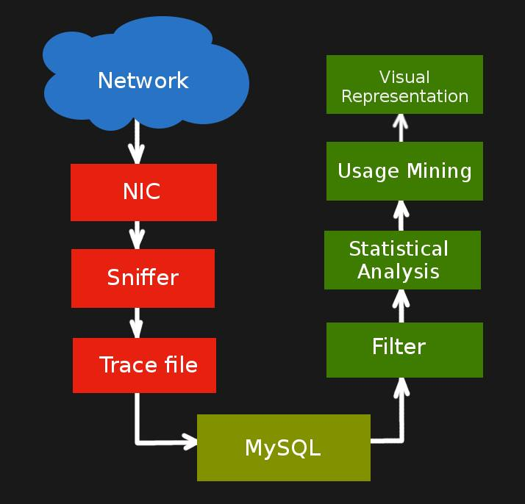

Block Diagram

Slide 18
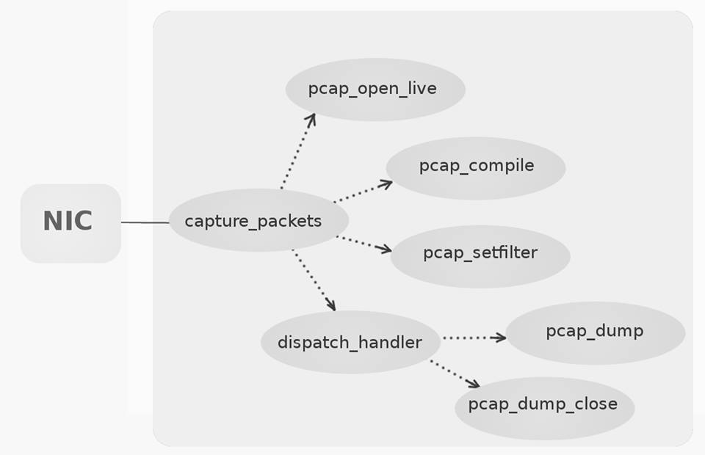

Use Case Diagram

Slide 19
THANK YOU !

