Slide 2
Positive Clamper

Slide 3






Initial Circuit
$$I_{L}$$
$$C$$
$$V_{in}$$
$$D$$
$$R_{L}$$
$$V_{O}$$

Slide 4



1st Positive Half Cycle
$$C$$
$$I_{L}$$
$$V_{in}$$
$$R_{L}$$
$${V_{O}=V_{in}}_{ }$$
Diode is reverse biased ➔ Open circuit
Capacitor takes 5 times tau (5*tau) to charge to 2/3 percent
Time constant = 10*Time period of input ➔ So capacitor does not even start charging

Slide 5



1st Negative Half Cycle (till negative peak is reached)
$${V_{p}}_{ }$$
$$V_{in}$$
$$R_{L}$$
$${V_{O}=0}_{ }$$
$$I_{c}$$
Diode is Forward biased ➔ Short circuit
Since it is short circuit, large current flows and this current charges the capacitor to V_m in shorter duration

Slide 6


1st Negative Half Cycle (At the point when negative peak is reached)
$${V_{p}}_{ }$$
$$V_{in}<V_{p}$$
$$R_{L}$$
$${V_{O}=0}_{ }$$
Capacitor is charged to V_m
It cannot discharge quickly since time constant is very large
Voltage across diode ➔ 0V = - Vp + Vp = 0 => No current flows
Diode becomes open circuit. Vo = -Vp + Vp = 0
Now the current flows through load.

Slide 7
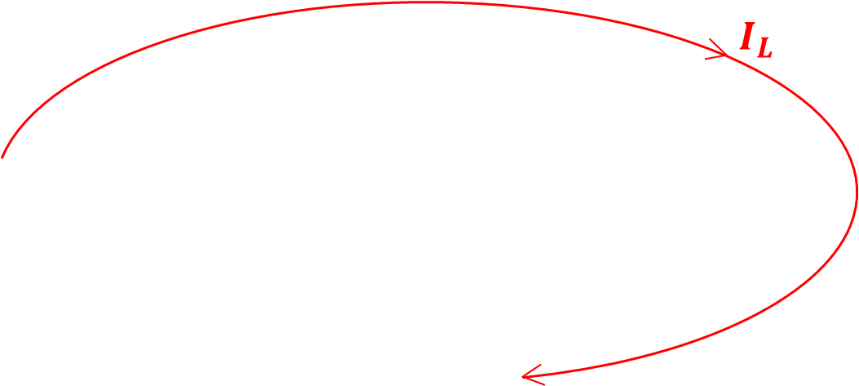


1st Negative Half Cycle (After negative peak is reached)
$${V_{p}}_{ }$$
$$V_{in}$$
$$R_{L}$$
$${V_{O}=V_{in}+V_{p}}_{ }$$
Capacitor gives a voltage of Vp
Net Voltage across diode and load hereafter ➔ = Vin + Vp
Vp is like DC value so the entire waveform is shifted upwards by a value of Vp
Vin + Vp is always greater than or equal to zero hereafter. Hence Diode is always reverse biased (open circuit)

Slide 8
Initial Circuit
$$I_{L}$$
$$C$$
$$V_{in}$$
$$D$$
$$R_{L}$$
$$V_{O}$$

